Slide 1
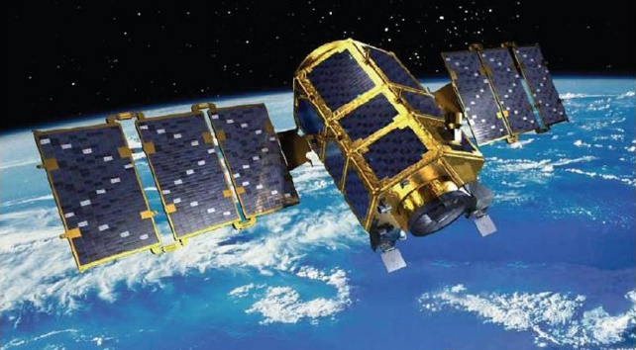
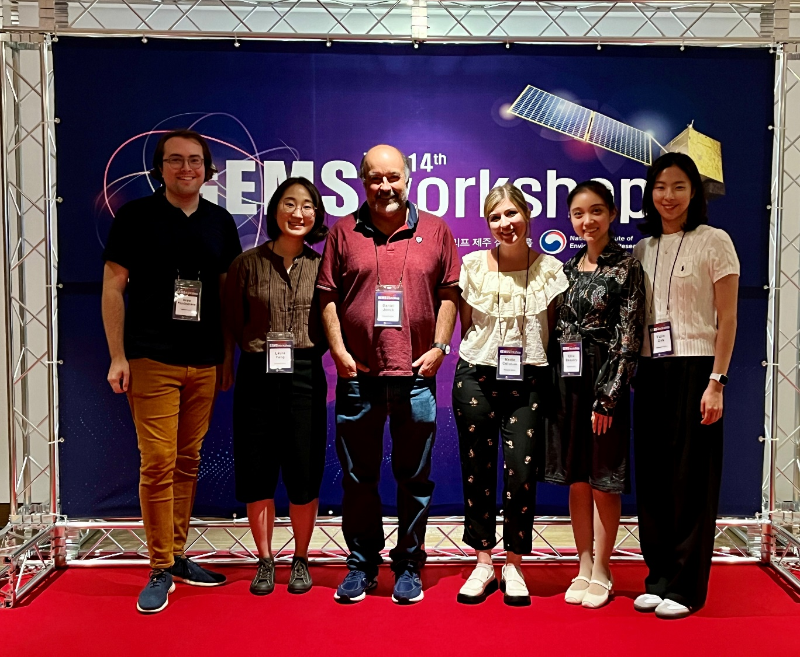
14th GEMS Workshop
Jeju, Sept 6-8. 2023
Harvard group
at GEMS meeting
Thanks to SAIT for supporting our GEMS research!

Slide 2



Improved understanding of PM_{2.5} in Korea and China through integrated modeling and analysis of satellite, aircraft, and surface observations
Daniel Jacob
Samsung PM_{2.5} Strategic Research Program
Interim Year 4 Report
Two new papers since last report:
Dang, R., D.J. Jacob, S. Zhai, P. Coheur, L. Clarisse, M. Van Damme, D.C. Pendergrass, J.-S. Choi, J.-S. Park, Z. Liu, and H. Liao, Diagnosing the sensitivity of particulate nitrate to precursor emissions using satellite observations of ammonia and nitrogen dioxide, submitted to Geophys. Res. Lett., 2023.
Pendergrass, D.C., D. J. Jacob, H. Nesser, D.J. Varon, M. Sulprizio, K. Miyazaki, and K.W. Bowman, CHEEREIO 1.0: a versatile and user-friendly ensemble-based chemical data assimilation and emissions inversion platform for the GEOS-Chem chemical transport model, EGUsphere [preprint], https://doi.org/10.5194/egusphere-2023-616, 2023.
Ruijun Dang
Drew Pendergrass
Also six presentations at GEMS Science Team meeting held on Sept 6-8 in Jeju

Slide 3
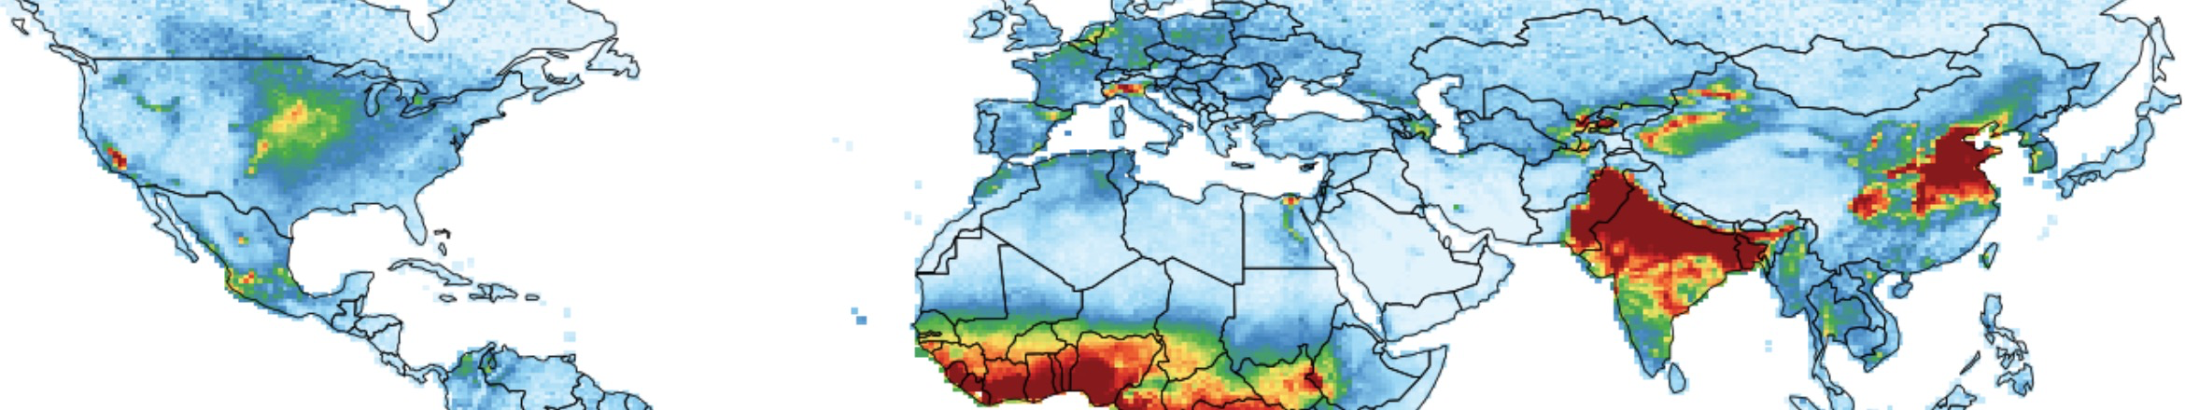
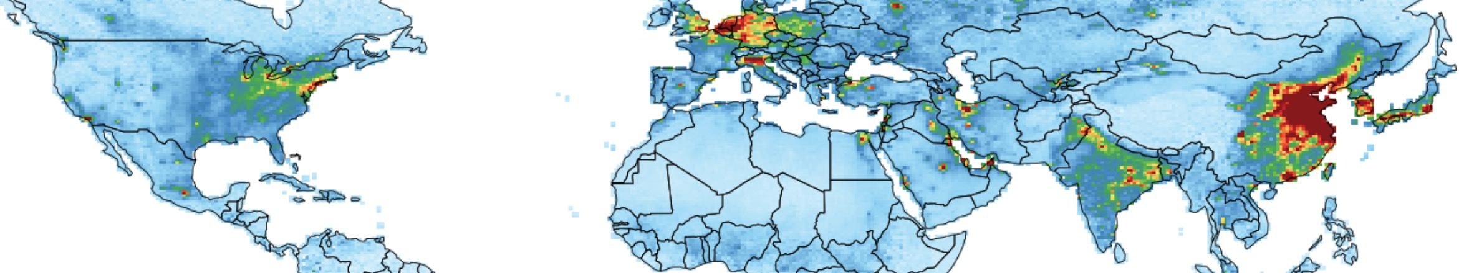
Using satellite observations of NH₃ and NO₂ to diagnose sensitivity of PM_{2.5} nitrate to emissions
NH₃
IASI, 2017
Tropospheric NO₂
OMI, 2017

Slide 4
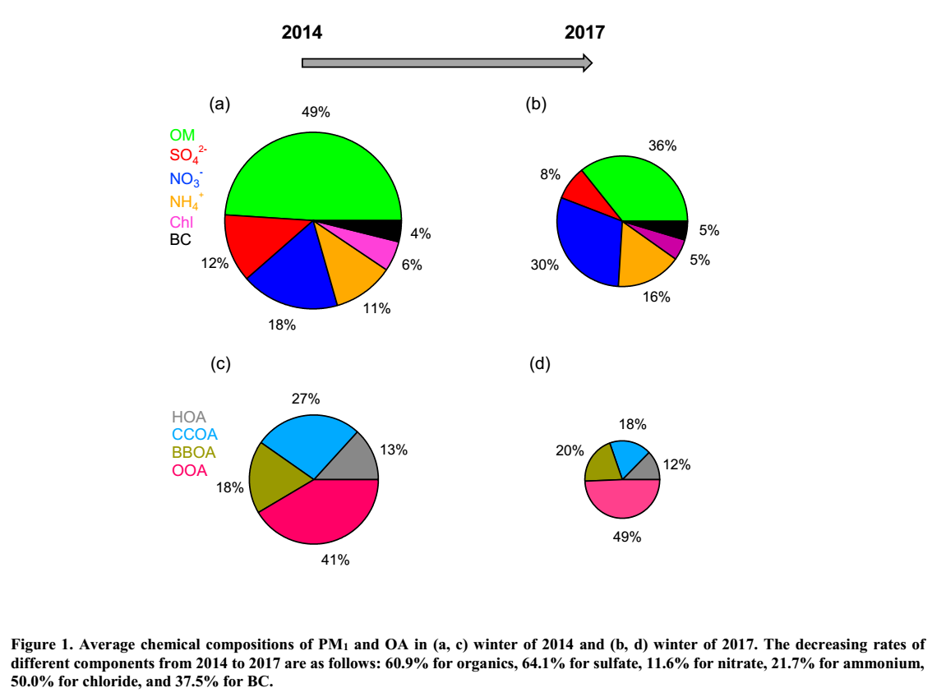
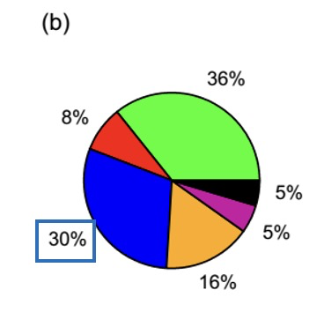
As SO₂ and primary organic aerosol emissions have decreased, nitrate has emerged as a top problem for PM_{2.5} air quality
PM_{2.5} composition in Beijing, 2014-2017
Organic
Sulfate
Nitrate
Ammonium
Chloride
Elemental
carbon
Li et al., 2019
Seoul PM_{2.5} trend, 2015-2019 – increasing winter trend due to nitrate?
Pendergrass et al., 2022

Slide 5

PM_{2.5} nitrate formation may be NO_{x}-, NH₃-, or VOC-sensitive
NO₂: OMI, TROPOMI, GEMS
NH₃: IASI, CrIS
NH₃
hv
NH₄⁺ + NO₃⁻
NO
NO₂
HNO₃
O₃, peroxy
OH, O₃
PM_{2.5} nitrate
VOCs
agriculture
vehicles
fuel
fuel
volatile chemical compounds (VCPs)
vegetation
Can we use the NH₃/NO₂ ratio from satellite to diagnose sensitivity regime?
Test in GEOS-Chem model world

Slide 6
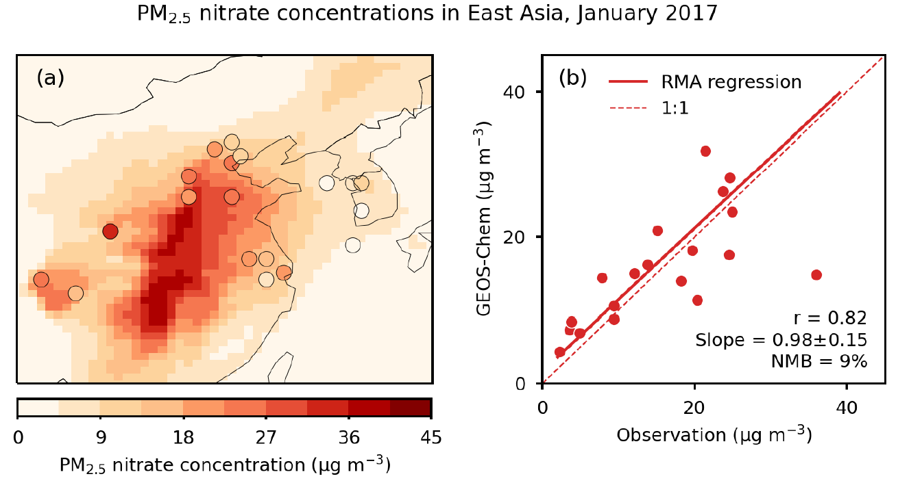
Diagnosing PM_{2.5} nitrate formation sensitivities in GEOS-Chem
GEOS-Chem provides credible simulation of PM_{2.5} nitrate variability
Diagnose local model sensitivity S of monthly mean PM_{2.5} nitrate [NO₃⁻]
to 20% decreases (Δ) of emissions (X≡ NH₃, NO_{x}, NMVOCs)
Dang et al., submitted

Slide 7
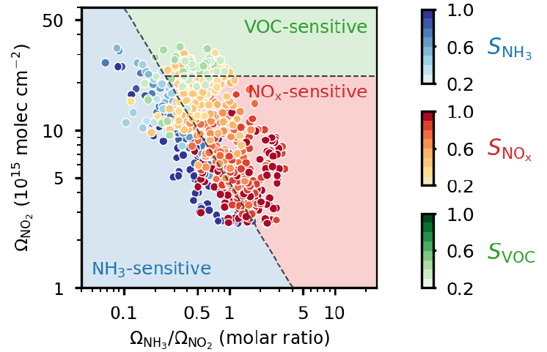
Diagnosing PM_{2.5} nitrate sensitivities vs. Ω_{NH3}/Ω_{NO2} and Ω_{NO2} in model world
Ω denotes the tropospheric columns as would be observed from satellites
Points show dominant sensitivities for 50-km model grid cells in China and S. Korea
(January 2017)
Ω_{NO2} diagnoses
NO_{x}- vs. VOC-limited
oxidant regime
Location in (Ω_{NH3}/Ω_{NO2}, Ω_{NO2}) space diagnoses dominant sensitivity
Dang et al., submitted

Slide 8
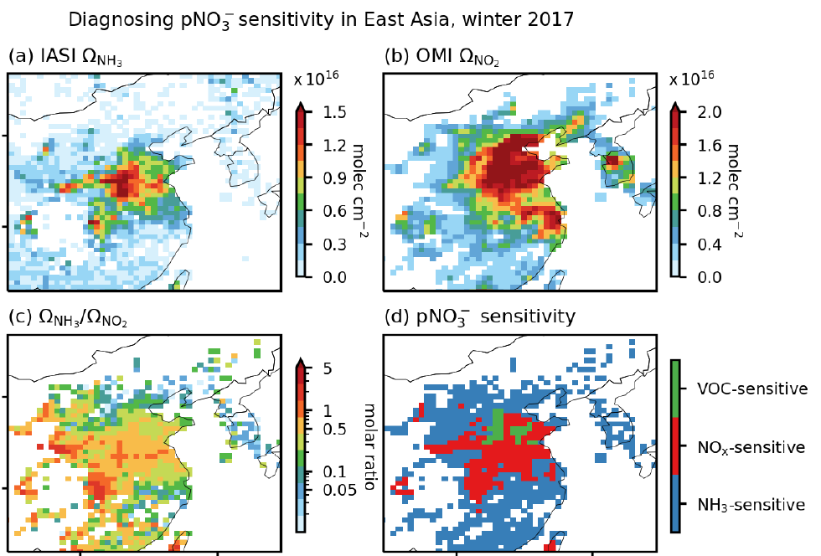
Application to IASI (NH₃) and OMI (NO₂) satellite data
Satellite data indicate different sensitivity regimes for PM_{2.5} nitrate formation:
NH₃-sensitive in Beijing;
mostly NO_{x}-sensitive in North China Plain (but VOC-sensitive where NO_{x} is very high)
mostly NH₃- sensitive elsewhere, including in Korea
Dang et al., submitted

Slide 9
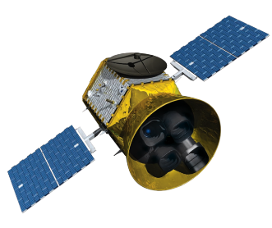
CHEEREIO: an LETKF-based user-friendly inversion tool to infer emissions from satellite (and other) data
LETKF = localized ensemble transform Kalman filter
GEMS observations: NO₂, formaldehyde, glyoxal, CO, ozone
IASI/CrIs observations: NH₃
Chemical transport model (CTM): predict concentrations
from input emissions
Inversion:
infer emissions
from observed concentrations
Transport
Non-linear chemistry
NO_{x} VOCs NH₃ CO
emissions of PM_{2.5} and ozone precursors

Slide 10
LETKF:
allows non-linear inversions without a model adjoint
can flexibly integrate all observations available
provides error characterization on results
Observations
Concentration
Information from observations
accumulates with time
Create ensemble of CTM simulations sampling uncertainty range of emissions
Ensemble of simulations
Time
Start with prior estimate of emissions
Assimilate observations, correct emissions including error characterization
Emission estimates evolve with time

Slide 11
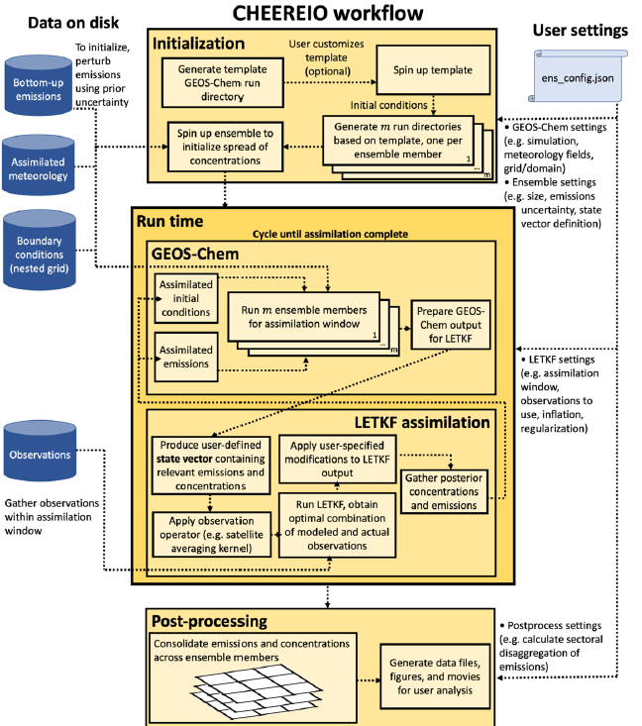
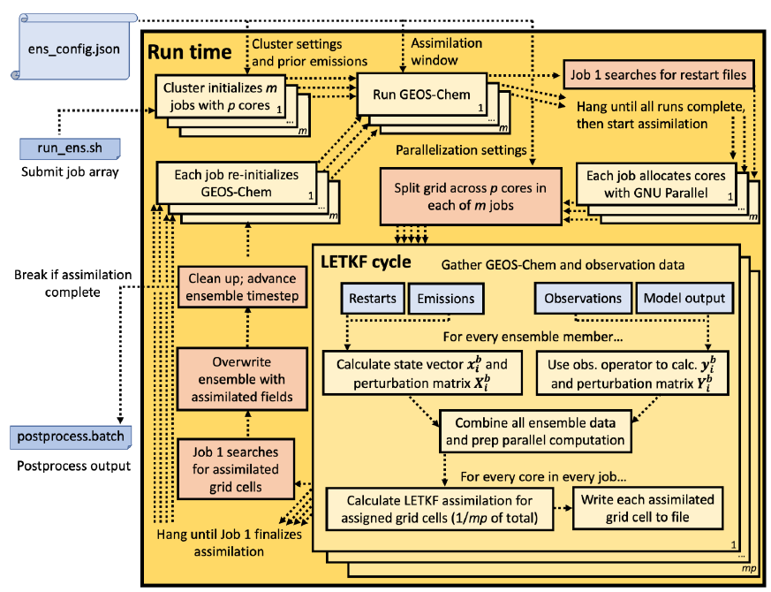
CHEEREIO is designed to allow non-expert users to flexibly apply LETKF to a wide range of observations for optimizing time-dependent emissions
All the software engineering is under the hood
User configuration file:
Select satellite and other data
Select emissions to be optimized
Select domain and period
Select prior estimate, error parameters
Runtime operations
Run CHEEREIO
https://cheereio.readthedocs.io/
Optimized high-resolution time-dependent emissions
Pendergrass et al., in press

Slide 12
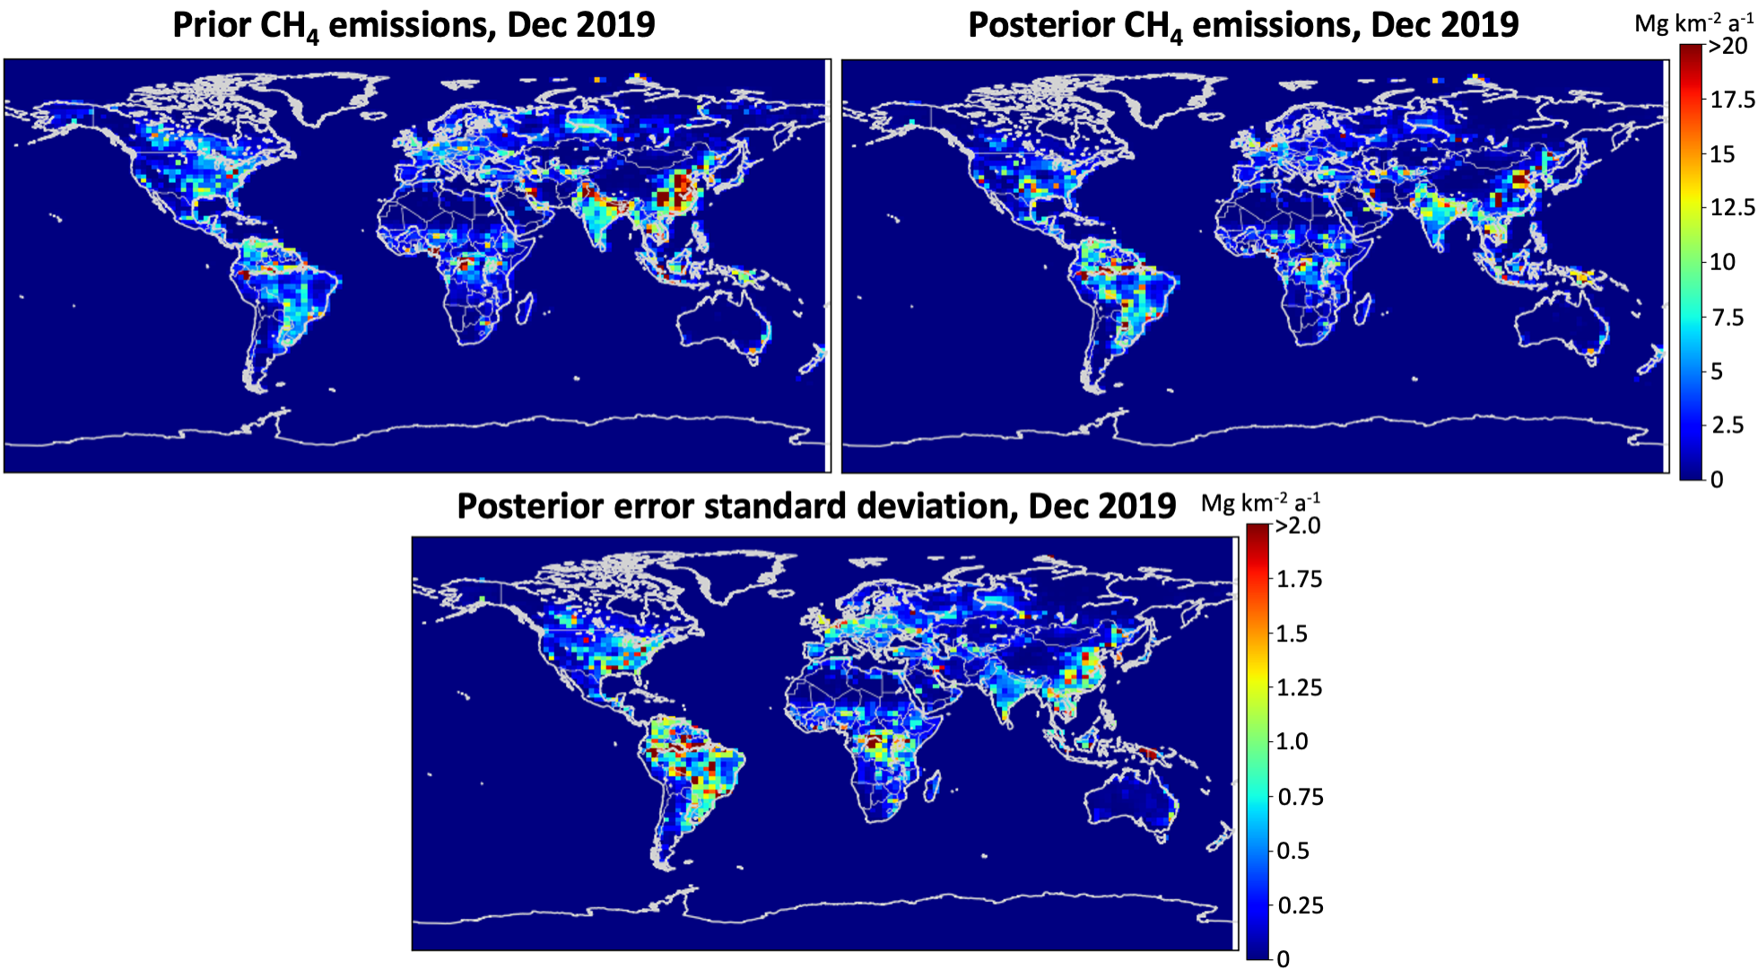
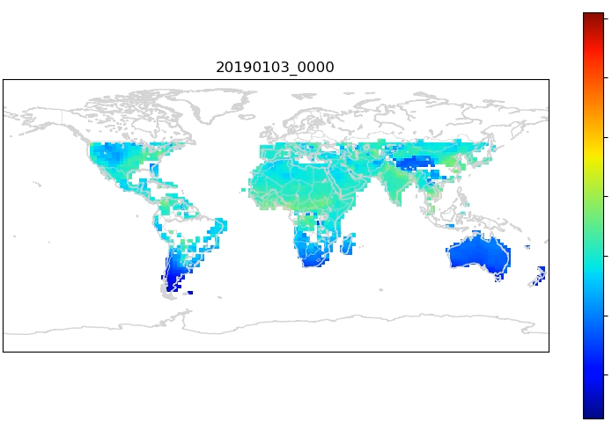
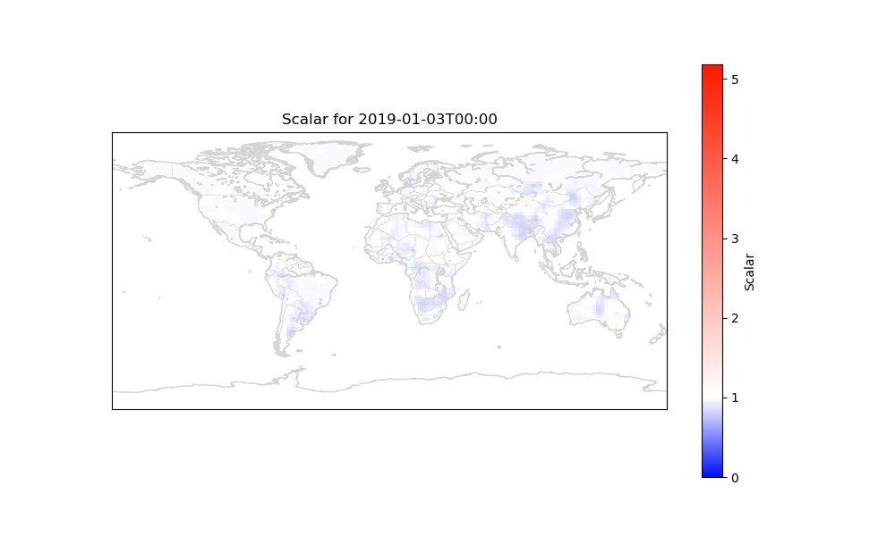
Demo weekly inversion of TROPOMI methane satellite data
2050
1950
CHEEREIO
XCH4, ppb
1850
TROPOMI data
1750
posterior / prior methane emissions
0
1
2
3
4
5
Pendergrass et al., in press

Slide 13
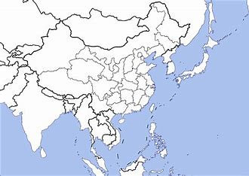
Next step: apply CHEEREIO to GEMS+IASI satellite data over East Asia
GEMS: geostationary instrument
3.5x8 km² pixels, hourly data
NO₂, formaldehyde, glyoxal, ozone, CO
IASI: low Earth orbit instrument
12x12 km² pixel, daily data
NH₃
CHEEREIO
Optimized emissions
of NO_{x}, VOCs, CO, NH₃

Slide 14
1-slide summaries of GEMS meeting presentations
…to be turned into papers acknowledging SAIT support

Slide 15
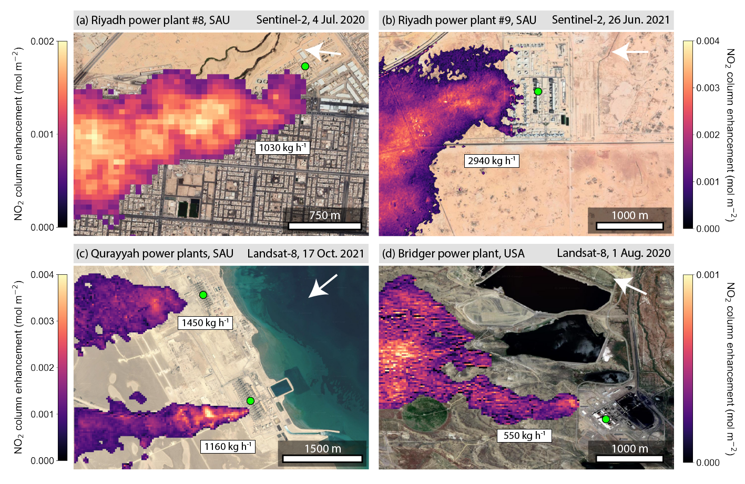
Quantifying NO_{x} point sources with Landsat and Sentinel-2 satellite observations of NO₂ plumes
Landsat and Sentinel-2 have ultra-blue (430-450 nm) bands sensitive to NO₂
10-60 m pixel resolution offers unique capability to observe NO₂ point sources
Apply to power plants in Saudi Arabia and US
Detect plume over urban background
Resolve individual stacks
Resolve point sources 2 km apart
Detect down to 500 kg h⁻¹
Daniel Varon et al., in prep.

Slide 16
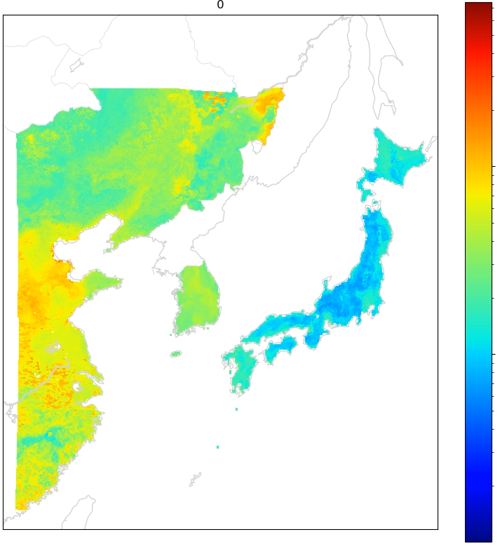
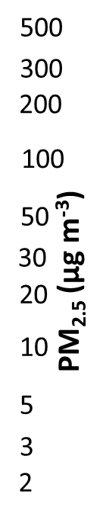
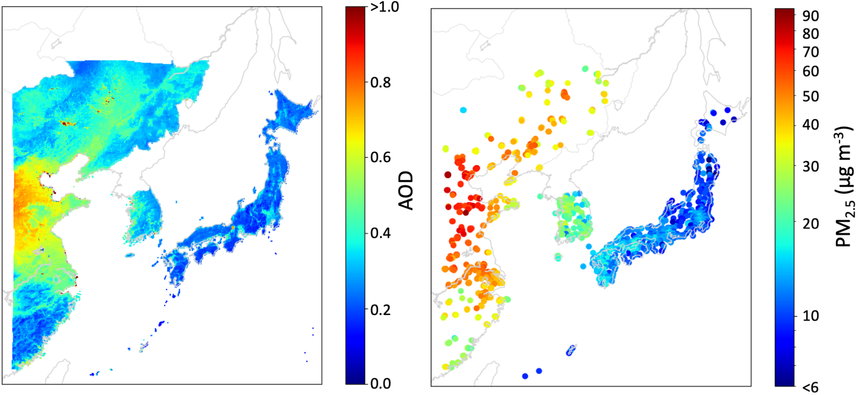
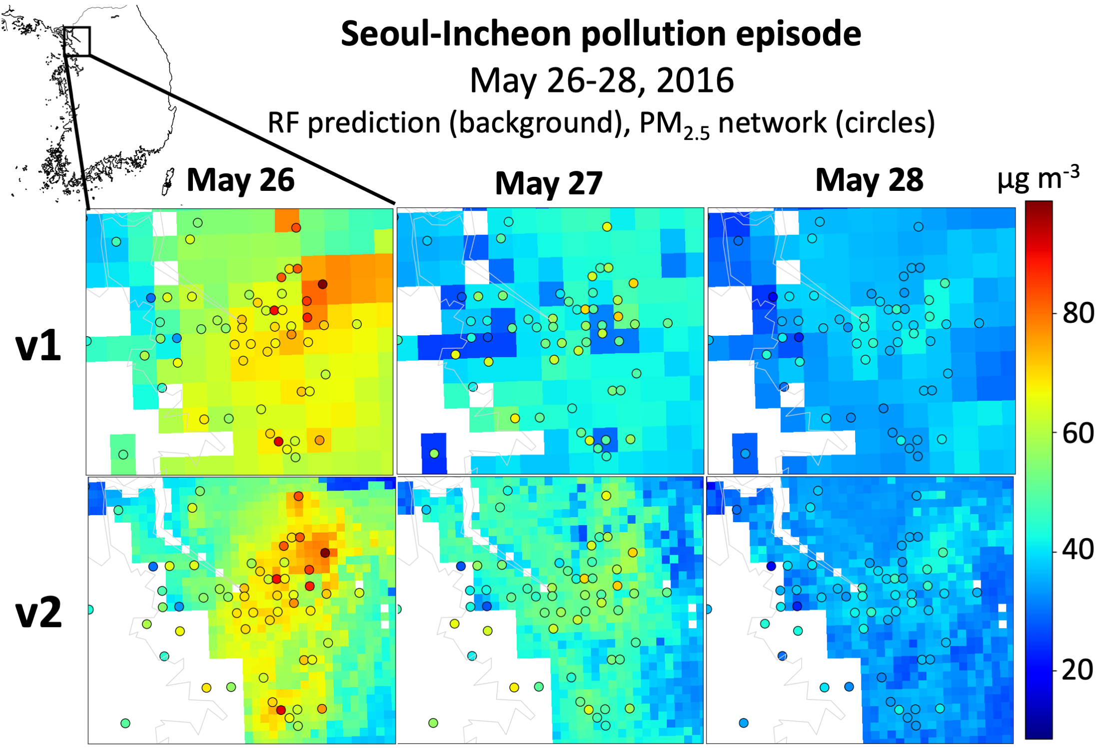
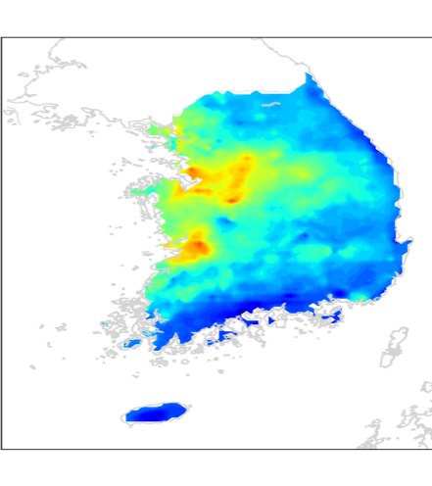
Improved mapping of PM_{2.5} over East Asia with GOCI geostationary data (2010-)
Daily PM_{2.5} with 2x2 km² resolution for eastern China, S. Korea, Japan
Visible radiation
aerosol
optical
depth (AOD)
aerosol
surface reflection
Yonsei 2x2 km² GOCI AOD product
AOD
gap-filling
random forest algorithm
trained with surface network data
daily 2x2 km² PM_{2.5}
Drew Pendergrass et al., in prep.

Slide 17
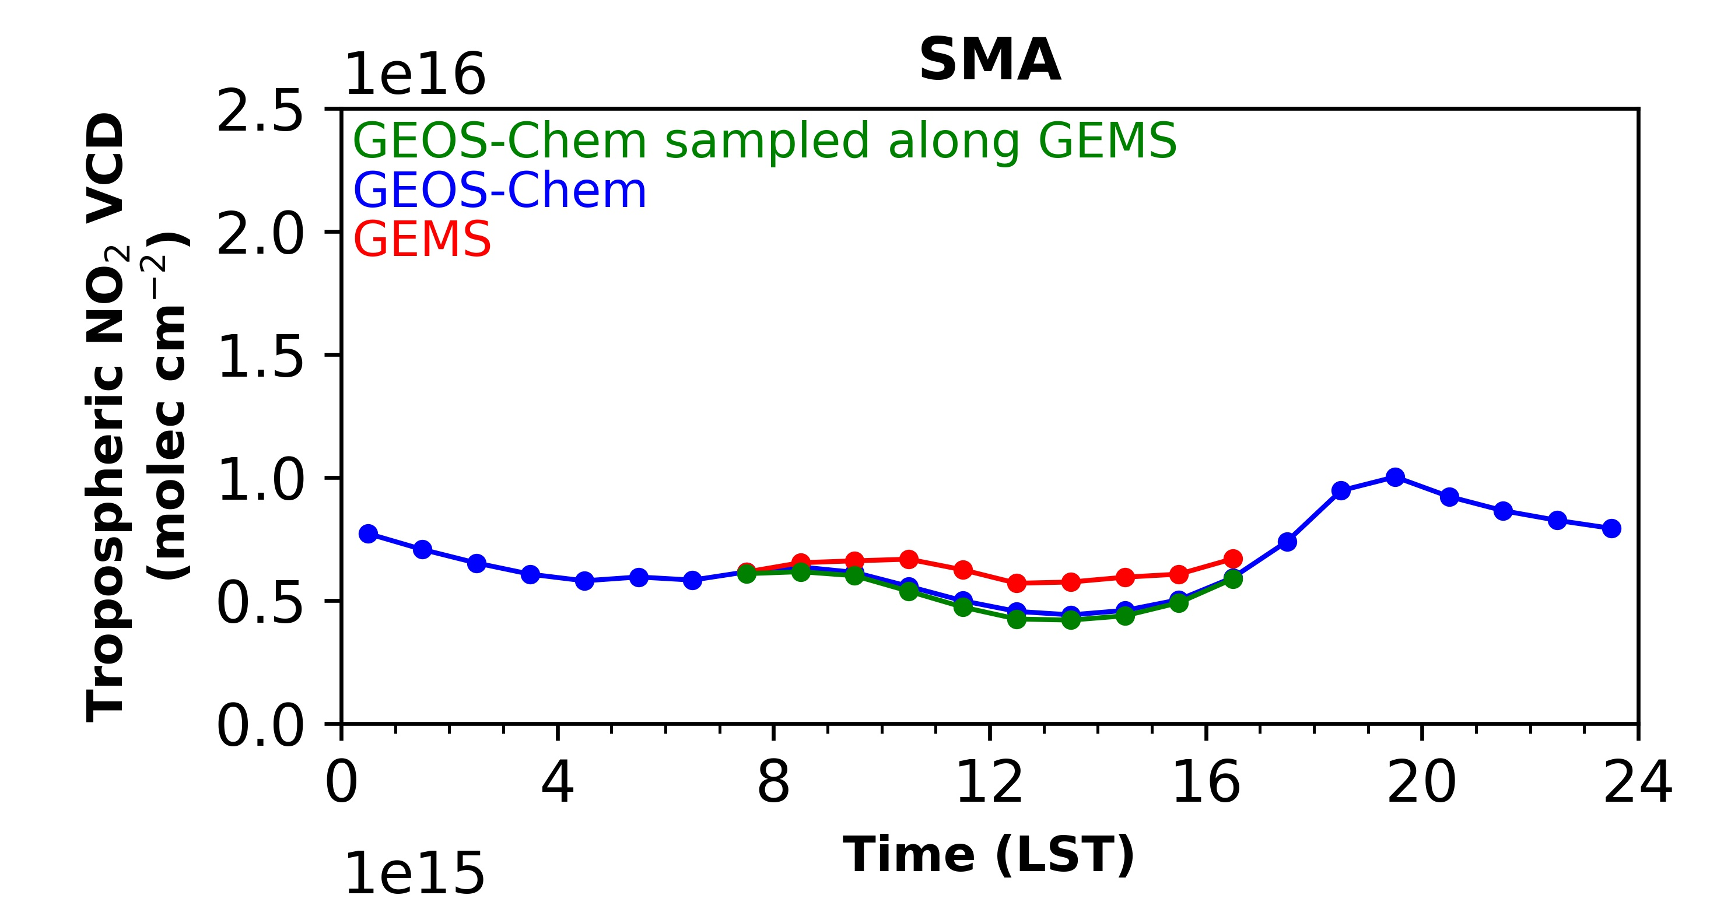
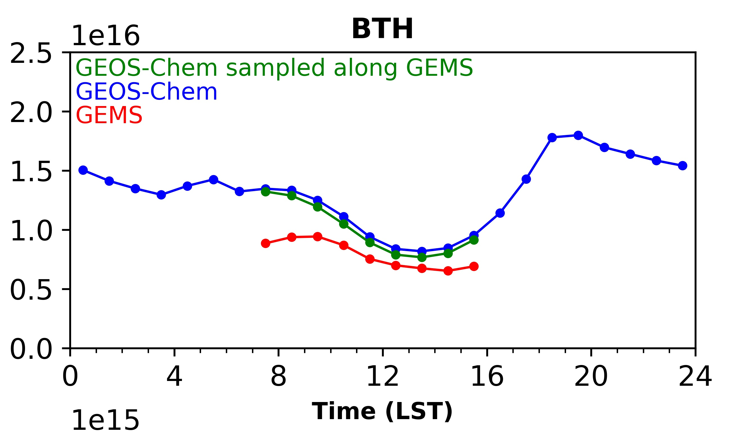
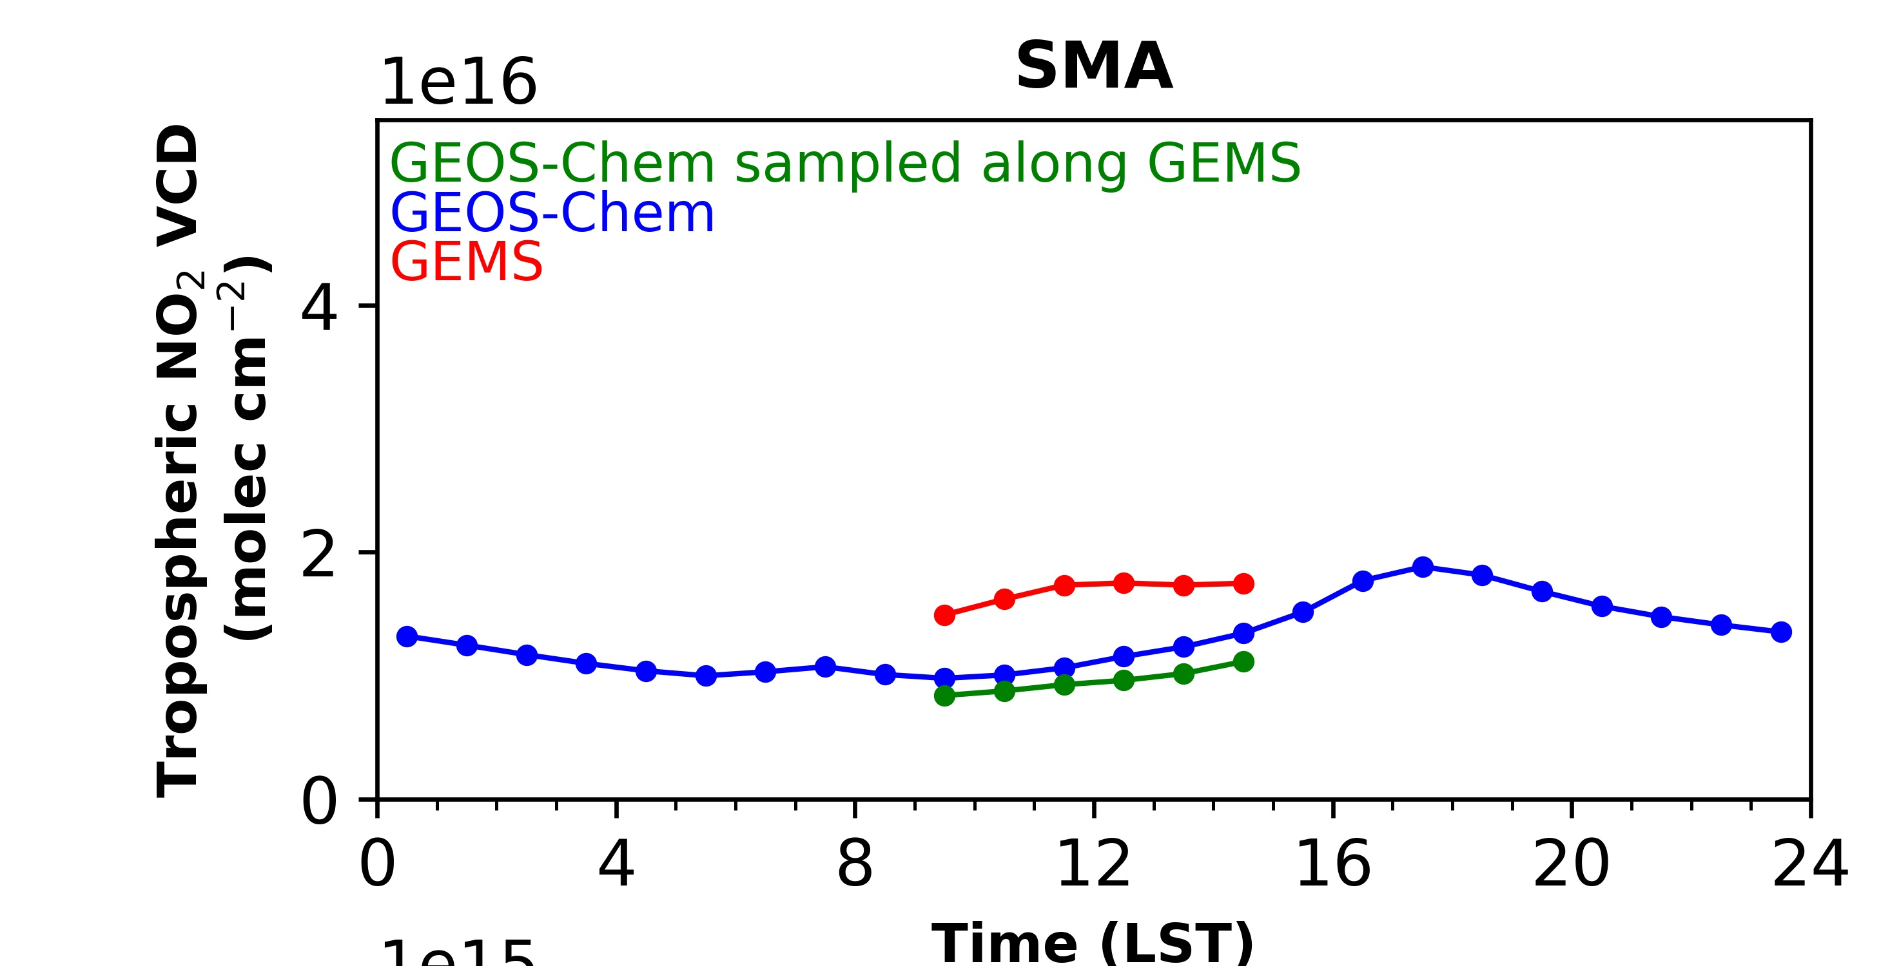
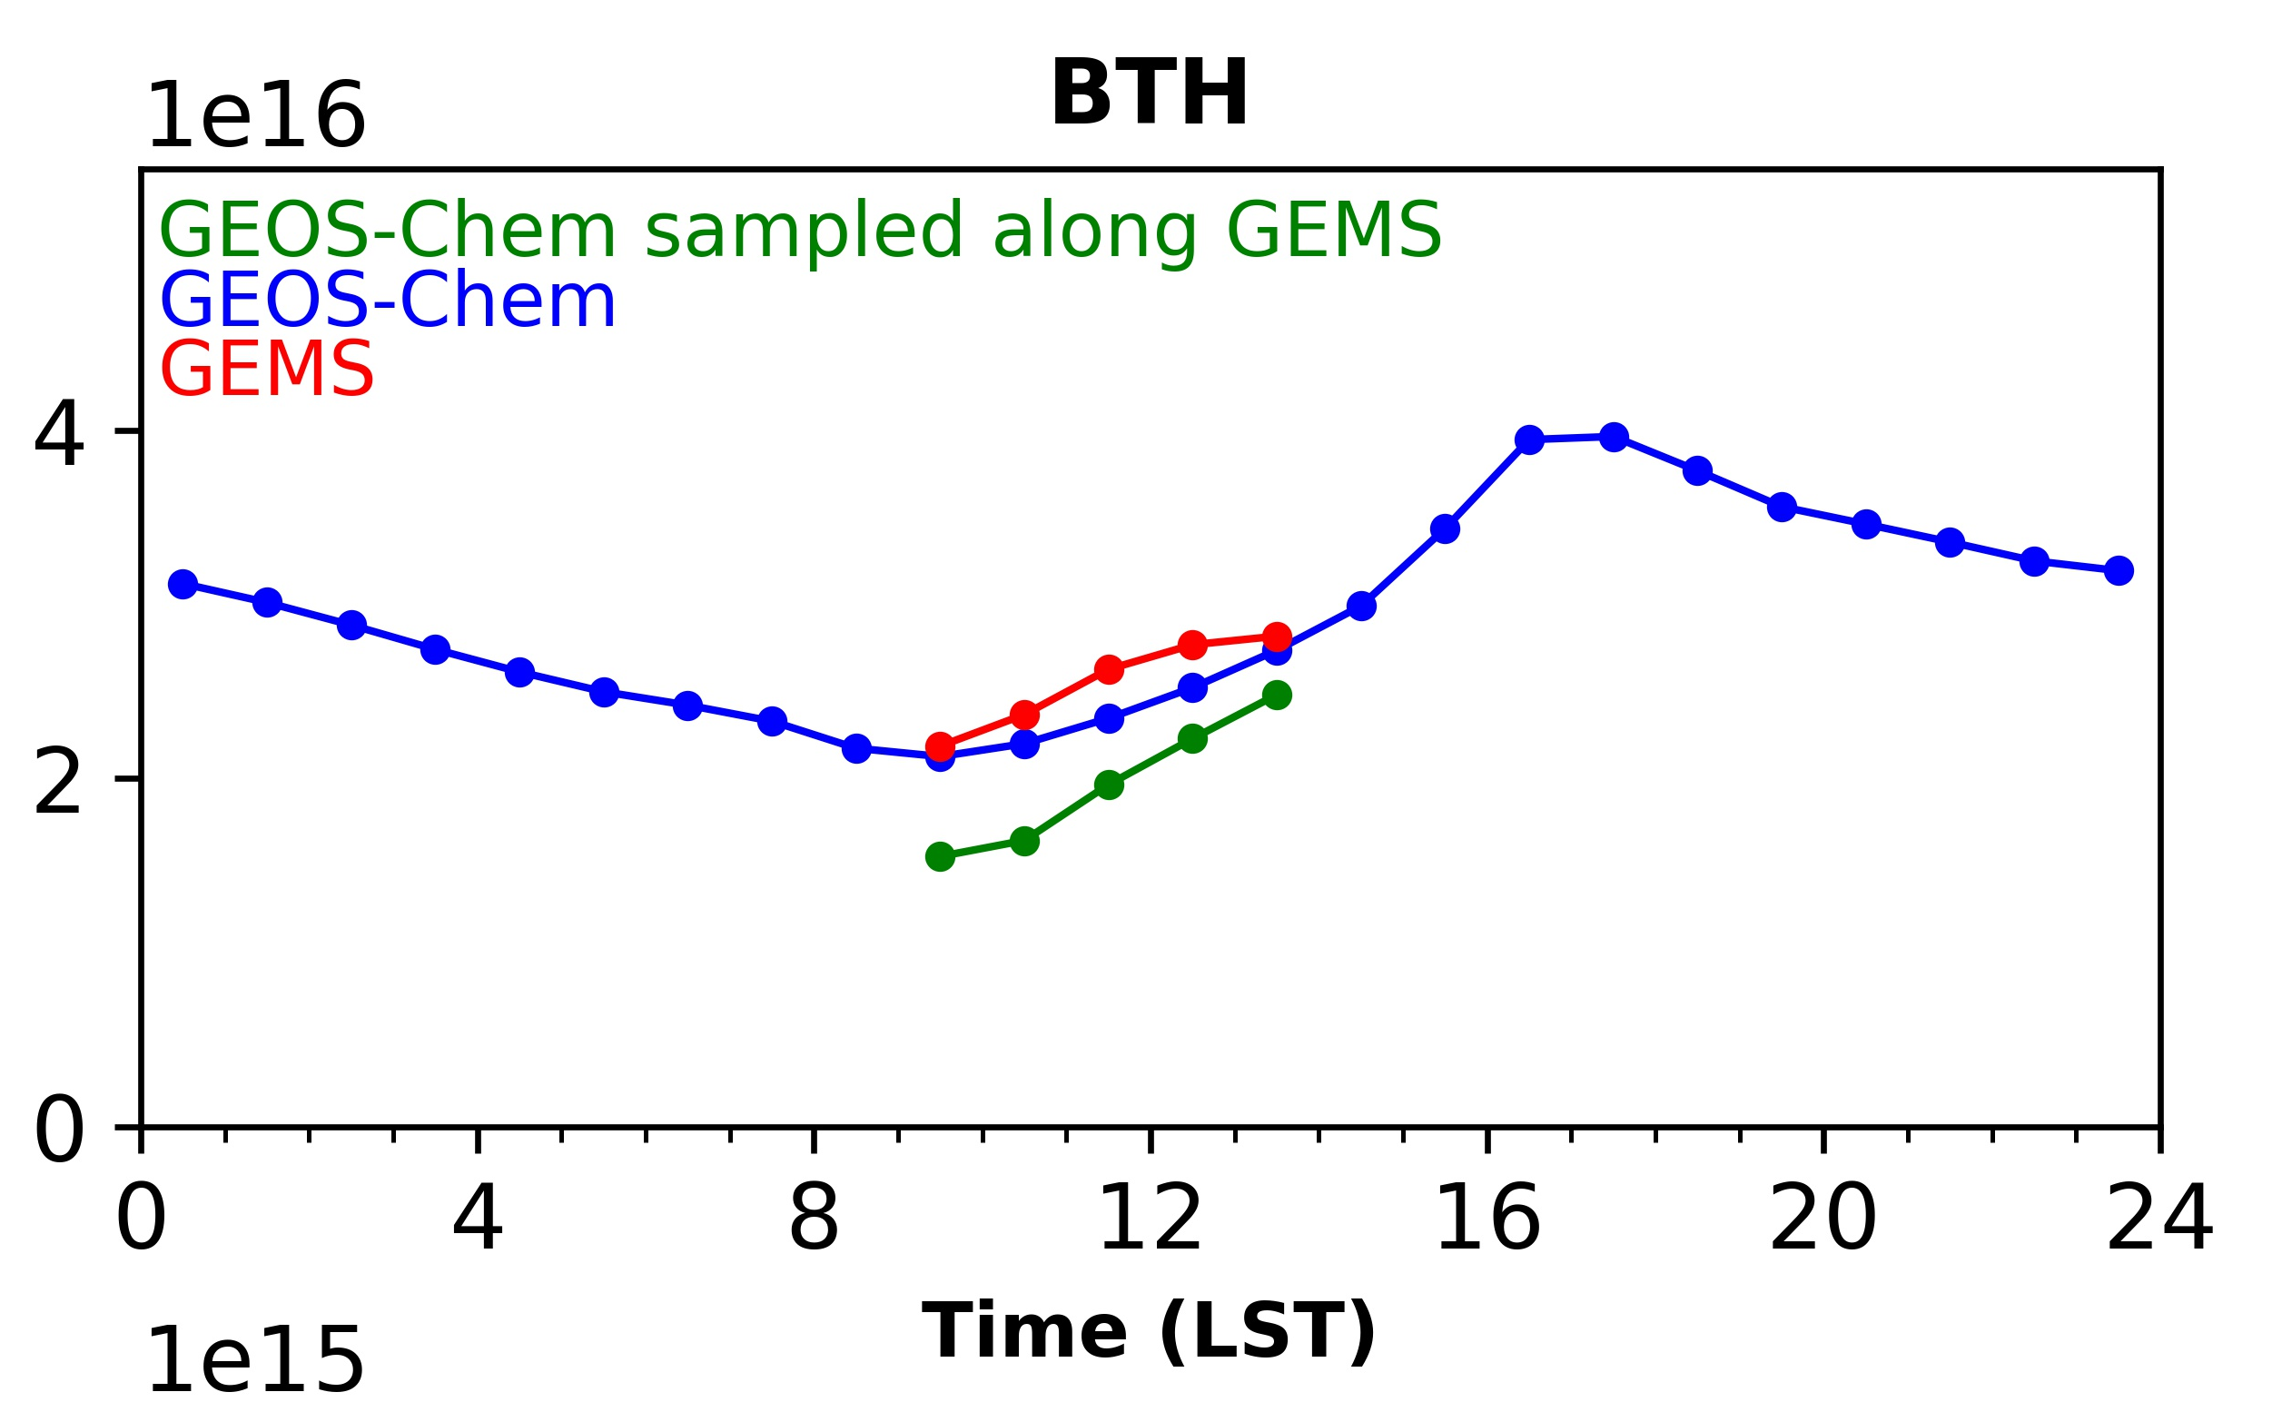
Interpretation of the diurnal variation of NO₂ observed by GEMS
GEMS and GEOS-Chem diurnal variations over Seoul (SMA) and Beijing (BTH)
summer
winter
Daytime chemical loss in summer, emission build-up in winter
Laura Yang et al., in prep.

Slide 18
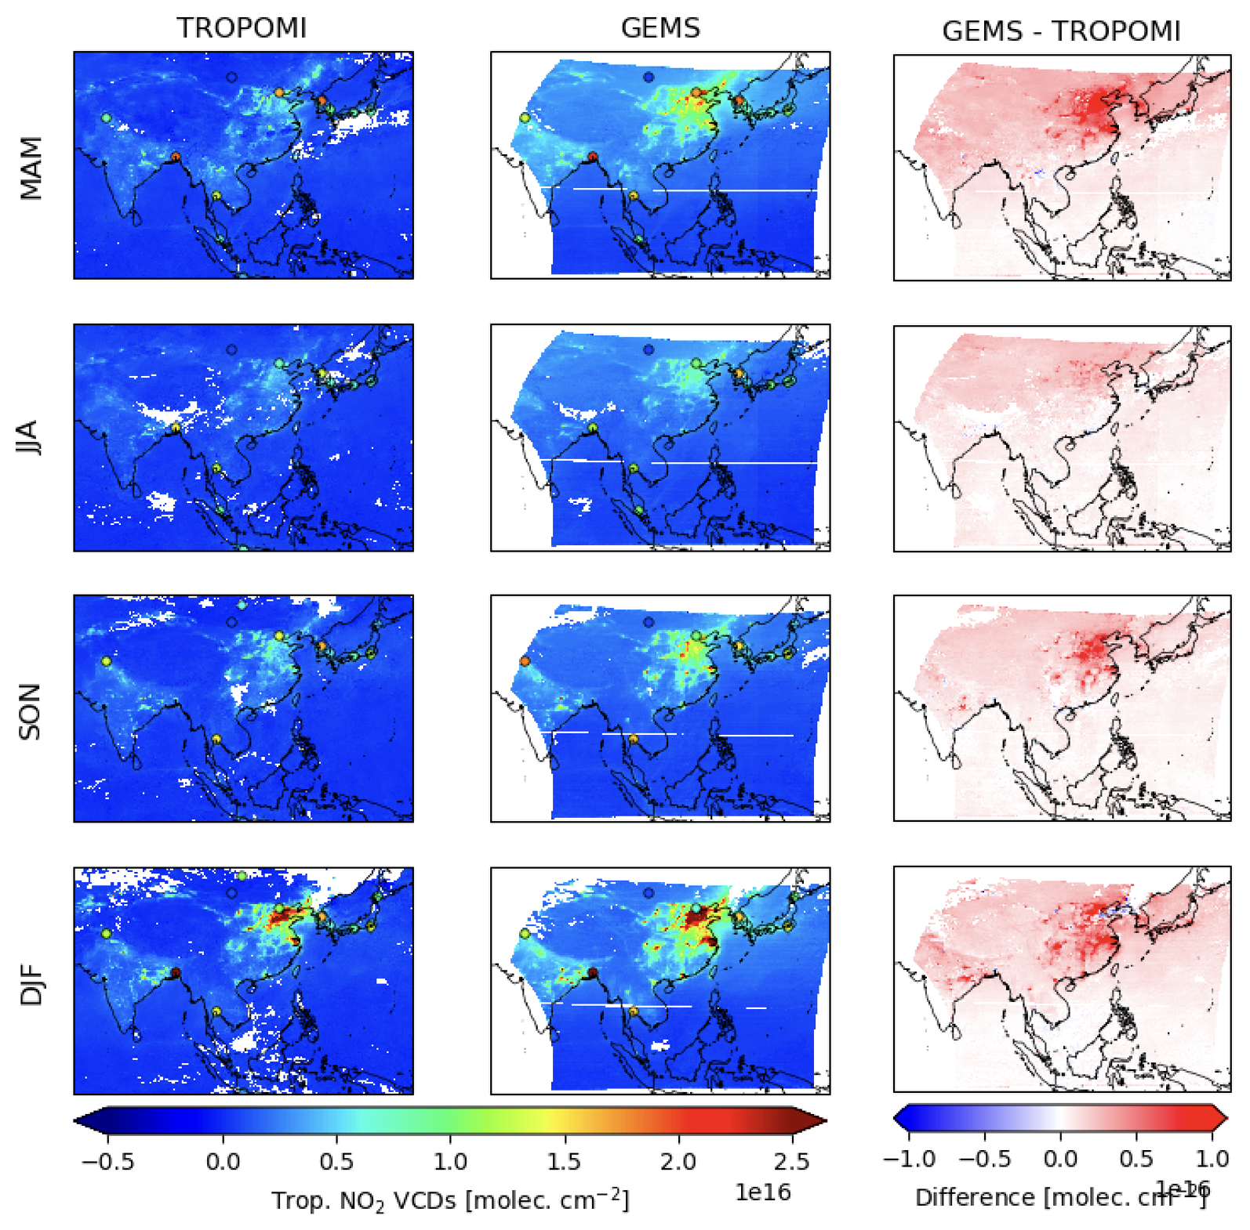
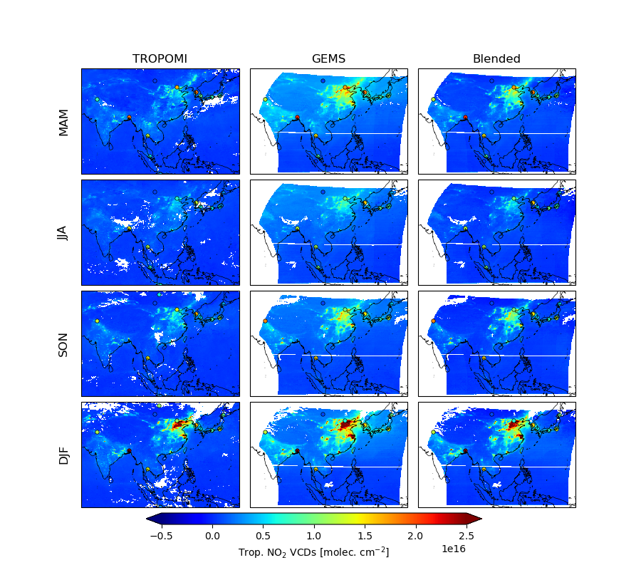
TROPOMI-corrected GEMS NO₂ product
X = NO₂ tropospheric column
new product
mature product
GEMS:
X_{G} + retrieval
parameters x_{G}
TROPOMI:
X_{T}
collocated data subset
GEMS version 2.0 TROPOMI-corrected
improve
retrievals
Train ML model for
Δ(X_{G} – X_{T}) = f(x_{G})
full dataset
Correct GEMS product:
X_{G} – f(x_{G})
dense and precise
TROPOMI-corrected GEMS product combines precision of TROPOMI with density of GEMS
We will use this for inversions with CHEEREIO
Yujin Oak et al., in prep.

Slide 19
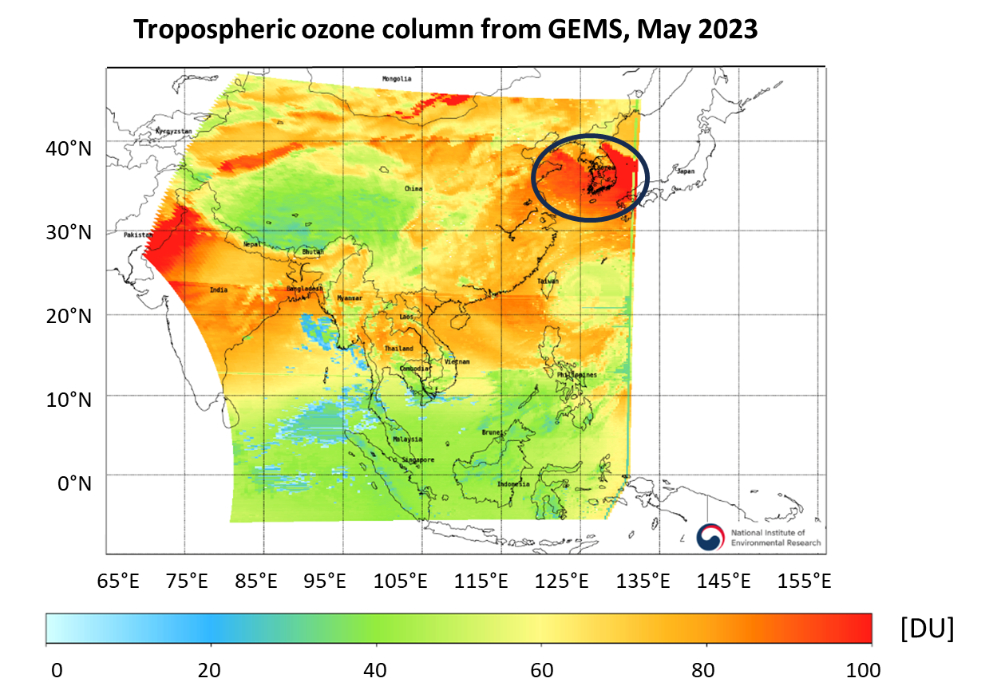
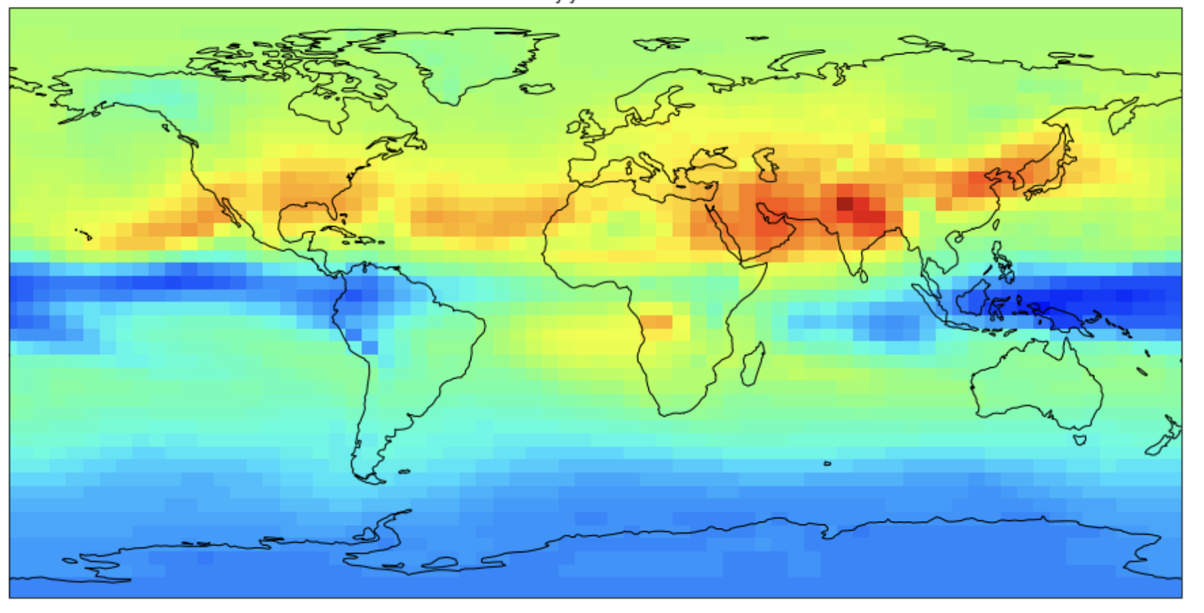
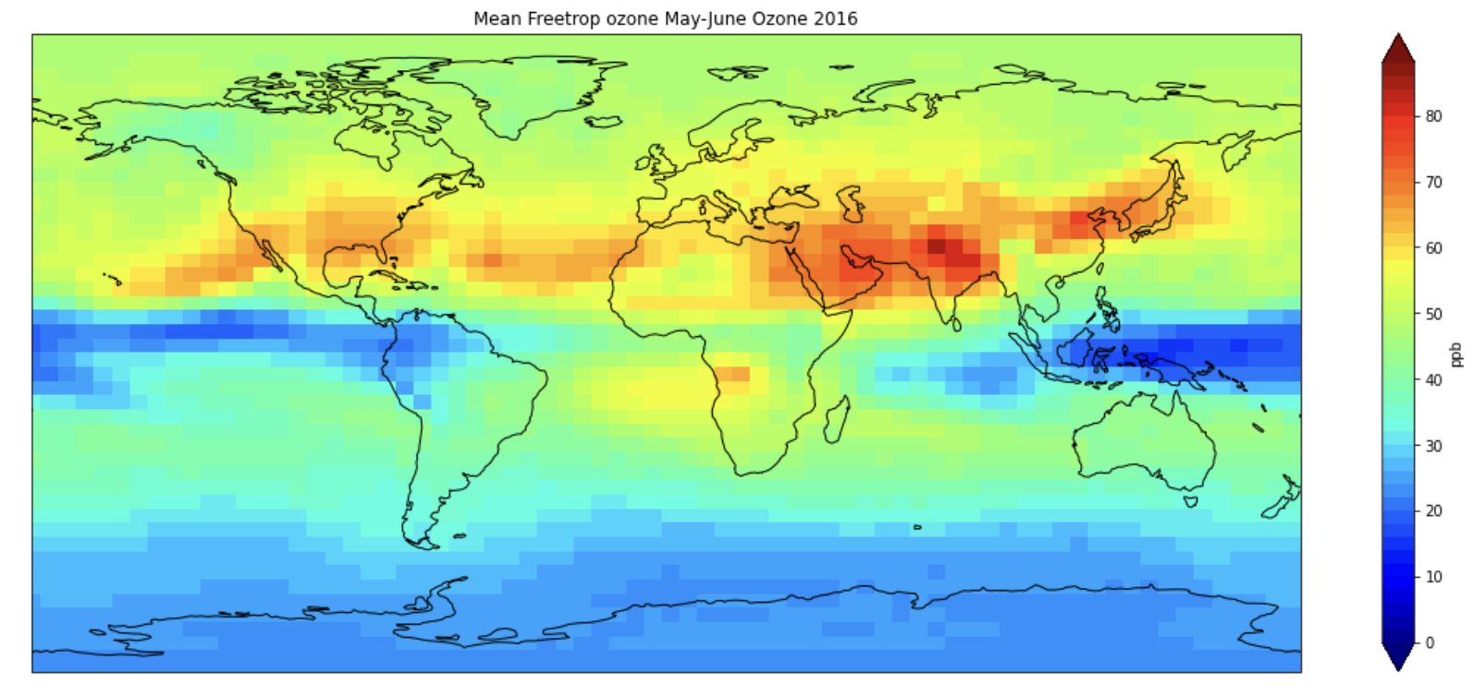
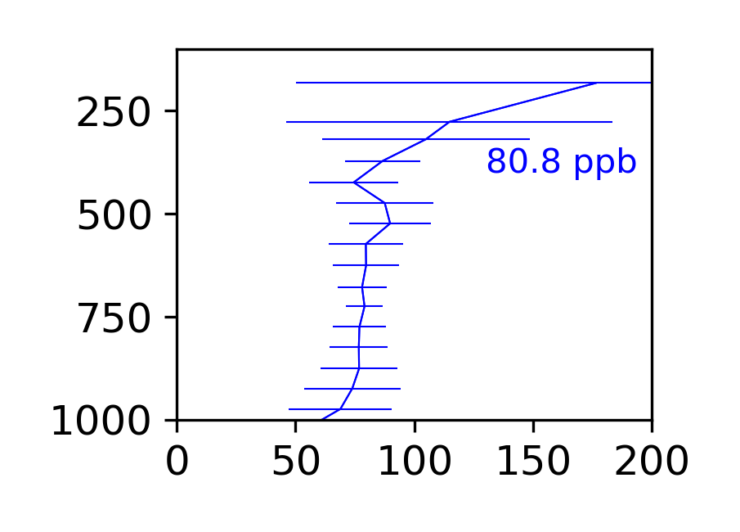
Origin of high free tropospheric ozone over Korea
Korea cannot meet its 60 ppb ozone air quality standard because of high concentrations in free troposphere (2-8 km altitude) subsiding to the surface
GEOS-Chem
90
50
0
Ozone, ppb
GEMS observes high free tropospheric ozone over Korea, reproduced by GEOS-Chem; now investigating the source of this maximum
Pressure, hPa
Pohang vertical profile
Nadia Colombi et al., in prep.
Ozone, ppb

Slide 20
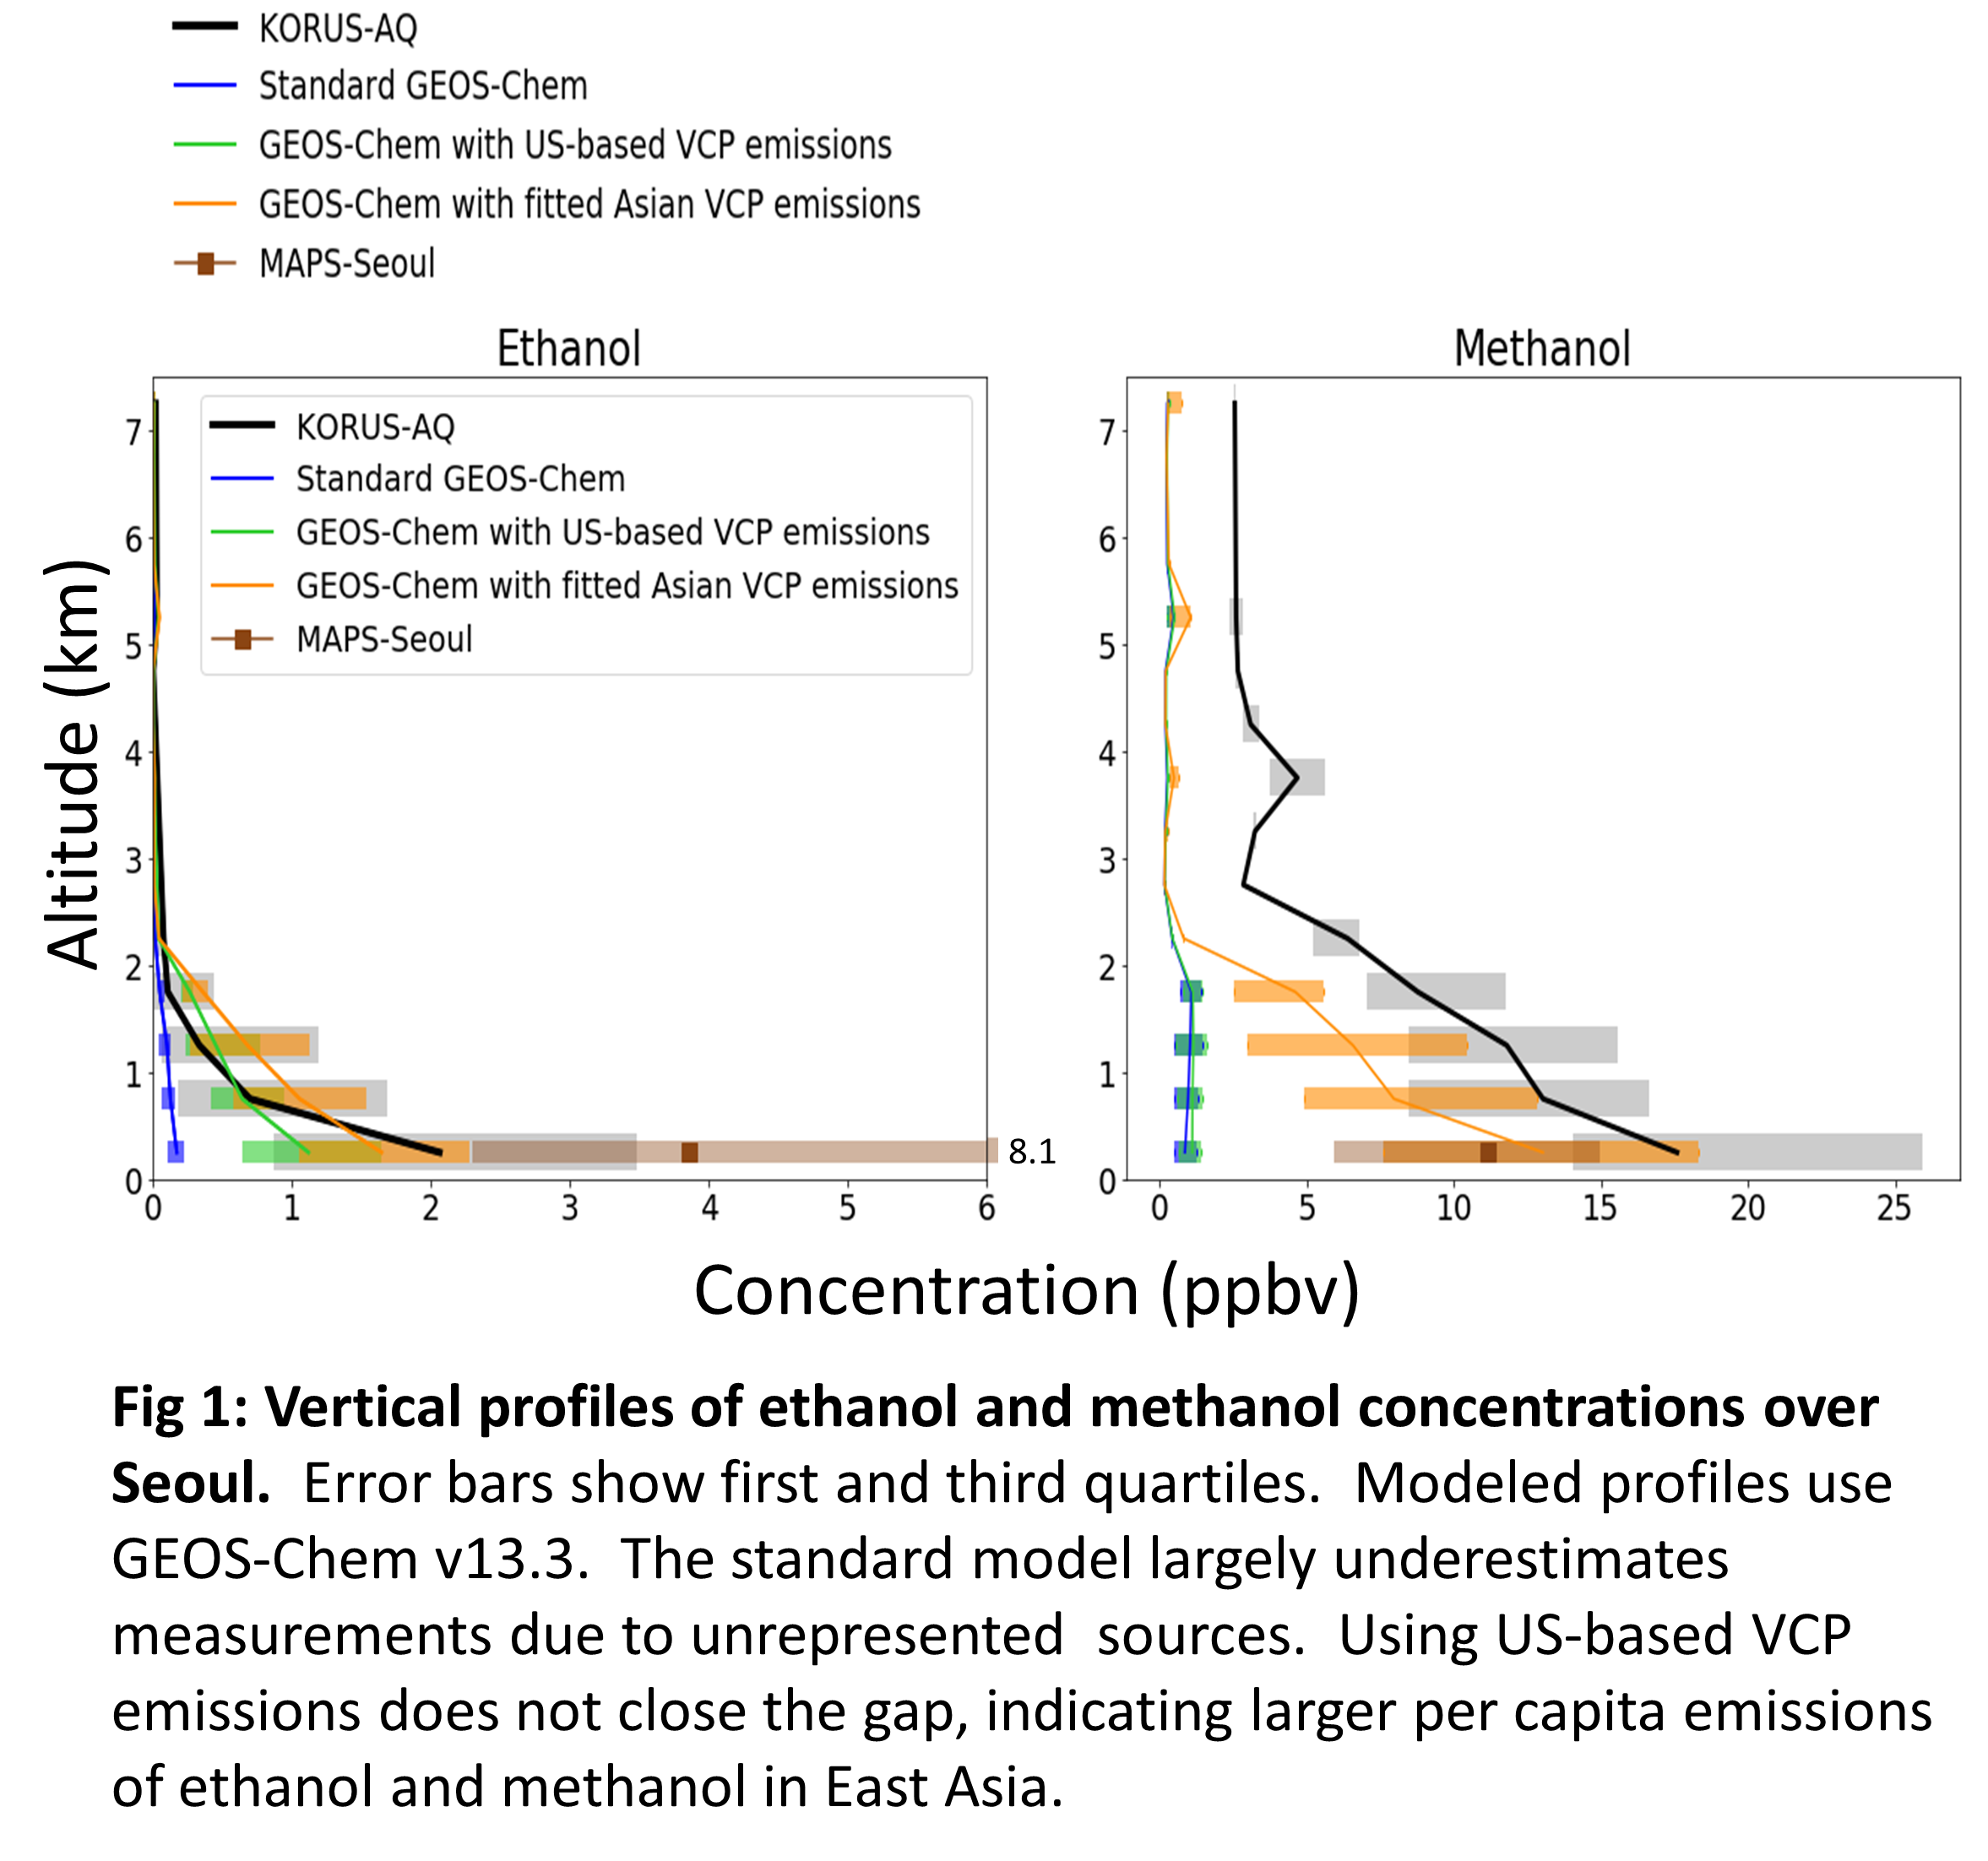
Evidence for high emissions of volatile chemical products (VCPs) in East Asia
Very high concentrations of ethanol and methanol in aircraft and surface observations over Seoul: implications for SOA and ozone formation
Ellie Beaudry et al., in prep.

