Slide 1

Improved understanding of PM_{2.5} in Korea and China through integrated modeling and analysis of satellite, aircraft, and surface observations
Daniel Jacob
with Junfeng Wang, Shixian Zhai, Ke Li, Drew Pendergrass,
Jared Brewer, Nadia Colombi, Haipeng Lin, Ellie Beaudry
Samsung PM_{2.5} Strategic Research Program
Year 1 progress report

Slide 2
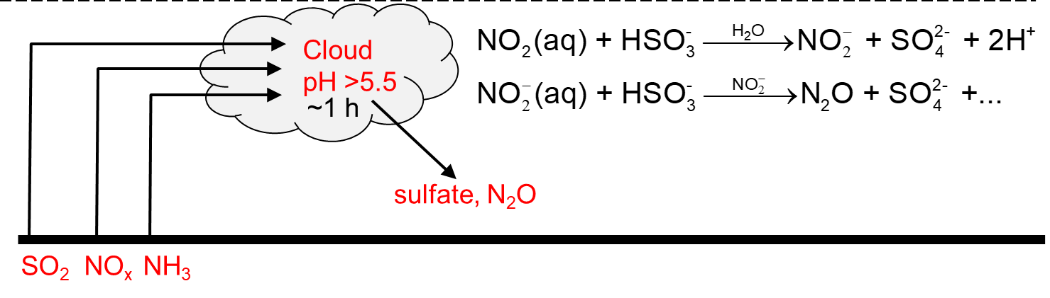
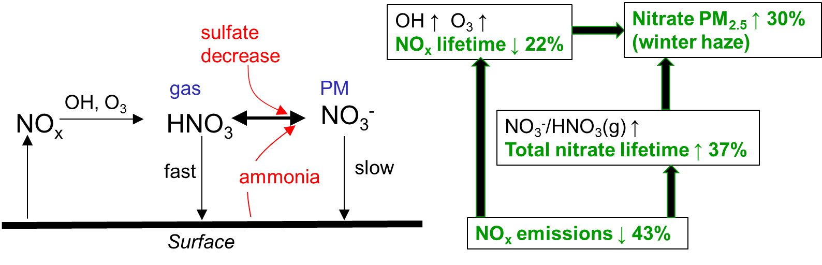
Summary of work previously presented in interim report
1. Wang, J., J. Li, J. Ye, J. Zhao, Y. Wu, J. Hu, D. Liu, D. Nie, F. Shen, X. Huang, D. Huang, D. Ji, X. Sun, W. Xu, J. Guo, S. Song, Y. Qin, P. Liu, J.R. Turner, H.C. Lee, S. Hwang, H. Liao, S.T. Martin, Q. Zhang, M. Chen, Y. Sun, X. Ge, and D.J. Jacob, Fast sulfate formation from oxidation of SO₂ by NO₂ and HONO observed in Beijing haze, Nature Comm., 11, 2844, 2020.
2. Zhai, S., D.J. Jacob, X. Wang, Z. Liu, T. Wen, V. Shah, K. Li, J. Moch, K.H. Bates, S. Song, L. Shen, Y. Zhang, G. Luo, F. Yu, Y. Sun, L. Wang, M. Qi, J. Tao, K. Gui, H. Xu, Q. Zhang, T. Zhao, H.C. Lee, H. Choi, and H. Liao, Controlling particulate nitrate pollution in China, submitted to Nature Geoscience, 2020.

Slide 3

Secondary organic aerosol (SOA) in Beijing winter haze produced by aqueous-phase oxidation of fossil fuel primary OA (FF-POA)
December 16-22 2016 winter haze event at Beijing IAP
moderate RH high RH cold front
SP-AMS (μg m⁻³)
Highly oxidized aqueous SOA (aq-SOA) is produced rapidly at high RH in correlation with sulfate while fossil fuel POA declines
Junfeng Wang
Wang et al., submitted to PNAS

Slide 4
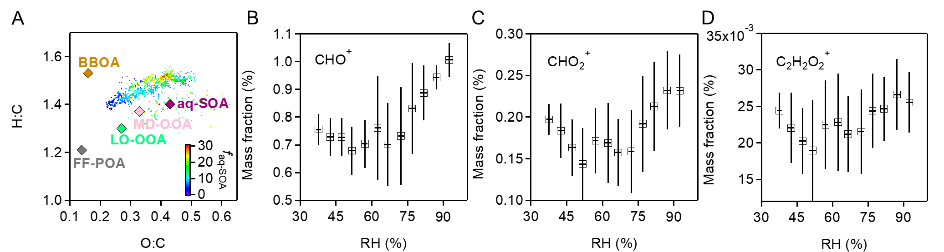
PAH ring-breaking: pathway for oxidation of FF-POA to aq-SOA
PM mass fraction,
16-22 December haze event
Van Krevelen diagram,
16-22 December haze event
as fossil fuel POA
as aqueous SOA
- 1:1 slope supports aqueous-phase oxidation of FF-POA to SOA
van Krevelen diagram suggests ring-breaking of aromatics (PAHs) to explain increase in both O:C and H:C
Results suggest that SOA PM_{2.5} in winter haze can be decreased by control of POA from fossil fuel combustion – it’s not just coming from VOCs
Wang et al., submitted to PNAS

Slide 5

Unlike PM_{2.5}, summer ozone pollution in China is getting worse
Trends at the Ministry of Ecology and Environment sites
MDA8
ozone
PM_{2.5}
Most of that increase is anthropogenically driven:
PM_{2.5} ↓ leads to increased radicals
NO_{x} ↓ + flat VOCs drives ozone increase under VOC-limited conditions
Li et al., ACP 2020
Ke Li

Slide 6
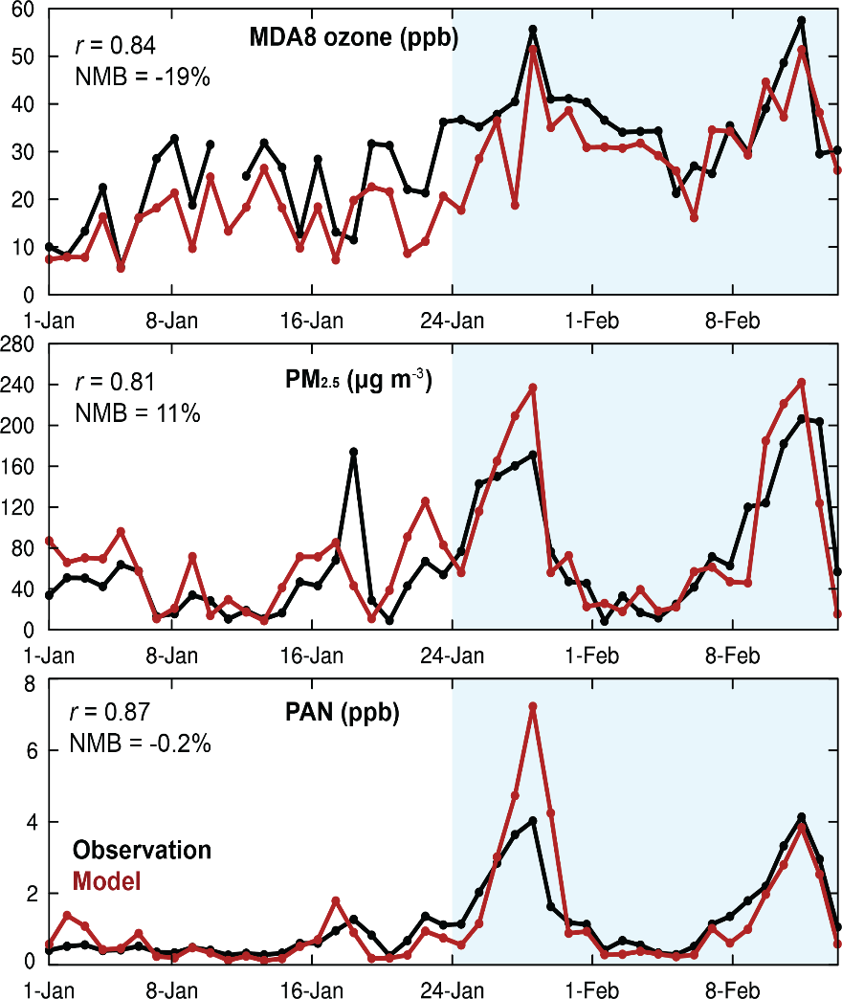
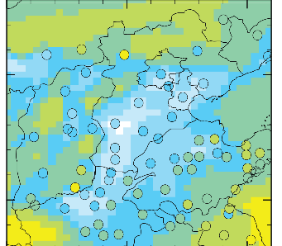
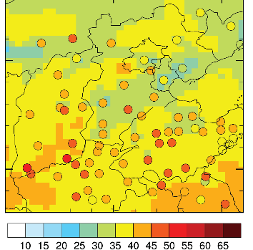
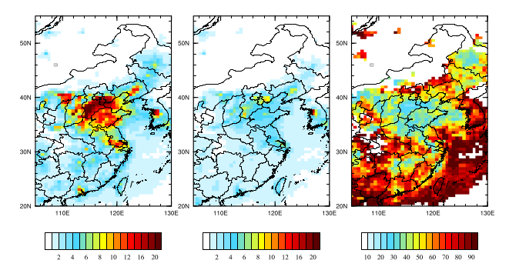
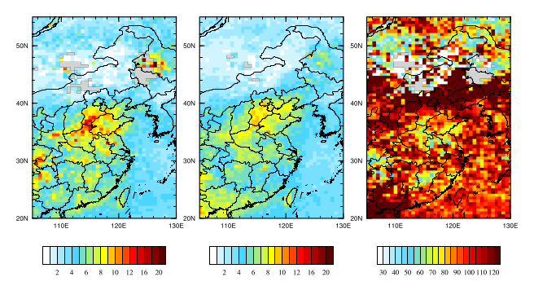
COVID-19 2020 lockdown reveals fast wintertime ozone production in Beijing
Beijing observations and model
before Jan 24 after Jan 24
MDA8 ozone
in N China Plain
MDA8 ozone
PM_{2.5}
TROPOMI NO₂
TROPOMI HCHO
Observations
Model
PAN
As NO_{x} emissions decrease during lockdown, ozone production surges
Formaldehyde from VOCs provides the main radical source:
Emphasizes the need for VOC emission controls
Li et al.,
under revision for PNAS

Slide 7
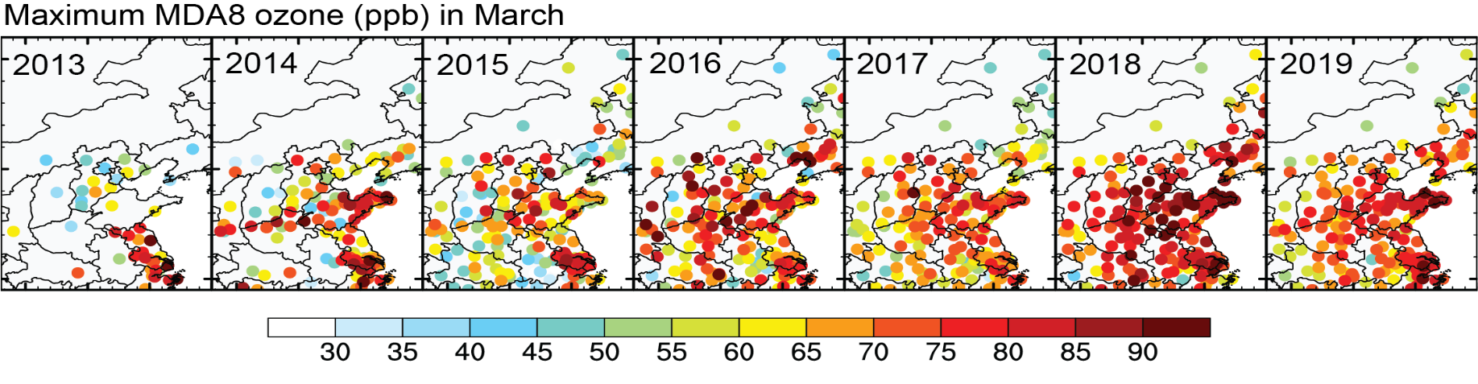
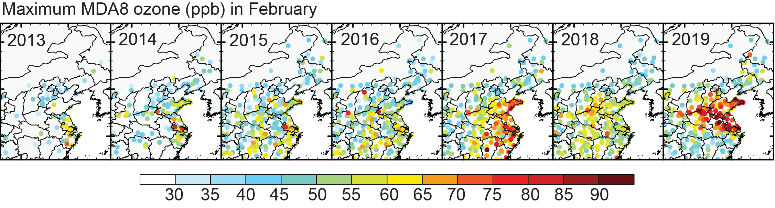
2013-2019 network data show ozone pollution spreading into winter as NO_{x} emissions decrease but VOC emissions do not
Li et al.,
under revision for PNAS

Slide 8
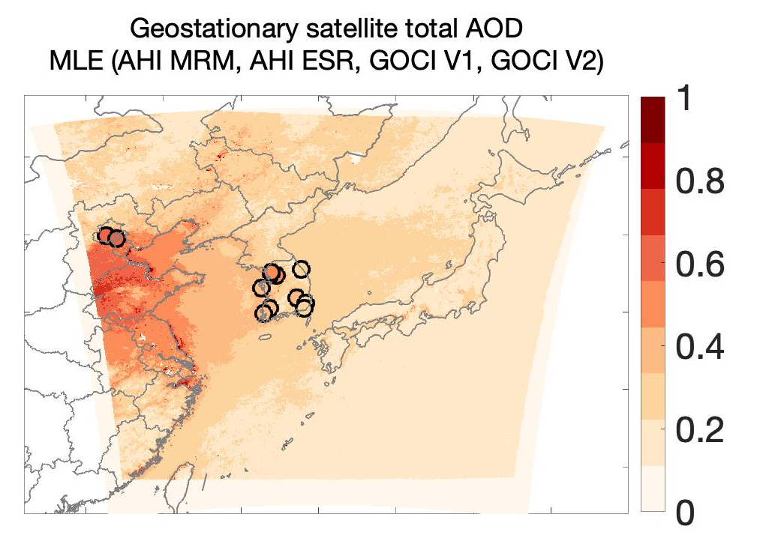
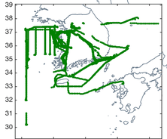
Using KORUS-AQ aircraft observations to relate aerosol optical depth (AOD) measured from geostationary satellite (GOCI+AHI) to surface PM_{2.5}
in collaboration with Jhoon Kim, Yonsei U.
Aerosol concentration and extinction profiles
PM_{2.5}
KORUS-AQ flights
Shixian Zhai

Slide 9
Aerosol concentration and extinction profiles in KORUS-AQ
Sulfate-nitrate-ammonium (SNA) aerosol dominates extinction because of its hygroscopicity
Most of the extinction is below 3 km altitude despite dust above
RH is critical for modeling extinction
Shixian Zhai, in prep.

Slide 10
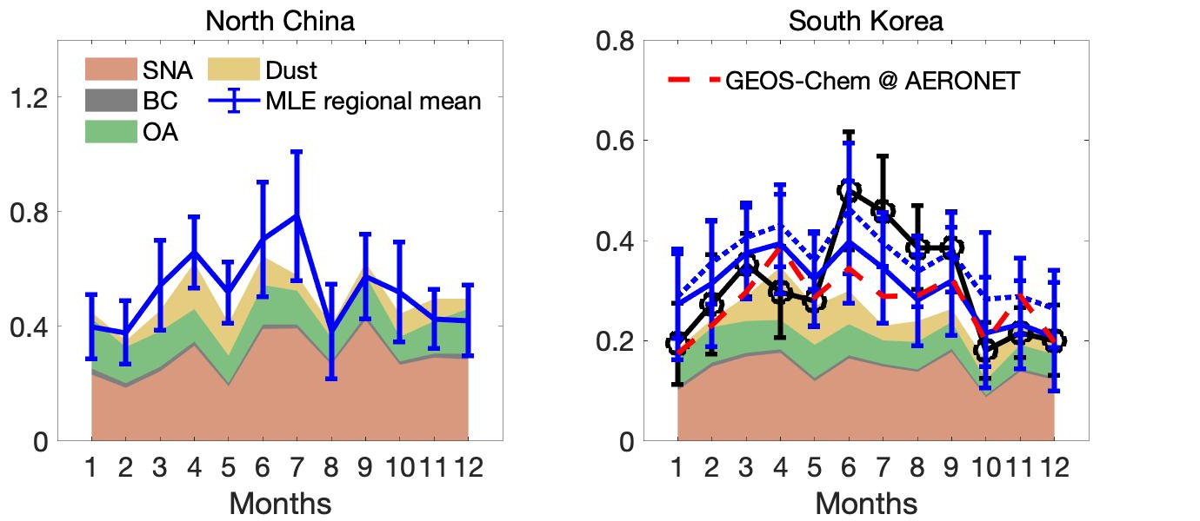
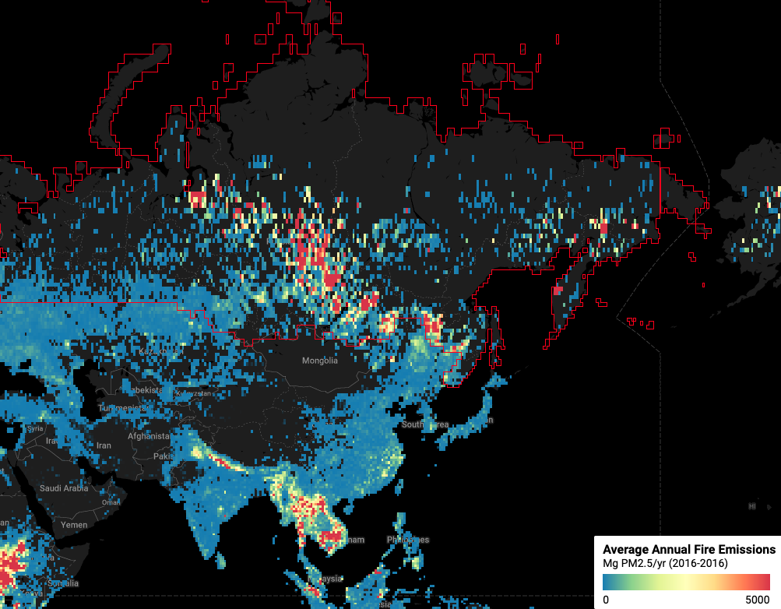

Seasonality of PM_{2.5} and AOD over China and Korea
Observed (circles), model (background)
GFED fire inventory
Good spatial annual correlation between PM_{2.5} and AOD
Opposite seasonality of PM_{2.5} and AOD due to PBL height, RH, June-July Russian fires;
fire influence underestimated in model because of injection height?
Fire influence complicates interpretation of long-term trends in AOD
Shixian Zhai, in prep.

Slide 11
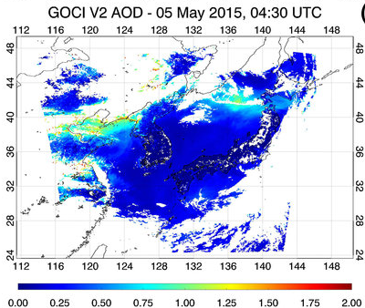

Using machine learning for high-resolution daily PM_{2.5} mapping from GOCI AOD data
in collaboration with Jhoon Kim, Yonsei U.
8x/daily GOCI data, 2011-present
Random forest algorithm
trained on PM_{2.5} data subset
For Korea, China, Japan
Inference of 24-h PM_{2.5}
at 6x6 km² resolution
Drew Pendergrass, in progress
Drew Pendergrass

Slide 12
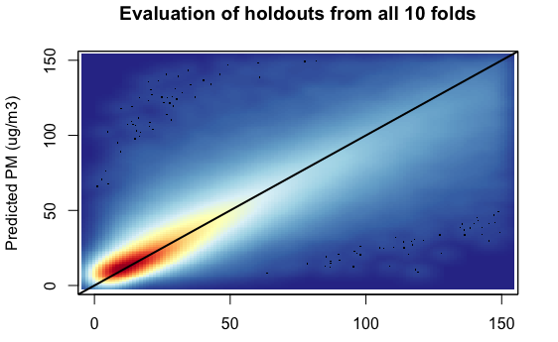
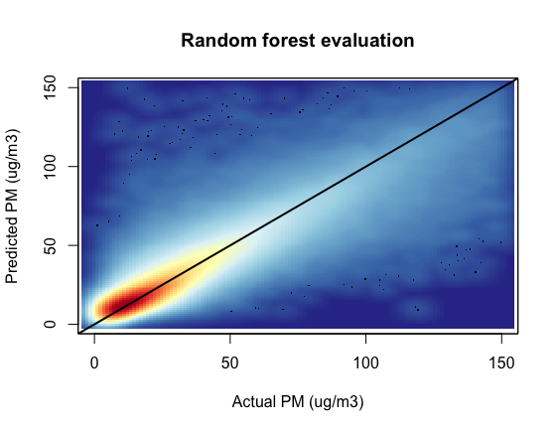
Evaluation of ML algorithm with independent 24h-PM_{2.5} data
R²: 0.857
OOB R²: 0.863
Mean abs. err.: 5.50 ug/m³
Med. abs. err.: 3.18 ug/m³
Mean abs. % err.: 29.97%
Med. abs. % err.: 16.77%
Results are even better when examining monthly or annual data
Drew Pendergrass, in progress

Slide 13
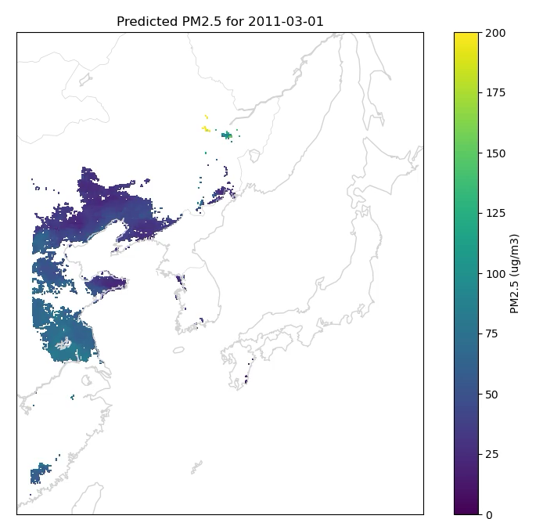
Daily PM_{2.5} mapping at 6x6 km² resolution from GOCI data
Next step is gap filling:
Spatial interpolation (spline)
Prior information
  observation days
  chemical transport model
Drew Pendergrass, in progress

Slide 14
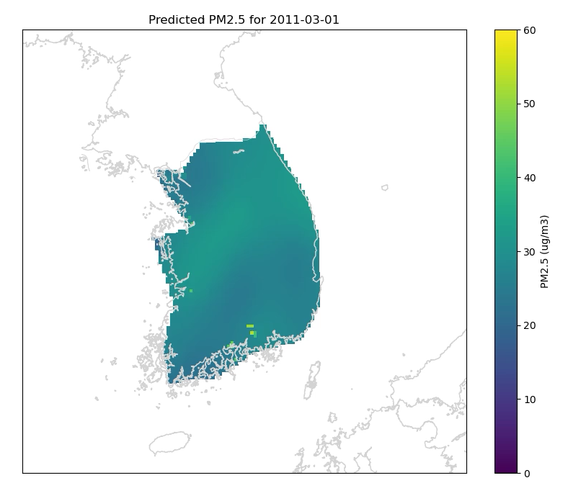
Demo of thin plate spline gap-filling for Korea
Drew Pendergrass, in progress

Slide 15
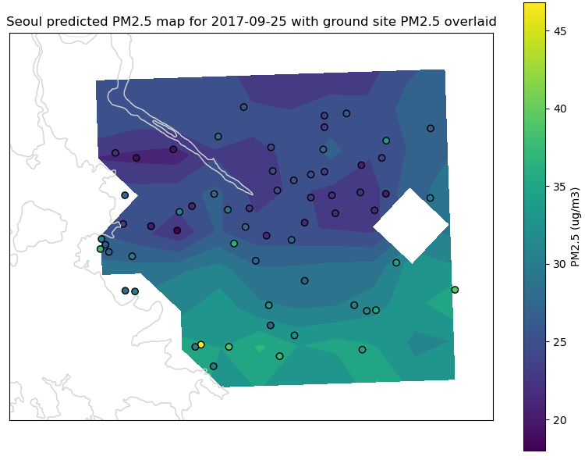
PM_{2.5} mapping from GOCI data for random day in Seoul
Circles are
AirKorea data
High success in reproducing observed spatial patterns at 6x6 km² resolution
Drew Pendergrass, in progress

Slide 16
Other work in progress
Evaluation of VOC inventories and recent trends in China and Korea using TROPOMI satellite data (Ke Li)
New size-resolved VBS approach to model SOA in KORUS-AQ data (Jared Brewer)
Integrated analysis of surface ozone over Korea using AirKorea, aircraft, sonde, and satellite data (Nadia Colombi)
WRF-GEOS-Chem simulation of Korea air quality during KORUS-AQ (Haipeng Lin)
Sources of oxygenated VOCs during KORUS-AQ and implications for SOA formation (Ellie Beaudry)

