Slide 1
Towards an improved understanding of factors affecting ozone pollution in East Asia
Nadia Colombi
G1 Symposium

Slide 2
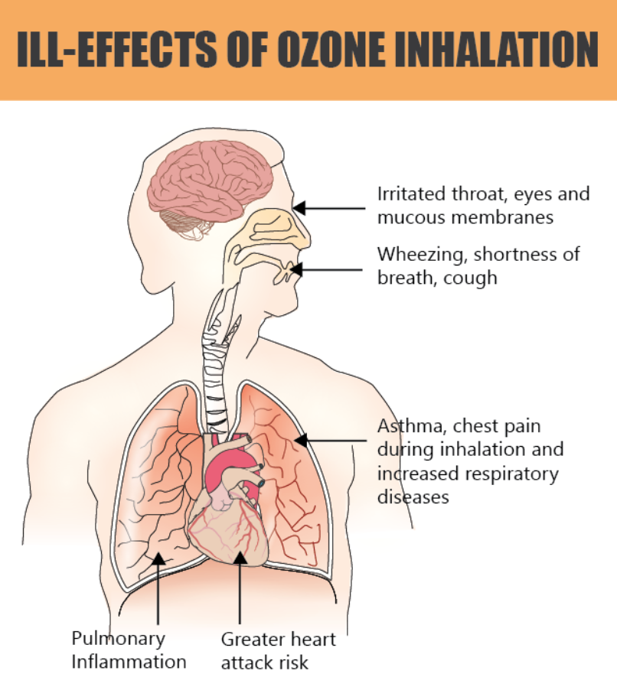
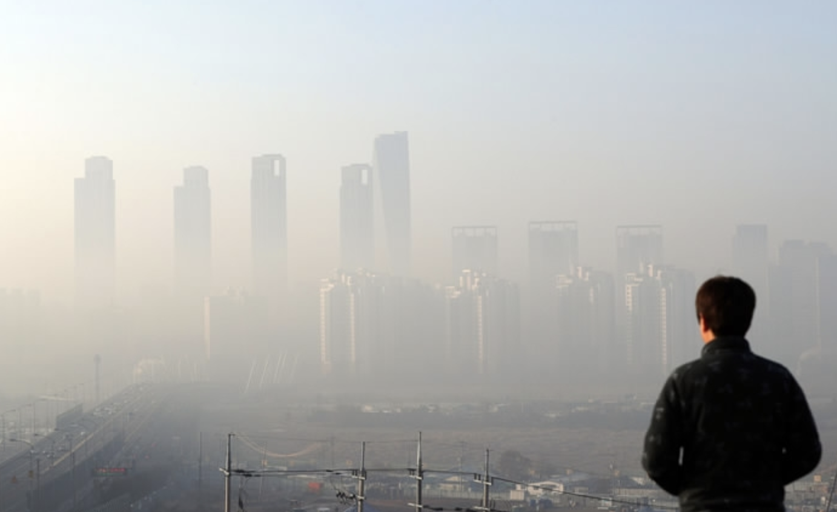
Tropospheric ozone is detrimental to human and ecosystem health
In 2017, ozone exposure accounted for 427,000 deaths.
Surface ozone concentrations are increasing in many regions across the globe (State of Global Air, 2019).
Global State of Air, 2019
Notes:
-Tropospheric ozone acts as a greenhouse gas and pollutant which is detrimental to human health and ecosystem productivity, and it is the main component in the formation of urban smog.
-In 2017, ozone exposure accounted for 427,000 deaths from COPD, most of which occurred in China and India (State of Global Air, 2019).
-Surface ozone concentrations are increasing in many regions across the globe, with a pronounced increase in developing nations (State of Global Air, 2019).

Slide 3
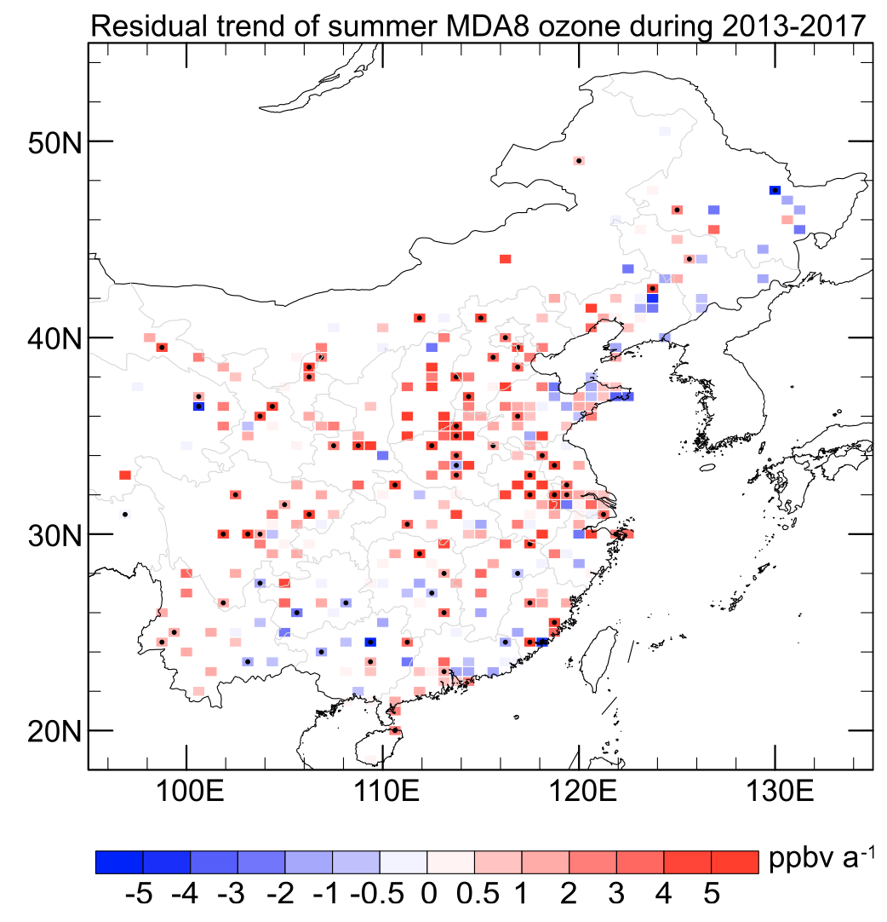
Surface ozone has increased in East Asia over the past two decades
Reducing precursor emissions does not always lead to a reduction in ozone levels (Lin et al, 1988).
Key controlling factors for the O₃ formation remain uncertain (Park and Kim, 2014).
Understanding the drivers of ozone formation requires combining observations with modeling.
MDA8 ozone 2000-2014 (Chang et al,, 2017)
MDA8 ozone China 2013-2017 (Li et al., 2019)
Notes:
In the troposphere, ozone is formed via the photochemical oxidation of volatile organic compounds (VOC) and carbon monoxide (CO) in the presence of Nitrogen Oxides (NO_{x}) (Jacob, 1999).
Although stringent air pollution controls have been executed in countries including Japan, Korea, and China, surface ozone has shown an increasing trend.
However, simulated O3 concentrations in Korea and East Asia have generally been underestimated in CTMs (Han et al., 2008; Kang et al., 2016), which might be due to a combination of several factors including horizontal and vertical resolutions, uncertainty in meteorological parameters, vertical mixing schemes, and chemical mechanisms (Han et al., 2008; Kang et al., 2016).
An important issue influencing efforts to reduce ozone at the surface is its abundance in the greater atmosphere above Korea. Ozone in the free troposphere over the SMA during KORUS-AQ was persistently greater than 60 ppbv.

Slide 4
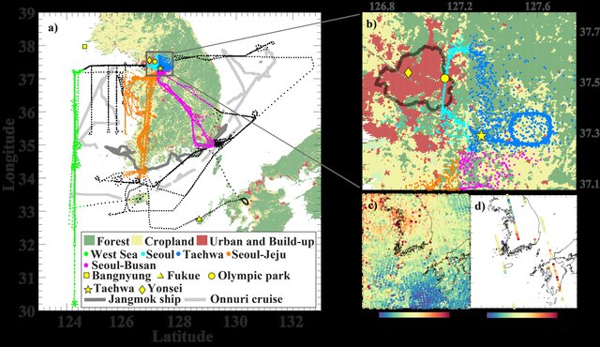
KORUS-AQ provides a unique ensemble of data to test and improve model representation of ozone formation processes
Conducted in May-June 2016 under the joint sponsorship of NIER of South Korea and NASA.
Employed a multi-perspective observing strategy including aircraft, ground sites, and satellites.
Notes:
-Korea-United States Air Quality field study
-NIER (National Institute of Environmental Research)
-KORUS-AQ employed a multi-perspective observing strategy including aircraft, ground sites, satellites, and models to understand the factors controlling air quality over the Seoul Metropolitan Area and across the Korean peninsula and surrounding waters.
-The project also provided a testbed for future remote sensing of air quality from geostationary orbit by satellite launches planned by both nations.
https://collections.elementascience.org/korusaq

Slide 5
Methodology
Simulate the KORUS-AQ period in a global 3D Chemical transport model (GEOS-Chem).
Use the detailed KORUS-AQ observations to diagnose the model’s shortcomings in simulating ozone in East Asia.
Update the model accordingly and use it along with new geostationary satellite (GEMS) data to analyze pollutant control strategies aimed at reducing ozone in East Asia.
Notes:
On point 3: “We will place these detailed but temporally limited observations in the context of the continuous observations from satellites and from the surface air quality network”
-exploit the new GEMS geostationary satellite observations (Feb-March 2020 launch) for high-resolution mapping of PM_{2.5} in Korea and more broadly in Eastern Asia.
-GEOS-Chem interpretation of GEMS observations for gases (NO₂, SO₂, formaldehyde) in terms of the implications for PM_{2.5} composition, PM_{2.5­} formation processes, and surface ozone.

Slide 6
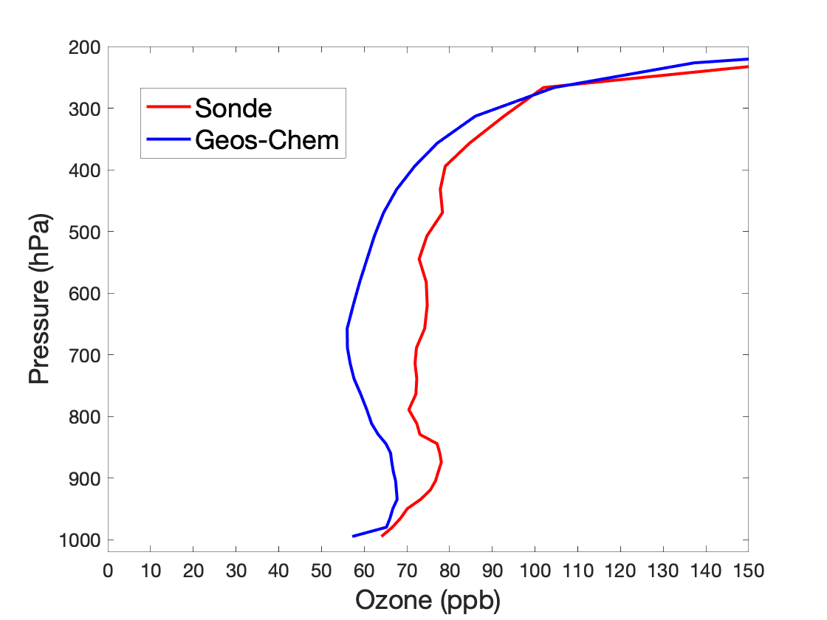
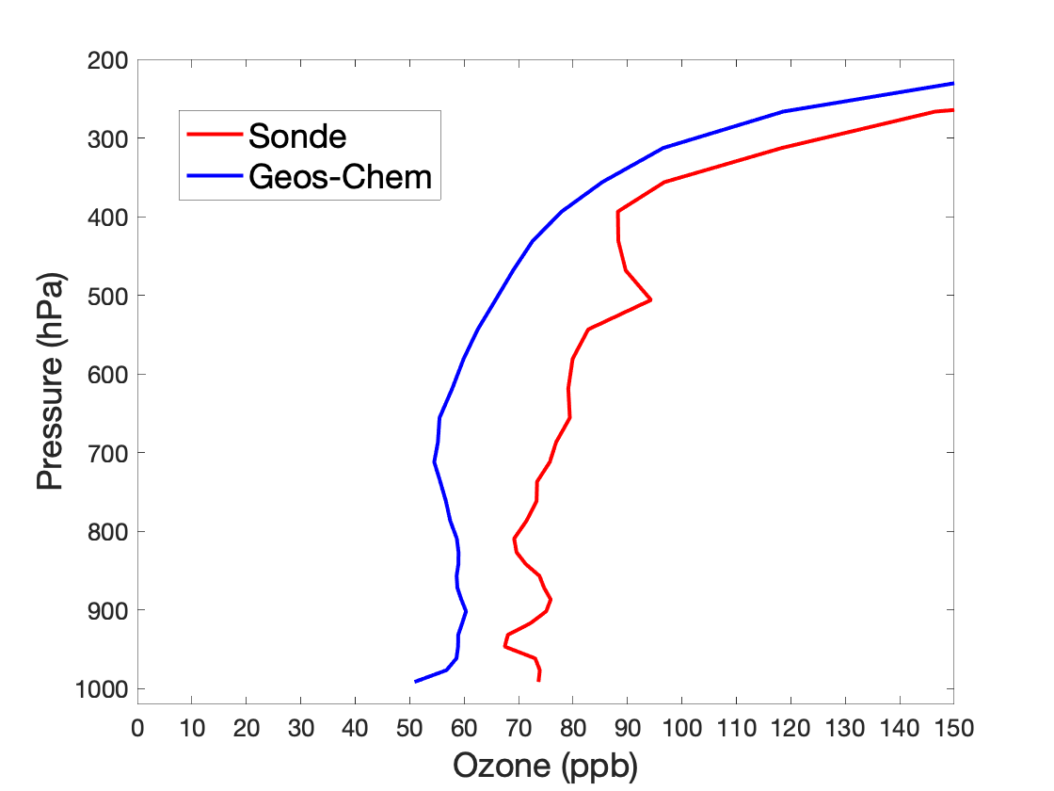
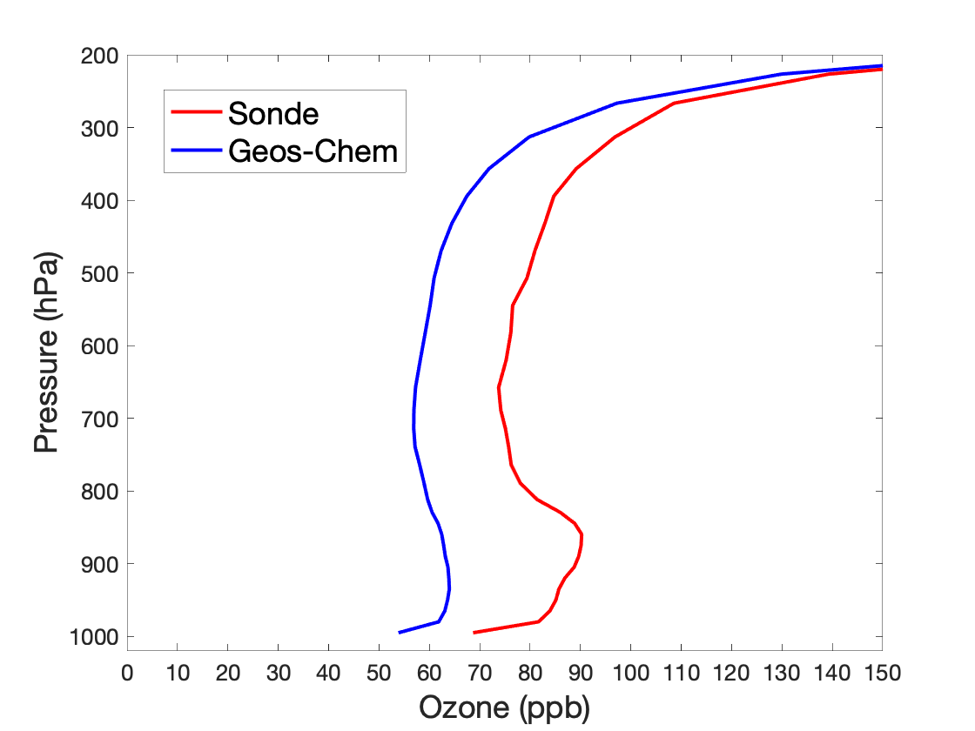
GEOS-Chem underestimates free tropospheric ozone by up to 30 ppb
Mean ozone averaged over 1st May – 10th June 2016
Olympic Park
(37.5 N, 127.1 E)
Pohang
(36.0 N, 129.4 E)
Taewha
(37.3 N, 127.3 E)

Slide 7
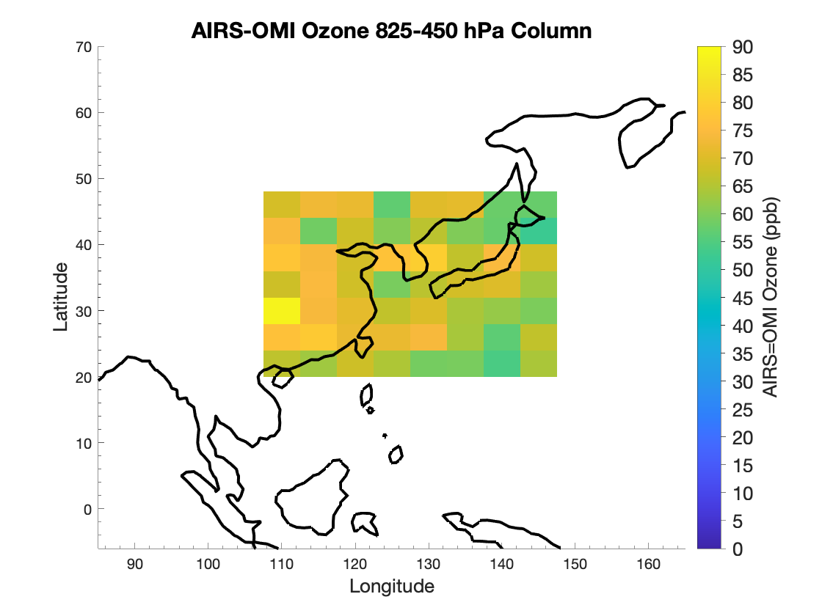
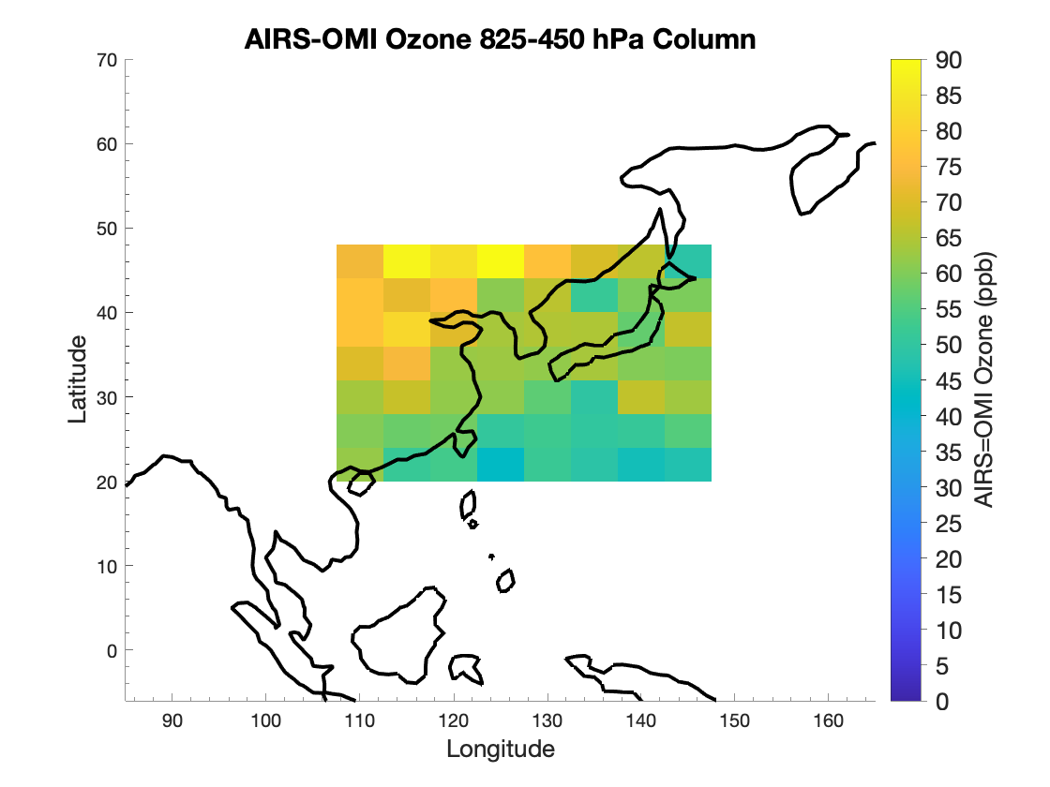
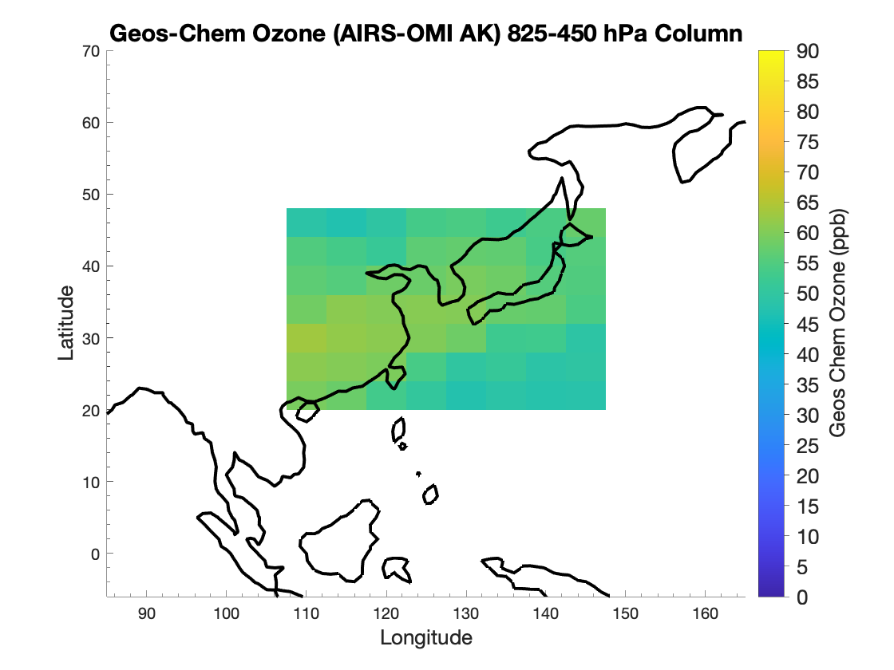
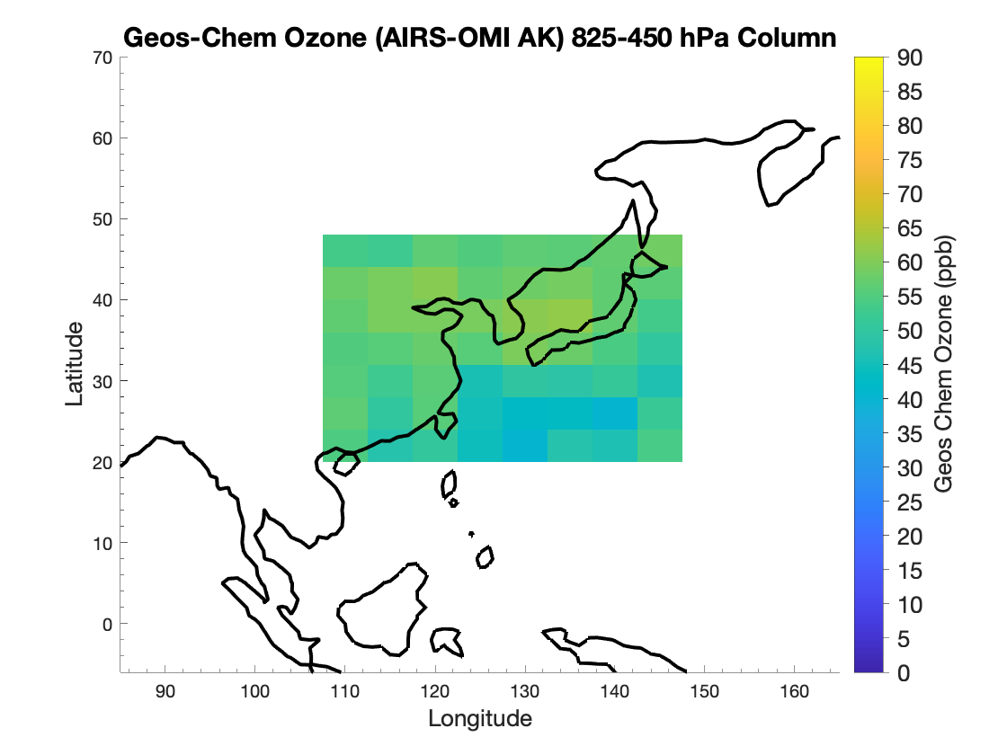
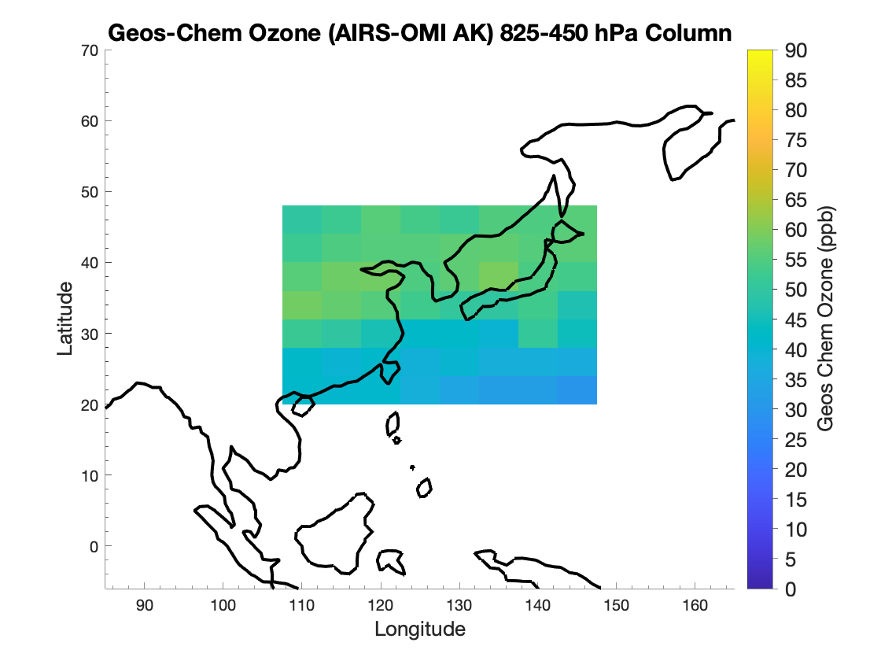
GEOS-Chem shows the greatest bias when pollution comes from Korea
AIRS/OMI vs. Geos Chem Ozone Column Mean (825-450 hPa) During Three Korus AQ Synoptic Periods
”Dynamic Period” (May 10-16)
”Stagnant Period” (May 17-22)
”Extreme Pollution Period” (May 23-28)
AIRS/OMI
GEOS-CHEM
(AIRS/OMI AVERAGING KERNEL)
Notes:
Local pollution creates the greatest discrepancy with the model
-AIRS/OMI dense sampling mode during KORUS:
-AIRS/OMI ozone retrievals have two modes: global survey and regional mapping. The global survey mode provides profile data at nadir position along the satellite ground track, i.e., a spatiotemporal sampling identical to TES global survey mode, whereas the regional mapping mode processes all available AIRS/OMI measurements over a region, specifically in this case the Korean Penninsula during KORUS-AQ.
-KORUS-AQ: four synoptic periods: dynamic, stagnant, extreme pollution, blocking.
(AIRS/OMI dense sampling mode not available for last one (blocking)
-During the stagnant period, ozone pollution in Korea is being influenced by local pollution, but in the other two periods
-overall bias appears to be higher for those periods influenced by pollution from China, BUT, over Korea specifically, the bias is highest when the pollution is coming from Korea
-the very high bias in the north is likely due to stratospheric influence (dynamic period saw a good deal of vertical mixing that would allow for this). This is unsurprising because the inability of GC to capture strat/trop exchange is well known.

Slide 8
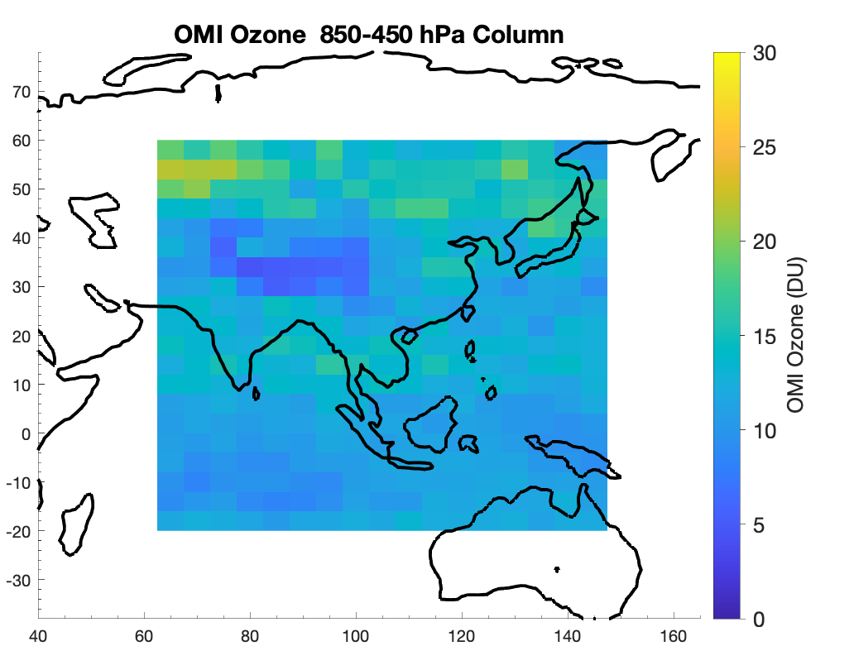
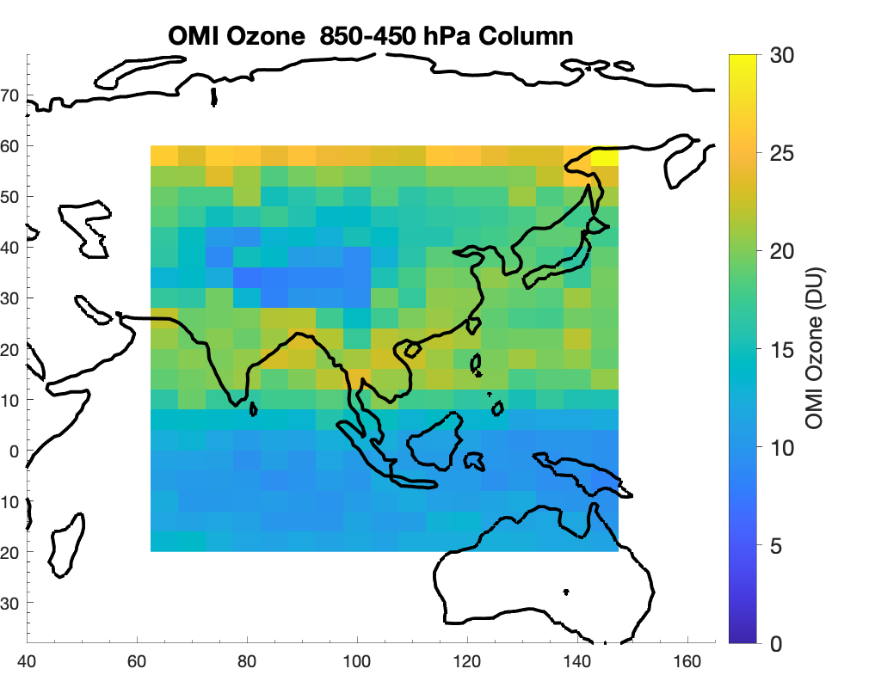
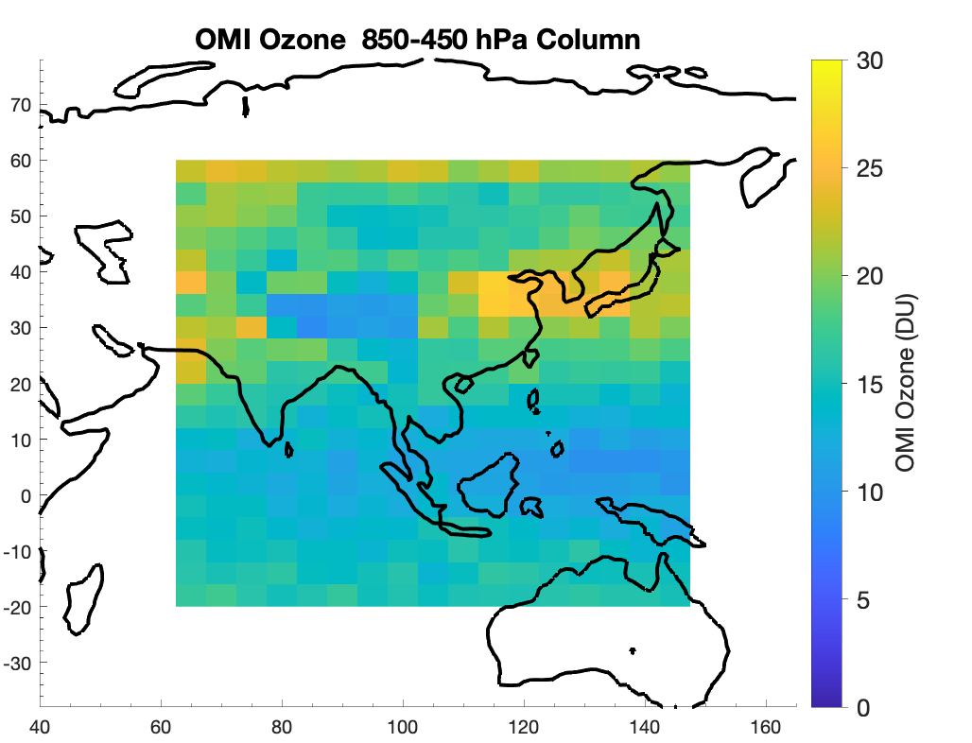
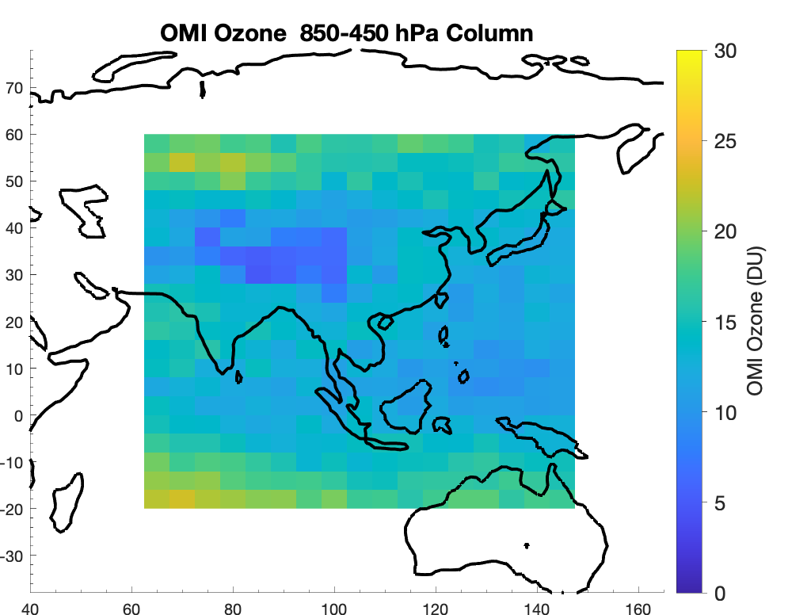
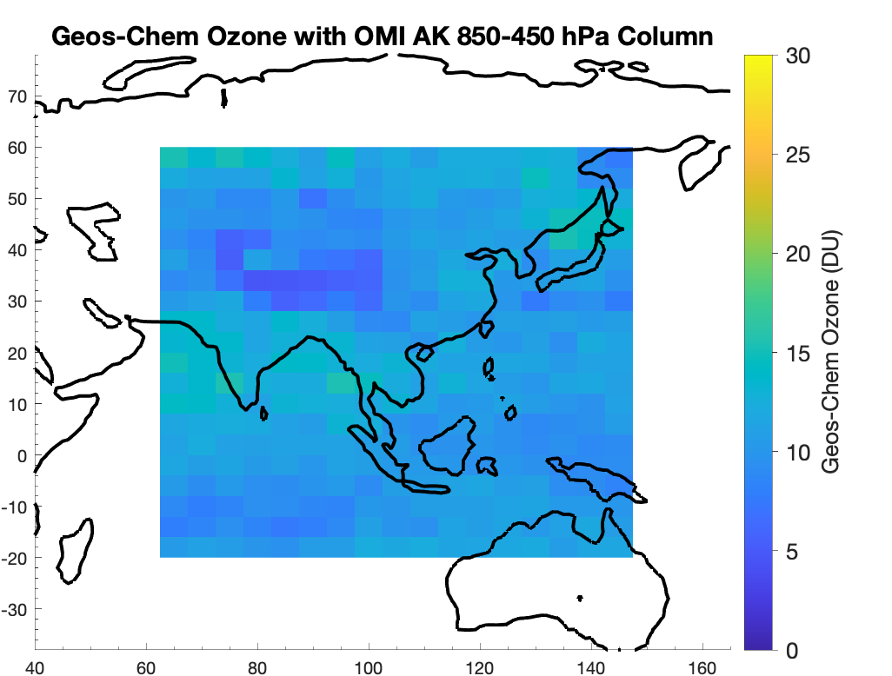
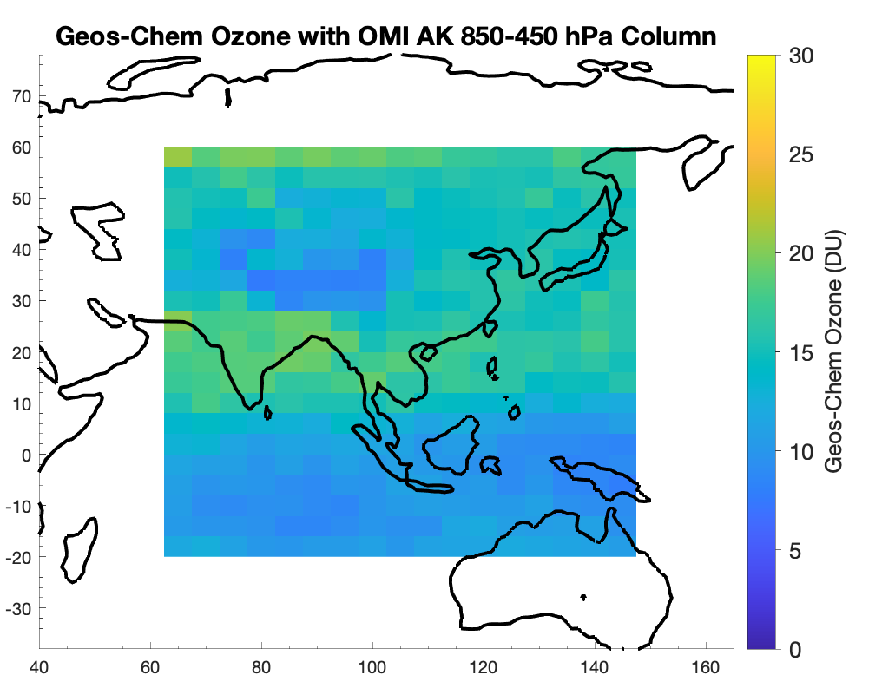
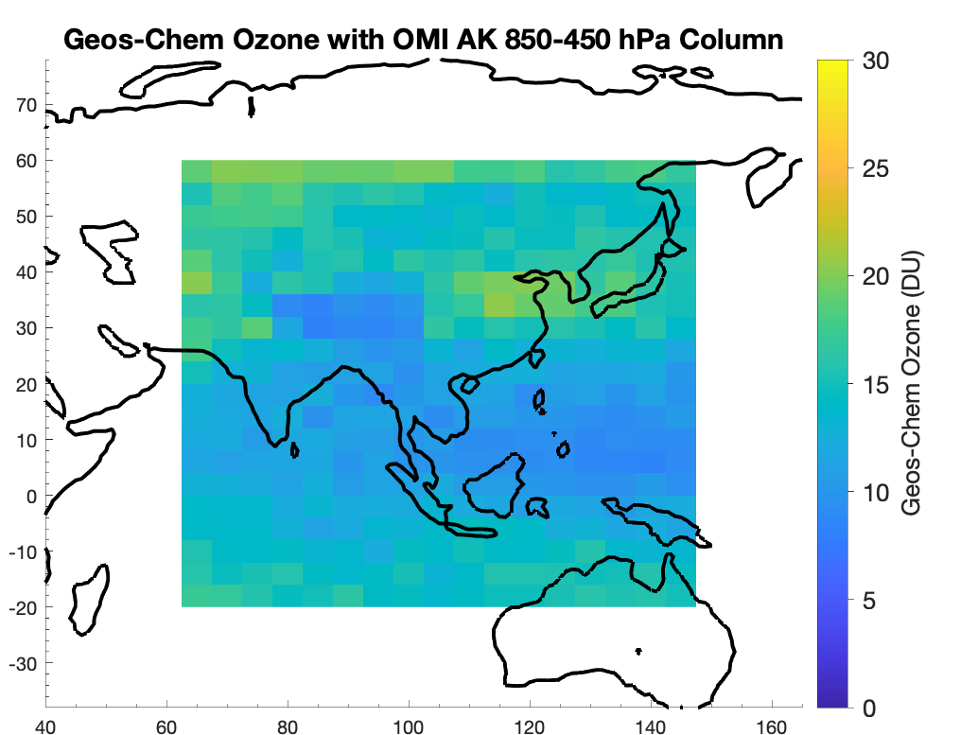
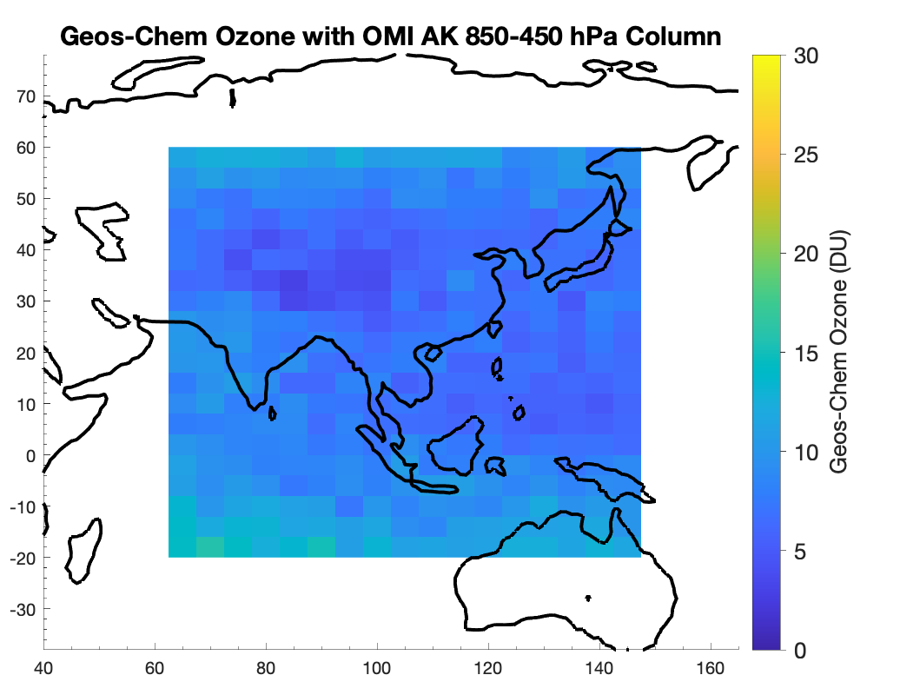
The low ozone bias persists in all seasons
OMI
GEOS-CHEM
(OMI AVERAGING KERNEL)
Winter
Spring
Summer
Fall
Notes:
-what is OMI overpass frequency?
Place detailed observations in context of continuous data from satellites.
This bias persists in all seasons. This is important, because parts of the KORUS-AQ period (late spring) occur during a time where significant downwelling of stratospheric ozone occurs in East Asia. However, as said before, the inability of CTM’s to model stratospheric/tropospheric ozone exchange in this region is well documented. If the bias only persisted in the Spring, that would be an expected result.

Slide 9
But where is the bias coming from (i.e what processes are we unable to properly simulate?)
Notes:
We know that is more than an inability to represent stratospheric/tropospheric exchange of ozone.

Slide 10
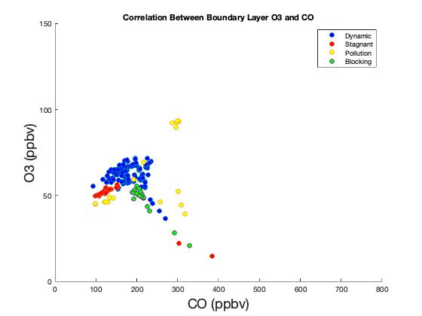
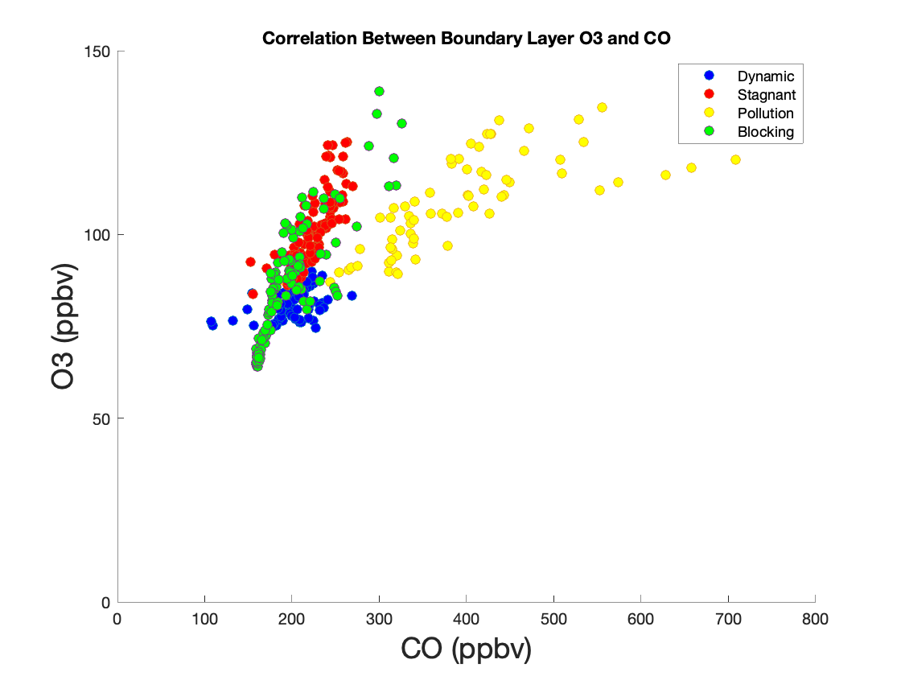
Ozone-CO correlations can be used to constrain ozone sources and transport
Correlation between afternoon ozone and CO for the dynamic, stagnant, extreme pollution, and blocking periods for boundary layer (<2km)
Geos-Chem
DC-8
Notes:
Many studies have used ozone-CO correlations to constrain ozone sources and transport
If there is a positive relationship between CO and ozone, this means that the ozone is photochemically produced, and coming likely coming from pollution. Otherwise, it is likely coming from subsidence.
While the background ozone (ozone when CO levels are low) in these plots is not too different in the model versus observations, there are a few key differences that likely contribute to the model’s ozone bias we saw in the previous plots.
1. The GC plots show a cluster of points where CO is very high but O3 is very low (lower than the other “background ozone” points. These points have ozone levels that are too low to be over the land, and are likely coming from points over the ocean.
Normally, ozone levels are expected to be very low over the ocean, however, this is a part of the world with the highest density of ships, as shown by this image of night lights.
Thus, it is possible that the model is underestimating the amount of ozone produced in shipping plumes.
-another takeaway from these plots is that ozone is produced more efficiently in Korea than China. We know this because the slopes (an indicator during the stagnant

Slide 11
Ozone production efficiency is higher over Korea than China
Correlation between afternoon ozone and CO for the dynamic, stagnant, extreme pollution, and blocking periods for boundary layer (<2km)
Geos-Chem
DC-8
Notes:
Many studies have used ozone-CO correlations to constrain ozone sources and transport
If there is a positive relationship between CO and ozone, this means that the ozone is photochemically produced, and coming likely coming from pollution. Otherwise, it is likely coming from subsidence.
While the background ozone (ozone when CO levels are low) in these plots is not too different in the model versus observations, there are a few key differences that likely contribute to the model’s ozone bias we saw in the previous plots.
1. The GC plots show a cluster of points where CO is very high but O3 is very low (lower than the other “background ozone” points. These points have ozone levels that are too low to be over the land, and are likely coming from points over the ocean.
Normally, ozone levels are expected to be very low over the ocean, however, this is a part of the world with the highest density of ships, as shown by this image of night lights.
Thus, it is possible that the model is underestimating the amount of ozone produced in shipping plumes.
-another takeaway from these plots is that ozone is produced more efficiently in Korea than China. We know this because the slopes (an indicator during the stagnant

Slide 12
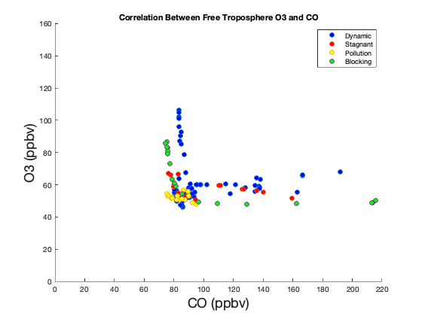
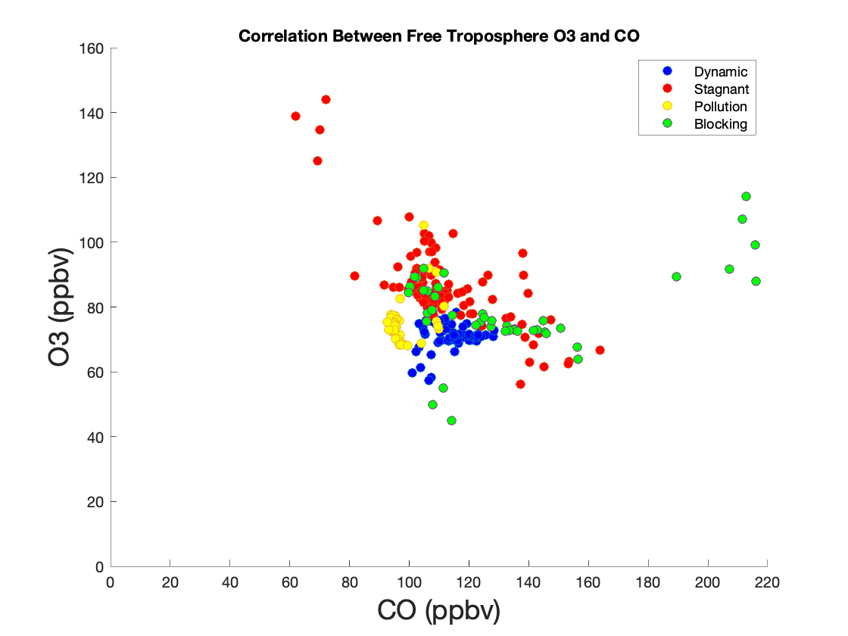
GEOS-Chem does not make enough ozone from pollution in the boundary layer
Correlation between afternoon ozone and CO for the dynamic, stagnant, extreme pollution, and blocking periods for the free troposphere (>2km)
Geos-Chem
DC-8
Notes:
-GC shows two populations-places where o3 is very high and co is very low and vice versa.
-The DC-8 does not show a region of CO being very high and ozone being low, but rather CO being high AND ozone being high.
-The high values of CO are indicative of influence from the boundary layer. This means that geos-chem is not making enough ozone from pollution in the boundary layer.

Slide 13
Conclusions
GEOS-Chem underestimates ozone in the free troposphere by up to 30 ppb; the low bias persists in all seasons. The bias is likely coming from misrepresentation of ozone formation in the boundary layer.
Ozone production efficiency is higher over Korea than China.
Emissions from ships may be an important source of ozone in Korea.

Slide 14
Future Work
Investigate why GEOS-Chem is unable to represent ozone formation in the boundary layer.
Update GEOS-Chem accordingly.
Examine the impact of different pollutant control strategies in reducing ozone concentrations in East Asia.

Slide 15
Thank you!

