Slide 1
A blended GEMS+TROPOMI product for tropospheric NO₂ using machine learning to correct retrieval errors
14th International GEMS workshop, Jeju
Sep 6−8, 2023
Yujin Oak¹, Daniel Jacob¹, Nicholas Balasus¹, Laura Yang¹, Junsung Park², Hanlim Lee², Gitaek Lee³, Rokjin Park³, Heesung Chong⁴, Hyeong-Ahn Kwon⁵
¹ Harvard University, ² Pukyong National University, ³ Seoul National University, ⁴ Harvard-Smithsonian Center for Astrophysics, ⁵ University of Suwon

Slide 2
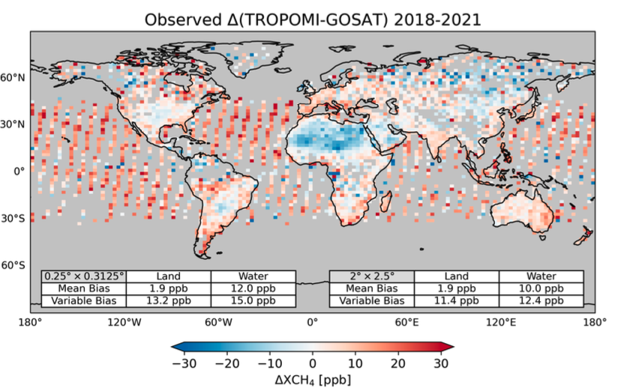
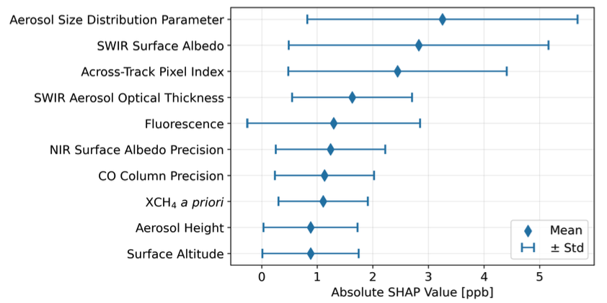
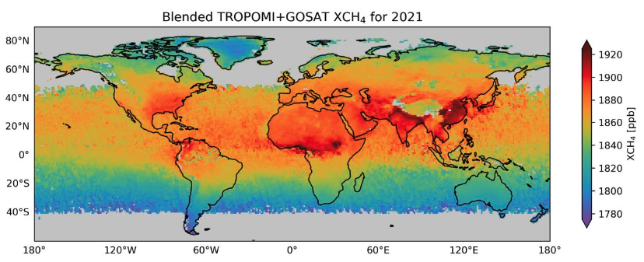
Blended TROPOMI+GOSAT CH₄ product using ML to correct retrieval biases
GOSAT: less subject to retrieval biases but coarse
TROPOMI: higher resolution but subject to artifacts that bias the retrieval
Largest corrections associated with coarse aerosol particles, high SWIR surface albedo, across-track pixel index
Construct a model-ready blended product for inversion
Balasus et al. (2023)

Slide 3
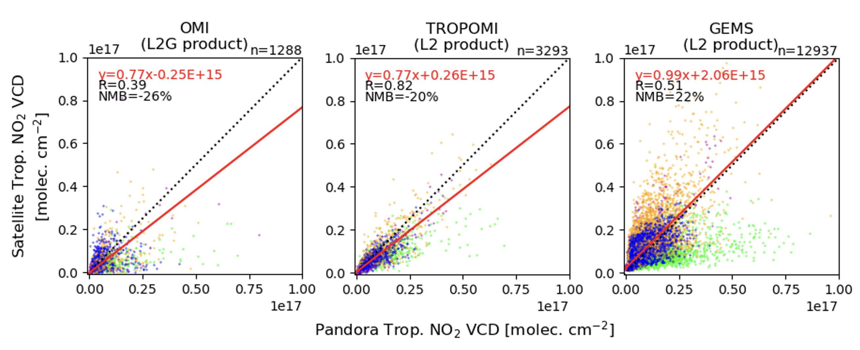
High bias in GEMS NO₂ compared to OMI, TROPOMI, Pandora (July 2022 – June 2023)
 | Orbit | Temporal coverage | Spatial resolution
OMI L2G NO₂ v4.0 | LEO | 13-14 LT | 0.25° × 0.25°
TROPOMI L2 NO₂ v2.4 | LEO | 13-14 LT | 5.5 × 3.5 km²
GEMS L2 NO₂ v2.0 | GEO | 07-17 LT (hourly) | 7 × 8 km²
Comparison at 22 Pandora stations: China/Central Asia Korea Japan Southeast Asia
Notes:
OMI: VCDQF=even integer, XtrackQF=0
TROPOMI: QA>0.75, CF<0.3, SZA<70
GEMS: AlgQF<112, AMFQF<64, FinalQF<1, CF<0.3, SZA<70
Pandora: QF=0,1,10,11

Slide 4
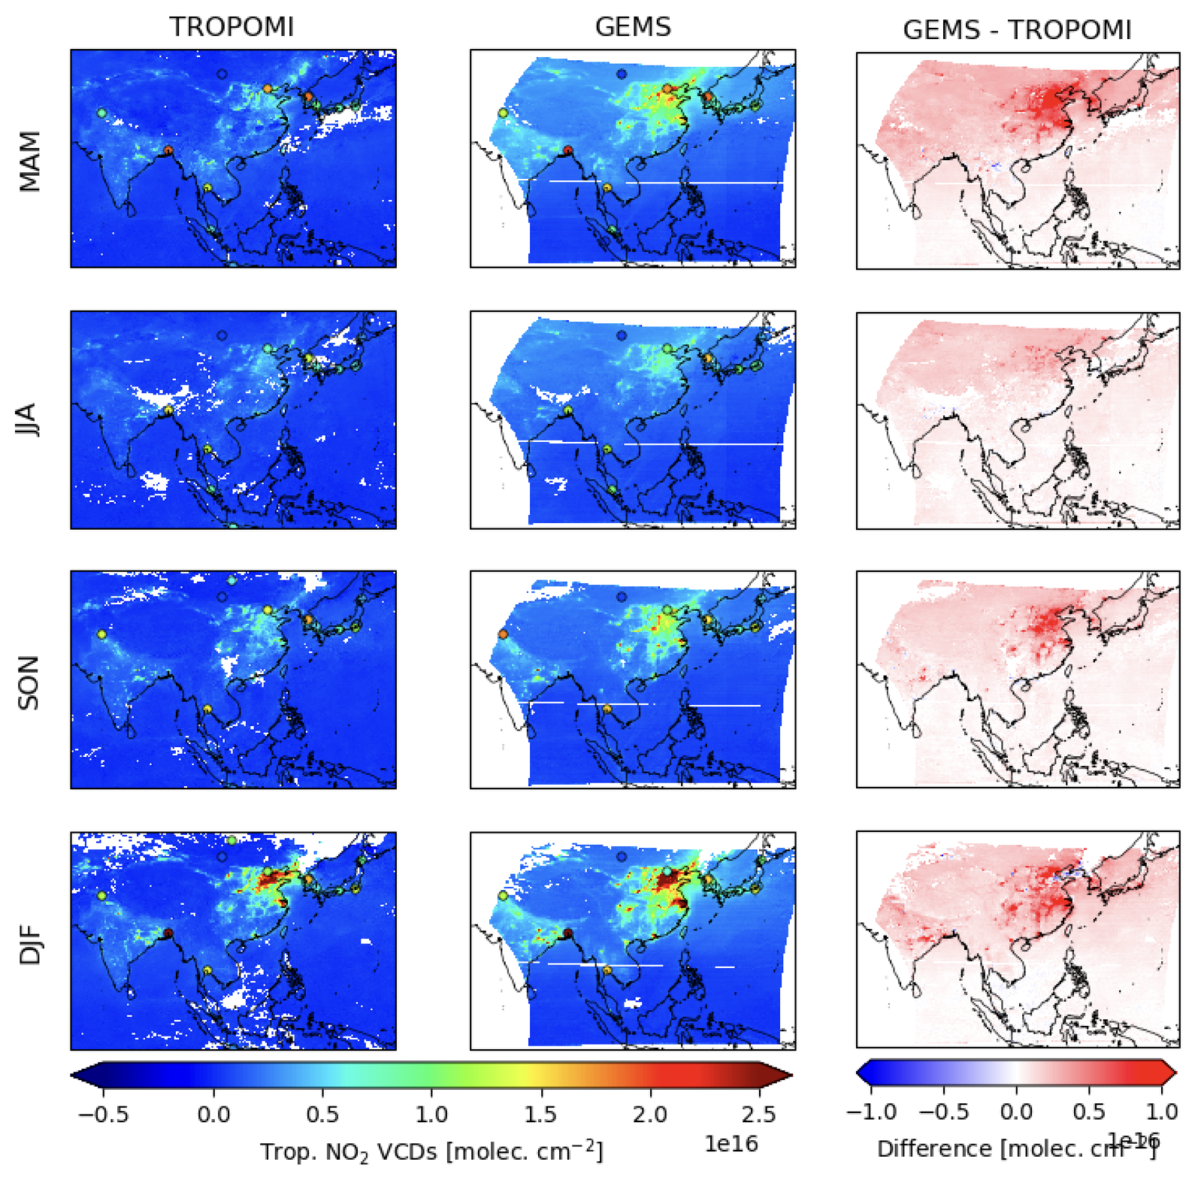
Precision and spatial coverage enables TROPOMI to serve as reference to correct GEMS
Pandora located in urban areas, less suitable for bias correction
Consistent overestimation (factor of ~2) of GEMS regardless of season

Slide 5
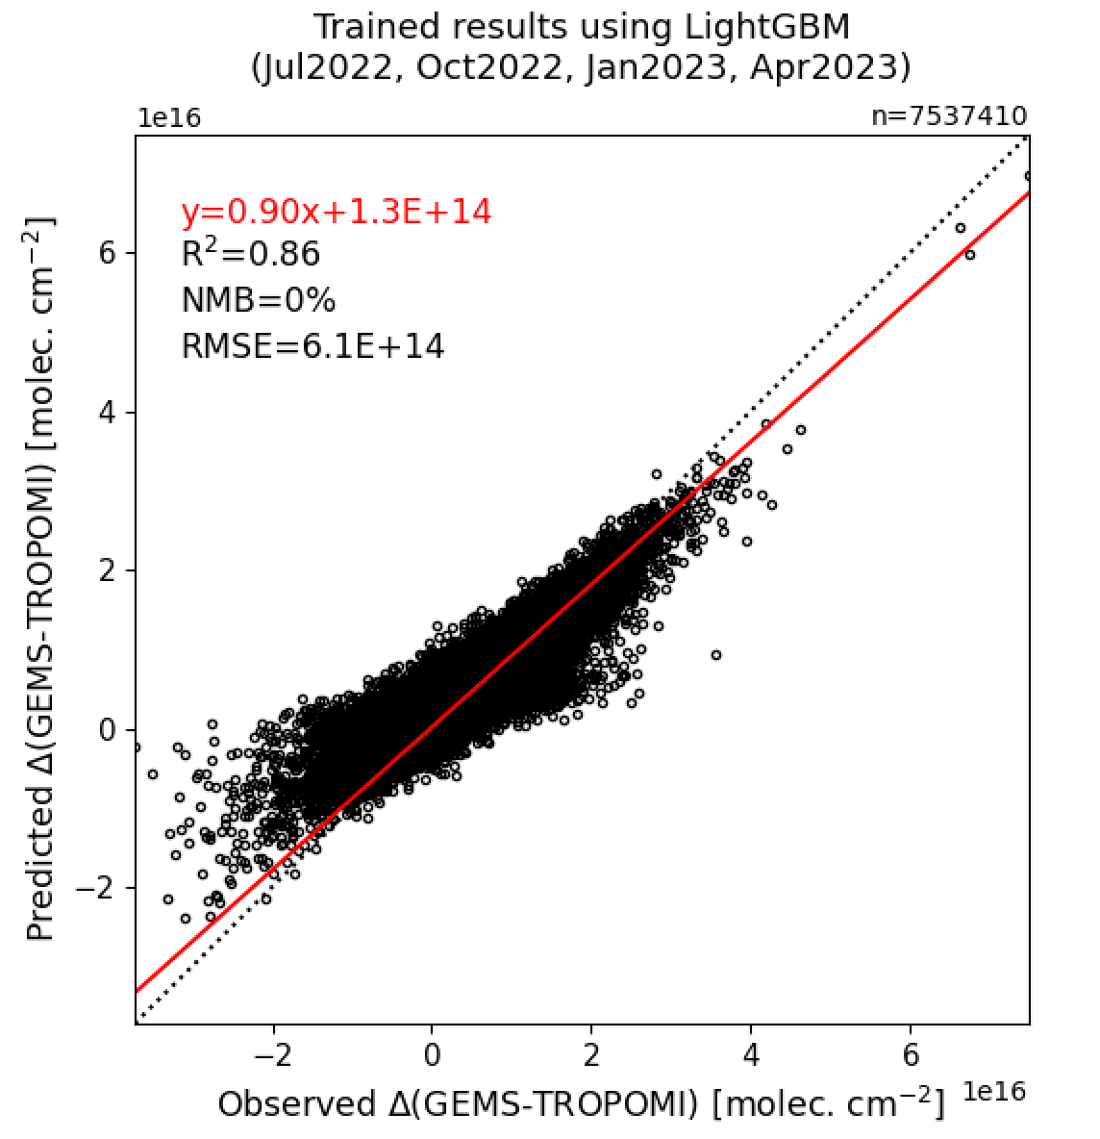
Training ML model to predict Δ(GEMS−TROPOMI)
Observed ∆(GEMS-TROPOMI)
Predictor Variables
Solar Zenith Angle
Viewing Zenith Angle
Relative Azimuth Angle
Aerosol Optical Depth
Aerosol Layer Height
Air Mass Factor
O₃ Column
Surface Reflectivity (440 nm)
Single Scattering Albedo
Cloud fraction
Cloud pressure
Stratospheric NO₂ VCD
Train ML model (Random Forest, LightGBM, XGBoost, …)
Predict ∆(GEMS-TROPOMI) & apply to GEMS
GEMS+TROPOMI blended product (bias corrected)

Slide 6
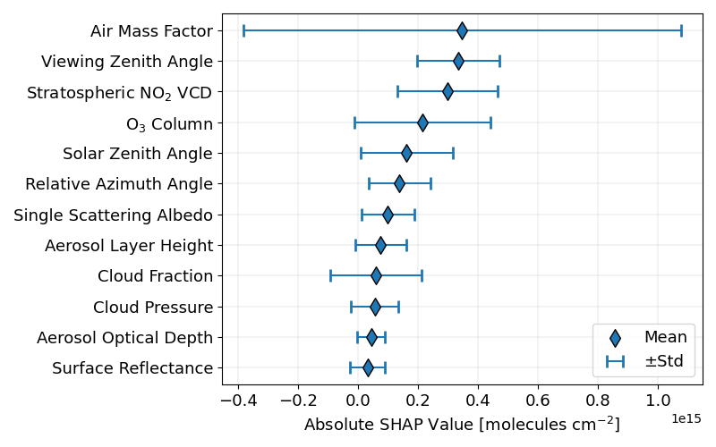
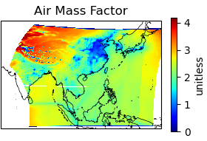
AMF associated with largest correction in the blended product

Slide 7
Reconstruction of AMF to reduce biases associated with a priori information
SCDs
÷ Air Mass Factor (AMF)
VCDs
$$AMF={AMF}_{G}\int_{0}^{z_{T}}{W\left(z\right)S\left(z\right)dz}$$
${AMF}_{G}$: Geometric AMF
$z_{T}$: Tropopause height
$W\left(z\right)$: Scattering weights from RTM
$S\left(z\right)$: Vertical shape factor from CTM
 | Original (L2) a priori | New (common) a priori
TROPOMI | TM5-MP | *Hourly GEOS-Chem (0.25° × 0.3125°) profiles for each month using KORUSv5 emissions
GEMS | GEOS-Chem
*Provided by Rokjin Park (SNU)

Slide 8
Summary and next steps
Construction of a blended GEMS+TROPOMI product (July 2022 – June 2023) with the resolution of GEMS and the precision of TROPOMI
ML model corrects high biases in GEMS L2 product with AMF contributing to the largest correction
Large sensitivity found in GEMS VCDs to the AMF (a priori profile)
Produce a new blended product with adjustments for vertical shape factors (usage of common a priori to both GEMS and TROPOMI)
Application of the blended product to inversions and further analyses
email: yjoak@g.harvard.edu

Slide 9
GEMS a priori profiles significantly lower than GEOS-Chem, TM5-MP

Slide 10
Minor differences in vertical shape factors near surface

Slide 11
Notes:
Inclusion of vza uncertainty (precision)
Compare diurnal with pandora and figure out the hourly uncertainty
Comparison with analytical approach?

