Slide 1
Space-based NH₃/NO₂ ratio as a diagnostic of sensitivity of particulate nitrate formation to emissions
NH₃ (IASI, CrIS)
NO₂ (OMI, TROPOMI)
Ruijun Dang
with Daniel Jacob, Shixian Zhai (Harvard University)
Pierre Coheur, Lieven Clarisse, Martin Van Damme
(Université libre de Bruxelles)
AMS annual Meeting - January 12, 2023

Slide 2
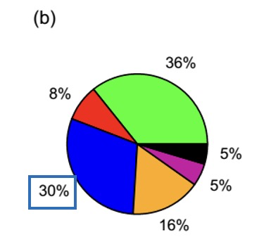
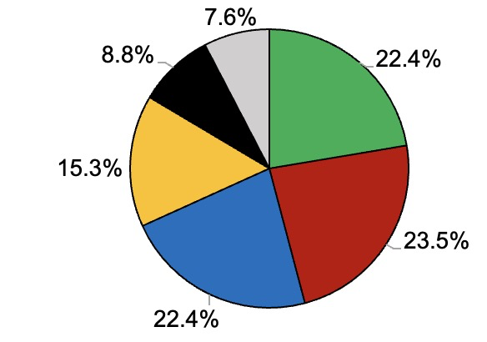
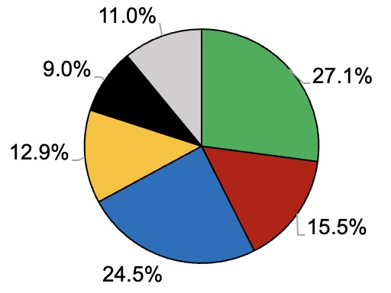
Wintertime PM nitrate pollution is a severe air quality issue …
Evolution of winter PM_{2.5} composition in Beijing, China:
Also, in eastern US:
Transition from sulfate-organic dominated to nitrate-organic dominated
2007
2015
Organic
Sulfate
Nitrate
Ammonium
Chloride
Elemental
carbon
Li et al. (2019)
Edited from Shah et al. (2018)

Slide 3
PM nitrate formation is limited by the supply of either NH₃ or HNO₃
Which one to control?
Oxidation
NO_{x}
Emissions
?
NH₃
Emissions
?
OH
NO
NO₂
HNO₃
O₃ -> NO₃
NH₄⁺ + NO₃⁻
NH₃
PM
Fuel combustion
Agricultural practices
(manure and fertilizer)
AQ manager

Slide 4
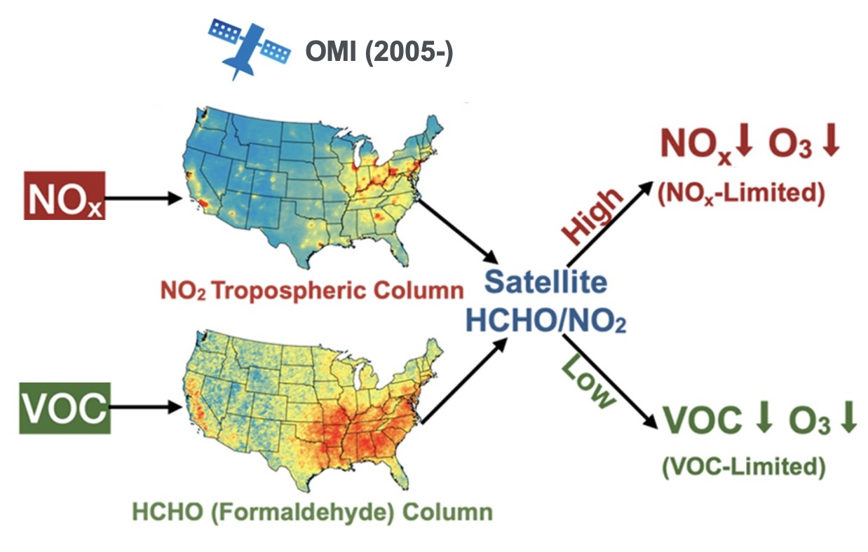
Space-based formaldehyde/NO₂ ratio has been widely used to diagnose the
sensitivity of ozone production to VOC and NO_{x} emissions
Edited from Jin et al. (2020)

Slide 5
Satellite observations provide us daily global maps of NH₃ and NO₂
NH₃ column (Ω_{NH3}): IASI, Metop-A, B, C, (2006-) / CrIS, S-NPP, NOAA-20, (2012-)
NH₃ from IASI winter 2017
NO₂ column (Ω_{NO2}) OMI, Aura, (2005-) / TROPOMI, S5P, (2018-)
NO₂ from OMI winter 2017
Could we build a space-based NH₃/NO₂ diagnostic for nitrate formation regime?
…just like the space-based HCHO/NO₂ diagnostic for O₃ formation
Ω_{NH3}/ Ω_{NO2} from IASI and OMI:

Slide 6
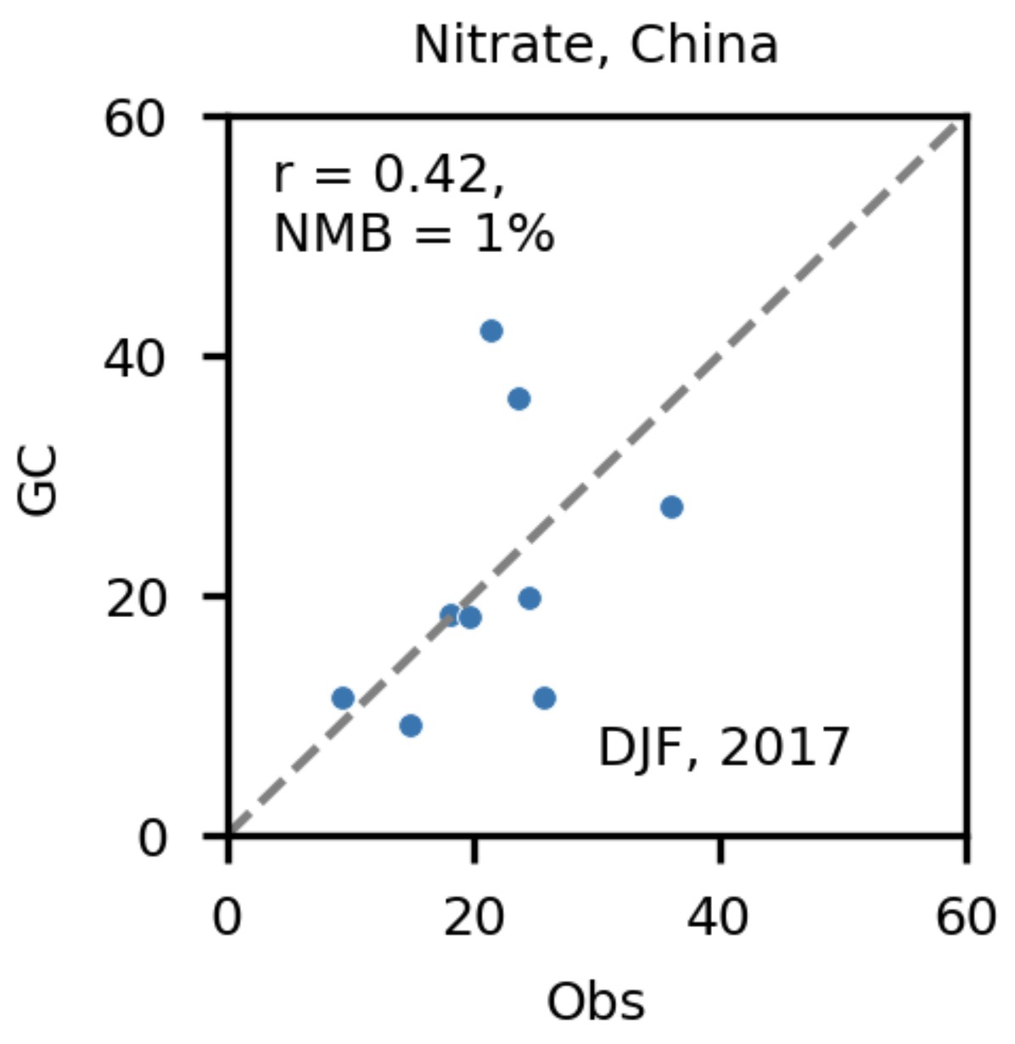
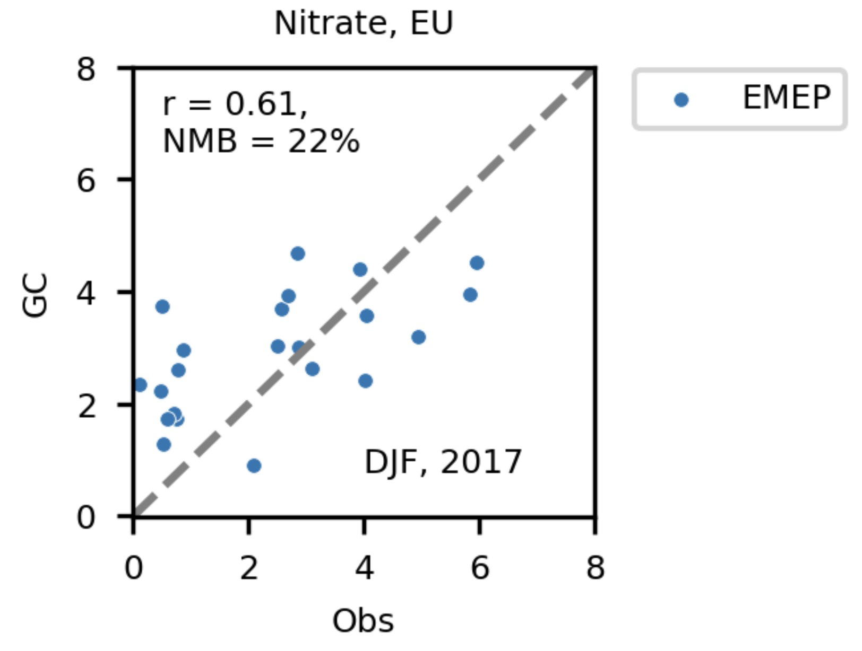
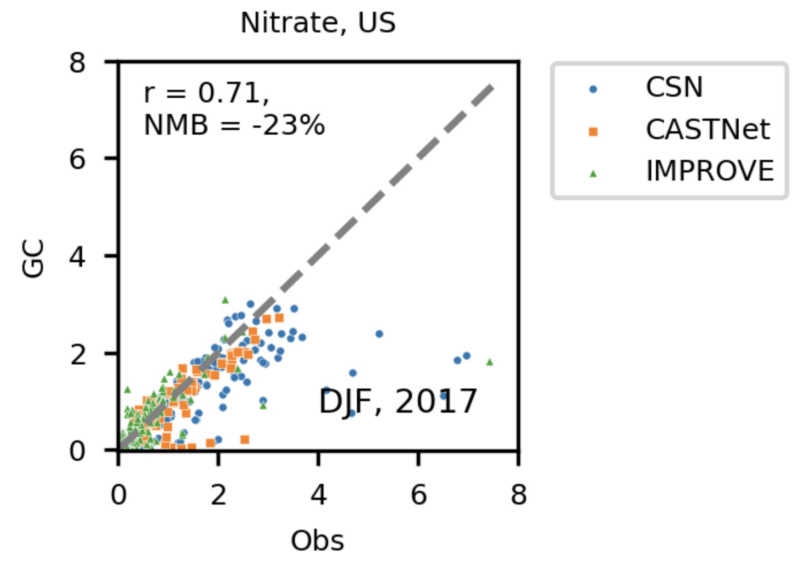
Using GEOS-Chem model to relate Ω_{NH3}/ Ω_{NO2} to nitrate chemical regime
GEOS-Chem has credible simulation of particulate nitrate
China
Europe
US
Model
Model
Model
Winter 2017
[μg m⁻³]
Observed
Observed
Observed
Diagnose relative sensitivities S_{X} = dlog[NO₃⁻]/dlogE_{X} in model world;
Use sensitivity ratio S_{NOx}/S_{NH3} to diagnose chemical regime;
East Asia
Europe
US
Winter 2017
S_{NOx}/S_{NH3}
$>1$, NO_{x}-limited
$<1$, NH₃-limited

Slide 7
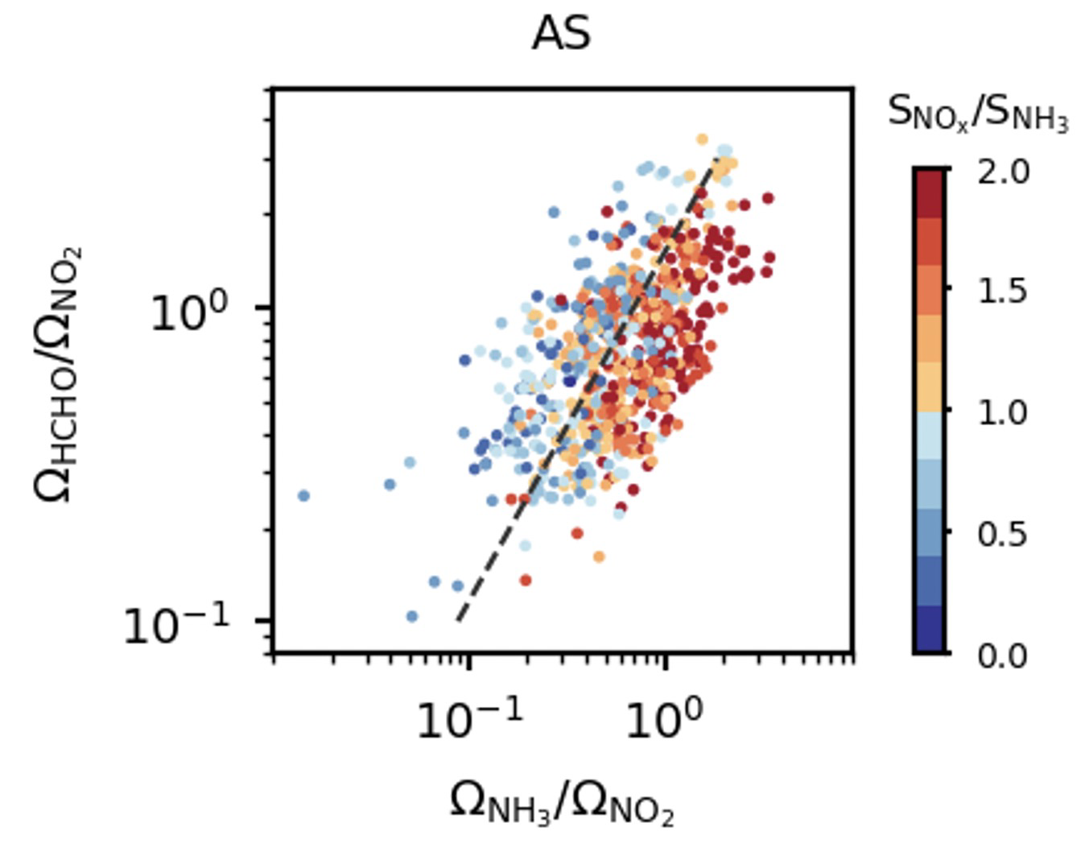
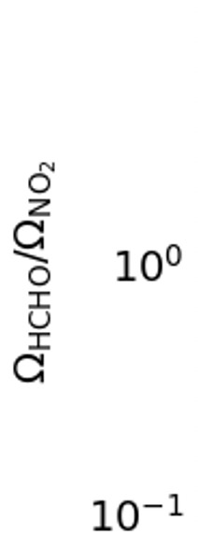
Relate Ω_{NH3}/ Ω_{NO2} to S_{NOx}/S_{NH3} in the model to diagnose a threshold column ratio
We need to bring in HCHO/NO₂ ratio to account for the oxidant limitations of NO_{x} -> HNO₃ in VOC-limited regimes
threshold
Asia
S_{NOx}/ S_{NH3}
NH₃-limited
Get the threshold_{HCHO/NO2} = f(NH₃/NO₂) in the model (black dashed line) that separates NH₃- (blue dots) and NO_{x}- (red dots) limited regime
Ω_{HCHO}/ Ω_{NO2}
NO_{x}-
limited
Ω_{NH3}/ Ω_{NO2}
Winter 2017

Slide 8
Real world application to IASI NH₃, OMI NO₂, and OMI HCHO in winter 2017
Preliminary results – column ratios:
Asia
Europe
US
Ω_{NH3}/ Ω_{NO2}
Ω_{HCHO}/ Ω_{NO2}

Slide 9
Real world application to IASI NH₃, OMI NO₂, and OMI HCHO in winter 2017
Preliminary results – PM nitrate formation regime:
Beijing, Tianjin, northern Hebei province (Zhai et al., 2021) and Yangtze River Delta are NH₃-limited
S. Korea is NH₃-limited
China
Europe
US
NO_{x}-limited
NH₃-limited
Paris (Petit et al., 2021) and for Europe are NO_{x}-limited
Eastern US is NH₃-limited
(Shah et al., 2018)

Slide 10
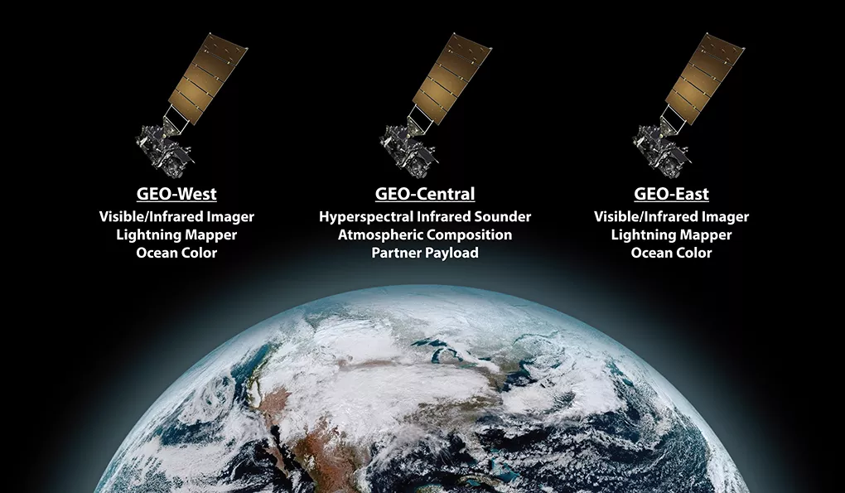
Upcoming satellites will enable a better understanding of nitrate formation regime
Geostationary observations:
Asia (GEMS, 2020) and North America (TEMPO, 2023)
UV (NO₂, HCHO)
Europe (Sentinel-4, 2024)
UV (NO₂, HCHO) + TIR (NH₃)
GeoXO
North America (GeoXO, 2030s)
UV (NO₂, HCHO) + TIR (NH₃)
Global observations:
NITROSAT, under consideration by ESA NO₂ + NH₃ simultaneously

Slide 11
Take-aways
We can diagnose the particulate nitrate formation regime from the space by using a combination of NH₃/NO₂ and HCHO/NO₂ column ratios.
Preliminary analysis for winter using OMI and IASI data finds different chemical regimes in different regions: for example, South Korea is NH₃-limited while most of Europe is NO_{x}-limited, consistent with observations from field campaigns.
Future work will clean up satellite data, explore sensitivity to VOC emissions, extend analysis to other regions, conduct further evaluation with field campaigns.
Contact: rjdang@g.harvard.edu

