Slide 1
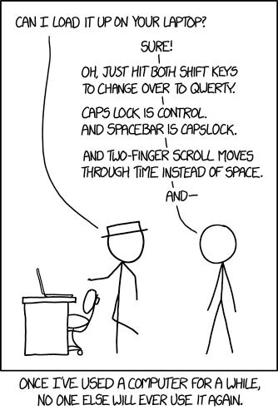


Implementing software engineering best practices in GEOS-Chem:
Transforming a research project into a software product
Bob Yantosca
Senior Software Engineer
ACAG Grp Mtg @ WashU
08 Nov 2023
With the GCST (all incarnations over 25+ years)

Slide 2



With many thanks
to the
GCST!
Without whom none of this would have been possible!
Bob Yantosca
(Harvard)
Lizzie Lundgren
(Harvard)
Saptarshi Sinha
(WashU)
Melissa Sulprizio
(Harvard)
Photo from GCE2
Yidan Tang
(WashU)
She visited Harvard on September 13th

Slide 3
Contents
In the beginning…
BP #1: Modernizing obsolete source code
BP #2: Benchmarking
BP #3: Version nomenclature
BP #4: Version control
BP #5: Software tests
BP #6: Documentation

Slide 4



In the beginning…

Slide 5
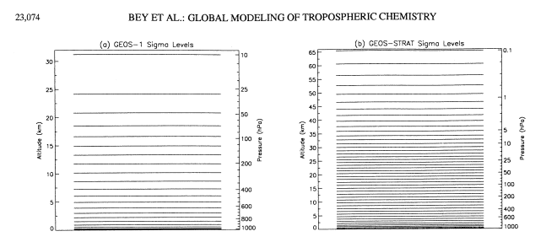
NASA GMAO (then DAO) assimilated met, mid-90’s
GEOS-1 had 20 vertical levels (@ 2˚ x 2.5˚) up to 10 hPa.
GEOS-STRAT (an updated GEOS-1) had 26 levels, but up to 0.1 hPa
Ricky Rood (head of NASA DAO at that time), said to Daniel:
“Why aren’t you using our GEOS archive of real winds rather than those GCM winds?”
This started a process which led to Daniel hiring:
Me (Scientific programmer)
Isabelle Bey (Postdoc)
Bey et al, 2001.

Slide 6
Square peg, meet round hole (ca. 1996)
Harvard–GISS CTM
GCM met @ 4x5 w/ 9 levels
Dry Dep: DEPVEL
Emissions: cf. Wang et al 1998
Photolysis: SLOW–J
Chemistry: Nox-Ox-HC; SMVGEAR I
GEOS–CTM
using GEOS-1 assimilated met
Met Fields: GMAO GEOS–1
Advection: TPCORE
Cld Conv: CLDMX
PBL Mixing: TURBDAY
+
“Harvard-GEOS” CTM (precursor of GEOS-Chem)
Met Fields: GMAO GEOS–1
Advection: TPCORE
Cld Conv: CLDMX
PBL Mixing: TURBDAY
Dry Dep: DEPVEL
Emissions: cf. Wang et al 1998
Photolysis: SLOW–J
Chemistry: Nox-Ox-HC; SMVGEAR I
Dynamics from GEOS-CTM
=
Emissions, drydep, chemistry
from Harvard-GISS CTM
Notes:
My job when I started at Harvard in 1996 was to take the dynamics out of the GEOS-CTM and the chemistry package out of the Harvard/GISS model.
Thus GEOS-Chem was born. It was a model that was built upon 2 different code bases.

Slide 7
Definitely a research project
At the time we were building the Harvard-GEOS CTM, we weren’t thinking about making it a general-use model, we just wanted it to work!
It was a bit of a hodge-podge:
  Configuration files from both models
  Diagnostics (i.e. NDxx) was from the Harvard-GISS CTM
  Code was written to the (now obsolete) Fortran-77 standard
  Documentation was sparse and inconsistent
But this was OK since all of the users of the model were in the same building!

Slide 8
But soon was a software product
Conversations with Prasad Kasibhatla (Duke Univ) resulted in the Harvard-GEOS model becoming public
  With corresponding name change to GEOS-Chem
  Denotes that GEOS-Chem is not a Harvard model, it’s owned by its users
We started getting requests from many more researchers outside of Harvard and Duke to use GEOS-Chem
Now we were developing a software product and not just a research project
  This necessitated code improvements and user support

Slide 9
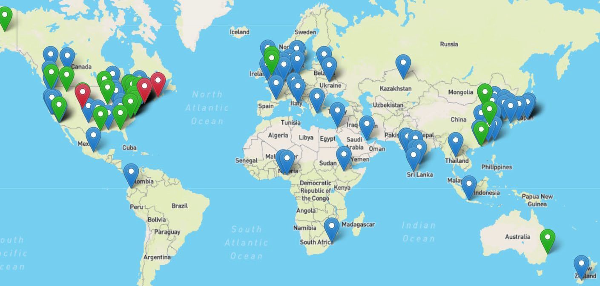
GEOS-Chem is much more than a model, it is a community
model
users
set development priorities
through Working Groups!
contribute developments, report bugs
support
GEOS-Chem Steering Committee Model scientists, WG chairs
GEOS-Chem Support Team
implement priorities review benchmarks
Emphasize:
user support and community spirit
nimble innovation
strong version control
documentation and traceability
New model versions

Slide 10
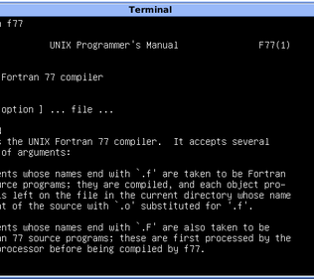

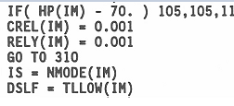
Best Practice #1:
Modernizing obsolete source code

Slide 11
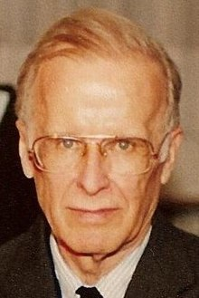
Science applications use Fortran
Formula Translator
  Was invented by John Backus & team at IBM in mid-50’s
  Optimized for mathematical computation. Fortran produces FAST code!!!
Embodied the
Three Cardinal
Virtues of
Programmers:
Laziness
Impatience
Hubris
(in a good way
of course!)
John was fed up with the tedium of writing programs in assembly language
Invented the Backus-Naur Form to completely specify a programming language syntax
Invented* the first compiler
Invented* the Fortran language
*with a team of IBM engineers

Slide 12
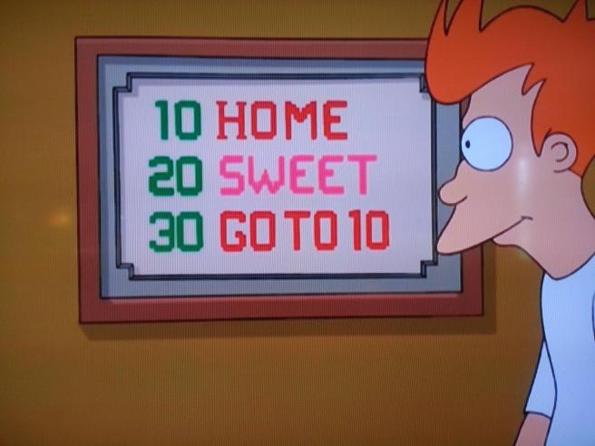
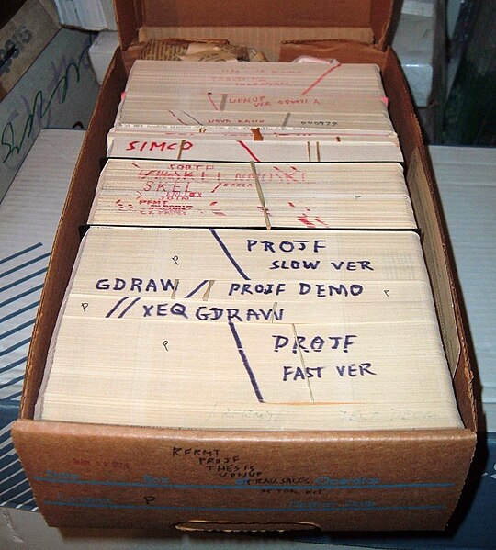
Old Fortran code was terse
Fortran’s original syntax was written for IBM punch cards
  “Do not fold, spindle, or mutilate…”
  Column 1: Add a C to indicate a comment line
  Columns 2-5: Label numbers
  Column 6: Continuation character (for multi-line statements)
  Columns 7-72: Source code
  Columns 73-80: Punch card index (e.g. “52-pickup”)
Fortran syntax didn’t change until the early 90’s
  Fortran-90 standard allowed for free-format source code
  Fortran-90 introduced several modern code constructs
  But GEOS-Chem code was still written to the older Fortran-77 standard

Slide 13
Replacing obsolete source code
Old Fortran
  Static memory management only
  You had to size arrays for the largest possible case → wasted memory
  INTEGER ARRAY(1000) ! Wasteful if you don’t need 1000 elements
Modern Fortran
  You can allocate/deallocate arrays as needed
  INTEGER, ALLOCATABLE :: ARRAY(:)
  ALLOCATE( ARRAY(1000) ) ! Use 1000 elements
  DEALLOCATE( ARRAY ) ! Free the memory
  ALLOCATE( ARRAY(10) ) ! Now use 10 elements
  . . .

Slide 14
Replacing obsolete code constructs
Old Fortran
  You could not protect subroutine arguments from being overwritten inadvertently
  CALL ADDIT(A, B, C)
  . . .
  SUBROUTINE ADDIT(A, B, C)
  INTEGER A, B, C
  C Add A + B to get C (but there’s a typo here!!!)
  A = A + B
  RETURN
  END SUBROUTINE

Slide 15
Replacing obsolete code constructs
Modern Fortran
  You CAN protect subroutine arguments from being overwritten inadvertently
  SUBROUTINE ADDIT(A, B, C)
  INTEGER, INTENT(IN) :: A, B
  INTEGER, INTENT(OUT) :: C
  ! Add A + B to get C (but there’s a typo here!!!)
  A = A + B
  END SUBROUTINE ADDIT
This will generate
a compilation error
Read-only: INTENT(IN)
Read-write: INTENT(INOUT)
Write-only: INTENT(OUT)

Slide 16
Replacing obsolete code constructs
Modern Fortran: Modules for grouping data and routines
MODULE My_Module
IMPLICIT NONE ! Explicitly declare all variables
PRIVATE ! Hide all functions/variables ...
PUBLIC :: Init_Some_Operation ! ... except for these
PUBLIC :: Do_Some_Operation
PUBLIC :: Cleanup_Some_Operation
CONTAINS
! These routines can be called elsewhere
SUBROUTINE Init_My_Module( ... )
SUBROUTINE Do_My_Module( ... )
SUBROUTINE Cleanup_My_Module( ... )
! These routines cannot be seen outside this module
SUBROUTINE Internal_Routine_1( ... )
SUBROUTINE Internal_Routine_2( ... )
END MODULE My_Module
Each module contains public IRF subroutines (Initialize, Run, Finalize).
Initialize: Called once at startup, allocates memory to internal variables, etc.
and does other init operation.
Run (aka Do) Called at each model timestep, to perform some operation.
Finalize (aka Cleanup): Called at shutdown. Deallocates memory from internal variables etc.
This facilitates connecting GEOS-Chem to ESMs.

Slide 17
What’s the IMPLICIT NONE?
Old Fortran:
  You could assign a type by the first letter of the variable name:
    Variables starting with I–N were assumed to be INTEGER
    Variables starting with A–H, O-Z were assumed to be REAL (32-bit floating point)
  Old joke: In Fortran, GOD is REAL!
Modern Fortran
  This is still allowed for backwards compatibility
  Best practice: Use IMPLICIT NONE to disable implicit typing

Slide 18

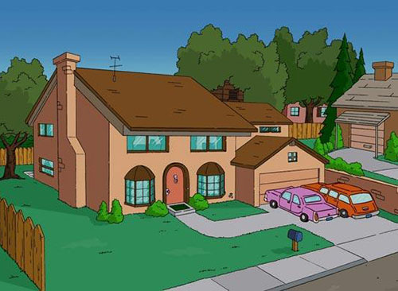

Modern Fortran:
You can define your own types and objects.
Useful for creating “buckets” of variables to pass to routines.
This replaces having to pass hundreds of individual arguments to routines.
A DERIVED TYPE is like the blueprint for a house or building.
Each “room” in the blueprint specifies a different type of variable (e.g. either scalars or arrays of integer, floating-point, characters, etc.)
An OBJECT is a variable that is built to the specifications of a DERIVED TYPE.
It is like a house that is built to a specific blueprint.
A VECTOR OF OBJECTS is like a row of identical houses built from the same blueprint.

Slide 19
Simple derived type example
TYPE :: MyType
INTEGER :: IntVar
REAL :: RealVar
CHARACTER(LEN=100) :: StringVar
. . .
END TYPE MyType
TYPE(MyType) :: MyObject
MyObject%IntVar = 1
MyObject%RealVar = 3.14159
MyObject%StringVar = “This is my object”

Slide 20
Derived type objects
CALL DO_CHEMISTRY( &
Input_Opt, & ! Config file inputs, INTENT(IN)
State_Chm, & ! Vars for chemistry, INTENT(INOUT)
State_Diag, & ! Vars for diagnostics, INTENT(INOUT)
State_Grid, & ! Vars to define grids, INTENT(IN)
State_Met, & ! Meteorological fields, INTENT(IN)
RC ) ! Error return code, INTENT(OUT)
Using derived-type objects (Input_Opt, State_*) simplifies the interface to GEOS-Chem subroutines.
New variables can be easily added to the objects without changing the subroutine calls.
This greatly facilitates interfacing GEOS-Chem into external models.

Slide 21
“Fire drill” error trapping”
Main program
Robust error trapping is crucial when running GC in an ESMF/MPI environment on 100’s or 1000’s of cores.
Otherwise, GC could halt on one core while program execution continues on the other cores. This results in a stalled simulation , as the other cores cannot communicate with the core on which the error occurs.
Trap error and shut down gracefully here.
Routine 1 (R1), called by Main
Exit R1, pass error code up.
R2, called by R1
Exit R2, pass error code up.
R3, called by R2
Error happens here!
Exit R3 with non-zero error code.
Notes:
When we hit an error, we now use the “fire drill” method.
In a fire drill, we leave the room we're in, then the hallway, then the stairway, etc. until we get outside.
In the same way, program flow exits thru all higher-level subroutines until we reach the interface level. Then we do something to handle the error there (i.e. finalize gracefully).

Slide 22
Commitment to open source
Early versions of GEOS-Chem supported several compilers
  SGI Fortran, IBM Fortran, Sun Fortran, Intel Fortran, PGI Fortran, …
GEOS-Chem now supports 2 compilers:
  GNU Fortran (part of the GNU Compiler Collection, aka GCC)
    Open source, easy to implement on cloud platforms
    GCC comes with every Linux distribution
  Intel Fortran (part of the Intel-OneAPI compiler suite)
    Now open-source, but was formerly proprietary
We don’t chase the newest compiler versions (that drives people crazy!)

Slide 23



Modern Fortran lets GC run in ESMs
The GEOS–Chem interface with the NASA GEOS ESM
  Steven Pawson (GMAO) requested a column version of GC to interface with GEOS
  GEOS ESM generates meteorology, handles advection
  GEOS-Chem does emissions, chemistry, deposition (i.e. local operations)
GEOS–Chem is a collection of columns!
NASA GEOS ESM
hν
Mike Long saw the potential of treating GEOS-Chem as a collection of columns.
Groups of columns are sent to different computational cores via ESMF/MPI interface. The grid can be defined at runtime instead of compile time. 100’s or 1000’s of cores can be used!
This is also the principle behind GCHP!
Interface
TOA
GEOS passes vertical columns of grid boxes
to the GEOS–Chem via an ESMF interface
Sfc
Notes:
The main motivation for the column code was that GMAO asked us to give them a 1-D version of GEOS-Chem that could be interfaced to GEOS-5 GCM
The GEOS-5 GCM is a collection of physical processes (represented by blue boxes). Where it says “chemistry”, we can slide in the G-C column code.
An interface has to be written (i.e. the arrow)
The G-C column code is written in pure fortran.

Slide 24
GEOS-Chem as chemical module for weather/climate models
any 3-D grid specified at run time
coupler
coupler
coupler
coupler
Advection
Mixing
Convection
O
Emissions
(HEMCO):
dC/dt = E
Chemistry (FlexChem): dC/dt = P –L - D
off-line
GEOS-Chem model with input met. data
GEOS-Chem chemical module
(i.e. local operations)
Slide from Daniel Jacob

Slide 25
GEOS-Chem as chemical module for weather/climate models
any 3-D grid specified at run time
coupler
coupler
coupler
O
Chemistry (FlexChem): dC/dt = P –L - D
Emissions
(HEMCO):
dC/dt = E
Dynamics, chemical transport
GEOS-Chem chemical module
(i.e. local operations)
weather/climate model with on-line GEOS-Chem
Slide from Daniel Jacob

Slide 26
GEOS-Chem as chemical module for weather/climate models
any 3-D grid specified at run time
coupler
coupler
coupler
coupler
coupler
Mixing
Convection
O
Advection
Chemistry (FlexChem): dC/dt = P –L - D
Emissions
(HEMCO):
dC/dt = E
Dynamics, chemical transport
off-line
GEOS-Chem model with input met. data
GEOS-Chem chemical module
(i.e. local operations)
weather/climate model with on-line GEOS-Chem
Off-line and on-line GEOS-Chem chemical modules use exactly the same code!
Off-line users contribute model advances
Advances are incorporated
into GEOS-Chem
and are seamlessly passed into weather/climate model
Advances are incorporated |  | …and are seamlessly passed to weather/climate model
into standard GEOS-Chem
Slide from Daniel Jacob

Slide 27

We built the “new bridge” next to the “old bridge” one without disrupting any workflow
Prior GEOS-Chem code
Code updates for Modern Fortran

Slide 28
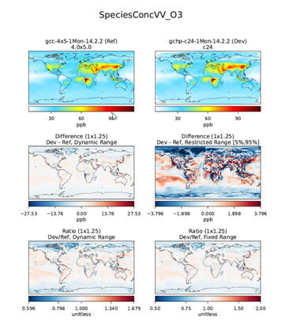
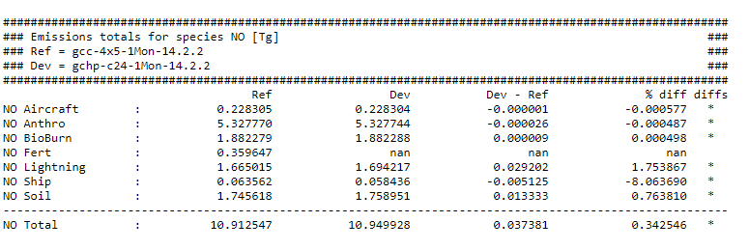
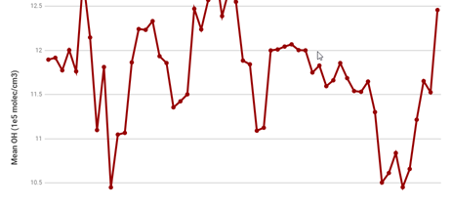
Best Practice #2: Benchmarking

Slide 29

Benchmarking started with Randall!
Daniel reminded me that our fearless leader Randall was the impetus behind the GEOS-Chem benchmarking process!
When Randall was a grad student at Harvard, he lamented that it was difficult relate source code updates to GEOS-Chem and the changes in output they produced. This spurred us to implement standard benchmarking procedures.
We have been benchmaring GEOS-Chem since very early versions, at least since GEOS-Chem v3 or v4!

Slide 30
Benchmark objectives
Benchmarking supports the maintenance of GEOS-Chem as a robust state-of-the-science facility with a nimble grass-roots approach and strong version control.
Benchmarking has four main objectives:
Document a consistent GEOS-Chem model configuration, and the expected characteristics of that configuration.
Support version control through traceability, and by confirming the expected behavior of model developments submitted by the community.
Track the evolution of the model over the years.
Promote scientific transparency of GEOS-Chem.
cf http://wiki.geos-chem.org/GEOS-Chem_benchmarking

Slide 31
Benchmark simulations
Benchmark simulations are standard simulations that archive several different types of diagnostic outputs
Plots and tables are generated from benchmark simulations
  Comparing model to model
  Comparing model to observations
  Most benchmark plots/tables are generated with GCPy
GCSC must approve benchmarks before a new G-C version is released
GCST also runs benchmark for quality control

Slide 32
Fullchem benchmarks
“Fullchem” = O_{x} + NO_{x} + Br_{x} + Cl_{x}+ I_{x} + aerosols mechanism
1-hour benchmark
  When a new feature is pushed to a development branch on GitHub
  Runs automatically on AWS cloud
  Results posted to gc-benchmark.org
1-month benchmark
  When a feature is “tagged” with a label at GitHub
  Runs automatically on AWS cloud
  Results posted to gc-benchmark.org

Slide 33
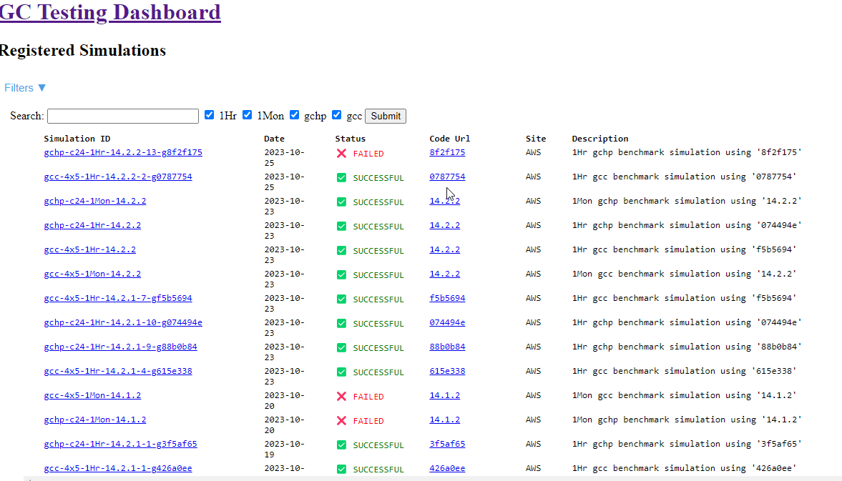
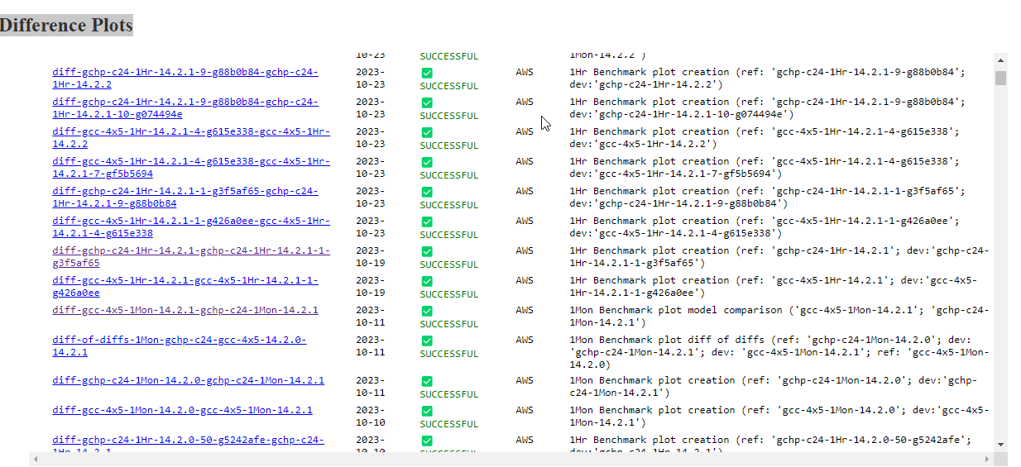
gc-benchmark.org
Thanks to Lucas Estrada and Liam Bindle,
former GCST members

Slide 34
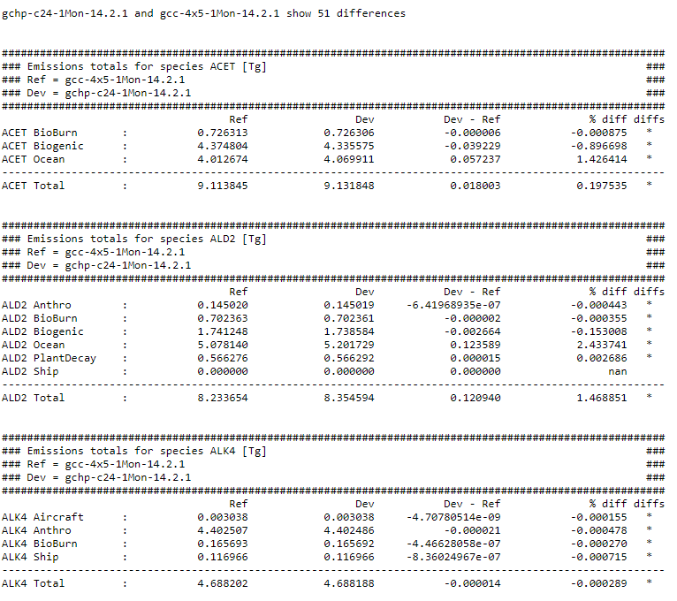
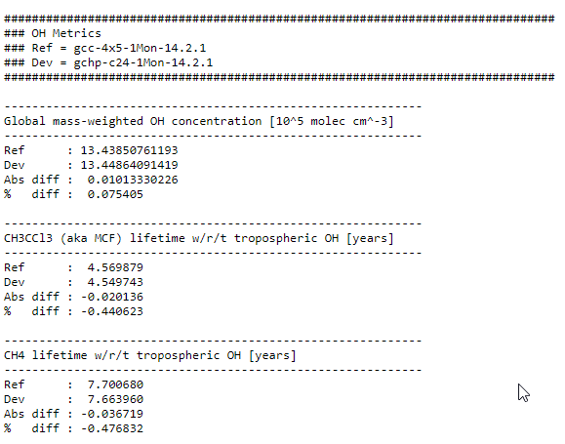
Fullchem benchmark plots/tables
Comparison plots
1. @ Surface
2. @ 500 hPa
3. Full column zonal mean
4. Stratosphere zonal mean
Tables
Emissions & Inventory totals
Mass tables (trop-only)
Mass tables (trop + strat)
OH metrics
Mean OH concentration
Methyl chloroform lifetime
CH4 lifetime w/r/t trop OH

Slide 35
Fullchem benchmarks
1-year benchmark
  Before a version release
  Runs on a computational cluster (e.g. Harvard Cannon)
  Results posted on Harvard FTP site
  Restart files from the most recent 1-yr benchmark will be used at rundir creation
10-year benchmark
  Before a major version release
  Runs on a computational cluster (e.g. Harvard Cannon)
  Results posted on Harvard FTP site
  Output from 10-year benchmarks are used for specialty simulation inputs

Slide 36
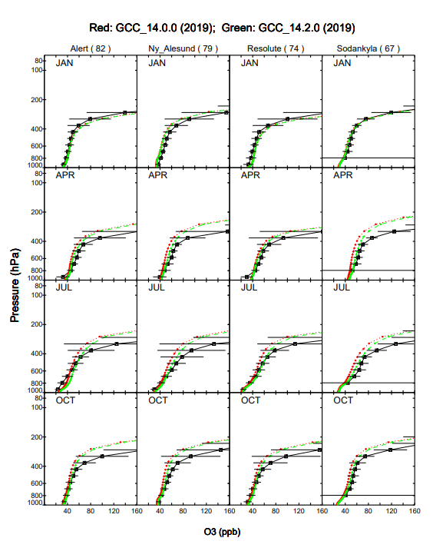
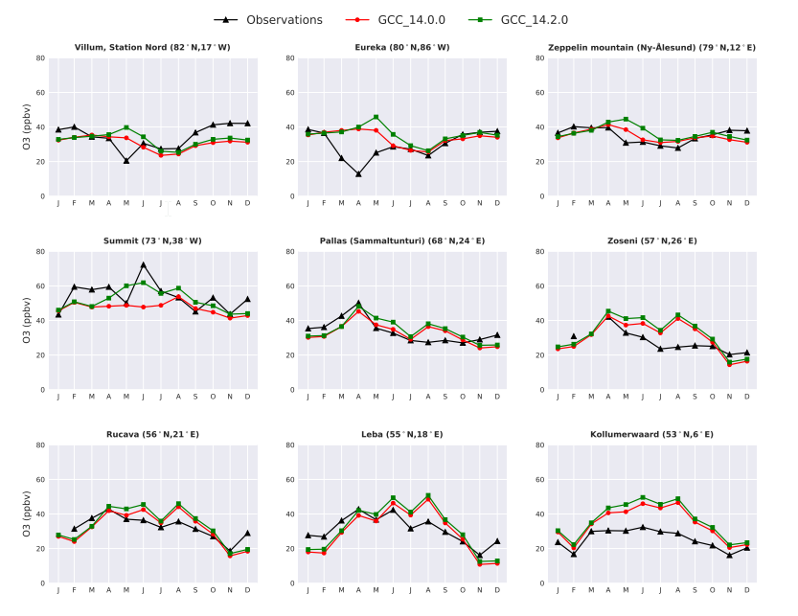
Models vs obs. Plots (1-yr, 10yr)
Seasonal cycles at surface
Sondes

Slide 37
TransportTracers benchmarks
TransportTracers = Rn, Pb, Be isotopes, plus passive species
1-year benchmark
  Before a version release where advection or wet deposition may be affected
  Runs on a computational cluster

Slide 38
CH4 benchmarks
1-month, 1-year
  Used by the GCST for validation of the CH4 and carbon simulations
  Results shared as needed

Slide 39

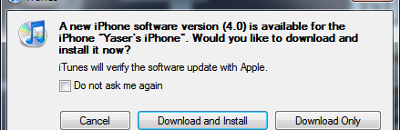
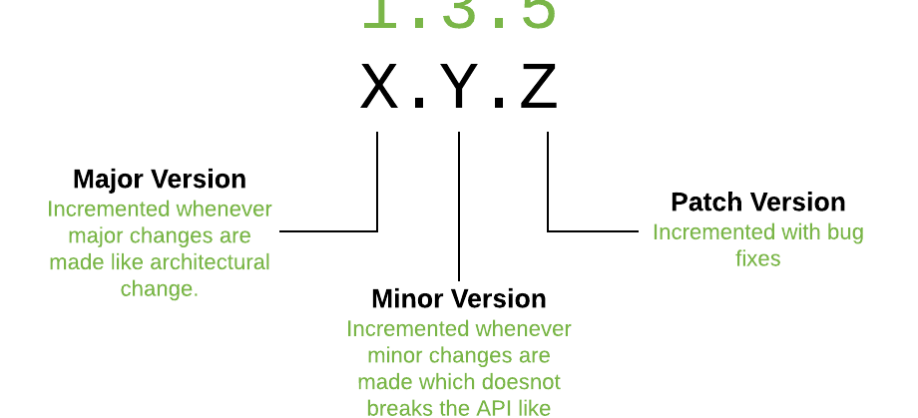
Best Practice #3: Version nomenclature
This Photo by Unknown Author is licensed under CC BY

Slide 40
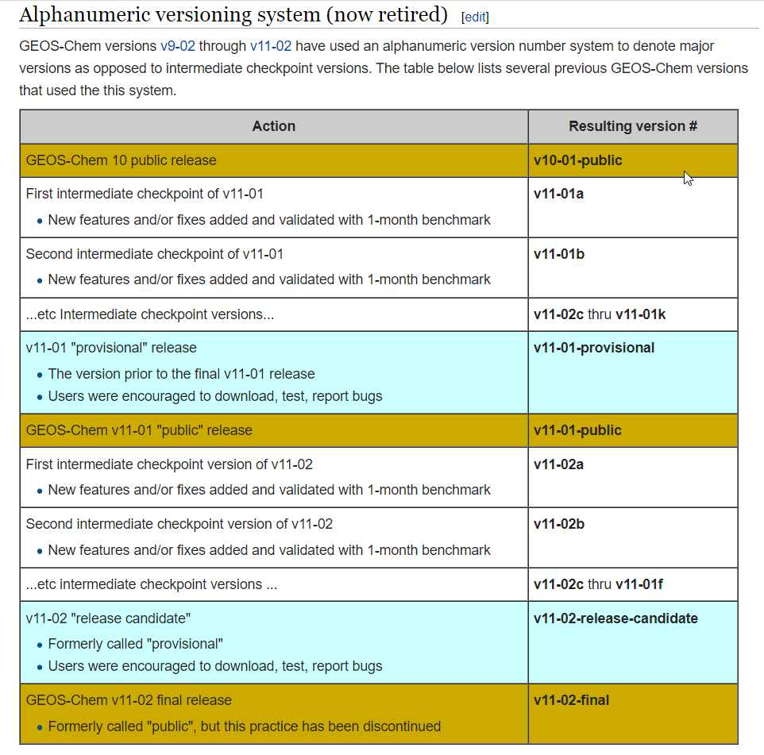
Old nomenclature for versions:
Alphanumeric
Was not intuitive
Used confusing terms, “public”, “provisional”

Slide 41
GEOS-Chem now uses semantic versioning
X . Y . Z
Semantic versioning is industry best practice.
See https://semver.org for more info.
Patch
Includes zero-diff updates: bug fixes, specialty simulations, structural updates
Not validated, other than to assure zero diffs w/r/t the fullchem benchmark simulation
Released as needed
Major version
Breaks backwards compatibility
10-year fullchem benchmark
Reviewed by GCSC
Minor version (aka “Feature” version)
Adds lumped new features, science updates, structural changes
1-month full-chemistry benchmark
1-year full-chemistry and/or TransportTracers benchmark as needed
Reviewed and approved by GCSC and developers
Released every ~3 months
Slide from Melissa Sulprizio
Notes:
- Numeric versioning was adopted by GEOS-Chem ~5 years ago, but there’s still some confusion
- Loosely based on semantic versioning - more closely adheres to industry-standard software versioning protocol
- Zero-diff updates for full-chemistry benchmark simulation

Slide 42
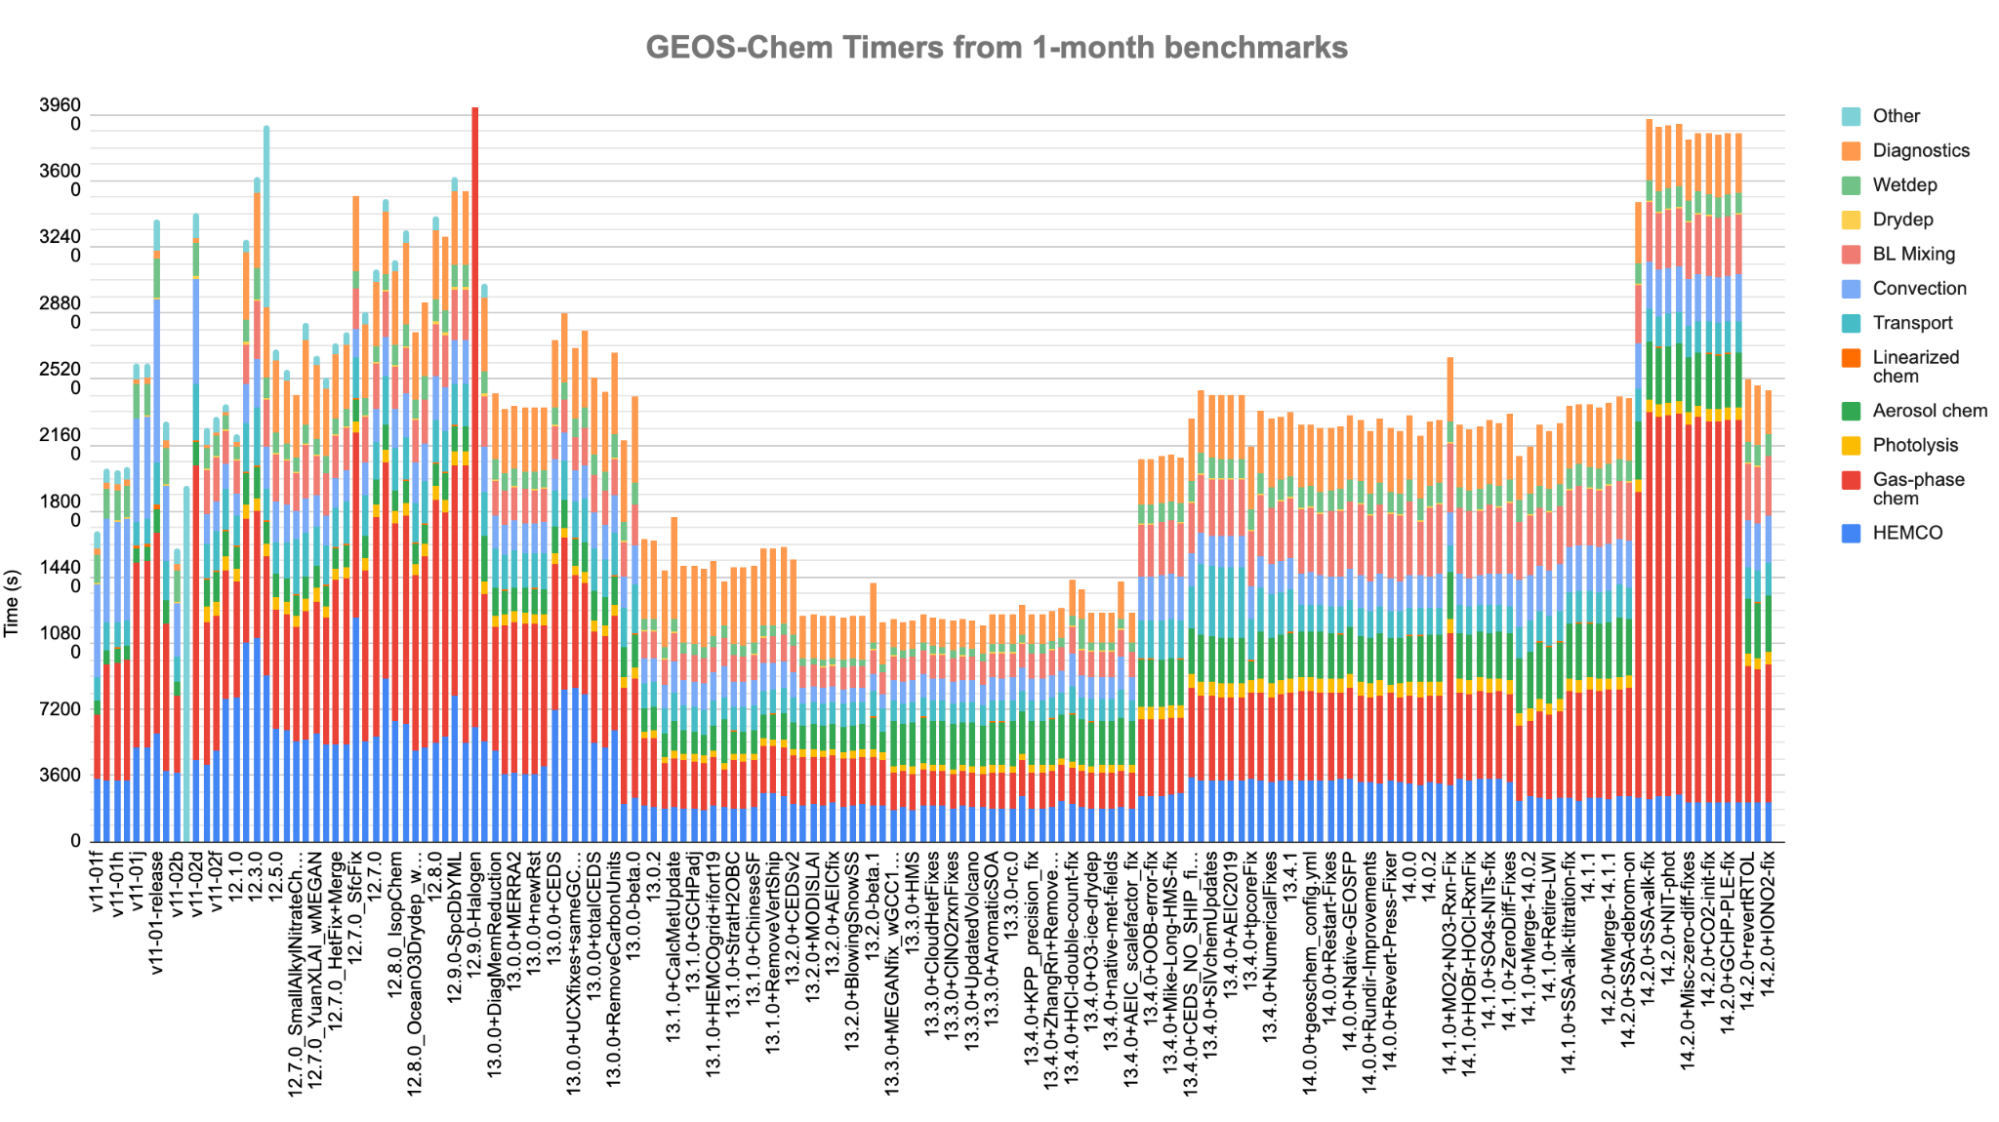
Alphas denote pre-release versions
X . Y . 0 - alpha.N
Pre-release version
New alpha version tagged for each feature that changes the full-chemistry benchmark
  N = 0, 1, 2 …
  Zero-diff updates may also be included
1-month fullchem benchmark simulation on AWS
The GCST inspects each benchmark to:
  Ensure changes are consistent with developers description
  Track changes in model performance and metrics
Unlimited number of alpha versions per minor version
Slide from Melissa Sulprizio

Slide 43
Release candidates
X . Y . 0 - rc.N
Release candidate version
Tagged alongside an alpha version
N = 0, 1, 2. …
Benchmarks for GCClassic and GCHP are inspected by GCSC and developers
  Always includes : 1-month fullchem benchmark
  May also include: 1-year fullchem and/or TransportTracers benchmarks
Version may be released upon benchmark approval, or
Version may be sent back for further work and a rerun of the benchmarks
Slide from Melissa Sulprizio

Slide 44
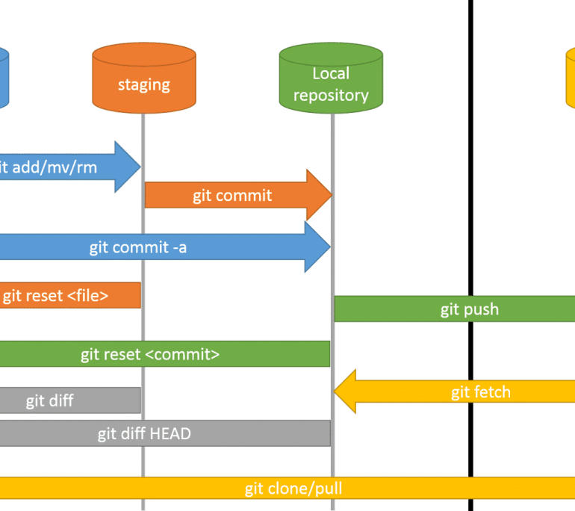




Best Practice #4: Version control

Slide 45
Version control primer
A Version Control System (VCS) tracks version history of software
  First-time setup: All project files are “checked in” or “committed” to a repository
  Subsequent updates: Differences w/r/t the prior commit (aka “deltas”) are stored
    This saves space; no need to store a new copy of modified files
  A VCS can recreate the version history at a particular state
    This allows developers to “go back in time” to a previous update
  A VCS allows for multiple branches of development to be merged together
    Important if you have several developers working on a project
cf. https://initialcommit.com/blog/Technical-Guide-VCS-Internals

Slide 46
Ancient history: We used RCS
RCS (Revision Control System) Pros:
  Revisions were handled on a file-by-file basis
  Revisions for each tracked file were stored in a corresponding history file
  Basic branching and merging of revisions within individual files.
RCS Cons:
  Changes across multiple files couldn’t be grouped together into a single commit
  Tracked files were intended to be modified by one user at a time
  No network functionality – all users had to have access to the same system
  Performance: Slow to retrieve updates from many files
cf. https://initialcommit.com/blog/Technical-Guide-VCS-Internals

Slide 47
Less ancient history: we used CVS
(Concurrent Versions System)
CVS used RCS “under-the-hood”, with improvements
  Used a network-accessible repository
  Files were “checked in” to the repo, converted to RCS history format, stored in a module
  Users would “check out” a module, which represented a state of the code
  Multiple users could work on the same file at the same time
  Users would “check-in” their modified codes back to the module
  Users could create branches and merge them back into the main development stream
cf. https://initialcommit.com/blog/Technical-Guide-VCS-Internals

Slide 48
Less ancient history: we used CVS
(Concurrent Versions System)
Downsides of CVS
  Reliability:
    An interrupted commit could corrupt the whole CVS repository
    A centralized repository is susceptible to failure/data loss
  Performance:
    CVS was slow for the same reasons RCS was slow
    Branching/merging was not efficient
  Security:
    The files in the repository could not be encrypted
cf. https://initialcommit.com/blog/Technical-Guide-VCS-Internals

Slide 49
We now use Git: The gold standard
The Git version control system (VCS) was invented in ~2005 by Linus Torvalds
  He felt that most VCSs weren’t adequate for Linux kernel development (his project)
  We started using it for GEOS-Chem in ~2010
Git is a distributed VCS
  No copy of the repository needs to be designated as the centralized copy
  All copies are created equal
Git allows for more flexible workflow than other VCSs
  Developers can work locally (w/o network) until they are ready to share their changes
  Developers can share changes directly with each other w/o going thru a centralized repo
  Developers can test code locally before merging it into an “official” branch
cf. https://initialcommit.com/blog/Technical-Guide-VCS-Internals

Slide 50
We now use Git: The gold standard
Other nice features of Git
  When you “clone” a repo, you get its entire version history
  Files, “deltas”, etc. are stored as compressed objects and hashed with SHA-1
    Cryptographically secure format
    Allows for a hierarchy of objects to be created in the object database
  Git allows you to compress older objects into “pack objects” to save space
  Copying (“cloning”) a Git repository is very fast
  Branching and merging is much easier than in CVS, RCS, etc.
cf. https://initialcommit.com/blog/Technical-Guide-VCS-Internals

Slide 51
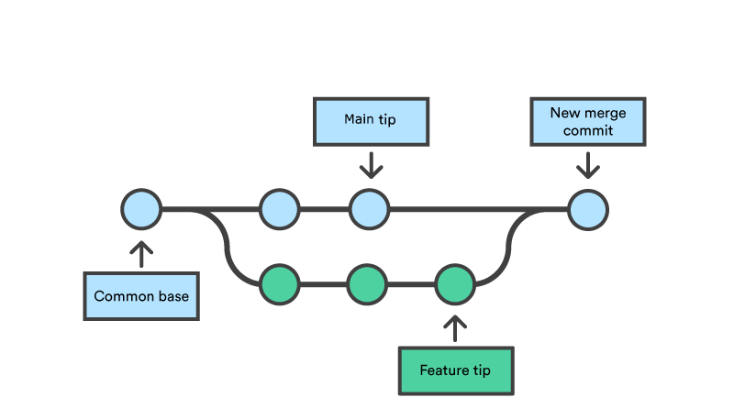
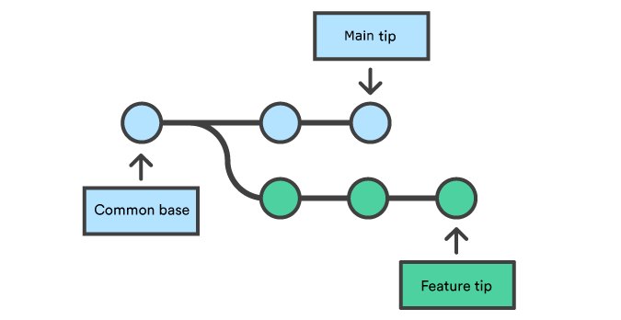

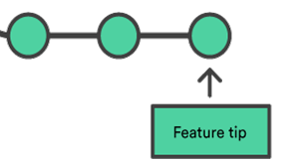

Git: Merging and rebasing
git merge
Feature merged into main;
Both main and feature have the same parent commit
git rebase
Caveat: Only rebase
local branches!
Feature merged atop main;
History is rewritten; Feature’s parent is now the old main
cf. https://www.atlassian.com/git/tutorials/using-branches

Slide 52
Git workflow for GEOS-Chem
Feature2
branch
No-diff-to-benchmark
branch
Feature1
branch
Dev/X.Y+1.0
branch
Main branch
X.Y.0 version
e.g. 14.2.0
X.Y.1 version
e.g. 14.2.1
But could also go into X.Y+1.0 if need be
X.Y+1.0 version
e.g. 14.3.0

Slide 53
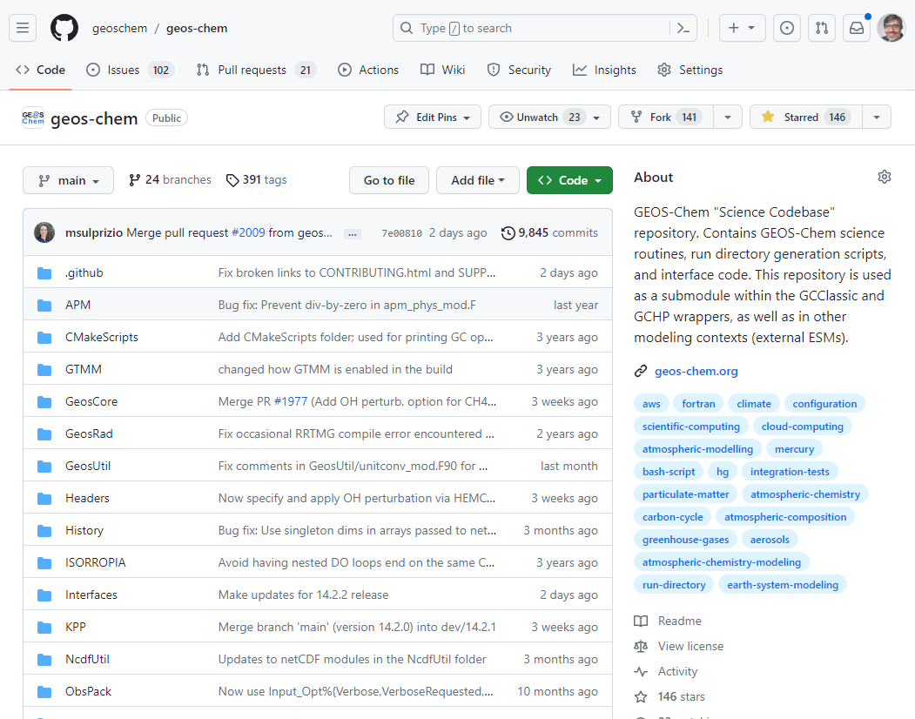
“Official” GEOS-Chem repositories are stored at GitHub.
GitHub provides a nice user interface with several nice features that facilitate efficient code development and support.

Slide 54
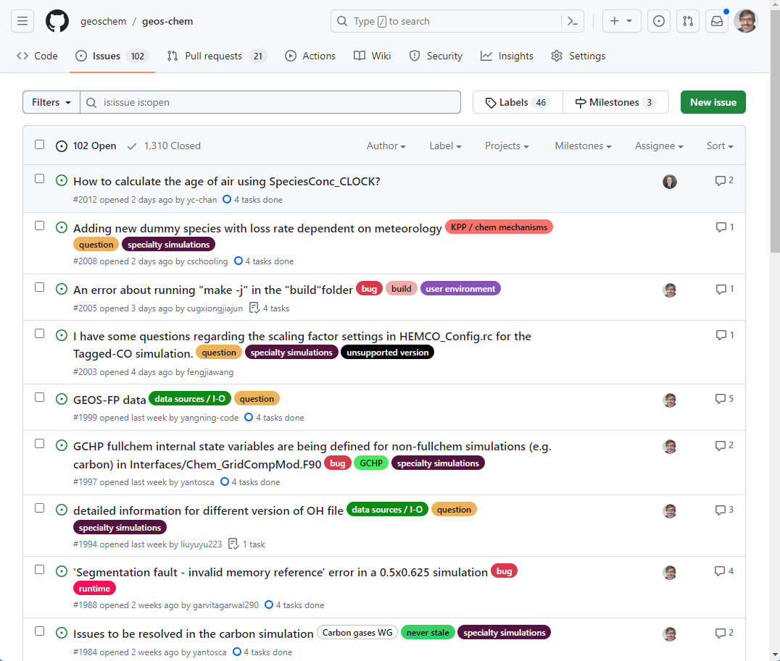
Issue Tracker
Users can report bugs, ask questions, or request new features.
Issues generate notifications that can be received via email (if so desired).
Issues remain searchable when closed).
Issues can be labeled for easy reference.
Users can be “tagged” in issues.

Slide 55
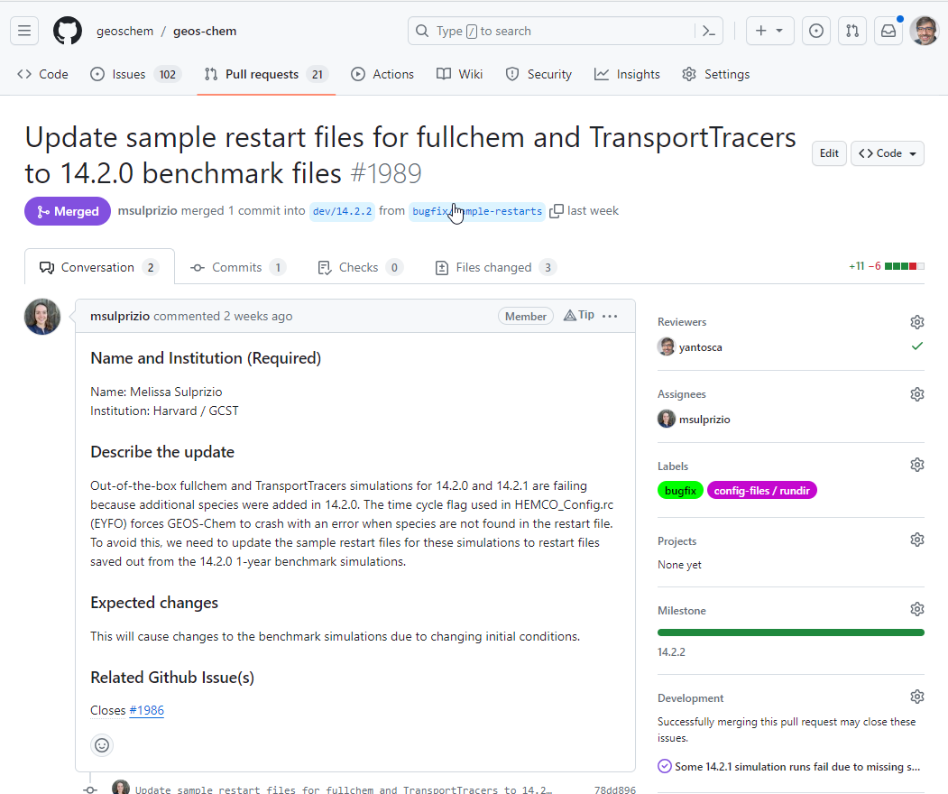
Pull requests
Users ask permission to merge their updates into the repo.
Pull requests can be reviewed by the repo maintainers, who can accept the changes, or request further modifications.
The repo maintainers can then pull the updates into a separate branch for testing before merge.

Slide 56
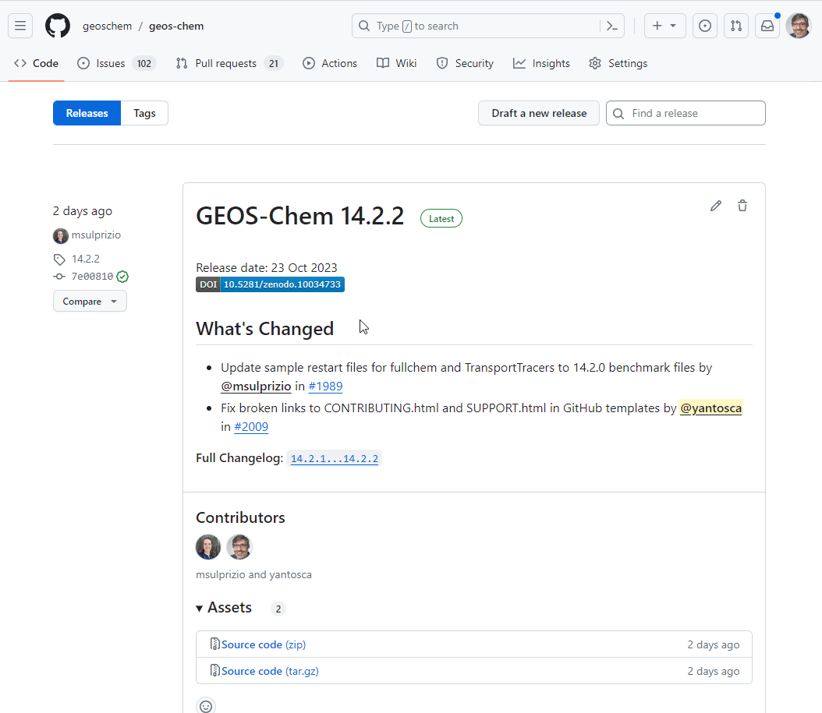
Releases
Github allows you to label any commit with a “tag”.
A release can be generated from a tag.
Specific actions (such as generating a DOI, or causing tests to be run) can be triggered by the release.

Slide 57
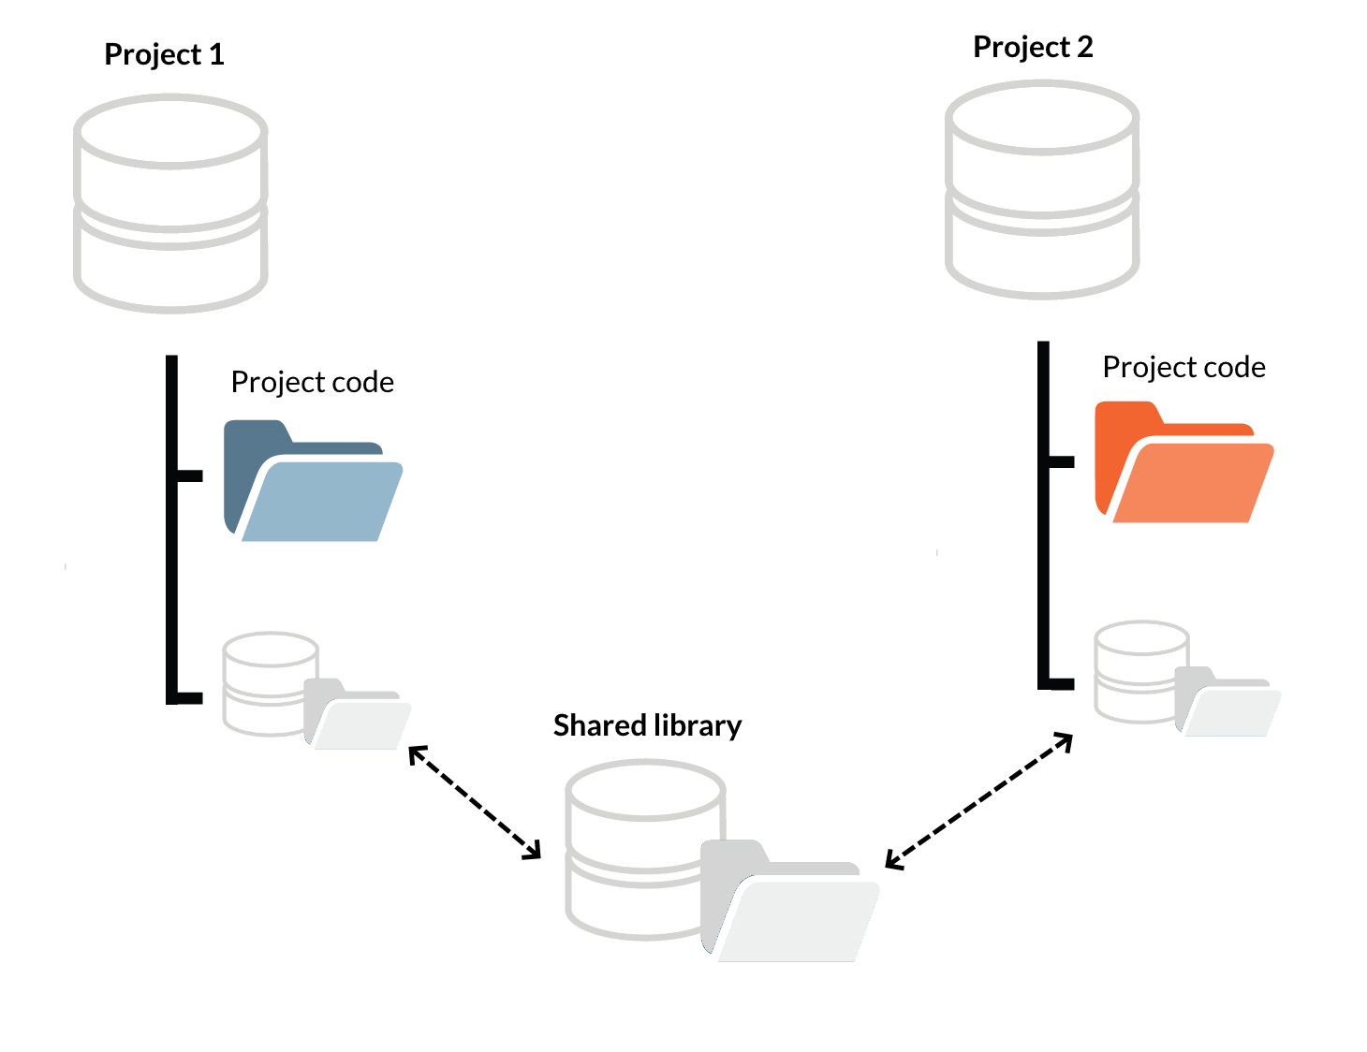
Submodules
Git allows you to include separately maintained codebases into a project.
The example shows how GCClassic and GCHP both inline the GEOS-Chem “Science Codebase” and HEMCO code, which are maintained in separate GitHub repositories.
github.com/geoschem/geos-chem
github.com/geoschem/HEMCO
Submodule
Submodule
github.com/geoschem/GCClassic
and
github.com/geoschem/GCHP
Superproject

Slide 58

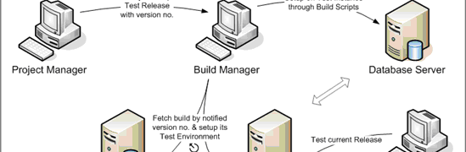
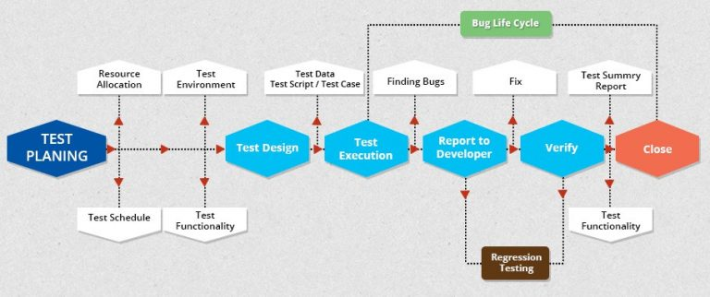
Best Practice #5:
Software tests
This Photo by Unknown Author is licensed under CC BY-SA

Slide 59
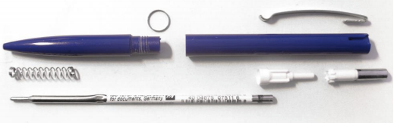
Software tests: Ballpoint pen analogy
Unit Testing: Test components individually
Slide from Melissa Sulprizio

Slide 60
Software tests: Ballpoint pen analogy
Integration Testing: Test component subassemblies
Slide from Melissa Sulprizio

Slide 61
Software tests: Ballpoint pen analogy
System Testing: Test system as a whole
Slide from Melissa Sulprizio

Slide 62

Software tests: Ballpoint pen analogy
Acceptance Testing: Make sure it’s ready to ship!
Slide from Melissa Sulprizio

Slide 63
Levels of software testing as applied to GEOS-Chem 13.0.0+
Unit Testing
Currently not done
1. CI tests (Azure Dev Pipelines)
2. Compilation & execution tests
Integration Testing
System Testing
“Alpha” benchmarks done after each feature/fix is added
Acceptance Testing
Official scientific benchmarks
reviewed by GCSC
Slide from Melissa Sulprizio

Slide 64
Questions asked by each phase of GEOS-Chem software testing
Unit Testing
N/A for time being
1. Does GC compile after each commit?
2. Does GC compile & run “out-of-the-box?”
Integration Testing
System Testing
What changed due to a specific feature or fix being added?
Acceptance Testing
Does GEOS-Chem output make scientific sense?
Slide from Melissa Sulprizio

Slide 65
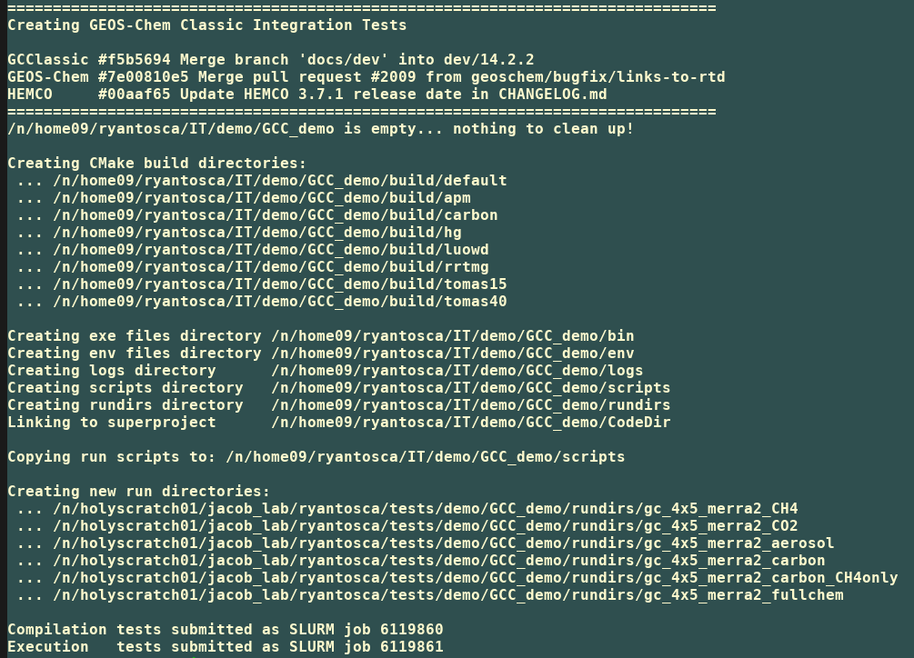
Example: Integration tests on Cannon
Integration tests can now be run on the Harvard Cannon and WashU Compute1 clusters by running a script.
The script will create the necessary directories where the GEOS-Chem executables will be built, as well as run directories for several simulations.
Cannon uses SLURM, so the compilation and execution phases are submitted as separate SLURM jobs. If the compilation fails, the execution will also fail.

Slide 66
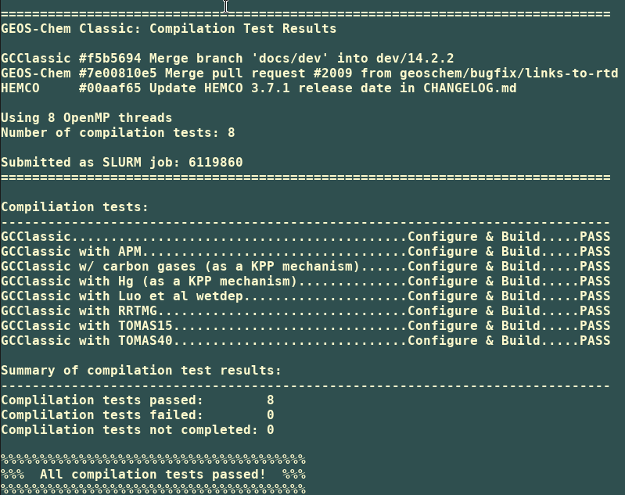
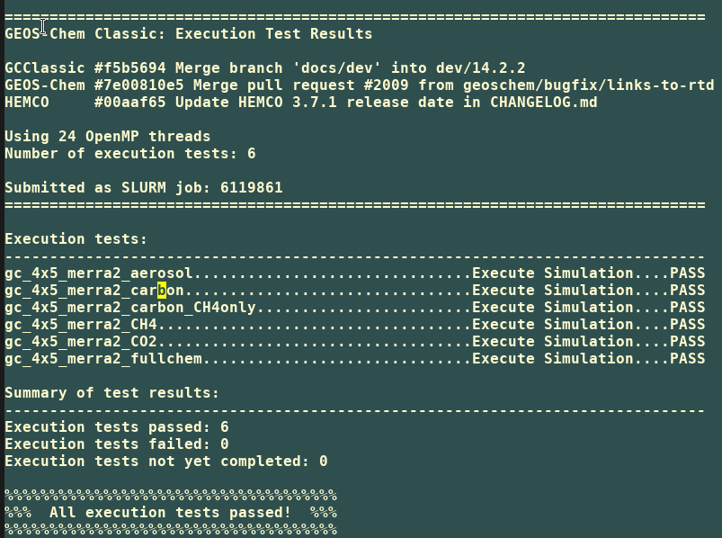
Integration test results
Integration tests can be run for GCClassic and GCHP (not shown). The example below is from a “quick” set of integration tests, which facilitates debugging.
Each integration test contains 2 phases:
Configure & Build
Execute
The results from each phase are sent to log files

Slide 67
Bonus: Built-in memory leak checker
We can now check for leaked memory in GEOS-Chem and HEMCO!
  $ cd build
  $ cmake ../CodeDir -DRUNDIR=.. -DSANITIZE=y
  $ make -j
  $ make install
Output looks like:
  Direct leak of 926512128 byte(s) in 744 object(s) allocated from:
  #0 0x2b33574f71ff in __interceptor_malloc ../asan_malloc_linux.cpp:145
  #1 0x7532cb in hco_valinit_3d_dp ../hco_arr_mod.F90:925
Routine file line number

Slide 68
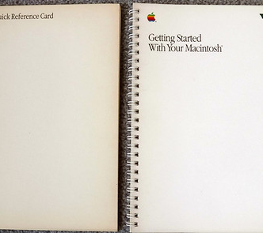



Best Practice #6: Documentation
GEOS-Chem

Slide 69
Source code documentation
GEOS-Chem has copious source code comments
  I started writing good documentation early, for my own sake
  Except for third-party routines, all G-C source code modules are extensively documented
    Descriptions of variables and subroutine arguments, units, dimensions, etc.
    References to scientific journals where appropriate
We encourage you to comment your source code well, too!
  “Six months ago, only God and I knew what I was doing.
  Now only God knows.” – Haipeng Lin (grad student @ Harvard)

Slide 70
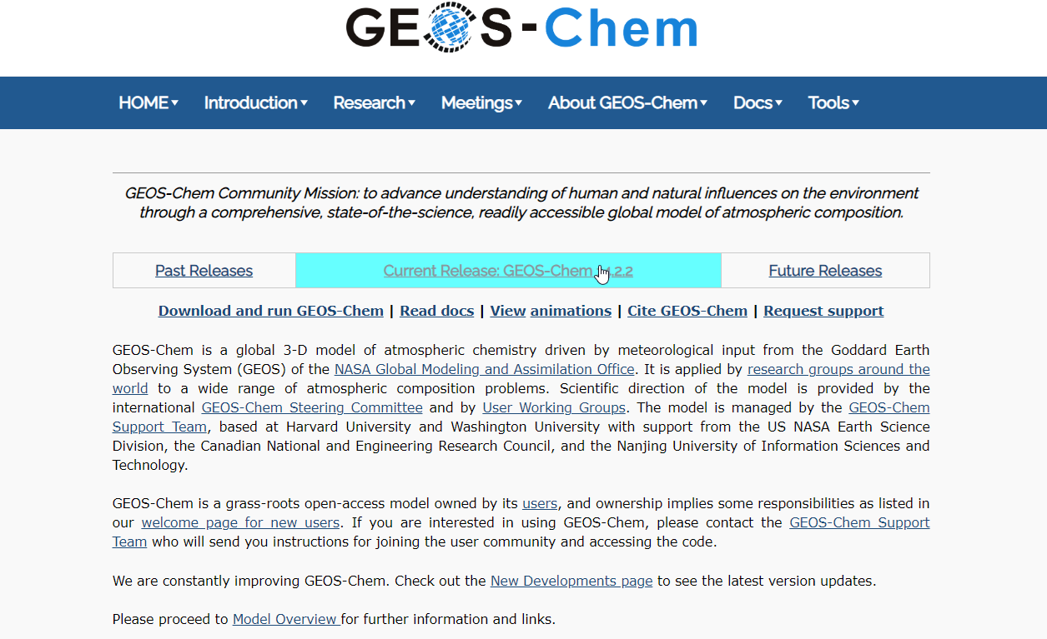
GEOS-Chem website
https://geoschem.github.io
aka http://geos-chem.org
The “first stop” for GC reference:
New user information
How to cite GEOS-Chem
Narrative description
Presentations
Publications
Steering Committee
Working Groups
Support Team
GEOS-Chem Meetings
Links to documentation and other relevant information

Slide 71
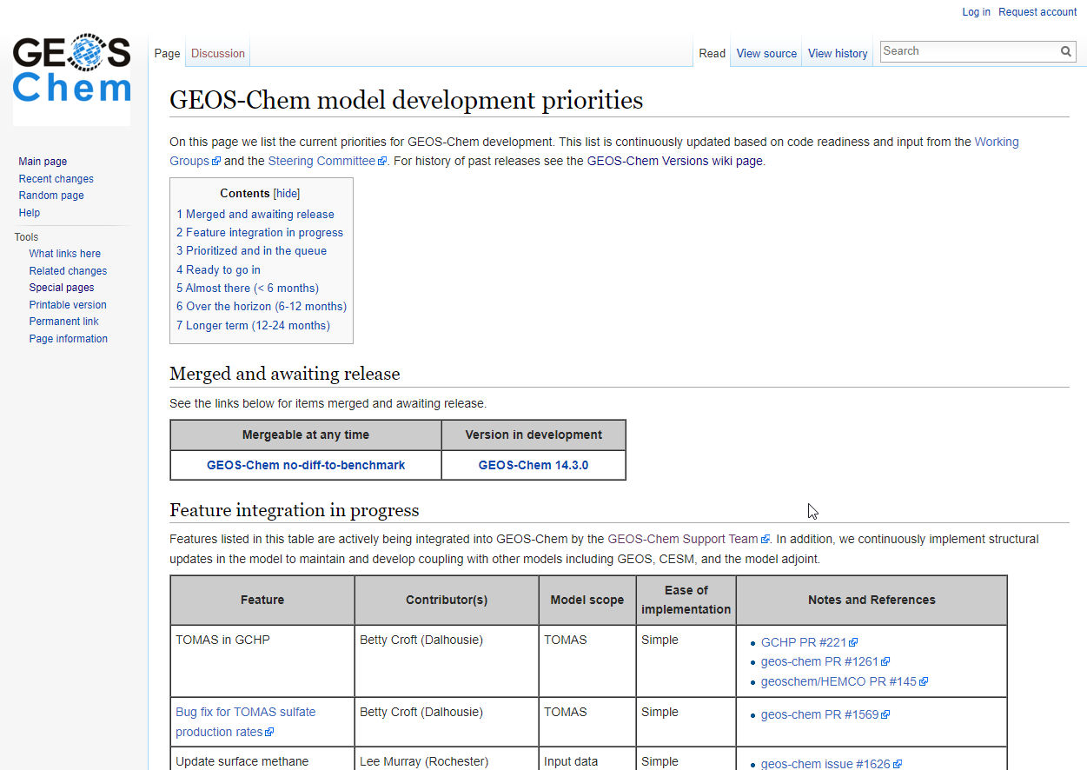
GEOS-Chem wiki
http://wiki.geos-chem.org
Contains the GEOS-Chem model development priorities page, which lists the features that have been prioritized for inclusion based on their readiness.
Developments are prioritized by the GCSC based on need and readiness, as determined from Working Groups.

Slide 72
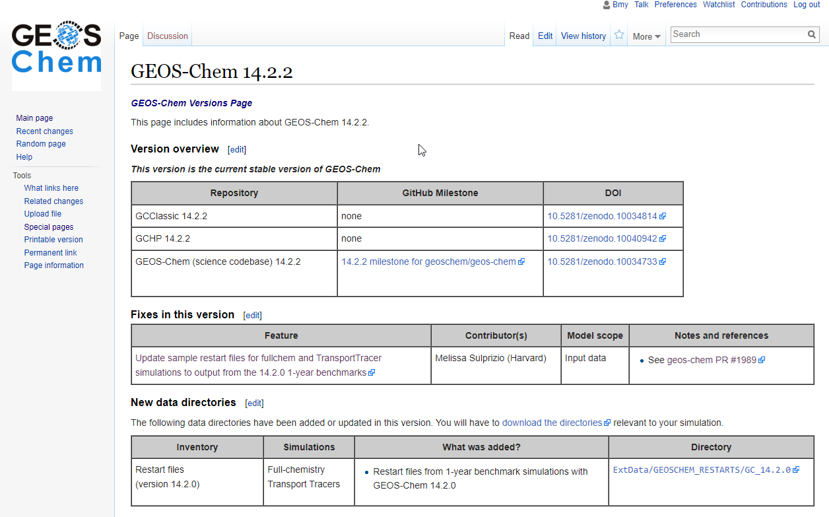
GEOS-Chem wiki
http://wiki.geos-chem.org
Also contains information about GEOS-Chem model versions (such as the 14.2.2 page, shown here) with links to plots/tables from benchmark simulations.
We have recently migrated several pages to ReadTheDocs and have culled obsolete information.

Slide 73
GEOS-Chem Documentation
In GEOS-Chem 14.0.0+, documentation has been ported to ReadTheDocs
Software | Documentation
GEOS-Chem Classic | geos-chem.readthedocs.io
GCHP | gchp.readthedocs.io
HEMCO | hemco.readthedocs.io
GEOS-Chem on the cloud | geos-chem-cloud.readthedocs.io
WRF-GC (GEOS-Chem in WRF) | wrf.geos-chem.org
GCPy (Python toolkit) | gcpy.readthedocs.io
KPP (The Kinetic PreProcessor) | kpp.readthedocs.io
IMI (Integrated Methane Inversion) | imi.readthedocs.io
CHEEREIO (Data assimilation & emissions inversions) | cheereio.readthedocs.io
Slide from Melissa Sulprizio

Slide 74
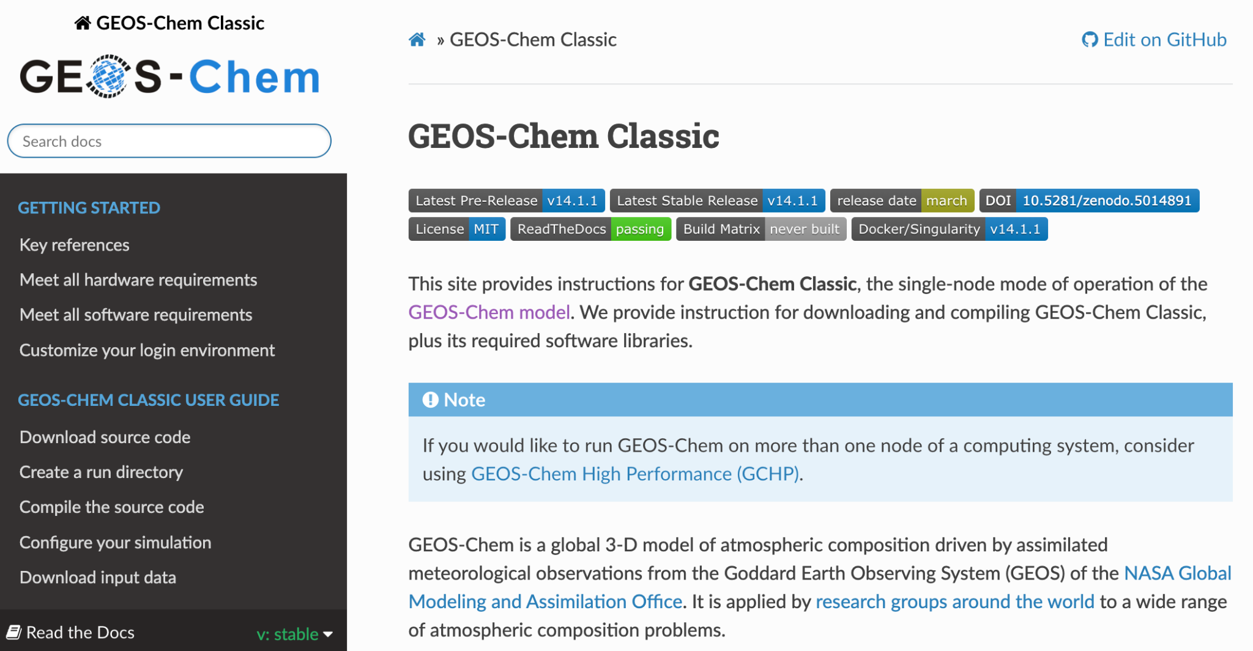
GEOS-Chem documentation
Documentation files (in ReStructured Text format) are stored along with source code.
This allows GEOS-Chem (HEMCO, GCHP, …) to have version controlled documentation.
Slide from Melissa Sulprizio

Slide 75
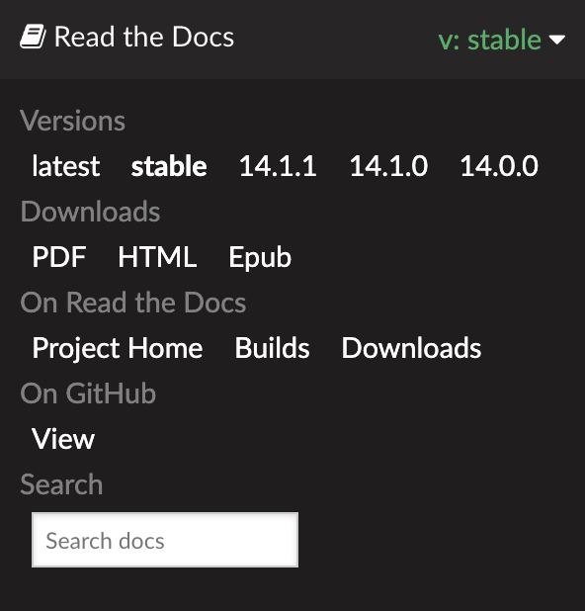
GEOS-Chem documentation
Documentation files (in ReStructured Text format) are stored along with source code.
This GEOS-Chem (HEMCO, GCHP, …) version to have version controlled documentation
Slide from Melissa Sulprizio

Slide 76
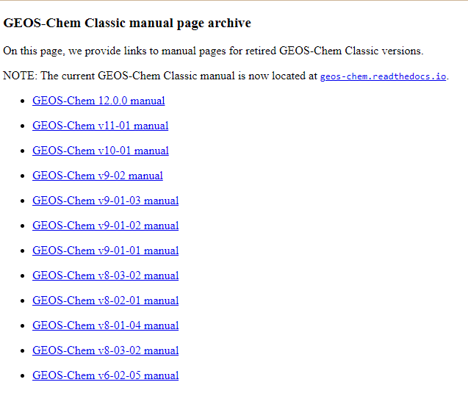
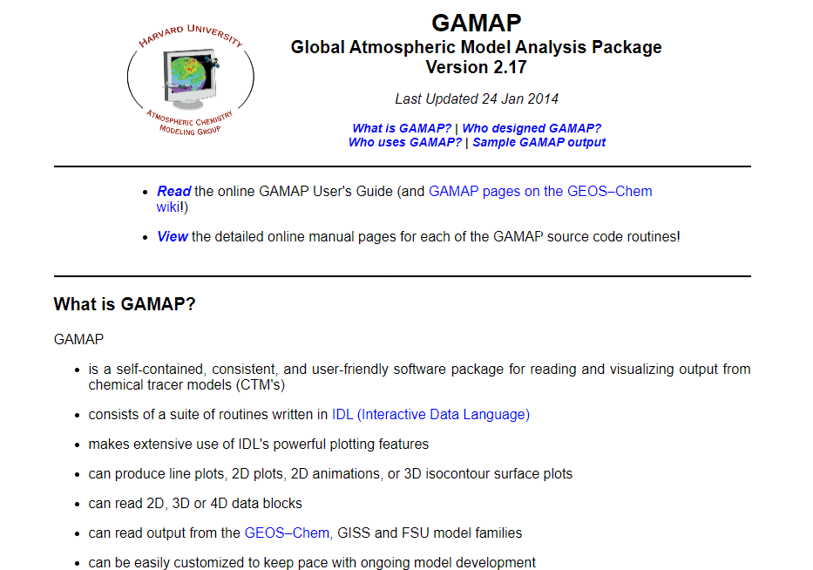
Archival documentation
For the sake of reference: We ported the manuals for old GEOS-Chem model versions and for the old GAMAP IDL package to GitHub Pages. (Yes, we do get asked for these.)

Slide 77

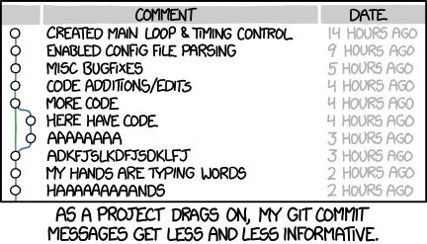

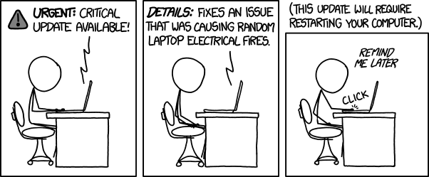
Thanks for your attention!
Questions?
You call *that* a supercomputer?

Slide 78
Extra slides

Slide 79
Replacing obsolete code constructs
Old Fortran
  You had to use DO loops to initialize array variables
    NOTE: Old Fortran DO loops required a labeled CONTINUE statement
  DO 10 N = 1, 1000
  ARRAY1(N) = 0.0
  ARRAY2(N) = 0.0
  10 CONTINUE
Modern Fortran:
  You can initialize arrays in one line.
  Much faster than looping!
  ARRAY1 = 0.0
  ARRAY2 = 0.0
Susceptible to array out-of-bounds errors if you change the array size w/o also changing the upper bound of the loop
You can now use the new loop syntax:
DO N = 1, 1000
. . .
ENDDO (or END DO)

Slide 80

A tale of two CTMs
Harvard–GISS CTM
(Y. Wang, L. Horowitz, et al @ Harvard)
4x5, 9-layer, driven w/ offline GISS met
Met fields: GISS 9-layer GCM
Advection: GISS SOM (M. Prather)
Cld Conv: GISS algorithm
PBL Mixing: GISS algorithm
Wet Dep: GISS algorithm
Dry Dep: DEPVEL (Harvard)
Emissions: cf. Wang et al 1998
Photolysis: SLOW–J (Harvard)
Chemistry: NOx-Ox-HC w/ SMVGEAR I (Harvard)
GEOS–CTM
(D. Allen, M, Chin @ GSFC)
This was the precursor to GOCART
Met Fields: GMAO GEOS–1 (20 sigma levels)
Advection: TPCORE (S-J Lin)
Cld Conv: CLDMX (S-J Lin)
PBL Mixing: TURBDAY (D. Allen/UMD)
Wet Dep: none
Dry Dep: none
Emissions: read from disk
Photolysis: none
Chemistry: offline CO or DMS
Bob’s job:
Notes:
We started from 2 models: the Harvard/GISS 4x5 9-layer CTM and Mian Chin's GEOS-CTM model.
The Harvard/CTM used an earlier version of the chemistry mechanism that we use today in G-C (cf. Wang et al 1998) but the met fields were based on GISS.
The GEOS-CTM was an offline model, but the met was based on the assimilated GEOS -1 fields

