Slide 1
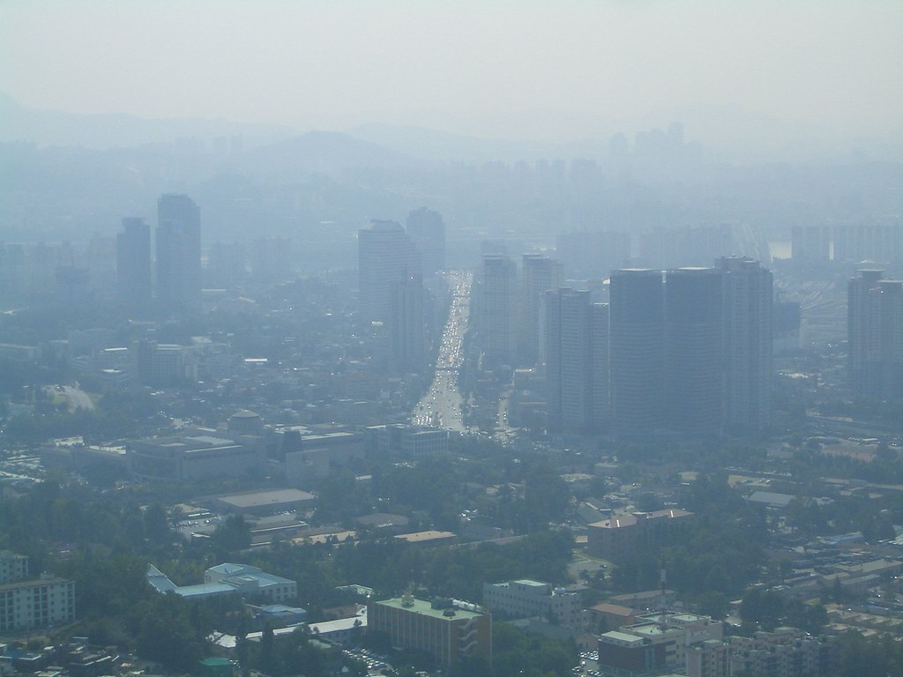





Why is ozone so high (and increasing) over Korea and China?
Daniel J. Jacob
Vasco McCoy Family Professor of Atmospheric Chemistry and Environmental Engineering
Harvard University
Nadia Colombi
Laura Yang
Ellie Beaudry
Drew Pendergrass
Shixian Zhai

Slide 2
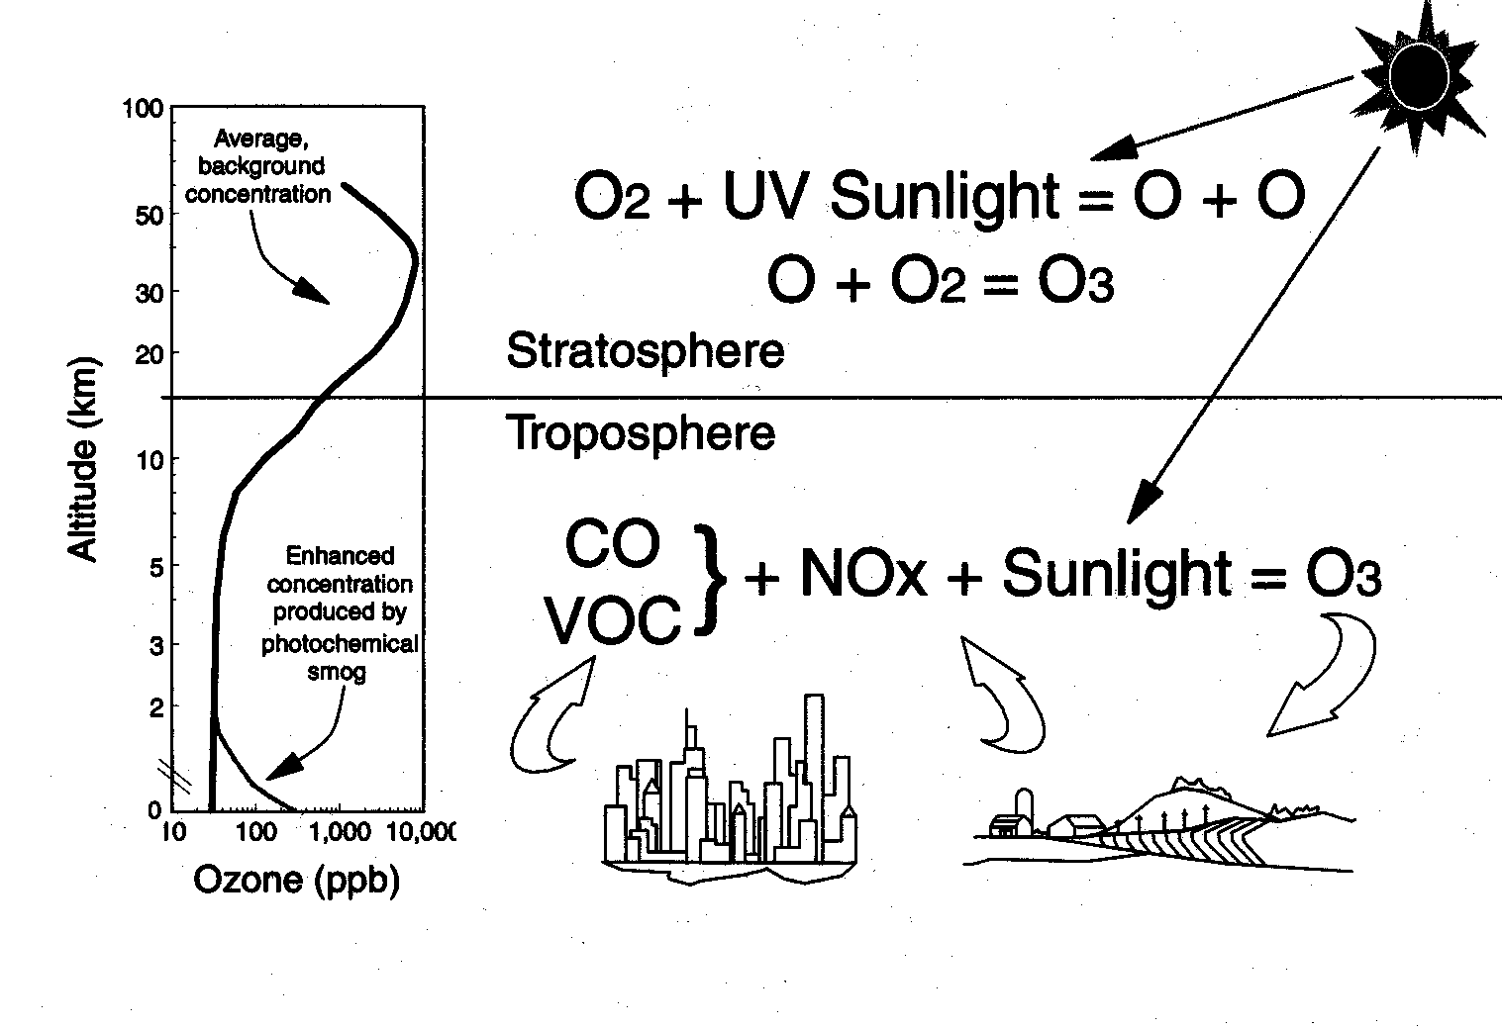
Atmospheric ozone: “good up high, bad nearby”
In stratosphere:
O₂ + hv → O + O
O + O₂ + M → O₃ + M
Stratosphere:
90% of total
UV SHIELD
tropopause
Troposphere
In troposphere:
NO₂ + hv → NO + O
O + O₂ + M → O₃ + M
(catalytic mechanism)
TOXIC
00

Slide 3
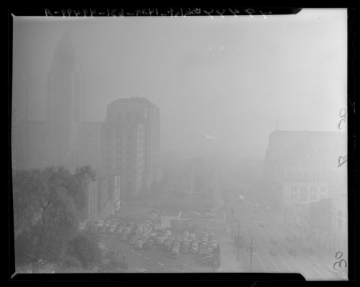
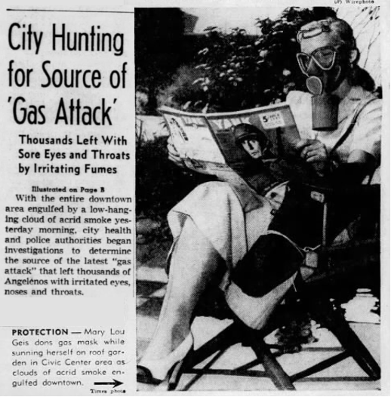
First recorded photochemical smog event: Los Angeles on July 26, 1943
Visibility down to three city blocks
Air smells like bleach
Is this Japanese chemical warfare?
Los Angeles Times, July 27, 1943

Slide 4


Haagen-Smit (1953) identifies ozone produced in air from car exhaust as the harmful component in Los Angeles smog
Shows in the lab that ozone is produced by photochemical oxidation of volatile organic compounds (VOCs) and CO in the presence of nitric oxide (NO)
NO₂ absorbs in the blue
Arie Haagen-Smit
ozone
hv
NO₂
In car engine:
fuel (C_{x}H_{y})
air
NO
VOCs, CO

Slide 5
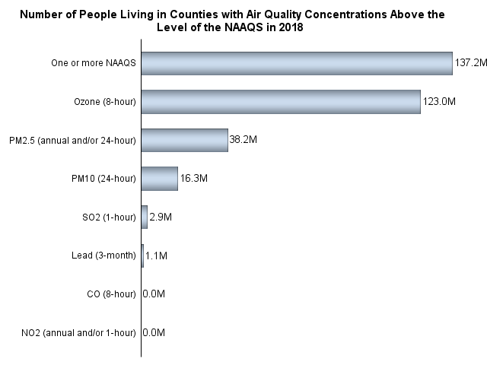
Current US exceedances of air quality standards (AQS)
US population (millions) exposed to air pollutants
in excess of national ambient air quality standards, 2018
Ozone
137M
70 ppb (maximum daily 8-h average, MDA8)
38M
PM_{2.5}
31
PM₁₀
16M
SO₂
3M
Lead
1M
CO
0
NO₂
0
One third of US population breathes unhealthy high-ozone air according to US EPA
US EPA [2020]

Slide 6
Days per year exceeding 70 ppb ozone standard, 2010-2014
Korean AQS: 60 ppb
China AQS: 75 ppb
TOAR [2020]

Slide 7
Very severe ozone pollution problem in China
revealed by air quality network observations starting in 2013
US
air quality standard
China
air quality standard
Li et al. [2019]

Slide 8
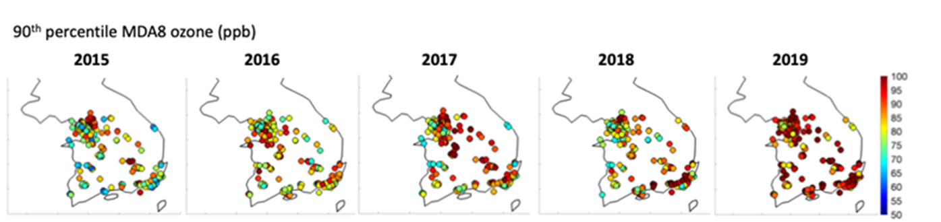
Ozone in China and Korea has been getting worse over past decade
Li et al. [2020],
Pendergrass et al. [2022], Colombi et al., in prep.

Slide 9
Role of emissions in driving 2015-2019 ozone trend in Seoul
90th percentile MDA8 ozone for 79 sites
in Seoul metropolitan area
Use random forest algorithm to correct for effect of meteorology in driving the 2015-2019 trend
Meteorology-corrected trend confirms effect of emission changes
Largest increasing trend in spring, decrease in August
Colombi et al., in prep.

Slide 10
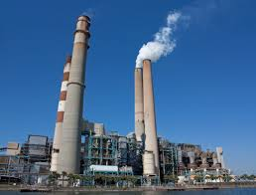
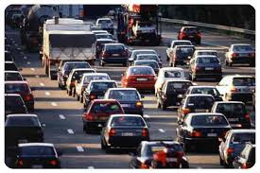

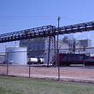

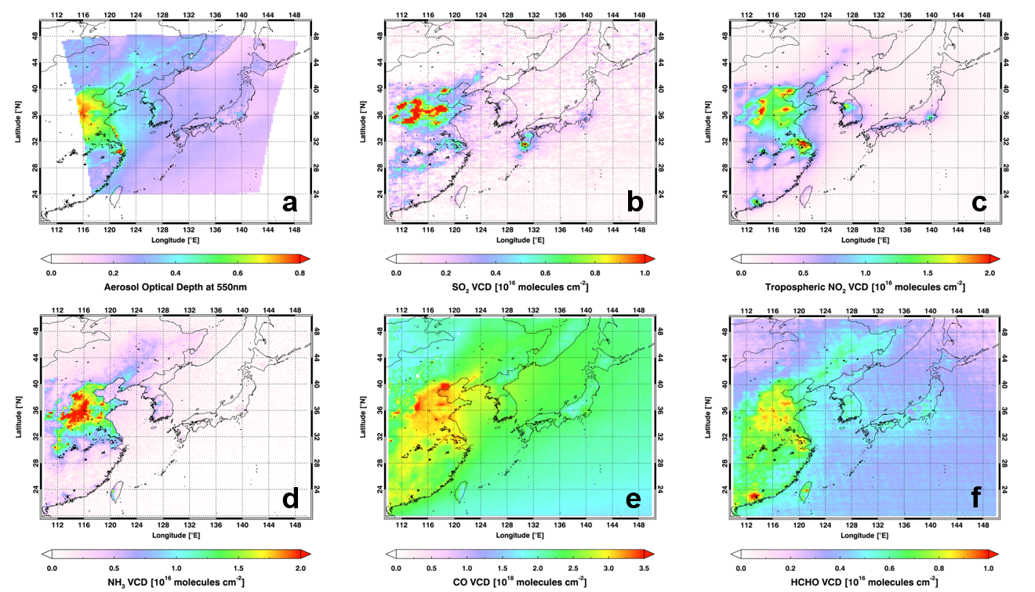
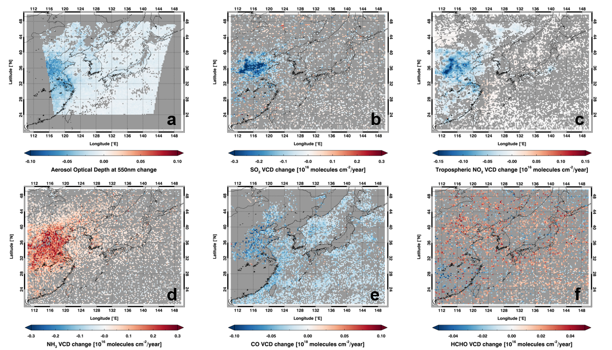
High ozone over Korea and China due to high emissions of NO_{x} and VOCs
NO_{x} from fuel combustion
VOCs from leaks, industry, domestic products
Satellite NO₂
2011-2019
Satellite HCHO
2011-2019
NO₂ trend
2011-2019
HCHO trend
2011-2019
NO_{x} emissions have decreased while urban VOC emissions have increased
Ahn et al., submitted

Slide 11
How does ozone production depend on NO_{x} and VOCs?
Need to understand chain mechanism
hydrogen oxide radicals: HO_{x} ≡ OH + HO₂
nitrogen oxide radicals: NO_{x} ≡ NO + NO₂
Oxidation of VOCs and CO catalyzed by
Initiation: production of HO_{x} radicals
Propagation: cycling of HO_{x} and NO_{x} radicals to produce ozone
Termination: loss of HO_{x} radicals
(both in gas phase and in aerosol)

Slide 12
Dependence of ozone and OH on NO_{x} and VOCs
HO₂ in this diagram denotes the ensemble of peroxy radicals including RO₂
View CO as just another VOC
hν
NO₂
NO
O₃
hv, H₂O
self, PM
OH
HO₂
H₂O₂
VOC
HNO₃
Two distinct chemical regimes depending on the chain-terminating pathway

Slide 13
Dependence of ozone and OH on NO_{x} and VOCs
hν
NO₂
NO
O₃
hv, H₂O
self, PM
OH
HO₂
H₂O₂
NO_{x}-limited regime:
O₃ ↑ as NO_{x}↑ PM ↓
VOC

Slide 14
Dependence of ozone and OH on NO_{x} and VOCs
hν
NO₂
NO
O₃
hv, H₂O
OH
HO₂
VOC-limited regime:
O₃ ↑ as VOCs↑ NO_{x}↓
VOC
HNO₃

Slide 15
Dependence of ozone and OH on NO_{x} and VOCs
hν
NO₂
NO
O₃
hv, H₂O
self, PM
OH
HO₂
H₂O₂
NO_{x}-limited regime
VOC-limited regime
VOC
HNO₃
O₃
NO_{x}-limited
NO_{x}-limited
O₃
O₃
NO_{x}-limited
VOC-limited
VOC-limited
NO_{x}
VOCs
PM

Slide 16
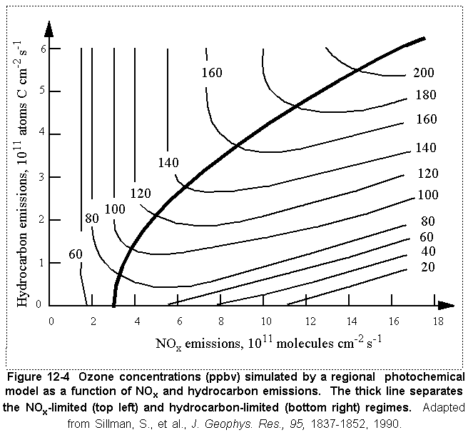
Ozone (ppb) vs. NO_{x} and VOC emissions
Generic model calculation
NO_{x}-limited regime
Ridge
VOC-limited
regime
Polluted air
clean
air
VOC
Ozone production in clean air is NO_{x}-limited
Ozone production in polluted air tends to be NO_{x}-limited in summer, VOC-limited in other seasons
Decreasing PM could explain summertime ozone increase in China

Slide 17
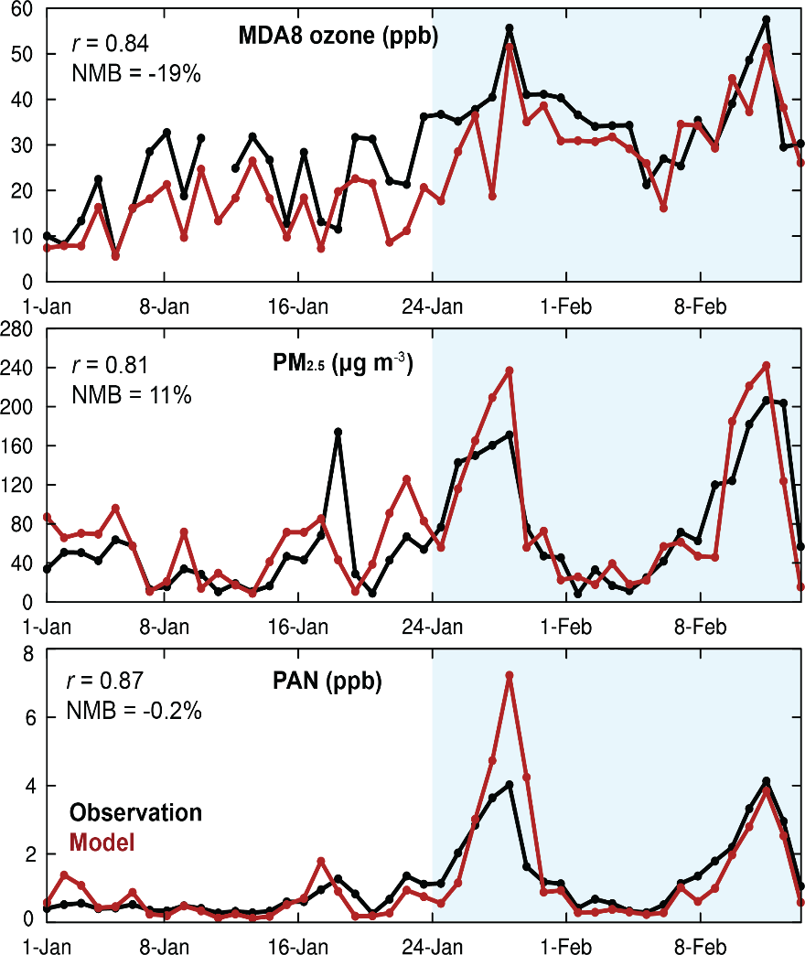
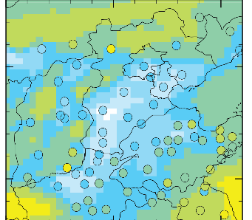
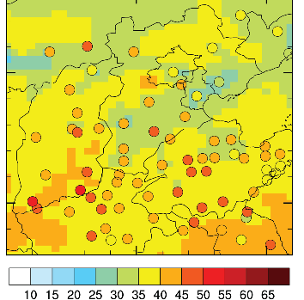
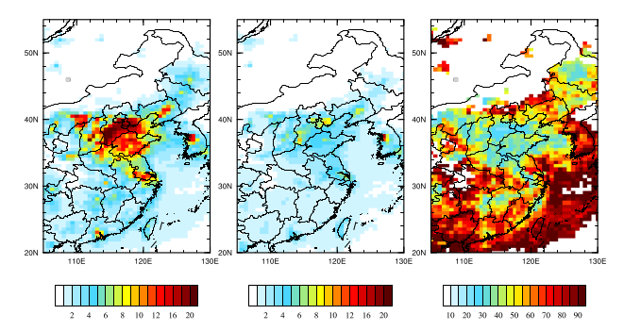
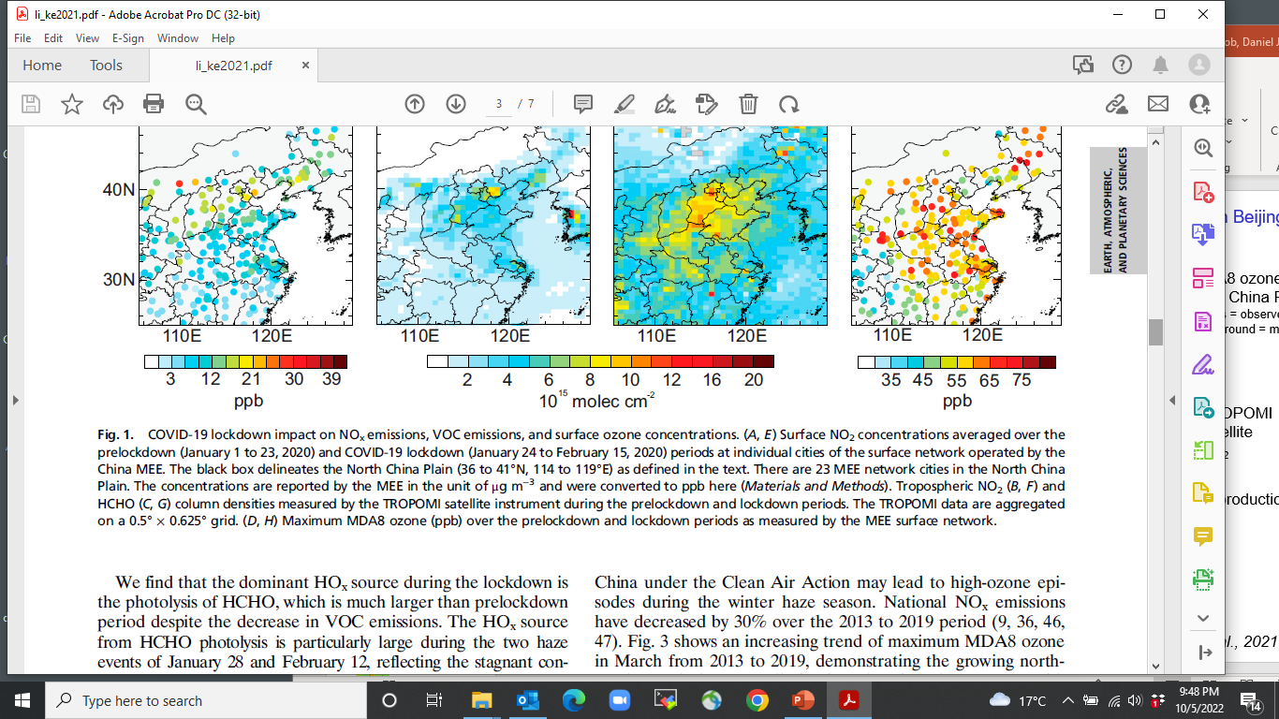
COVID-19 lockdown reveals fast wintertime ozone production in Beijing
Beijing observations and model
before Jan 24 after Jan 24
MDA8 ozone
in N China Plain
circles = observed, background = model
MDA8 ozone
PM_{2.5}
TROPOMI satellite NO₂
NO_{x} emissions decreased by 70% during lockdown, causing ozone production to surge under strongly VOC-limited conditions
Formaldehyde from VOCs provides the main HO_{x} radical source:
Observations
Model
PAN
Li et al., 2021

Slide 18
Decreasing NO_{x} emission in China drives ozone pollution spread to early spring
As NO_{x} emissions decrease, ozone production under VOC-limited conditions increases
Very high VOC emissions in China drive high ozone pollution as early as March
Li et al. [2021]

Slide 19
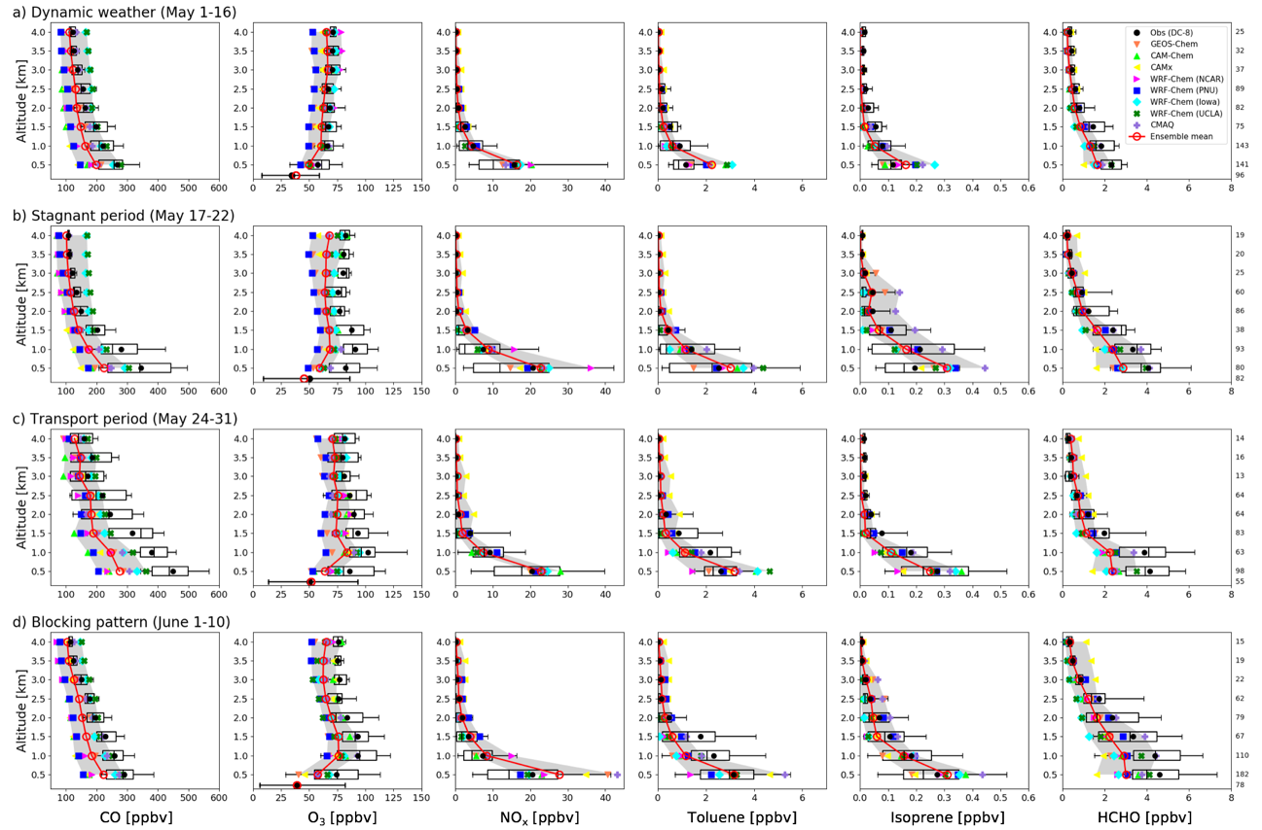
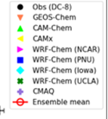
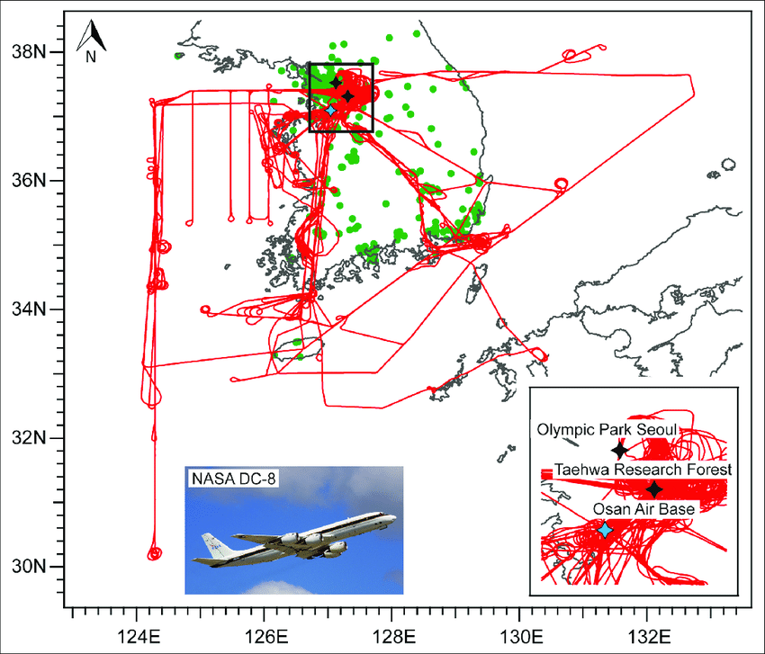
KORUS-AQ aircraft campaign targeted at air quality over Korea
Flight tracks, May-June 2016
Stagnant period (May 17-22)
AirKorea AQ network
Transport from China period (May 24-31)
Ozone, ppb
Models systematically underestimate ozone including the high-altitude background
Park et al. [2021]

Slide 20
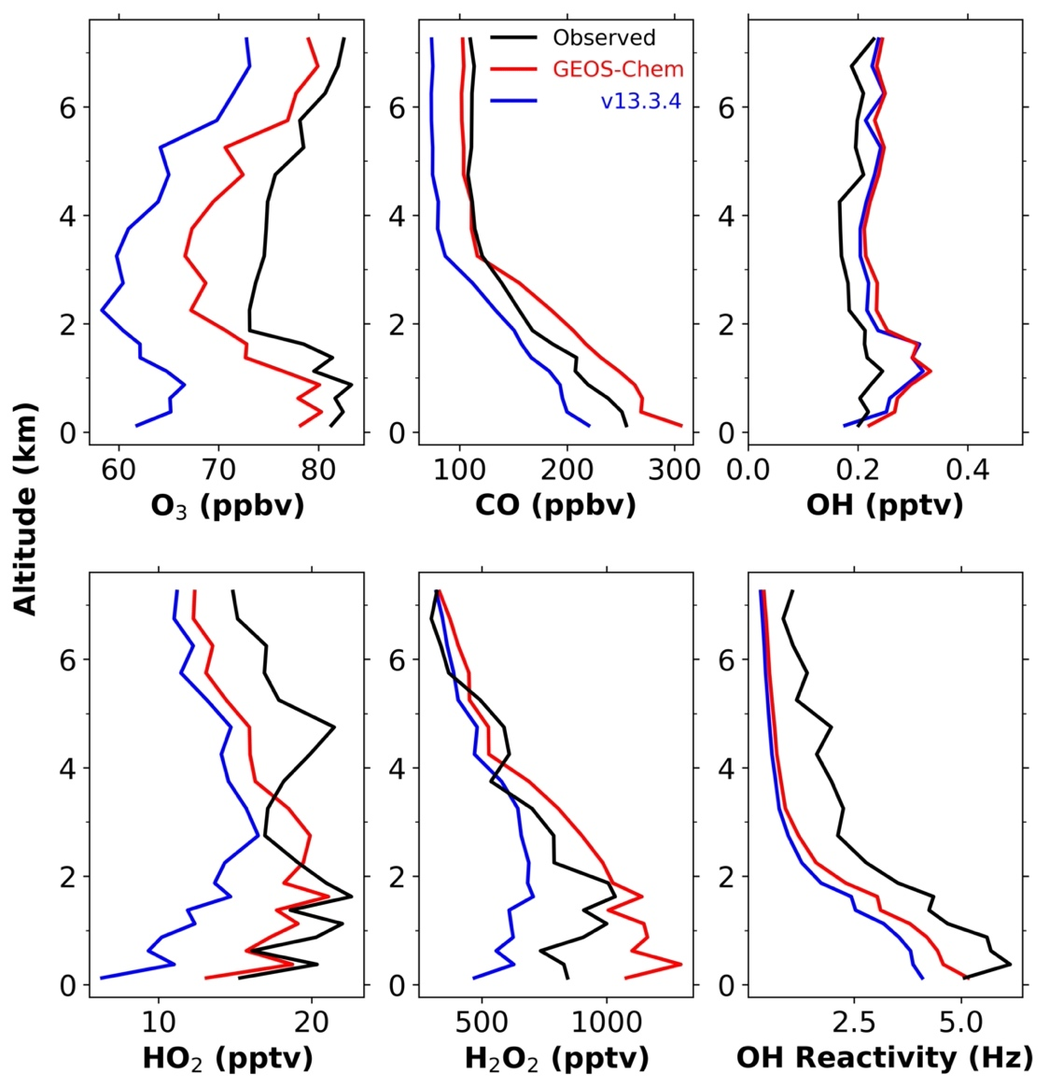
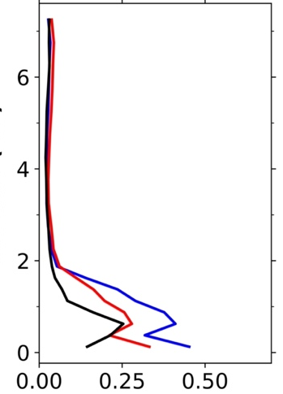
GEOS-Chem updates improve KORUS-AQ ozone simulation
Median vertical profiles
Observed
GEOS-Chem
old version 13.3
Altitude, km
Ozone, ppb HO₂, ppb NO, ppb
Inclusion of nitrate photolysis (NO₃⁻ + hv → 0.5 NO₂ + 0.5 HONO) corrects ozone background
Slowdown of HO₂ aerosol uptake, including volatile chemical product (VCP) emissions corrects HO₂ and increases ozone production in boundary layer
Yang et al.,. In prep.

Slide 21
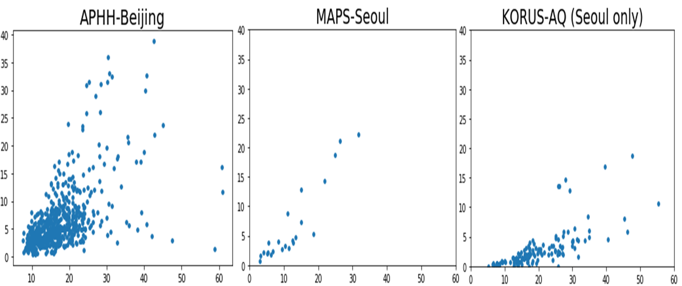
Evidence of very high residential use of volatile chemical products (VCPs) in Korea and China
Ethanol (ppb)
Methanol (ppb)
Methanol (ppb)
Methanol (ppb)
Ethanol is common tracer of residential VCPs; very high in Korea and China
Methanol is highly correlated with ethanol – also used in VCPs?
These emissions are not in current inventories!
Including US-based residential VCP emission factors cannot match the China and Korea data
Beaudry et al., in prep.

Slide 22
GEOS-Chem simulates ozone network and sonde data with minimal bias
90th percentile MDA8 ozone
(circles = network sites, background = GEOS-Chem)
Mean of daily ozonesondes over Seoul, May-June 2016
Seoul has broad maximum in May-August
High background confirmed by sondes
Colombi et al., in prep.

Slide 23
GEOS-Chem can also reproduce 2015-2019 ozone trend in Seoul
Maximum increase in spring due to NO_{x} decrease under VOC-limited conditions
Summer is more likely to be NO_{x}-limited
Colombi et al., in prep.

Slide 24
Sensitivity of ozone in Korea to anthropogenic emissions
GEOS-Chem 90th percentile MDA8 ozone in May
(all emissions)
East Asian background
(zero emissions in domain)
Background
+ ship emissions
Background
+ S. Korean emissions
Background
+ Chinese emissions
Korea and China emissions make comparable contributions to ozone over Korea
Very high East Asian ozone background prevents meeting a 60 ppb standard
Colombi et al., in prep.

Slide 25
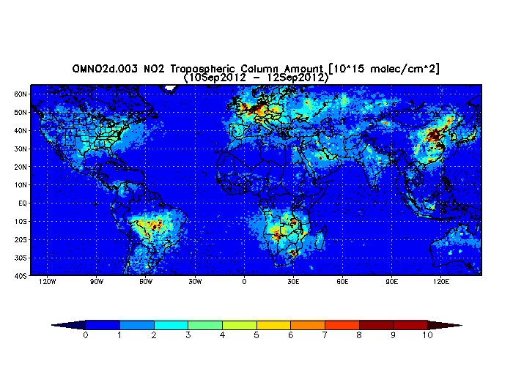
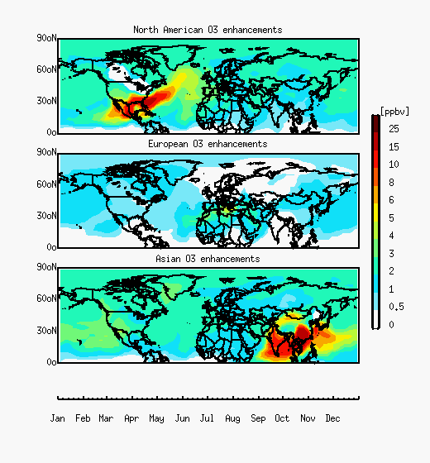
Need global perspective on ozone background and human influence
Satellite observations of NO₂ column, 10¹⁵ molecules cm⁻²
Strong westerlies,
1-month ozone lifetime
Ozone pollution transport by source continent (GEOS-Chem model)
N America
Europe
Asia

Slide 26
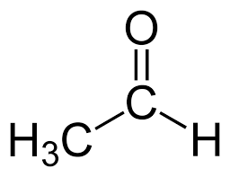
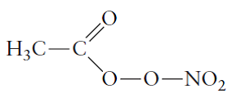

Peroxyacetylnitrate (PAN) as driver of human influence on ozone background
+ OH
acetaldehyde
(also methylglyoxal, acetone)
peroxyacetyl radical
PAN
PAN lifetime: 1 h at 295K
1 month at 250K
Subsidence over E Pacific:
Large ozone production
PAN
PAN gNO_{x}
PAN
Asian
boundary
layer
NO_{x}
U.S.
boundary
layer
HNO₃
E. Asia Pacific United States

Slide 27
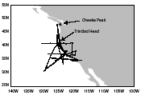
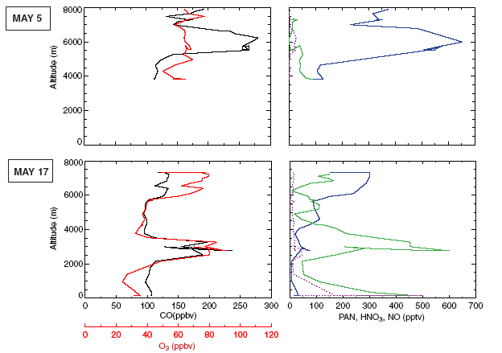
Evidence for the importance of PAN in intercontinental ozone pollution
Aircraft observations of Asian plumes transported over California
May 5 plume at 6 km:
High CO and PAN,
no O₃ enhancement
CO
PAN
O₃
HNO₃
NO_{x}
PAN
May 17 subsiding
plume at 2.5 km:
High CO and O₃,
PAN gNO_{x}gHNO₃
O₃
HNO₃
CO
NO_{x}
Hudman et al. [2004]

Slide 28
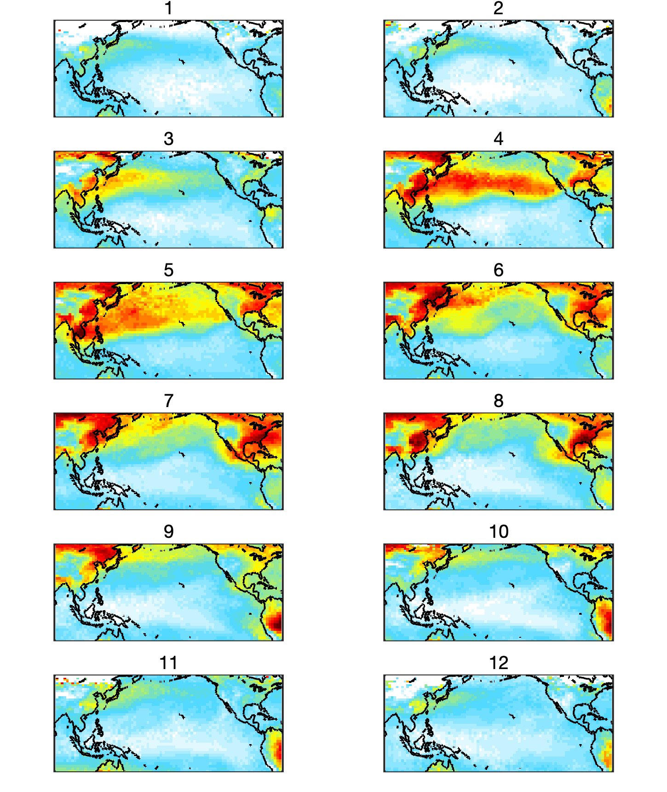
IASI satellite observations of PAN over Pacific: large transpacific influence in spring
Spring has active photochemistry combined with strong westerly winds
Increasing pollution in Southeast Asia may also contribute
Zhai et al., in prep.

Slide 29
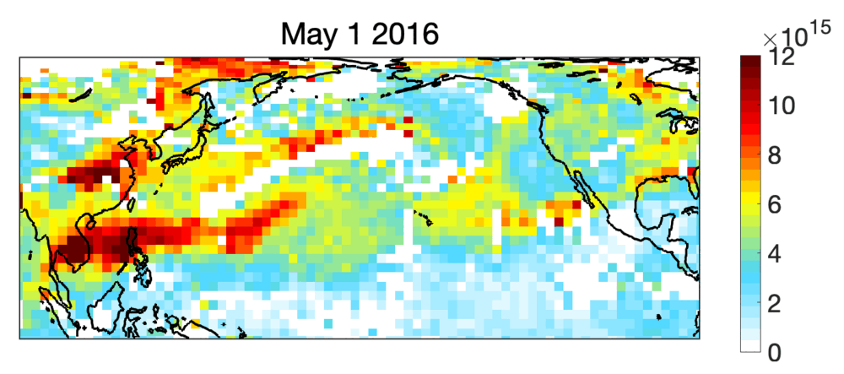
Daily IASI PAN from Metop-A: day to day animation
Molec cm⁻²
Zhai et al., in prep.

Slide 30
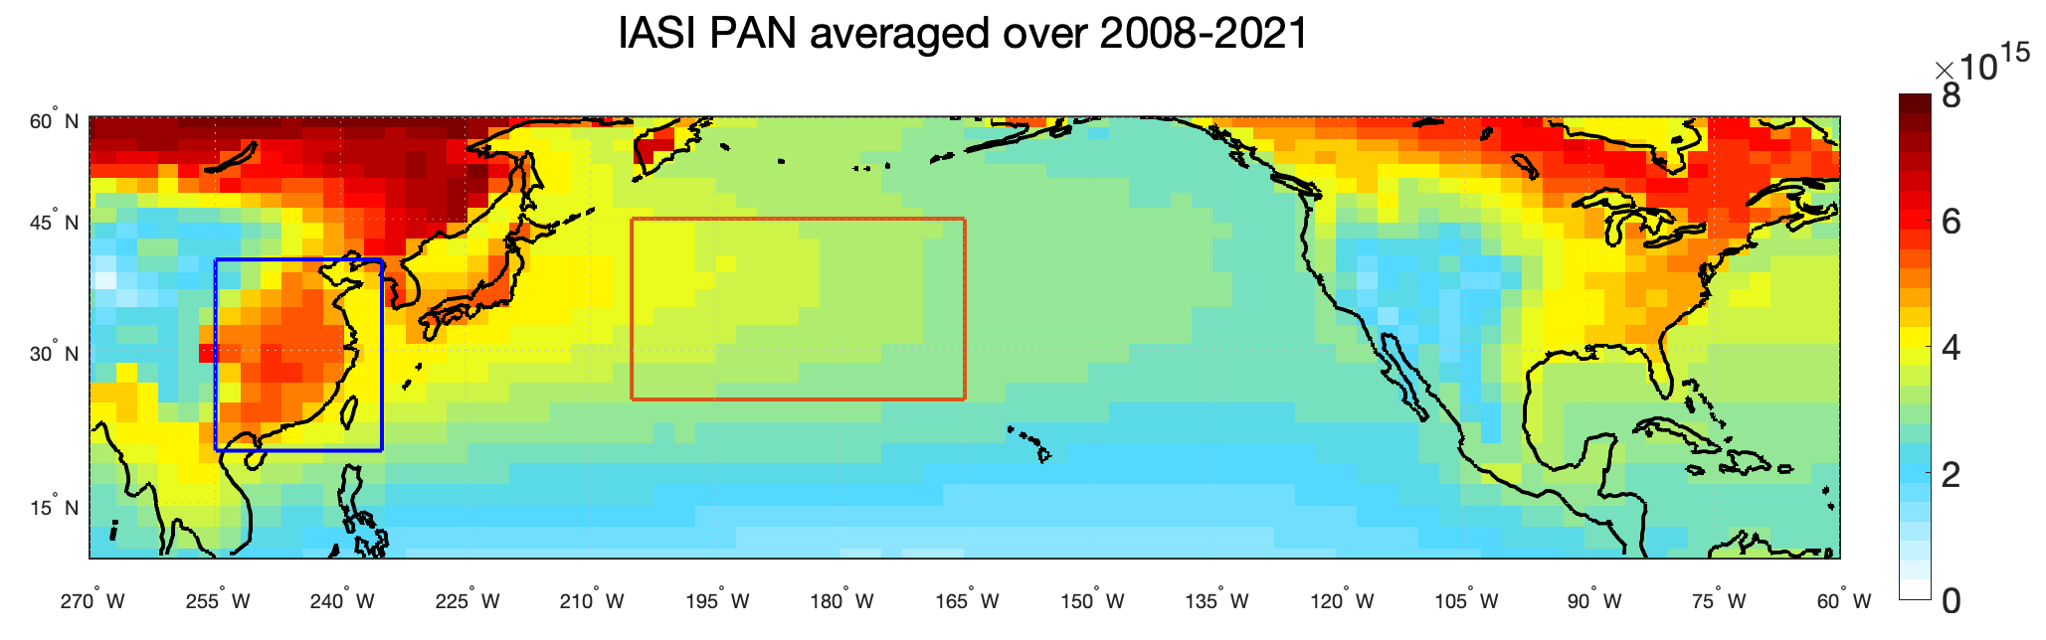
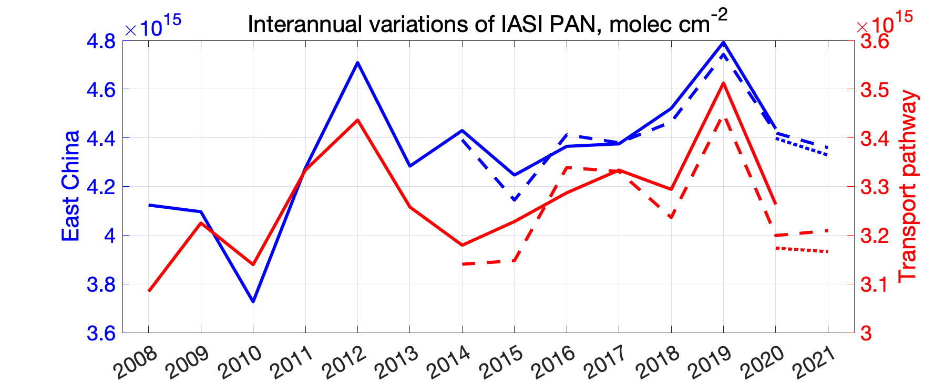
Rising PAN has implications for rising ozone background
molec cm⁻²
Transport pathway
East China
molec cm⁻²
MetopA
MetopB
MetopC
Zhai et al., in prep.

Slide 31
Take-away messages
Ozone pollution is very high and increasing in Korea and China
High ozone reflects NO_{x} and VOC emissions on top of a very high background
Increasing ozone over Korea is driven by declining domestic NO_{x} emissions under VOC-limited conditions
The Korean air quality standard of 60 ppb cannot be met unless the East Asian background decreases
Importance of ozone background requires a global perspective on ozone pollution, including the complex role of PAN.

Slide 33
Same basic mechanism for VOC oxidation but many branches
RO₂ can also
isomerize, or react with HO₂ or RO₂,
producing peroxides, epoxides,
alcohols,
carboxylic acids…
OH can also add to double bonds of unsaturated VOCs, producing hydroxyorganics
NO can also add to produce organic nitrates
RO can also decompose or isomerize to produce a range of aldehydes, ketones, dicarbonyls…
Oxidation product goes on to react with OH, adding functionality and making more ozone

Slide 34
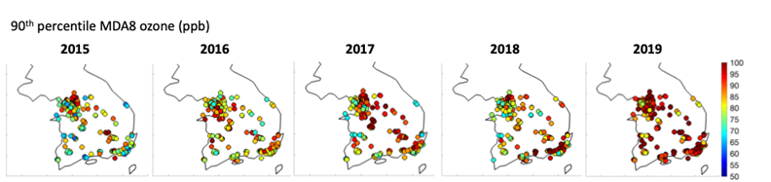
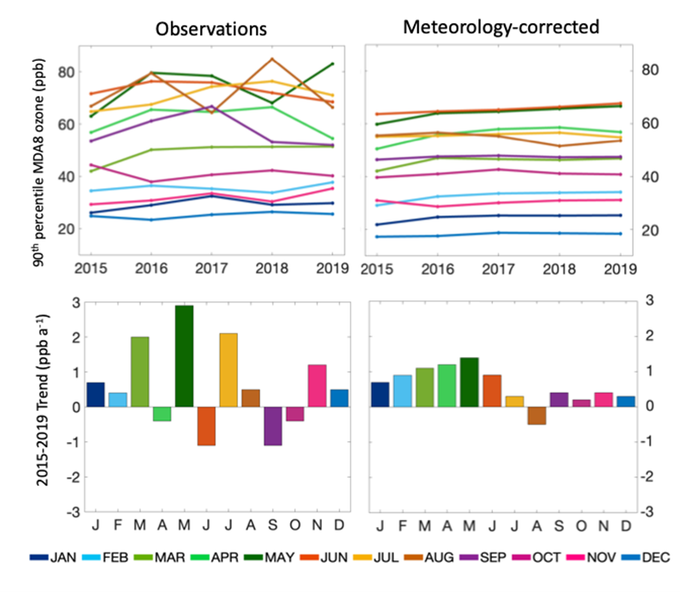
2015-2019 ozone increase in Korea
Meteorology-corrected ozone trend in Seoul
NO_{x} emissions in S. Korea decreased by 20% from 2015 to 2019 while VOCs and PM stayed flat.
Sharpest ozone increase in spring is consistent with VOC-limited conditions, influence from China
Colombi et al., in prep.

Slide 35
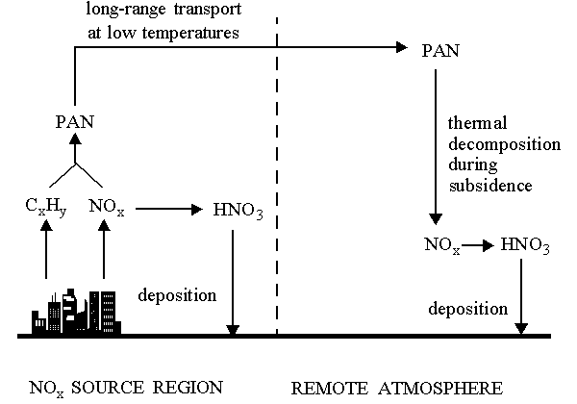
Peroxyacetylnitrate (PAN) as reservoir for intercontinental transport of NO_{x}
+ OH
acetaldehyde
(also methylglyoxal, acetone)
peroxyacetyl radical
PAN
PAN lifetime: 1 h at 295K
1 month at 250K
VOC

Slide 36
Ozone air quality standards (AQS) around the world
S. Korea AQS
Europe AQS
Canada AQS
Europe AQS
(seasonal)
U.S. AQS
U.S. AQS
2014
2008
1997
0 20 40 60 80 100 120 ppb
China AQS
Preindustrial
ozone
background
Present-day ozone background at northern mid-latitudes
Ozone AQS can be designed to protect against short-term effects (morbidity), long-term effects (mortality), vegetation
Standards tend to be aspirational or practical, with different levels of enforcement
Increasing epidemiological studies are revealing adverse effects at lower thresholds
Unlike for other pollutants, adverse effects of ozone occur at concentrations only marginally higher than background

