Slide 1
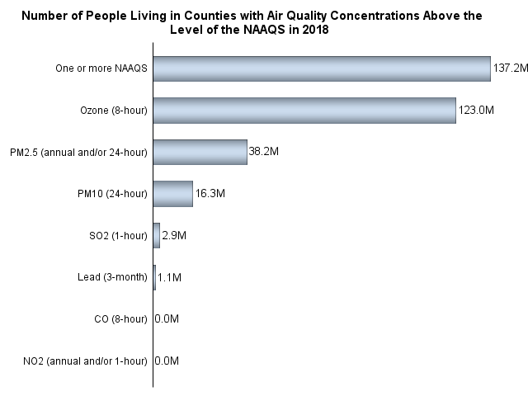
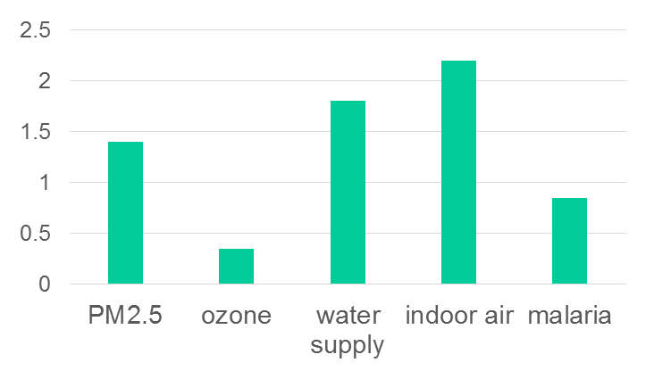
AIR POLLUTION TODAY:
Ozone and fine particulate matter (PM_{2.5}) are the major pollutants
US population exposed to air pollutants
in excess of national ambient air quality standards (NAAQS), 2018
Ozone
137M
70 ppb (8-h average)
38M
PM_{2.5}
31
12 µg m⁻³ (annual), 35 µg m⁻³ (24-h)
PM₁₀
16M
Million environmental deaths per year
worldwide
SO₂
3M
Lead
1M
CO
0
NO₂
0
2010 data
US EPA [2020], OECD [2012]

Slide 2
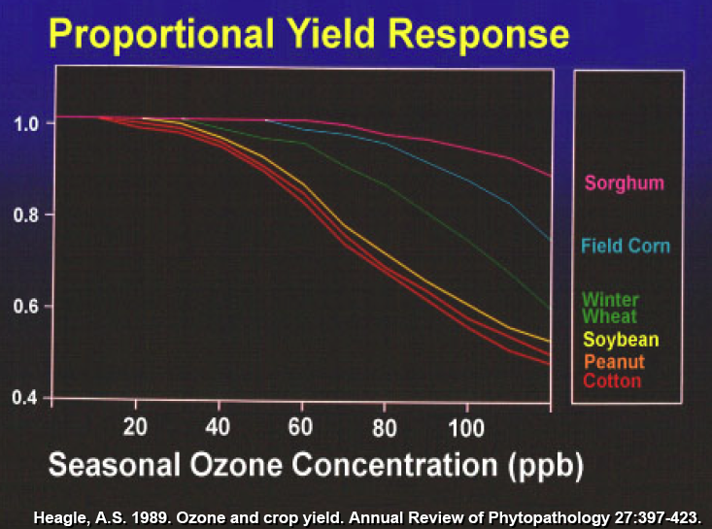
Ozone effect on crops
Many crops show decreased yield at ozone >40 ppb

Slide 3
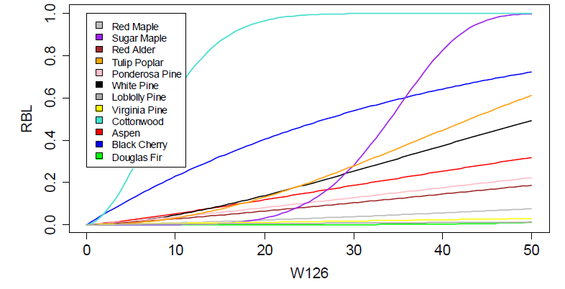
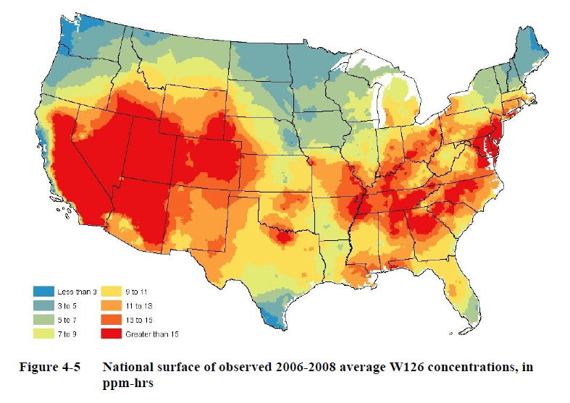
Ozone effect on trees
[EPA, 2014]
Relative biomass loss
W126 metric: weighted seasonal dose of ozone in excess of 60 ppbv
W126, ppm h
proposed secondary standard:
W126 = 7-15 ppm h
W126 ozone for 2006-2008

Slide 4
Ozone air quality standards in the US and in the world
Europe AQS
(8-h avg.)
Canadian AQS
(8-h avg.)
Europe AQS
(seasonal)
U.S. AQS
(8-h avg.)
U.S. AQS
(1-h avg.)
2014
2008
1997
0 20 40 60 80 100 120 ppb
China AQS
(8-h avg.)
Preindustrial
ozone
background
Present-day ozone background at northern mid-latitudes

Slide 5
Days per year exceeding 70 ppb ozone standard, 2010-2014
TOAR [2017]

Slide 6
Very severe ozone pollution problem in China
revealed by air quality network observations starting in 2013
US
air quality standard
China
air quality standard
Li et al. [2019a]

Slide 7
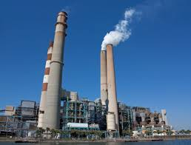


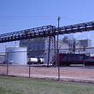

Controlling ozone pollution requires understanding of whether ozone production is NO_{x}- or VOC-limited
This is because anthropogenic sources are different:
NO_{x} is from fuel combustion
VOCs are from leaks, industry, domestic products

Slide 8
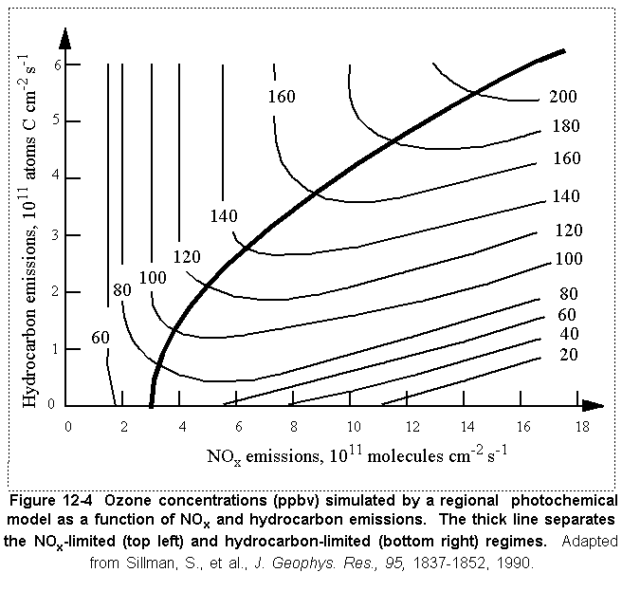
Until 2000s, ozone production in US was thought to be VOC-limited…
NO_{x}-limited regime
Typical
anthropogenic
emission inventory
estimate
VOC-limited regime
VOC
…motivating strategy of VOC emission controls

Slide 9
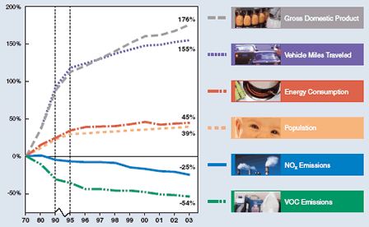
1970-2003 trend of US emissions
Focus until 2000s was on VOC controls,
but ozone was not decreasing except in
Los Angeles and New York. Why?
1980-1995 trend in summer ozone (ppb a⁻¹)
Fiore et al. [1998]

Slide 10

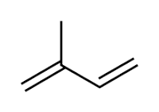
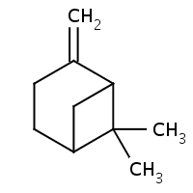
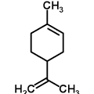
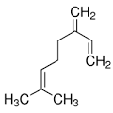
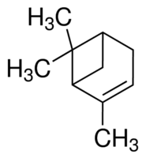


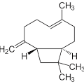
Emission of biogenic VOCs first quantified in late 1980s
Many, many compounds emitted as photosynthesis and metabolism by-products, insect attractors or repellents, response to stress and injury
Principal hydrocarbons are emitted as C₅H₈ units:
Isoprene (C₅H₈)
50% of total biogenic VOCs
very reactive
Terpenes (C₁₀H₁₆)
α-pinene
β-pinene
Limonene
Myrcene
Sesquiterpenes (C₁₅H₂₄)
Pat Zimmerman
Caryophyllene

Slide 11
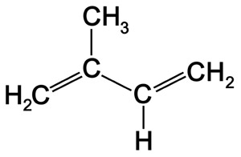
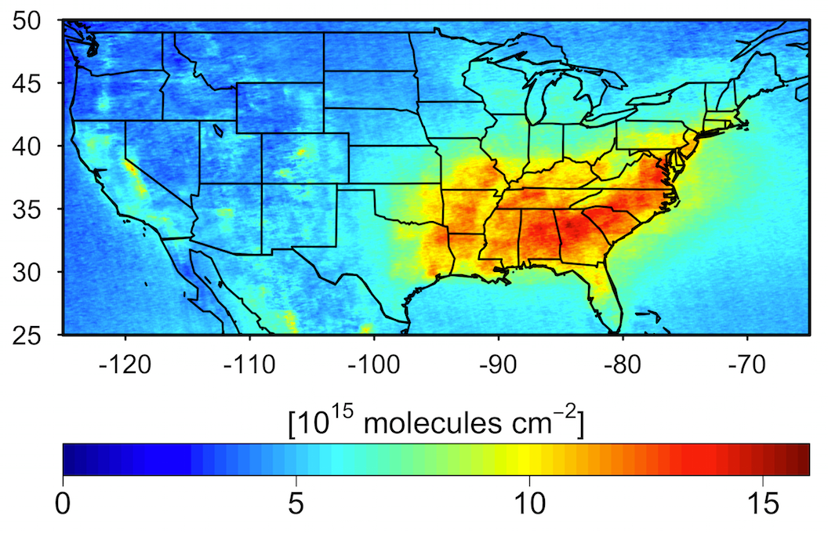
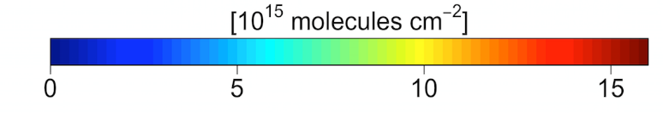
Most of US is NO_{x}-limited due to high emissions of biogenic isoprene
isoprene
oxidation
hν , OH
HCHO
~ 1 hour
~ 1 hour
Other VOCs
OMI satellite observations of formaldehyde (HCHO) columns, May-Aug 2005-2014
Zhu et al. [2017]

Slide 12
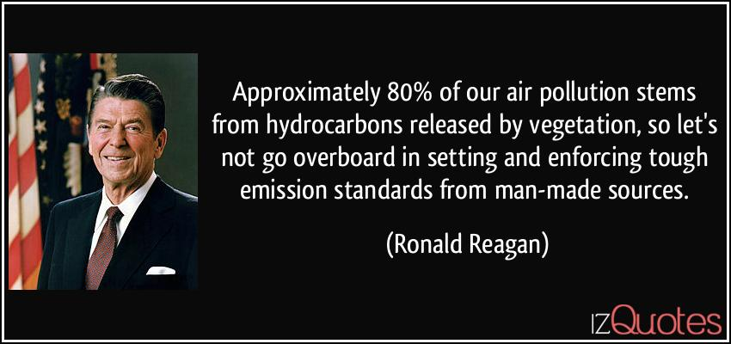

Slide 13
But what this really means is that ozone production is NO_{x}-limited
total
emissions
NO_{x}-limited regime
anthropogenic
emissions
+ biogenic emissions
VOC-limited regime
VOC
…so emission controls should focus on NO_{x}

Slide 14
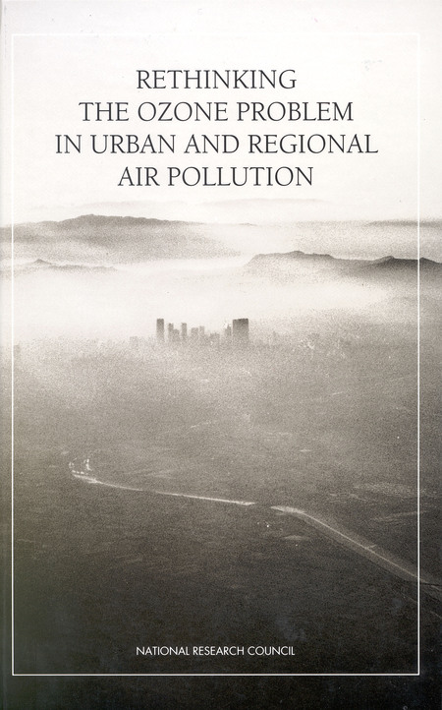


Rethinking the ozone problem (NRC, 1991)
Tells EPA that ozone is a regional pollution problem, advises NO_{x} emission controls
John Seinfeld
Jennifer Logan

Slide 15
US NO_{x} emissions have decreased by 54% from 2000 to 2016
2000
2016
Power
39% plants
Mobile 56%
26%
57%
4% Industry
(non-power plant)
13%
US EPA, National Emission Inventory (NEI) 2011
Notes:
TRANSITION: in order to monitor these changes in surface emissions we look to satellite observations

Slide 16
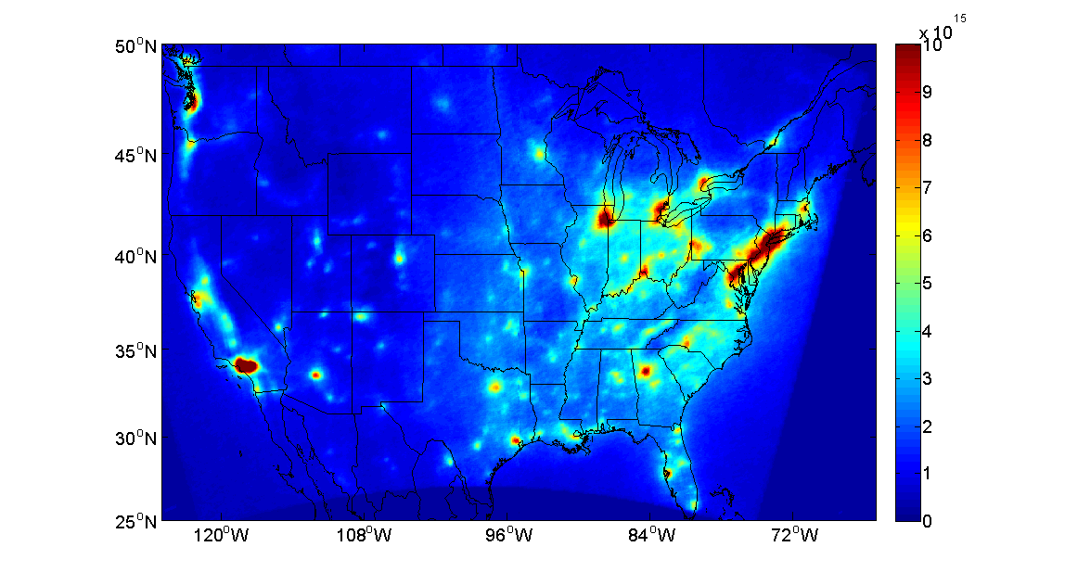
Evidence of NO_{x} emission decrease from satellite NO₂ data
OMI NO₂, summer 2005
Russell et al. [2012]

Slide 17
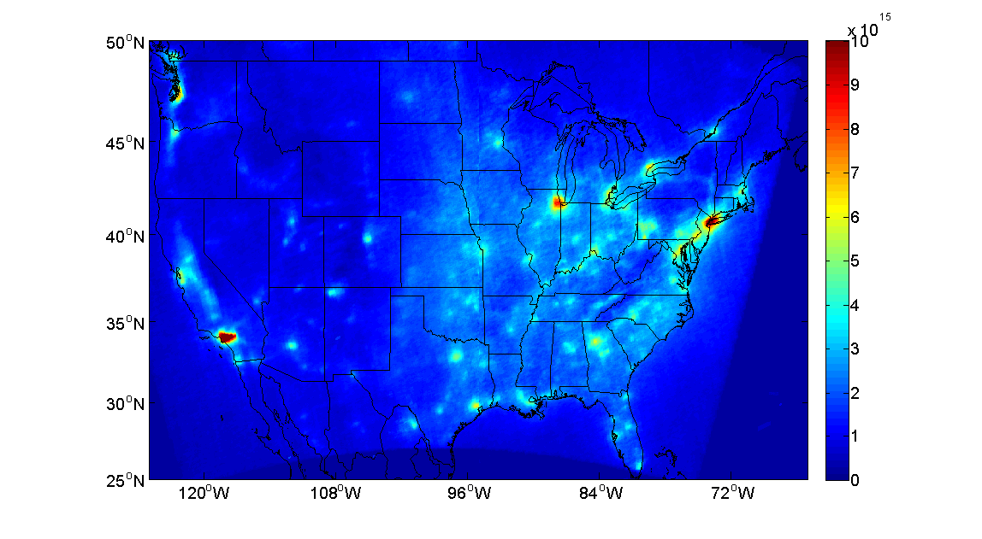
Evidence of NO_{x} emission decrease from satellite NO₂ data
OMI NO₂, summer 2011
OMI NO₂, summer 2005
30% decrease in NO_{x} emissions from 2005 to 2011
Russell et al. [2012]

Slide 18

Take it from the communicator-in-chief…

Slide 19
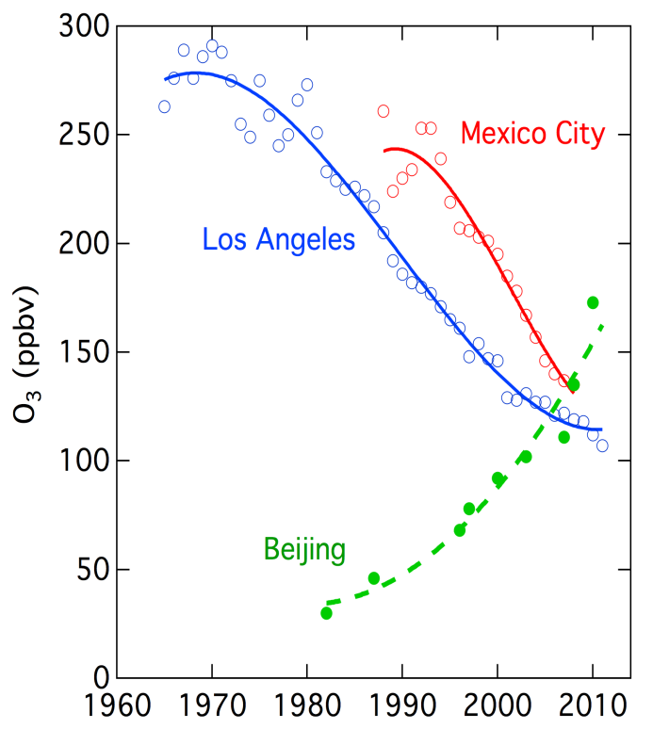
Trend in #days/year with ozone > 70 ppb, summer 2000-2014
Megacity trends
Parrish [2014], TOAR [2017], Wang et al. [2017]

Slide 20
Ozone production efficiency (OPE) per unit NO_{x} emitted
VOC
HO₂
OH
HNO₃
NO
NO₂
hv
O₃
Emission
Deposition
OPE ↑ as OH ↓ and therefore as NO_{x} ↓ and VOC ↑
So the efficacy of NO_{x} emission controls decreases as NO_{x} decreases

Slide 21
Ozone in China has been increasing despite Clean Air Action starting in 2013
Emission controls have been targeted (successfully!) at PM_{2.5}
NO_{x} emissions have decreased by 30% since 2013 while VOC emissions have stayed flat.

Slide 22
Unlike in US, ozone production in China is VOC-limited
OMI annual mean tropospheric column data, 2006-2007
Glyoxal (CHOCHO) Formaldehyde (HCHO) NO₂
(440-460 nm) (340-360 nm) (420-450 nm)
NO_{x} emissions are very high and VOC emissions are largely anthropogenic
Chan Miller et al. [2016]

Slide 23

Decrease in PM_{2.5} pollution may be responsible for increase in ozone
Sunlight
H₂O
particles
particles scavenge HO₂ radicals that would otherwise produce ozone
HO₂ radicals
Nitrogen oxides (NO_{x})
Organics (VOCs)
Ozone
Model increase in ozone due to PM changes
2013-2017 decrease in PM_{2.5}
increases radicals for ozone production
Li et al. [2019a]

Slide 24
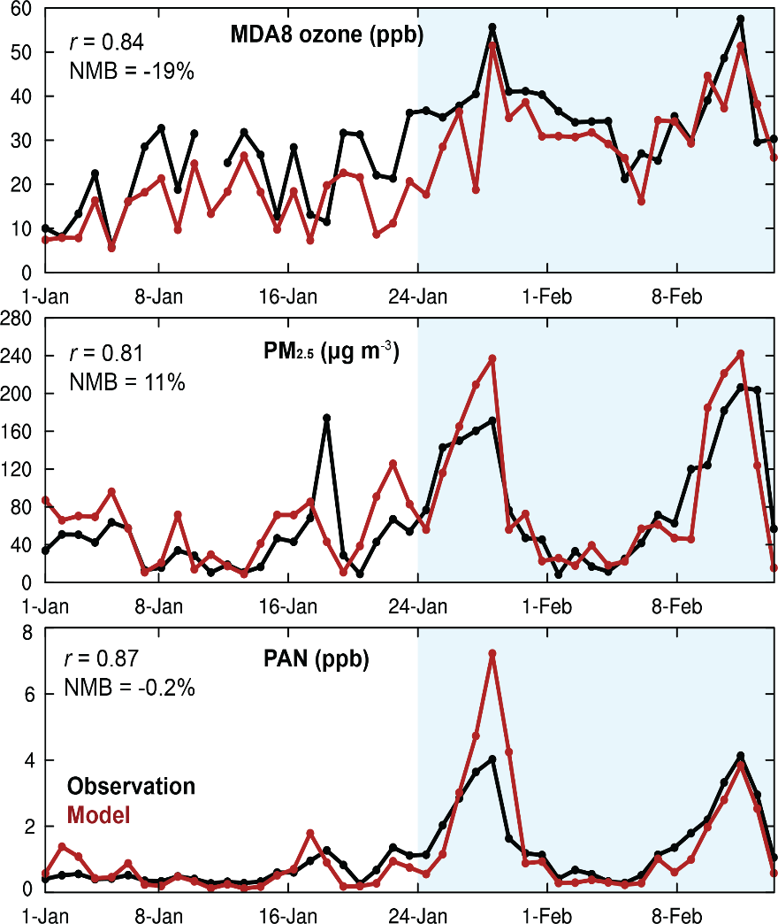
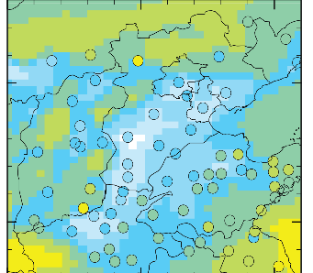
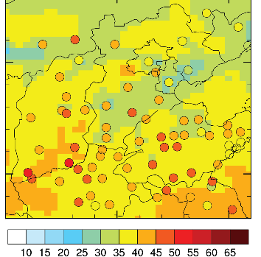
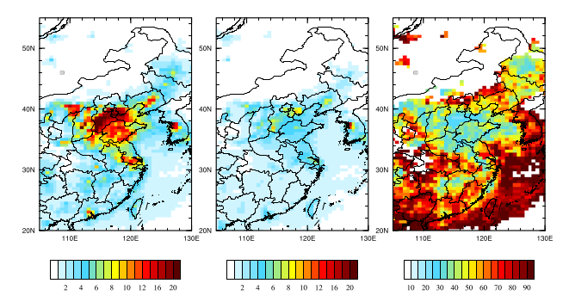
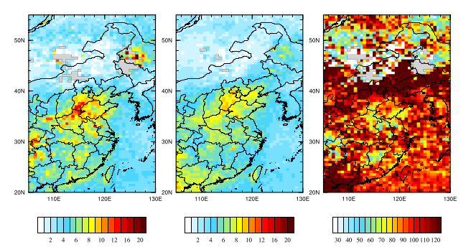
COVID-19 lockdown reveals fast wintertime ozone production in Beijing
Beijing observations and model
before Jan 24 after Jan 24
MDA8 ozone
in N China Plain
MDA8 ozone
PM_{2.5}
TROPOMI NO₂
TROPOMI HCHO
Observations
Model
PAN
As NO_{x} emissions decrease during lockdown, ozone production surges
Formaldehyde from VOCs provides the main radical source:
Li et al., 2021

Slide 25
NO_{x} controls are needed to meet current ozone standards … even if production is locally VOC-limited
NO_{x}-limited regime
start point
Natural NO_{x} background
VOC-limited regime
Biogenic VOC background
VOC
VOC controls will only get you so far until you are limited by biogenic background
NO_{x} controls are only way to get to current ozone standards and have side benefits
(NO₂ air quality, nitrogen deposition)

Slide 26
As ozone standard tightens, the nature of the problem changes
Seasonal dose in excess of 60 ppb [EPA, 2014]
60 ppb exceedances are largest in Intermountain West

Slide 27
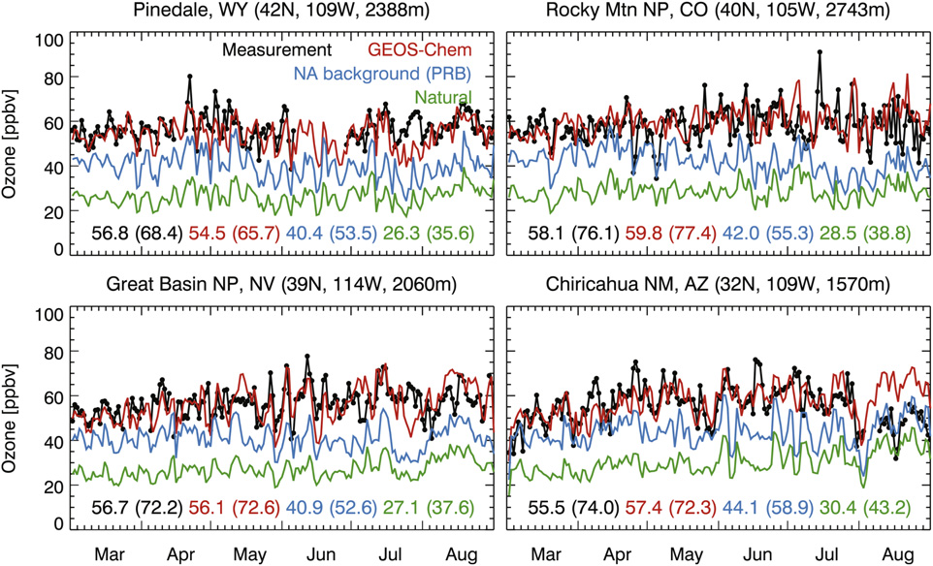
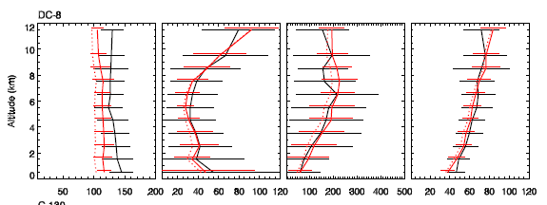
Ozone in Intermountain West originates out of N America
Background = ozone present in absence of anthropogenic sources in North America
observed
GEOS-Chem model
Mean profile over NE Pacific,
Apr-May 2006 (INTEX-B)
Pinedale, Wyoming
2.4 km altitude
Ozone over NE Pacific
(INTEX-B, Apr-May 2006)
observed
GEOS-Chem
MDA8 ozone, ppb
Altitude, km
GEOS-Chem background
downwelling
GEOS-Chem natural
2006
Ozone, ppb
Domestic emissions have little influence on intermountain west
Anthropogenic background contributes ~15 ppb with little day-to-day variability
Zhang et al. [2014]

Slide 28
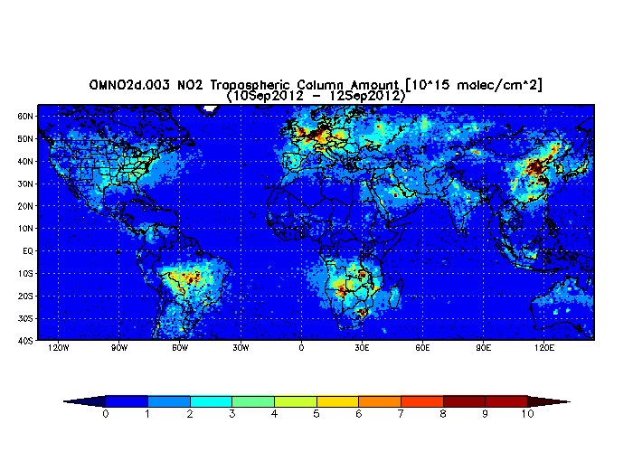
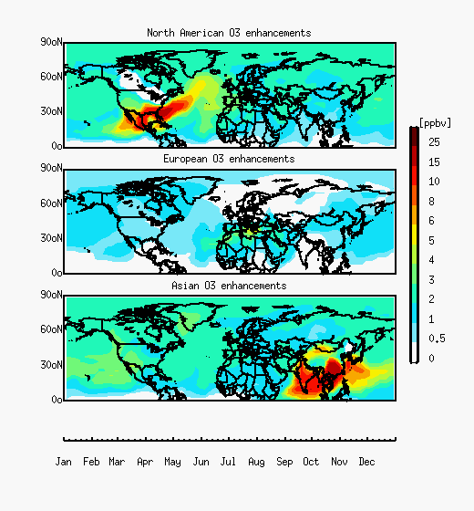
Intercontinental transport of ozone pollution
2012 OMI NO₂ column, 10¹⁵ molecules cm⁻²
Strong westerlies
transport ozone
around mid-latitudes
Ozone pollution transport (GEOS-Chem model)
N America
Europe
Asia

