Slide 1
Introduction: overview of atmospheric structure, radiation, circulation
Basic reading: chapters 1, 2, 4, 7 of Jacob (1999)
Advanced reading: chapters 2 and 5.2 of Brasseur and Jacob (2017)

Slide 2
Measure of relative concentration: mixing ratio (mole fraction) C_{X} [mol mol⁻¹]
Total (wet) mixing ratio:
Dry mixing ratio:
Trace gas concentration units:
1 ppm = 1 µmol mol⁻¹ = 1x10⁻⁶ mol mol⁻¹
1 ppb = 1 nmol mol⁻¹ = 1x10⁻⁹ mol mol⁻¹
1 ppt = 1 pmol mol⁻¹ = 1x10⁻¹² mol mol⁻¹
trace
gases
Air also contains variable H₂O vapor (10⁻⁶-10⁻² mol mol⁻¹), aerosol particles,
and many other trace gases at < 1x10⁻⁶ mol mol⁻¹

Slide 3
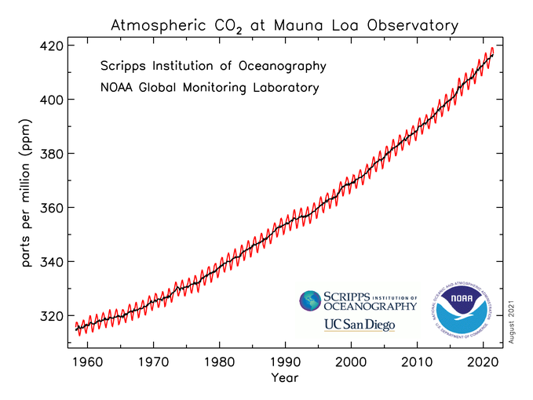
Conservation of mixing ratio
Total mixing ratio is not affected by changes in temperature, pressure
► it is conserved during atmospheric transport
Dry mixing ratio is not affected by water vapor condensation/evaporation
  ► it is conserved during processing of air by clouds
CO₂ concentration is reported as dry mixing ratio
Total (wet) mixing ratio would have fluctuations of ~1% simply from changes in water vapor
https://gml.noaa.gov/ccgg/trends/

Slide 4
Measure of absolute concentration [X]: mass or moles per unit volume of air
Number density n_{X} [molecules cm⁻³]
Proper measure of concentration for reaction rates
Proper measure for absorption of radiation by atmosphere
Number density and mixing ratio are related by the ideal gas law:
n_{a} = air number density
A = Avogadro’s number
p = pressure
R = Gas constant
T = temperature
M_{X}= molar mass of X [g mol⁻¹]
Mass concentration (μg m⁻³):
Commonly used for aerosol species

Slide 5
Gas-phase reaction rates depend on number densities
activated
complex
A
C
reactants
AB*
products
B
D
rate constant
product of number densities,
proportional to collision frequency

Slide 6
Absorption of radiation depends on column concentration
Radiation flux at top of atmosphere
Column
absorption proportional to n_{X}dz
dz
surface

Slide 7
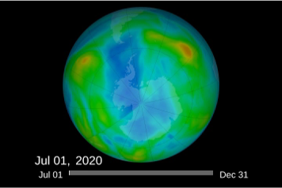

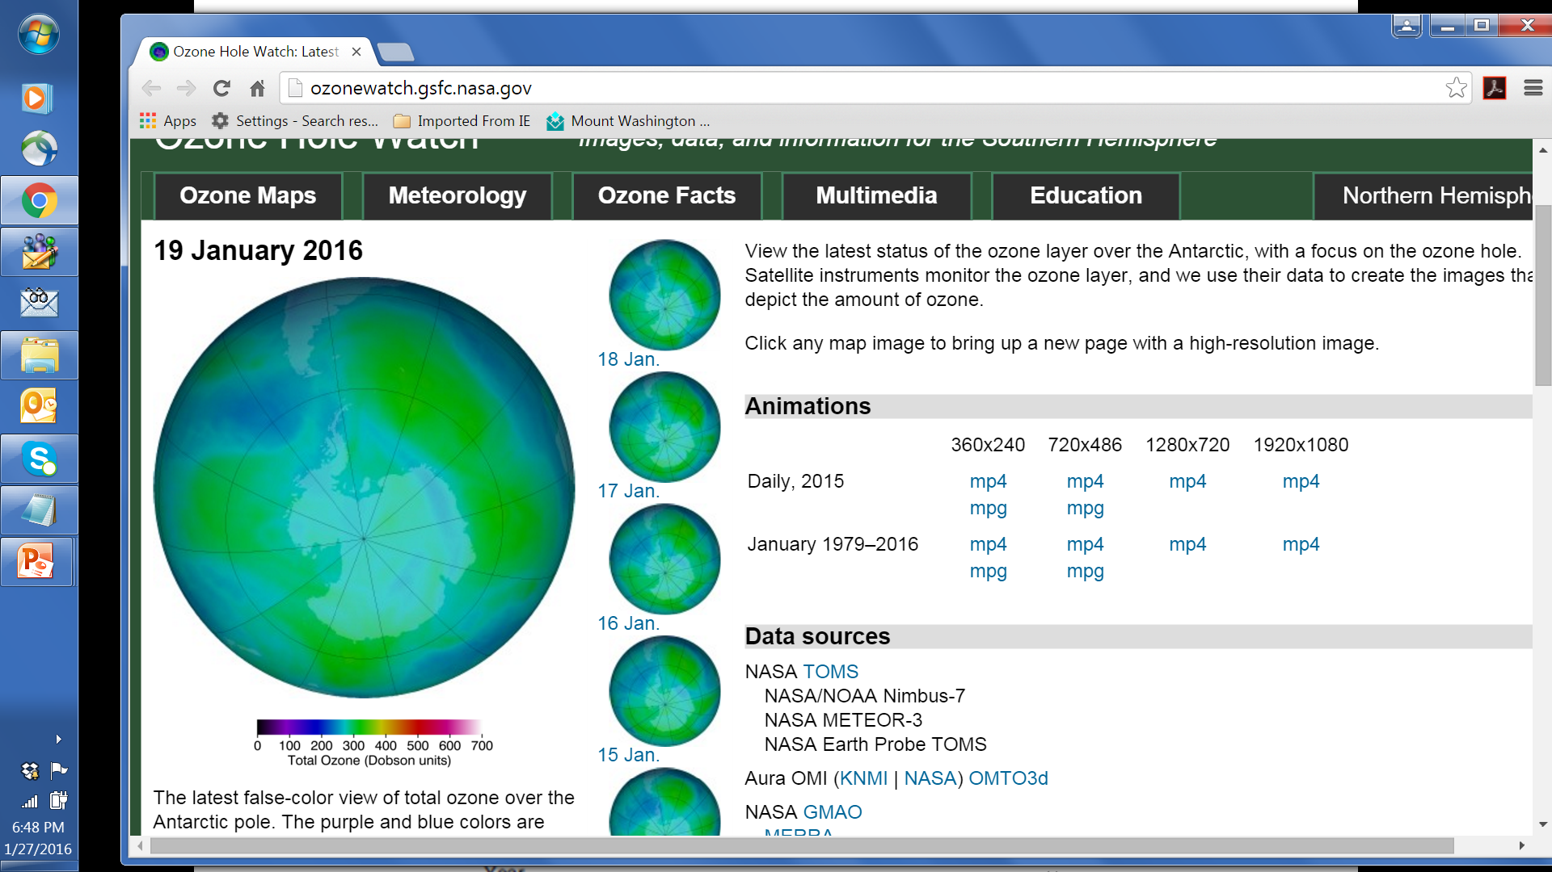
Monitoring the ozone column from satellite
http://ozonewatch.gsfc.nasa.gov/
Method: UV solar backscatter
Sun
λ₁
λ₂
Ozone layer
Reflection by
Earth surface
0
1 Dobson unit (DU) = 2.69x10¹⁶ molecules cm⁻²
Ozone
absorption
spectrum
Thickness of ozone layer is measured
as a column concentration
λ₁
λ₂

Slide 8
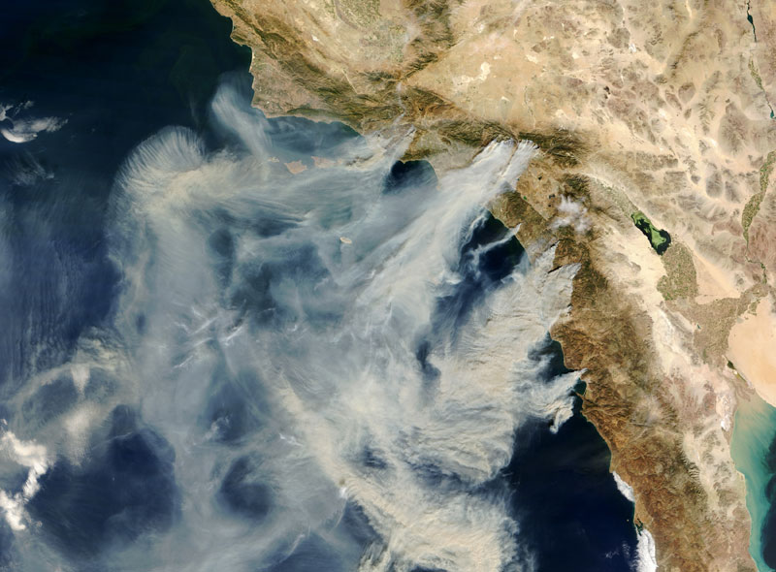
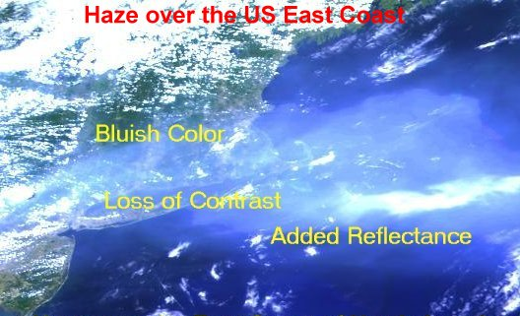
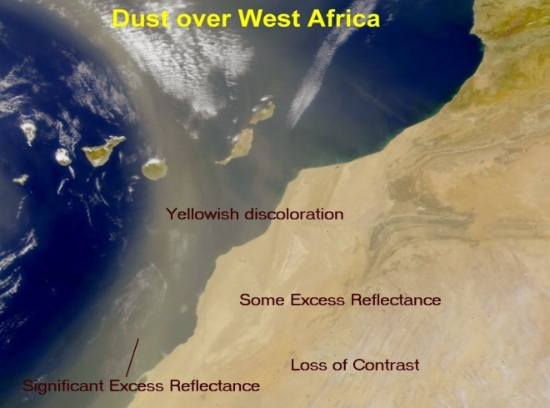
Atmospheric aerosol: suspension of condensed-phase particles in air
 | Mass concentration | Density | Fractional volume of atmosphere | Size | Number concentration
Aerosol | ~1 μg m⁻³ | ~1 g cm⁻³ | ~10⁻¹² | ~0.1 μm | ~1000 cm⁻³
Cloud | ~1 g m⁻³ | 1 g cm⁻³ | ~ 10⁻⁶ | 10 μm | ~1000 cm⁻³
Aerosols are the visible part of the atmosphere:
California fire plumes
Pollution off U.S. east coast
Dust off West Africa

Slide 9

Absolute concentration of gas can also be measured as partial pressure p_{x} [Pa]
The partial pressure p_{X} of a gas X in a mixture is the pressure that the gas would exert if all other gases in the mixture were removed.
Proper measure for phase change
(such as condensation of water vapor)
Dalton’s law
Thought experiment: consider a pan of water with a lid:
head space
T₁
p_{H2O} = p_{H2O,SAT}(T₁)
saturation vapor pressure
liquid water
Now heat the pan:
T₂ > T₁
p_{H2O} = p_{H2O,SAT}(T₂)
> p_{H2O,SAT}(T₁)

Slide 10
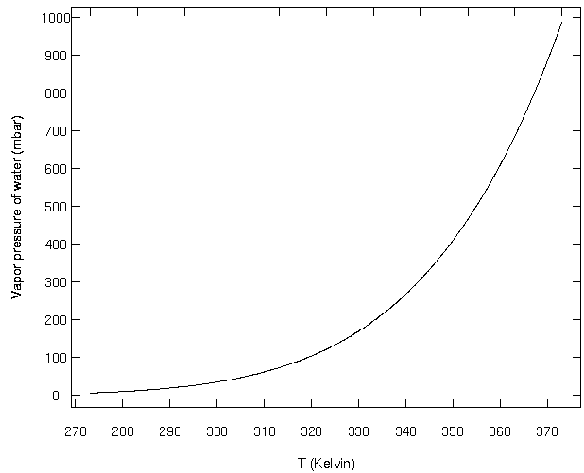
Clausius-Clapeyron equation: p_{H2O, SAT} = f(T)
A = 6.11 hPa
B = - 5310 K
T_{o} = 273 K
P_{H2O,SAT} (hPa)
T (K)
Notes:
DEMO: the freezing experiment. ask for student predictions.
Explain about nucleation of the bubbles. Why are bubbles formed in the liquid and what are they made from?
freezing: more energy in the ordered lattice, latent heat of "fusion" = 0.34 x 10⁶ J/kg (less than evaporation, but still considerable).
relate to boiling – what is boiling?
condensation—as in a shower stall. Is heat released on condensation?
To evaporate 1 kg of ice, 2.26 + .34 = 2.6 kJ/kg.
Clausius-Clapeyron relationship—
P_{sat} = A exp [B( 1/273.15 – 1/T)] A=6.11 mbar, B= 5308K. A=water vap. pressure at 0C.

Slide 11
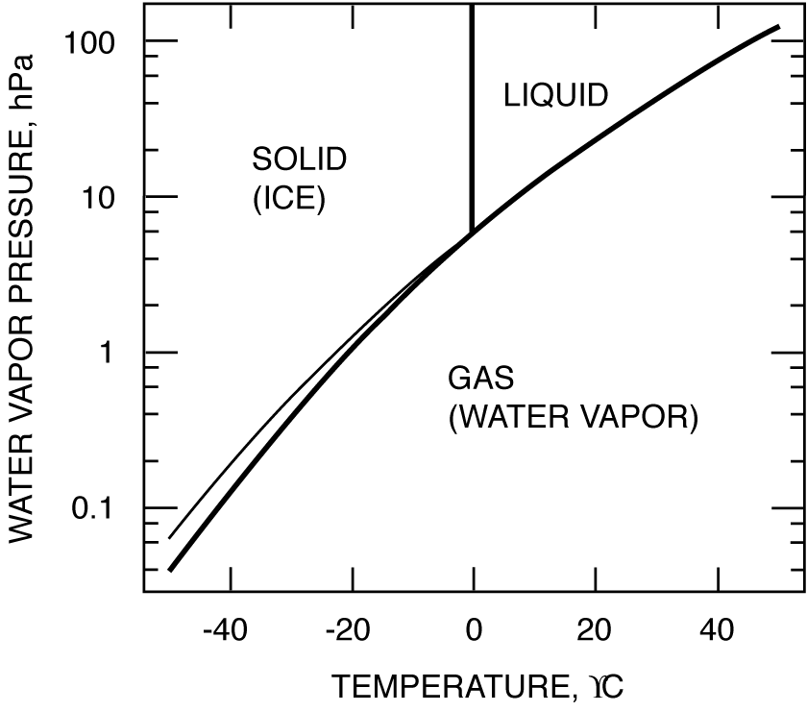
Phase diagram for water
gas-liquid
metastable
equilibrium
cooling
Initial state
cloud
o
Relative humidity (%) = 100(p_{H2O}/p_{H2O,SAT})
Dew point: Temperature T_{d} such that p_{H2O} = p_{H2O,SAT}(T_{d})

Slide 12
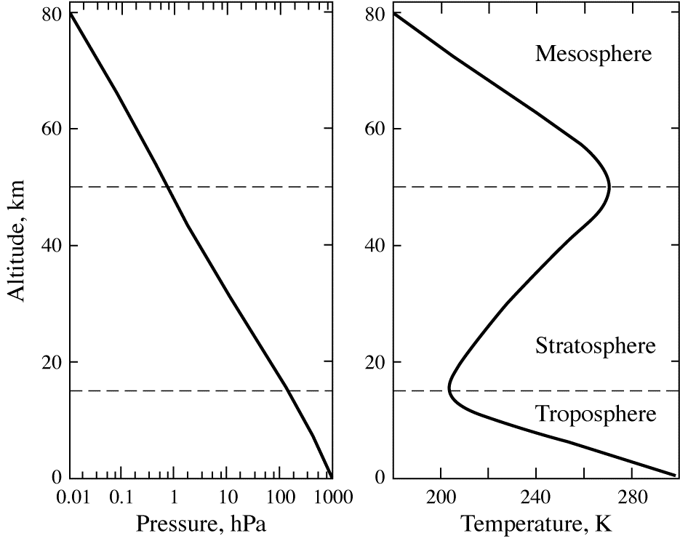
Vertical profiles of pressure and temperature
mean values for 30ºN, March
Stratopause
Tropopause
Barometric law:
Troposphere has 85% of atmospheric mass, stratosphere 15%, little above

Slide 13
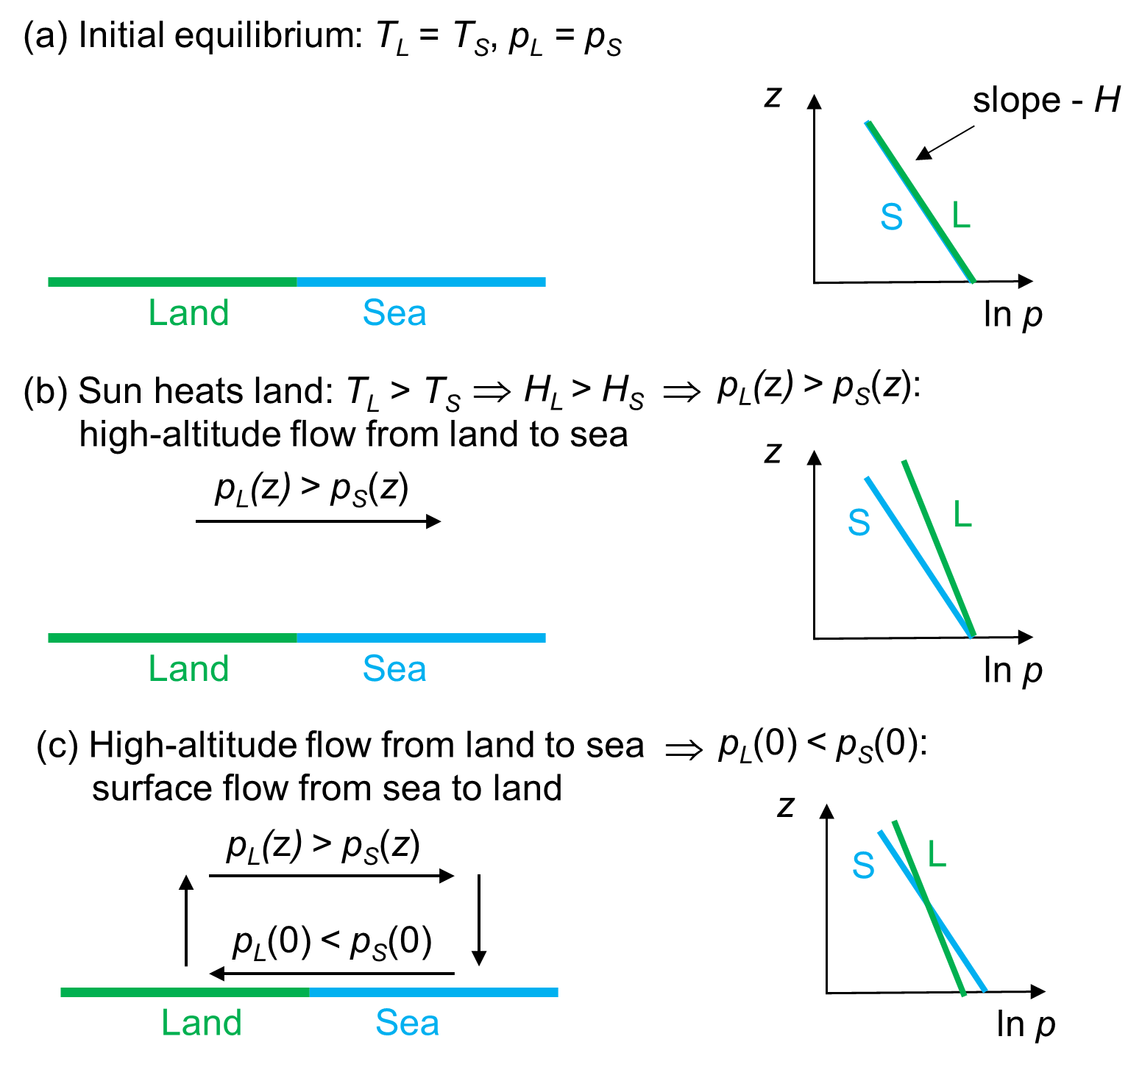
Application of barometric law: the sea-breeze effect
Notes:
add A30 sea breeze

Slide 14
The Hadley circulation (1735): global sea breeze
Explains:
Intertropical Convergence Zone (ITCZ)
Wet tropics, dry poles
Easterly trade winds in the tropics
But… Direct meridional transport of air between Equator and poles is not possible because Coriolis force is too strong
HOT
COLD
Trade winds
COLD
Coriolis force in rotating frame of reference:
acts to R of direction of motion in NH, to L in SH

Slide 15
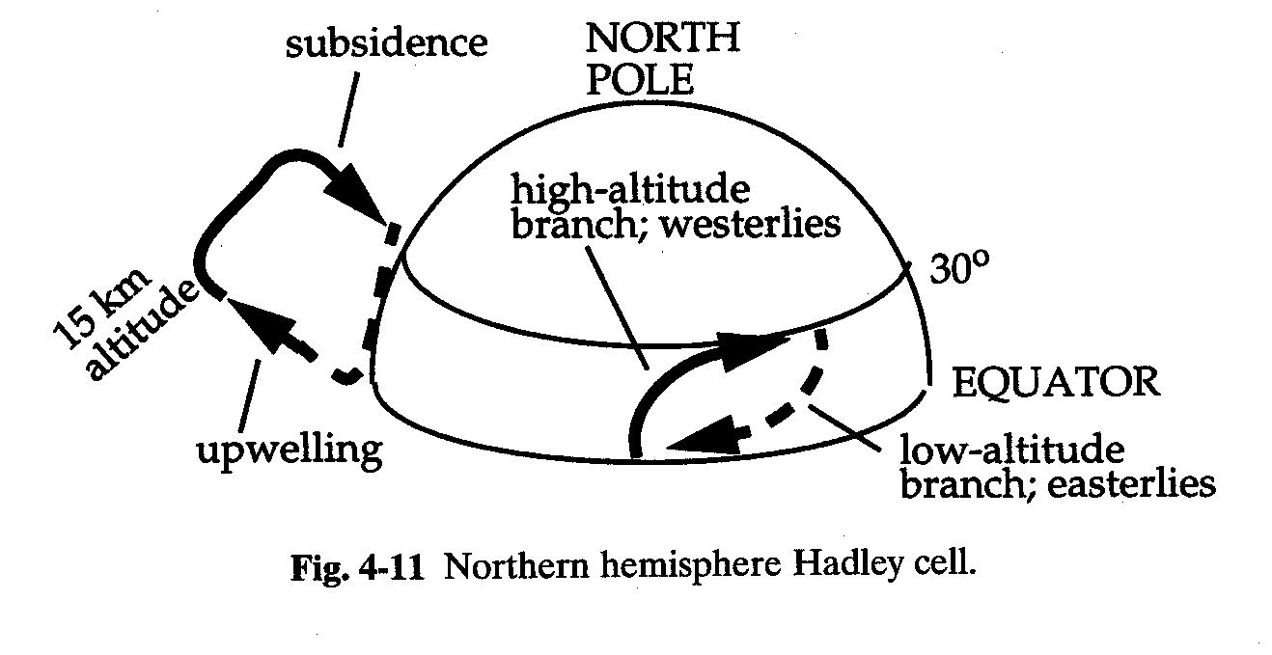
Hadley circulation only extends to about 30º latitude
Easterly trade winds in the tropics at low altitudes
Subtropical anticyclones at about 30º latitude
Westerlies at mid-latitudes

Slide 16
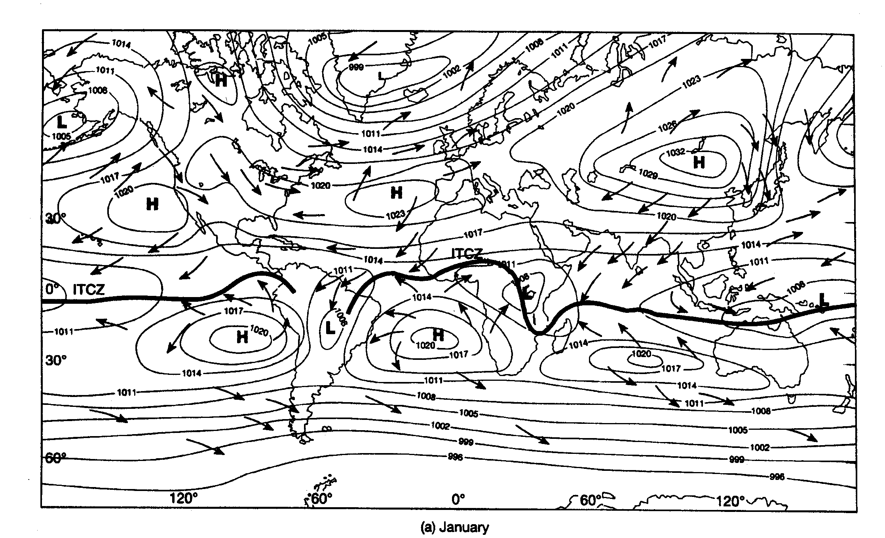
Climatological surface winds and pressures
(January)

Slide 17
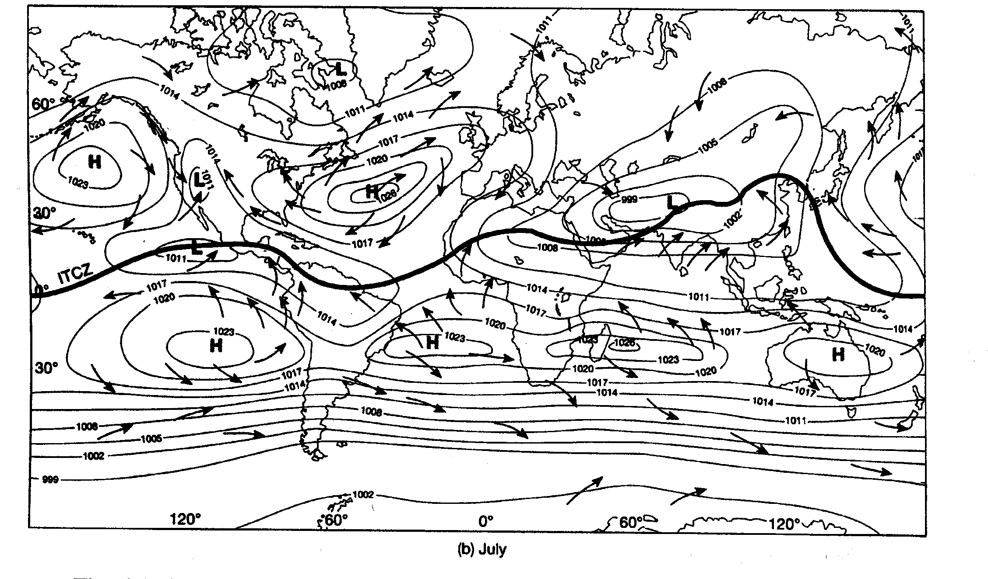
Climatological surface winds and pressures
(July)

Slide 18
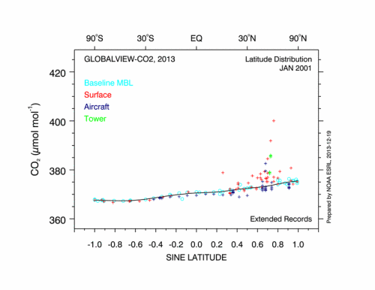
Rising atmospheric CO₂ vs. latitude, 2001-2012
https://www.esrl.noaa.gov/gmd/ccgg/globalview/

Slide 19
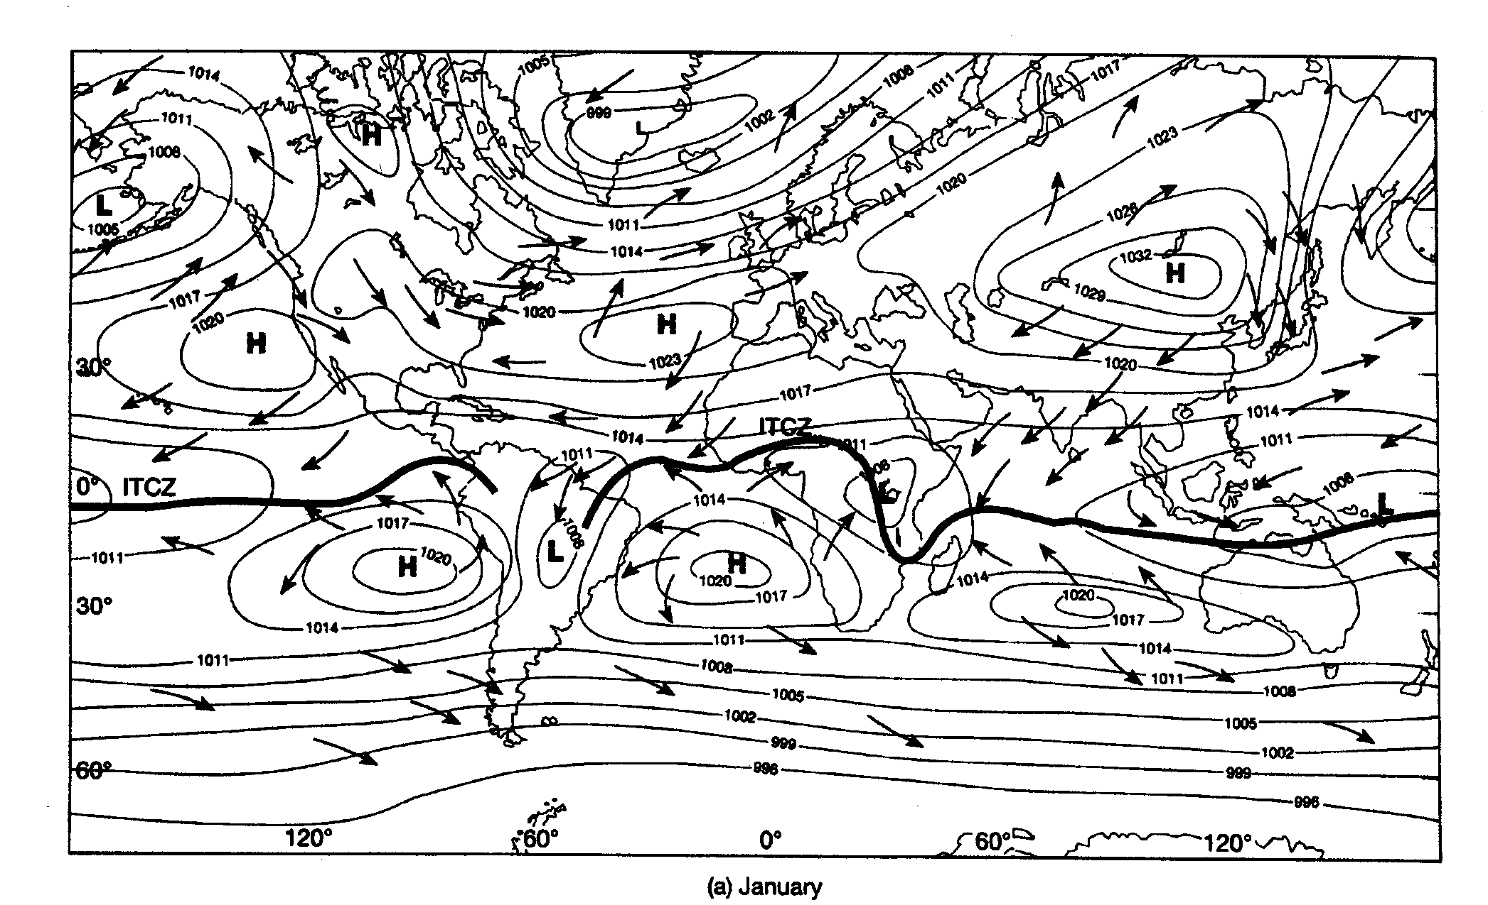
Time scales for horizontal transport
(troposphere)
1-2 months
2 weeks
1-2 months
1 year

Slide 20
Vertical transport: atmospheric lapse rate and stability
“Lapse rate” = -dT/dz
z
Consider an air parcel at z lifted to z+dz and released.
It cools upon lifting (expansion). Assuming lifting to be adiabatic, the cooling follows the adiabatic lapse rate Γ :
stable
Γ = 9.8 K km⁻¹
lifting
z
unstable
What happens following release depends on the local lapse rate –dT_{ATM}/dz:
-dT_{ATM}/dz > Γ e upward buoyancy amplifies initial perturbation: atmosphere is unstable
-dT_{ATM}/dz = Γ e zero buoyancy does not alter perturbation: atmosphere is neutral
-dT_{ATM}/dz < Γ e downward buoyancy relaxes initial perturbation: atmosphere is stable
dT_{ATM}/dz > 0 (“inversion”): very stable
inversion
ATM
(observed)
unstable
T
The stability of the atmosphere against vertical mixing is solely determined by its lapse rate.

Slide 21
What determines the atmospheric lapse rate?
An atmosphere left to evolve adiabatically from an initial state would eventually tend to neutral conditions (-dT/dz = Γ ) at equilibrium
Consider now solar heating of the surface. This disrupts the equilibrium and produces an unstable atmosphere:
z
z
z
ATM
Γ
ATM
final
Γ
Γ
initial
T
T
T
Initial equilibrium
state: - dT/dz = Γ
Solar heating of surface: unstable atmosphere
buoyant motions relax
unstable atmosphere back towards –dT/dz = Γ
Fast vertical mixing in an unstable atmosphere maintains the lapse rate to Γ.
Observation of -dT/dz ≈ Γ is indicator of an unstable atmosphere.

Slide 22
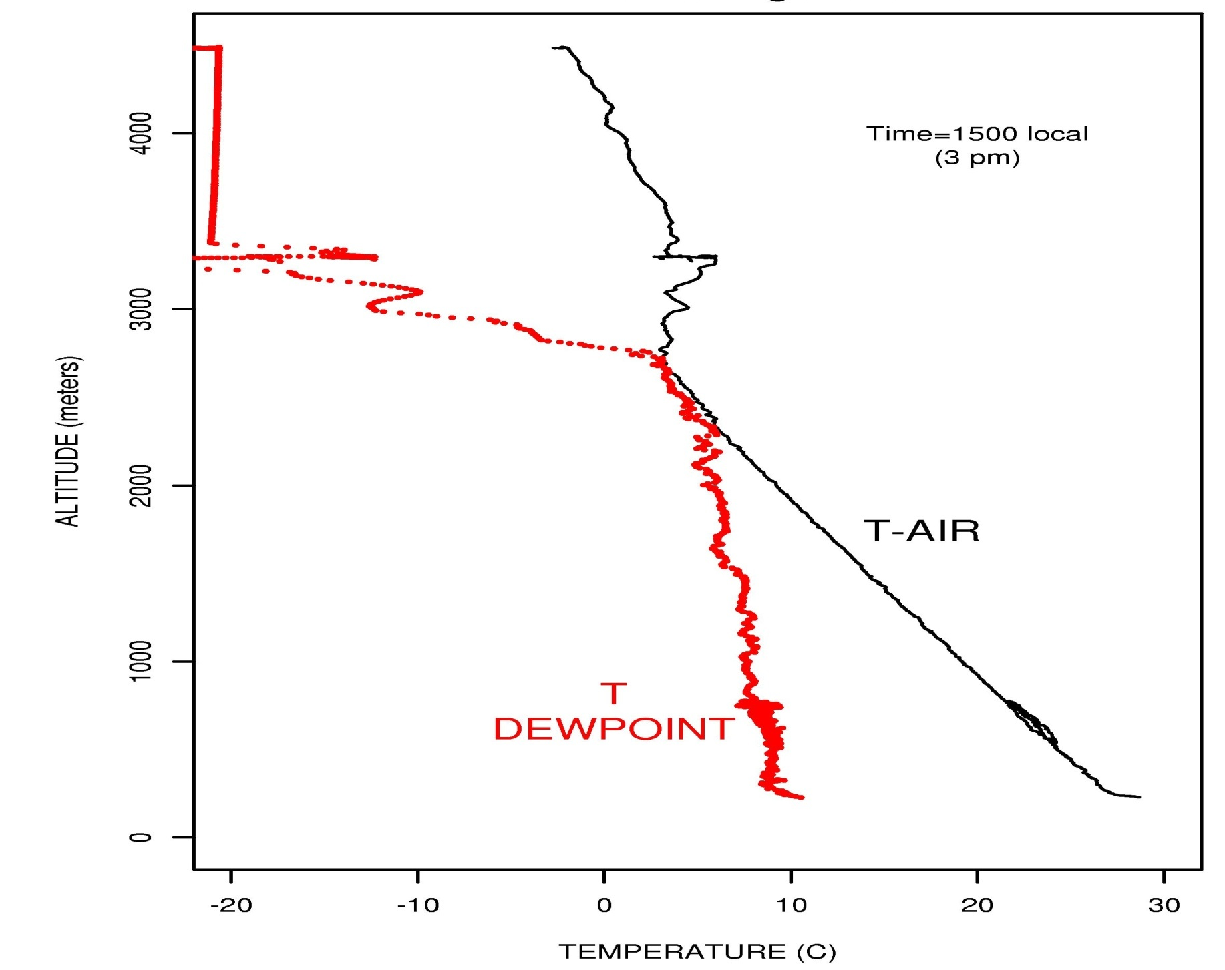

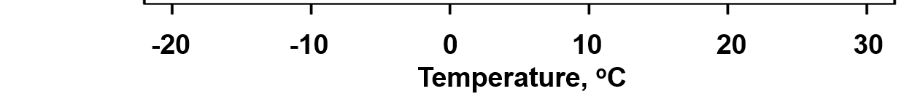
Typical summer afternoon vertical profile over Boston
4
3
cloud
Altitude, km
2
planetary
boundary
layer (PBL)
dT/dz ≈ Γ
1
0
0
Notes:
A picture to illustrate. Not the same place/time, but the same phenomenon!!
Have the students work out: why the clouds start where they do, and why they stop.
Air is turbulent (cf. airplane take off and landing) below the cloud base and usually smooth above—why?

Slide 23
In cloudy air parcel, heat release from water condensation decreases the lapse rate
Wet adiabatic lapse rate Γ_{W} = 2-7 K km⁻¹
z
T
RH
100%
Γ_{W}
“Latent” heat release
as H₂O condenses
Γ_{W} = 2-7 K km⁻¹
RH > 100%:
Cloud forms
Γ
Γ = 9.8 K km⁻¹

Slide 24
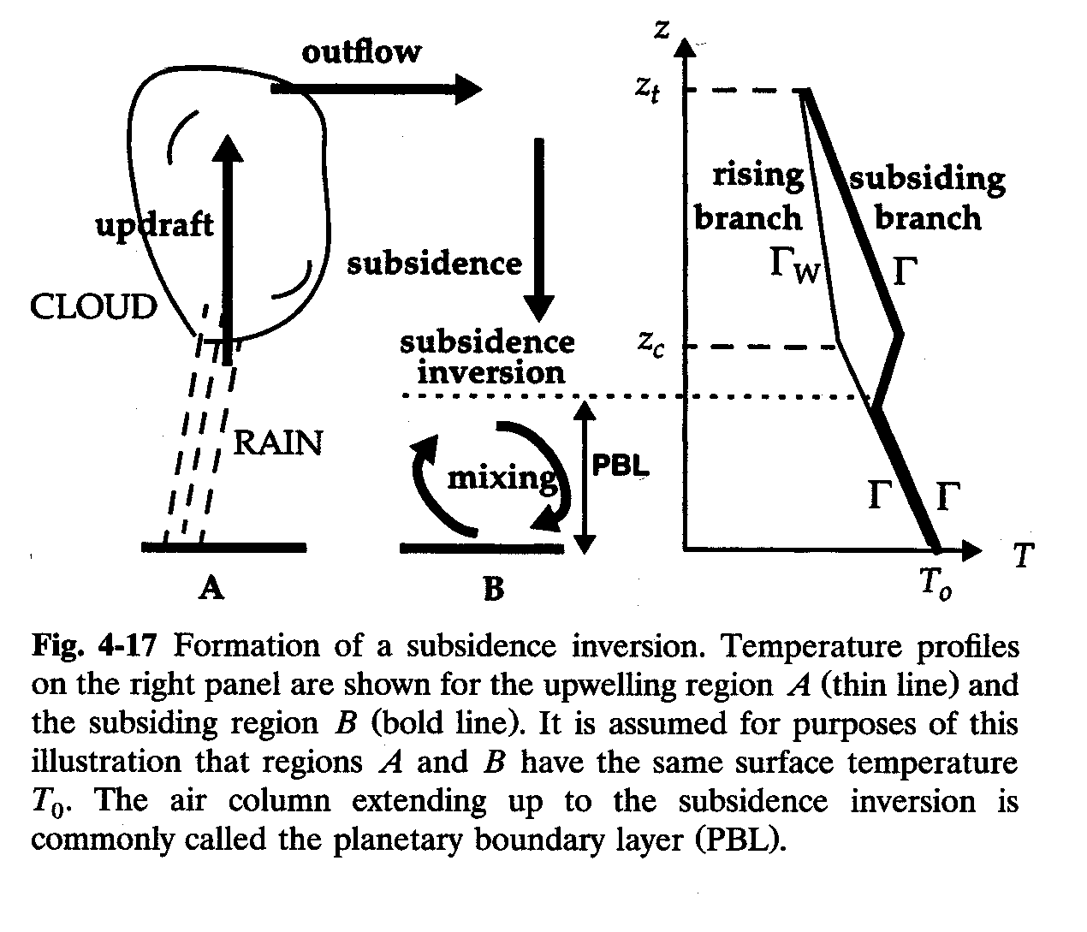
SUBSIDENCE INVERSION
typically
2 km altitude

Slide 25
DIURNAL CYCLE OF SURFACE HEATING/COOLING: ventilation of urban pollution
z
Planetary
Boundary
Layer (PBL)
depth
Subsidence
inversion
MIDDAY
1 km
Γ
Mixing
depth
NIGHT
0
MORNING
T
NIGHT
MORNING
AFTERNOON

Slide 26
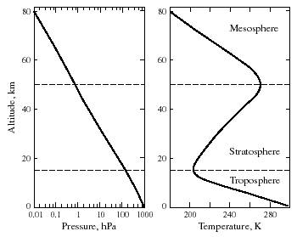
VERTICAL PROFILE OF TEMPERATURE
Mean values for 30ºN, March
Radiative
cooling
- 3 K km⁻¹
Altitude, km
+2 K km⁻¹
Radiative heating:
O₃ + hν → O₂ + O
O + O₂ + M → O₃+M
heat
Radiative
cooling
- 6.5 K km⁻¹
Latent heat release
Surface heating

Slide 27
TYPICAL TIME SCALES FOR VERTICAL MIXING
tropopause
(10 km)
10 years
1 month
2 km
planetary
boundary layer
1 day
0 km

Slide 28
Global energy budget of the Earth
Brasseur and Jacob, 2017

Slide 29
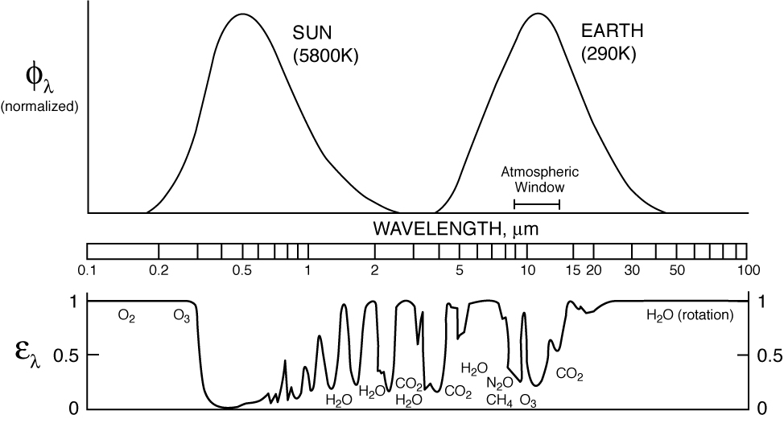
Greenhouse effect: absorption of terrestrial radiation by the atmosphere
blackbody
curves
  Major greenhouse gases: H₂O, CO₂, CH₄, O₃, N₂O, CFCs,…
  Not greenhouse gases: N₂, O₂, Ar, …

Slide 30
Radiative forcing of climate change: ΔF ~ ΔT
Greenhouse gases are gases that absorb in the terrestrial radiation range (5-20 μm)
Climate equilibrium: F_{in} = F_{out}
Radiative forcing: ΔF = F_{in} – F_{out} > 0
F_{in}
F_{out}
F_{in}
F_{out}
increase greenhouse gas
by ΔX
ΔX
Solar
Terrestrial
0.4-0.7 μm 5-20 μm
0.4-0.7 μm 5-20 μm
Aerosols scatter solar radiation but are largely transparent in the IR:
Climate equilibrium: F_{in} = F_{out}
Radiative forcing: ΔF = F_{in} – F_{out} < 0
F_{in}
F_{out}
F_{in}
F_{out}
increase aerosol
by ΔX
ΔX
Solar
Terrestrial
0.4-0.7 μm 5-20 μm
0.4-0.7 μm 5-20 μm

Slide 31
Notes:
“official chart”

