Slide 1
Tropospheric oxidants: ozone and OH

Slide 2
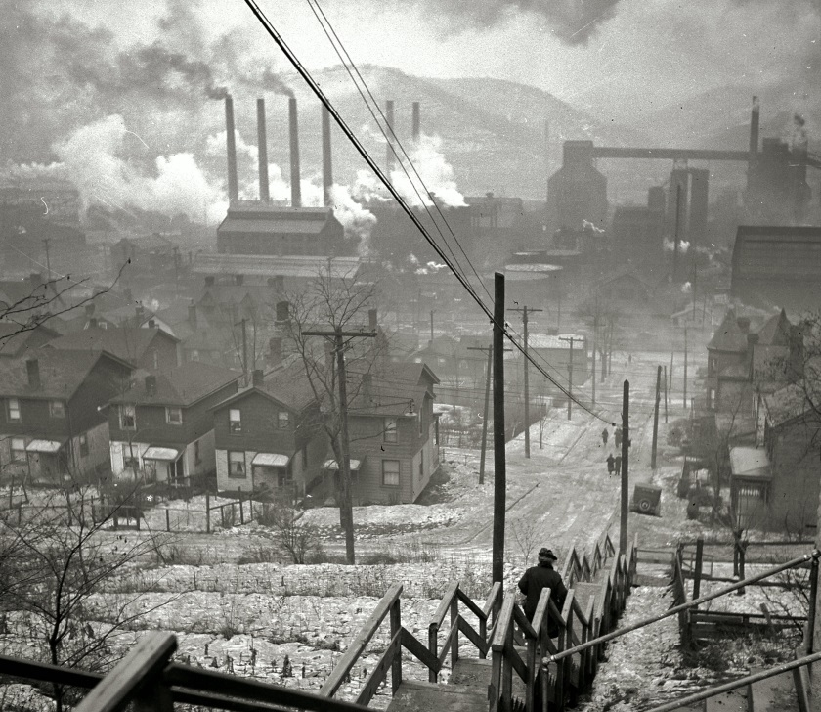
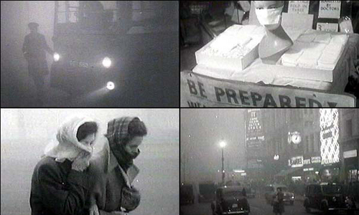
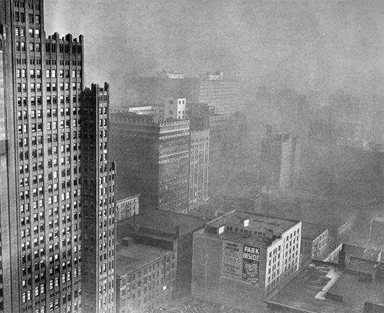
Historical interest in tropospheric chemistry focused on air pollution
…but did not actually involve chemistry
Air pollutants (smoke) were considered to be directly emitted, transported by wind
London fog
Pittsburgh in the 1940s

Slide 3
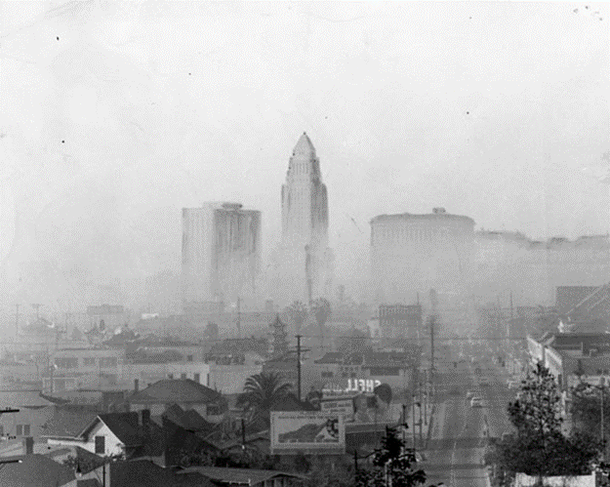
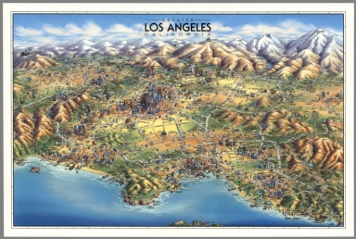
Los Angeles smog revealed a different beast
Smog became worse as air drifted downwind of LA – chemical production?
Respiratory effects, eye irritation, damage to crops pointed to something else in air than just smoke

Slide 4
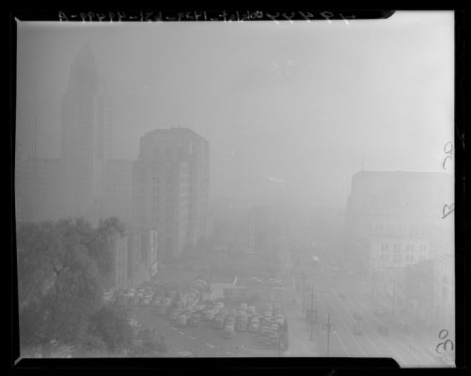
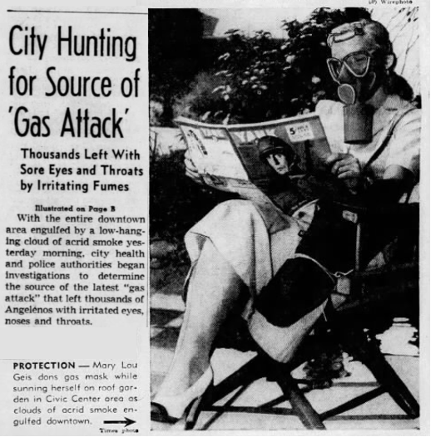
First recorded photochemical smog event: Los Angeles on July 26, 1943
Visibility down to three city blocks
Air smells like bleach
Is this Japanese chemical warfare?
Los Angeles Times, July 27, 1943

Slide 5


Haagen-Smit (1953): identifies ozone produced in air from car exhaust as the harmful component in Los Angeles smog
Shows that ozone is produced by oxidation of volatile organic compounds (VOCs)
in presence of NO_{x} and sunlight
Nitrogen dioxide (NO₂)
sunlight
Ozone
Arie Haagen-Smit
VOCs
NO_{x}
Postulated mechanism:

Slide 6
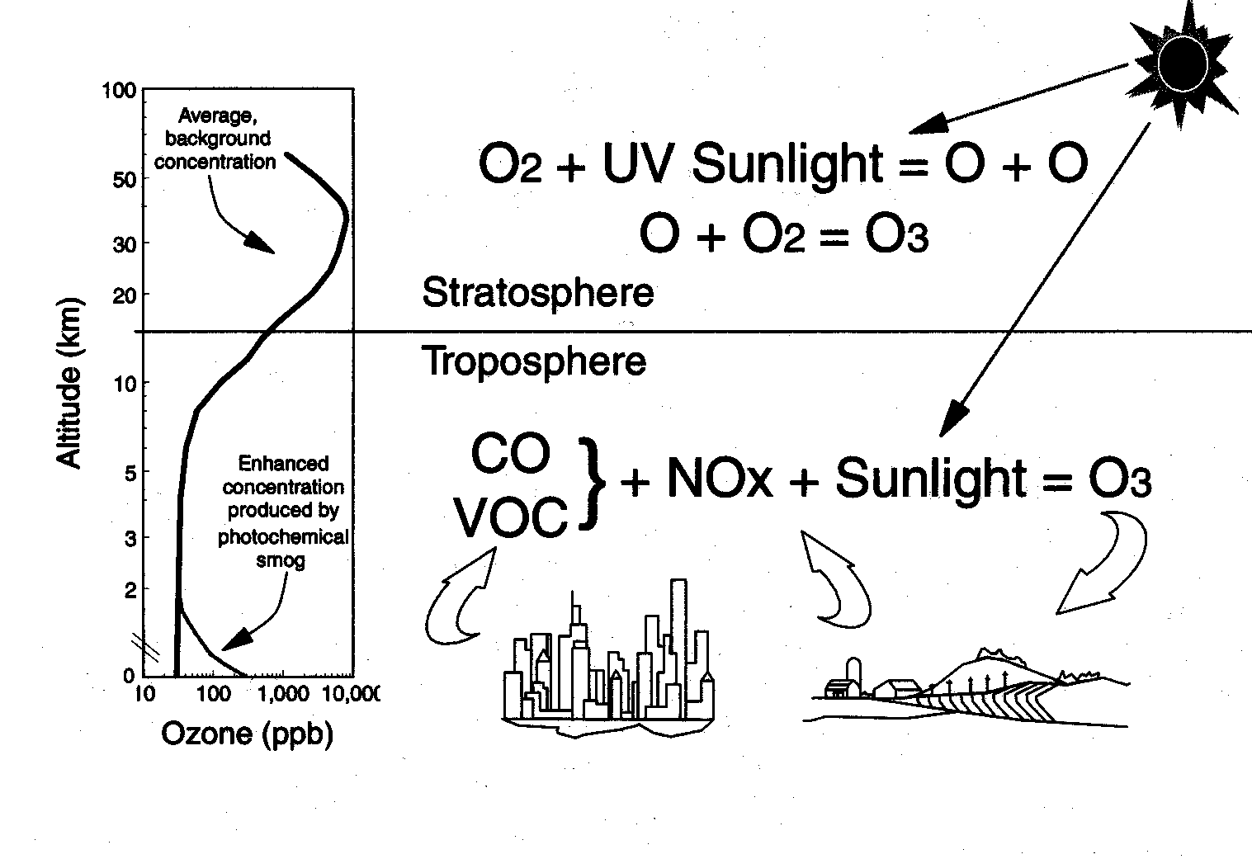
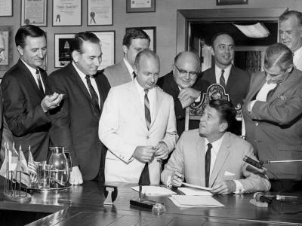
Early action to control VOCs and NO_{x} emissions to fight this urban ‘photochemical smog’
US EPA (1970):
ozone is “good up high, bad nearby”
Creation of California Air Resources Board (1967)
O₂+hv
Stratosphere:
90% of total
Troposphere
VOCs, NO_{x} + hv
00

Slide 7


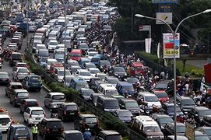

Discovery of ‘acid rain’ in the 1960s: long-range transport and atmospheric oxidation
by oxygen in clouds?
Oxidation…but how?
SO₂
NO_{x}
H₂SO₄
HNO₃
Sulfur dioxide (SO₂)
from coal power plants
NO_{x} from fuel combustion
Acidification of remote lakes and streams (Scandinavia, Canada, US)

Slide 8

Urban smog aside, troposphere until 1970s was thought to be inert except for slow oxidation by O₂
“The chemistry of the troposphere is mainly that of of a large number of atmospheric constituents and of their reactions with molecular oxygen…Methane and CO are chemically quite inert in the troposphere”
[Cadle and Allen, Atmospheric Photochemistry, Science, 1970]
Carbon monoxide (CO):
product of incomplete fuel combustion
Will CO from increasing vehicles accumulate to produce a global pollution cloud?

Slide 9
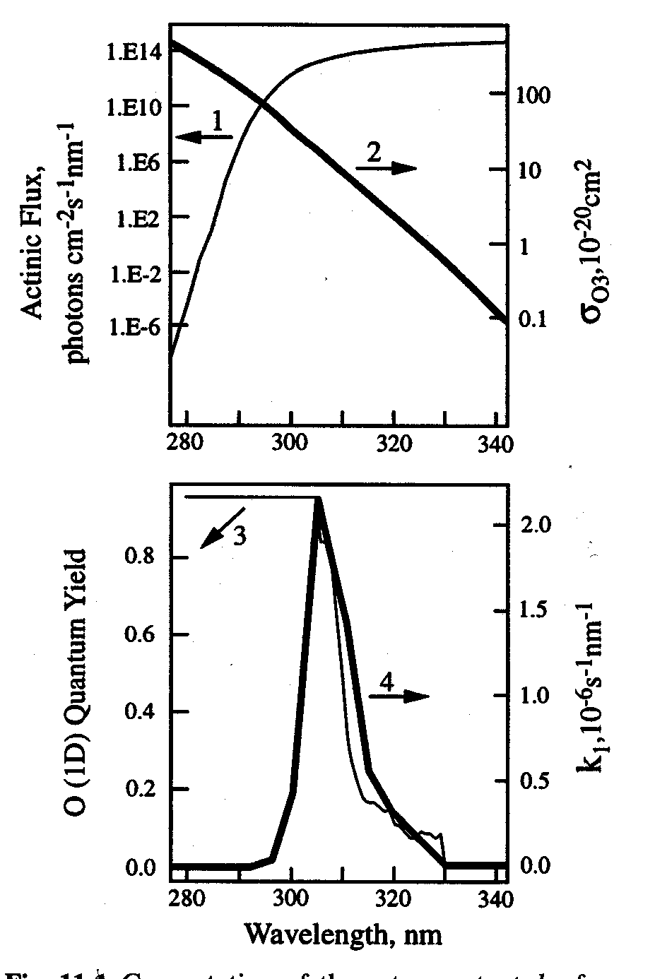
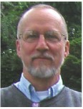
Discovery of OH radical production in troposphere (Levy, 1971)
solar flux φ_{λ}
at sea level
ozone absorption
cross-section σ
Photolysis at sea level
is controlled by photons in 300-320 nm range
qσφ_{λ}
O(¹D)
quantum
yield q
310 nm flux
Ozone layer
some flux remains
Chip Levy
surface

Slide 10


Tropospheric OH enables fast oxidation of non-radicals
Example: oxidation of CO to CO₂
Endothermic (requires heat): will not happen in atmosphere
Ozone is a stronger oxidant but is not a radical so reaction is too slow
Exothermic (releases heat)
but still negligibly slow in atmosphere
But oxidation of CO by OH is fast:
Oxidation by OH is further promoted if H abstraction can take place
hydrocarbon
OH is the PacMan of the atmosphere: it oxidizes anything that can be oxidized, with particular fondness for abstracting H atoms
OH

Slide 11
OH radical budget in the troposphere
Source:
Sink:
where X is any non-radical reduced species
Lifetime:
concentrations of OH are low, variable
…hard to measure!
Need to know [OH] to infer lifetime of X_{i}

Slide 12
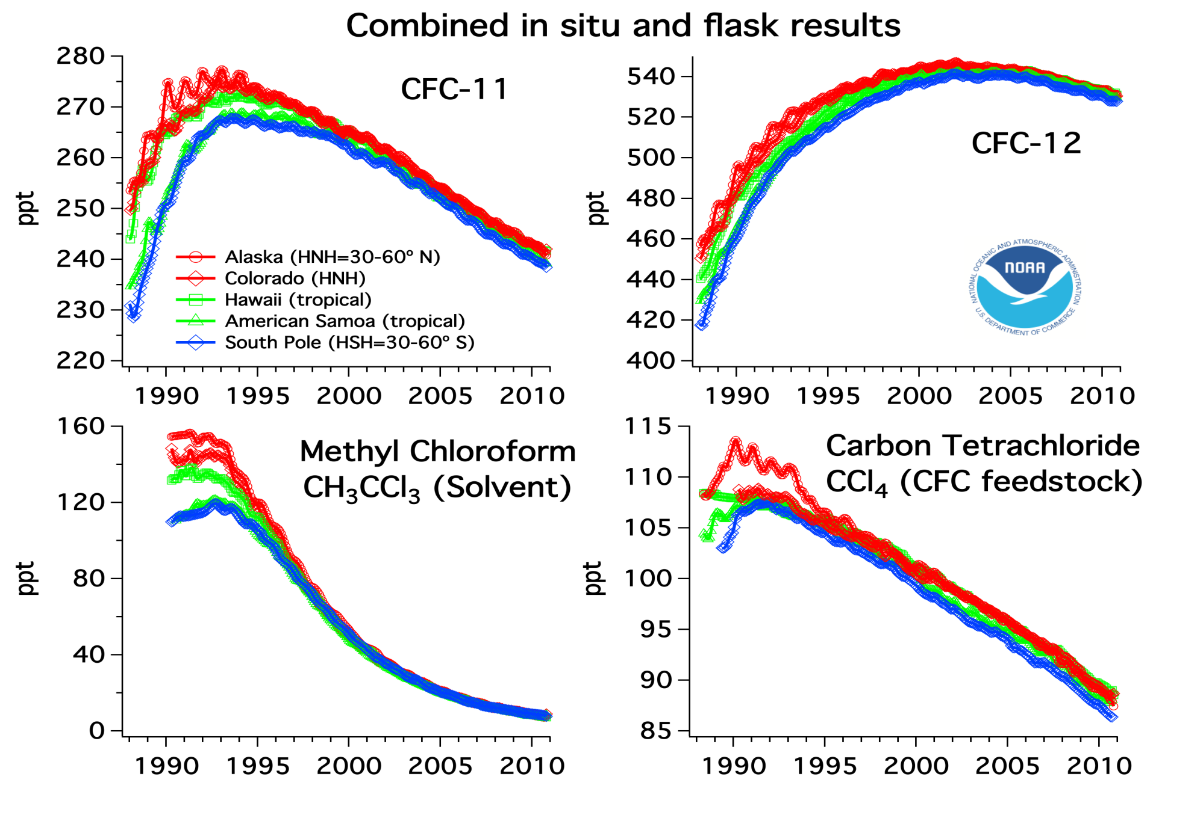

Inferring global tropospheric OH from methylchloroform (Singh, 1977)
Methylchloroform (CH₃CCl₃):
  Uniquely anthropogenic (industrial solvent), banned by Montreal Protocol
  Removed from troposphere by oxidation by OH
Mass balance equation for troposphere (T):
emission
loss rate from
CH₃CCl₃ + OH
CO lifetime: 2 months
Methane lifetime: 10 years
exponential decay
Lifetime =1/k[OH]_{T}
= 5 years
Hanwant Singh

Slide 13
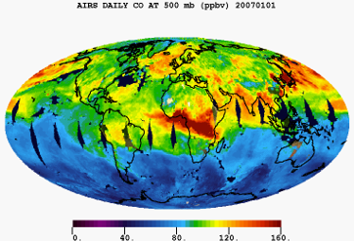
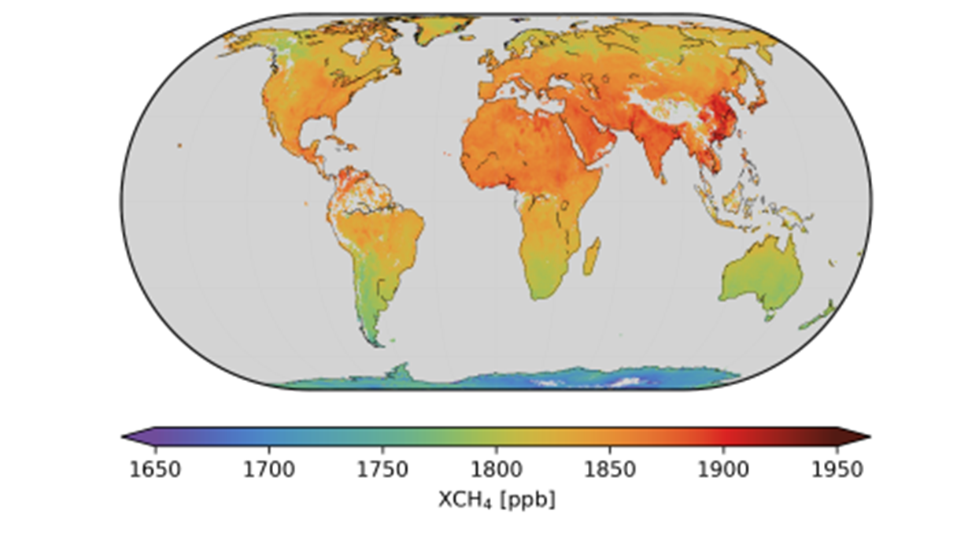
Global OH sink is controlled by CO and methane
Carbon monoxide (CO) observed from space: 50-200 ppb
Sources: fuel combustion, open fires, VOC oxidation
Lifetime against oxidation by OH: 2 months
Methane (CH₄)
observed from space: 1800-1900 ppb
2018-2019 TROPOMI satellite data
Sources: wetlands, livestock,
oil/gas production, landfills, coal mines, rice…
Lifetime against oxidation by OH: 10 years
…but at the same time, CO and methane sinks are controlled by OH: instability?

Slide 14
Until the 1980s, it was thought that tropospheric ozone was mainly of stratospheric origin – but that doesn’t work
Transport from stratosphere
10 Tmol O₃ yr⁻¹
Tropopause
O₃ + hv → O₂ + O(¹D)
O(¹D) + H₂O → 2OH
Chemical loss based on observed ozone
46 Tmol O₃ yr⁻¹
30 Tmol CO yr⁻¹
30 Tmol CH₄ yr⁻¹
A large tropospheric source of ozone is needed:
  to balance the chemical loss of ozone
  to avoid titration of OH by CO and CH₄ emissions

Slide 15


In meantime, Demerjian et al. [1973] used discovery of OH to explain the formation of ozone in urban smog
Ken Demerjian
VOCs
NO_{x}

Slide 16

Chameides and Walker [1973] and Crutzen [1973] suggest that smog-like ozone production driven by CO and methane could happen throughout troposphere
But where would the NO_{x} come from?
NO_{x}
OH
HNO₃
deposition
NO_{x} has a lifetime of a few hours against oxidation to HNO₃, so should only be present near combustion source regions
Bill Chameides

Slide 17
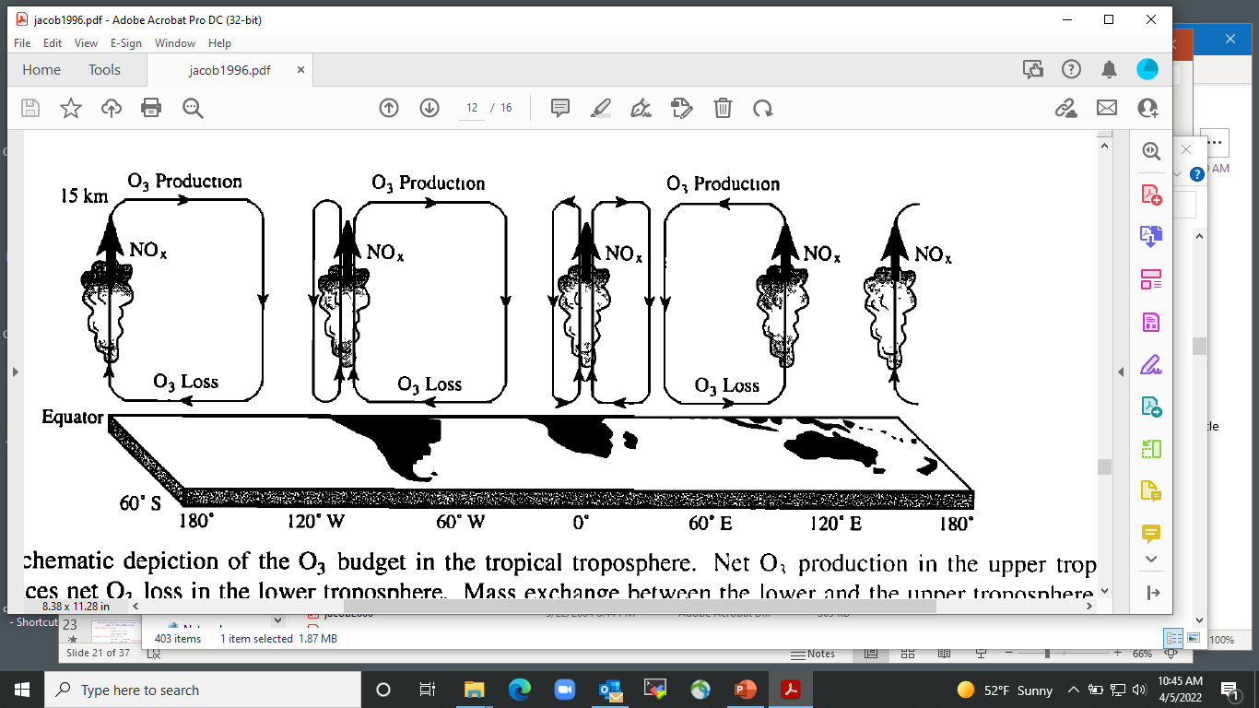
Discovery of NO_{x} in remote troposphere by aircraft in late 1980s
Observations over South Atlantic (NASA TRACE-A): sufficient ozone production to offset loss
net production
Implies that chemical production is main source of ozone in global troposphere, stratospheric input is small in comparison
Lightning NO_{x} drives ozone maximum in upper troposphere
net loss
lightning
Jacob et al. [1996]

Slide 18
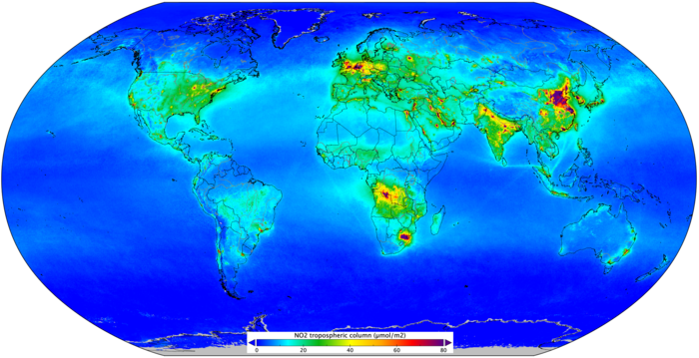
We now know that NO_{x} is present throughout troposphere and fuels ozone production
Sources: fuel combustion, open fires, lightning, soils
Tropospheric NO₂ columns measured by TROPOMI satellite (Apr-Sep 2018)
organic nitrate reservoirs
OH
NO_{x}
HNO₃
hours
Organic nitrate reservoirs allow transport of NO_{x} on global scale
Emission Deposition

Slide 19
Mechanism for ozone production from oxidation of CO catalyzed by HO_{x} and NO_{x} radicals
Initiation: production of HO_{x} radicals
Propagation: oxidation of CO in presence of NO_{x}
Mechanism drives ozone loss if NO is low (chain length <1)
Termination: loss of HO_{x} radicals
followed by H₂O₂ and HNO₃ deposition
H₂O₂ ≡ hydrogen peroxide

Slide 20
HO_{x} and NO_{x} radicals catalyze ozone production in troposphere, but loss in the stratosphere – why the difference?
In stratosphere,
In troposphere,
CO/O₃ and NO/O₃ ratios are much higher in troposphere than stratosphere
O concentrations are very low in troposphere

Slide 21
Methane oxidation cascade follows same schematic as CO
C oxidation #
CH₄ -4
methylperoxy radical
CH₂O 0
methoxy radical
formaldehyde
CO +2
CO₂ +4
Expanded HO_{x} family: HO_{x} ≡ OH + HO₂ + CH₃O₂ + CH₃O
HO_{x} cycle: OH → CH₃O₂ → CH₃O → HO₂ → OH
Oxidation of methane by above mechanism produces four ozone molecules
If low NO_{x}, then CH₃O₂ + HO₂ → O₂ + CH₃OOH (methyl hydroperoxide)

Slide 22
Same basic mechanism for higher VOCs but many branches
RO₂ can also
isomerize, or react with HO₂ or RO₂,
producing peroxides, epoxides,
alcohols,
carboxylic acids…
OH can also add to double bonds of unsaturated VOCs, producing hydroxyorganics
NO can also add to produce organic nitrates
RO can also decompose or isomerize to produce a range of aldehydes, ketones, dicarbonyls…
Oxidation product goes on to react with OH, adding functionality and making more ozone

Slide 23
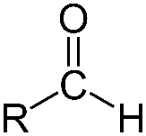
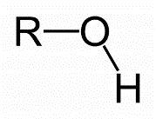
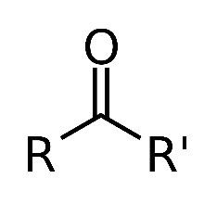
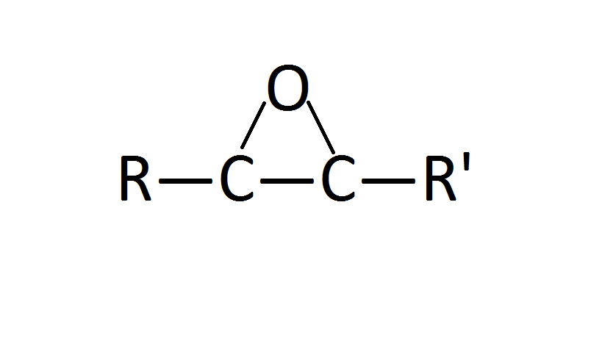
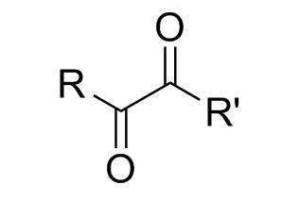
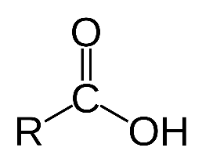
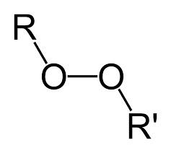
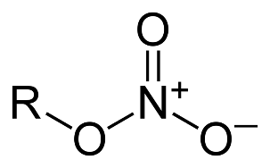
A brief cheat sheet for organic functions
aldehyde
ketone
dicarbonyl
peroxide
alcohol
epoxide
carboxylic acid
organic nitrate
carbonyl

Slide 24
Dependence of ozone and OH on NO_{x} and VOCs
HO₂ in this diagram denotes the ensemble of peroxy radicals including RO₂
View CO as just another VOC
hν
NO₂
NO
O₃
hν
M
O(¹D)
OH
HO₂
H₂O₂
H₂O
VOC
HNO₃

Slide 25
Dependence of ozone and OH on NO_{x} and VOCs
Is the production of ozone limited by supply of emitted NO_{x} or emitted VOCs?
NO_{x}-limited regime:
O₃ ↑ as NO_{x}↑
OH↑ as NO_{x}↑ VOCs↓
hν
NO₂
NO
O₃
hν
M
O(¹D)
OH
HO₂
H₂O₂
H₂O
NO_{x}-limited regime
VOC

Slide 26
Dependence of ozone and OH on NO_{x} and VOCs
VOC-limited regime:
O₃ ↑ as NO_{x}↓ VOCs↑
OH↑ as NO_{x}↓
a.k.a. NO_{x}-saturated regime
hν
NO₂
NO
O₃
hν
M
O(¹D)
OH
HO₂
H₂O
NO_{x}-saturated
regime
VOC
HNO₃

Slide 27
Dependence of ozone and OH on NO_{x} and VOCs
VOC-limited regime:
O₃ ↑ as NO_{x}↓ VOC↑
OH↑ as NO_{x}↓
NO_{x}-limited regime:
O₃ ↑ as NO_{x}↑
OH↑ as NO_{x}↑ VOC↓
a.k.a. NO_{x}-saturated regime
hν
NO₂
NO
O₃
hν
M
O(¹D)
OH
HO₂
H₂O₂
H₂O
NO_{x}-limited regime
NO_{x}-saturated
regime
VOC
HNO₃
O₃
NO_{x}-limited
O₃
NO_{x}-limited
NO_{x}-saturated
NO_{x}-saturated
OH
NO_{x}
VOCs
NO_{x}-limited
OH
NO_{x}-saturated
NO_{x}-limited
NO_{x}-saturated
NO_{x}
VOCs

Slide 28
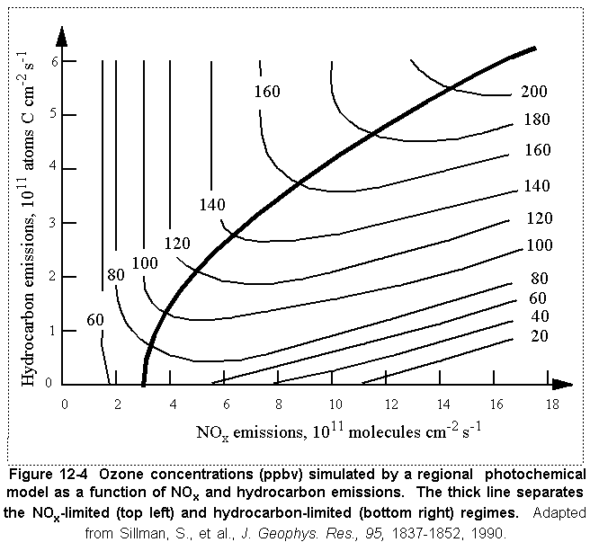
Ozone (ppb) vs. NO_{x} and VOC emissions
Generic box model calculation
NO_{x}-limited regime; most common
Ridge
NO_{x}-
saturated
regime;
urban, winter
conditions
VOC

Slide 29

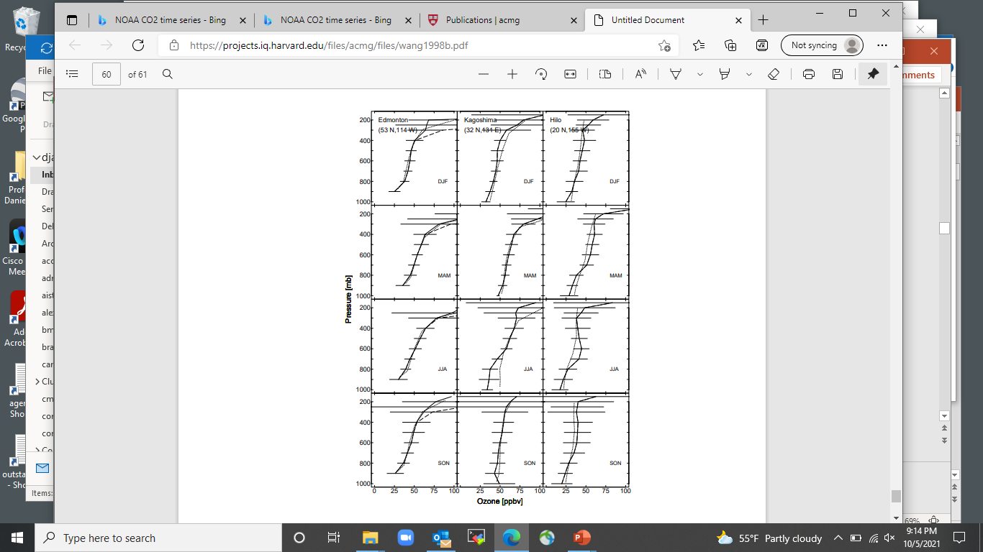
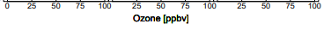
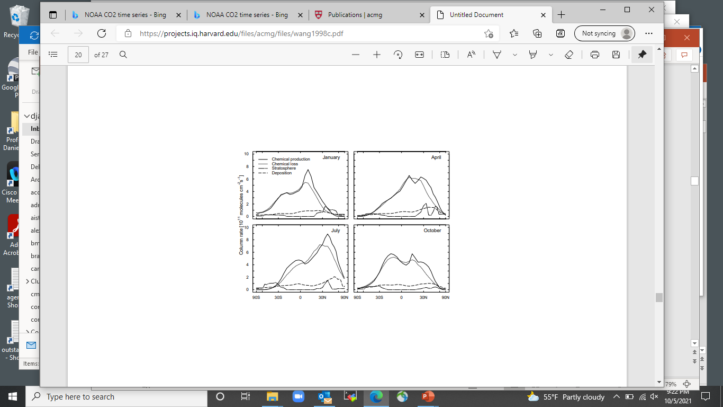
Late 1990s: first global 3-D models for tropospheric chemistry
Ozonesonde observations (solid), model (dashed)
Pressure, hPa
Yuhang Wang
Model budget of tropospheric ozone: chemical production and loss dominate everywhere
Wang et al. [1998]

Slide 30

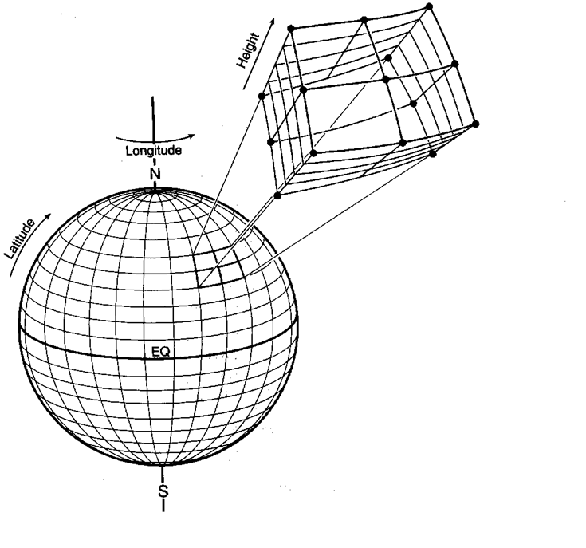
GEOS-Chem model (Bey et al., 2001)
Global 3-D model of tropospheric chemistry driven by observed winds
transport
chemistry
species
X
species
Y
Isabelle Bey
3-D grid
emission
deposition

Slide 31
Global budget of tropospheric ozone (Tg O₃ yr⁻¹)
IPCC (2013) average across all models
Chemical production in troposphere | 4600±400 | Chemical loss in troposphere | 4200 ±400
Transport from stratosphere | 500 ±100 | Deposition | 900 ± 100
O₂
hν
O₃
Tropospheric ozone lifetime: 24 ±4 days
STRATOSPHERE
8-18 km
TROPOSPHERE
hν
NO₂
NO
O₃
hν, H₂O
OH
HO₂
H₂O₂
Deposition
HNO₃
CO, VOC

Slide 32
GLOBAL DISTRIBUTION OF TROPOSPHERIC OZONE
OMI satellite observations at 700-400 hPa
Lifetime of 3 weeks allows transport around latitude bands
Maximum values at northern mid-latitudes in spring-summer due to anthropogenic pollution
High values in tropical regions affected by seasonal biomass burning
Minimum values over tropical oceans due to chemical loss
Hu et al. [2017]

Slide 33
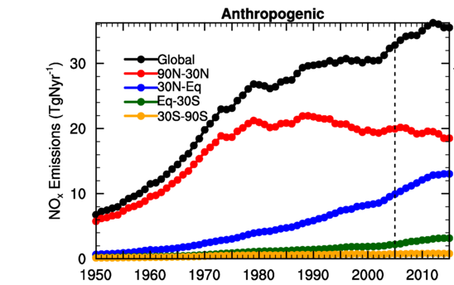
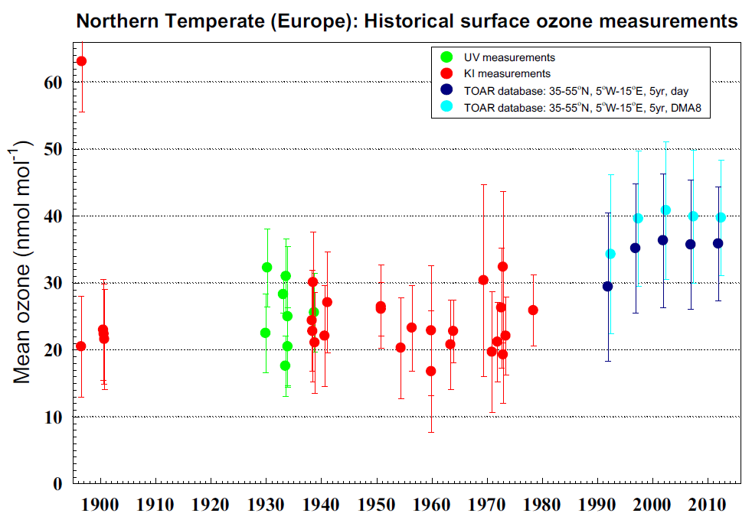
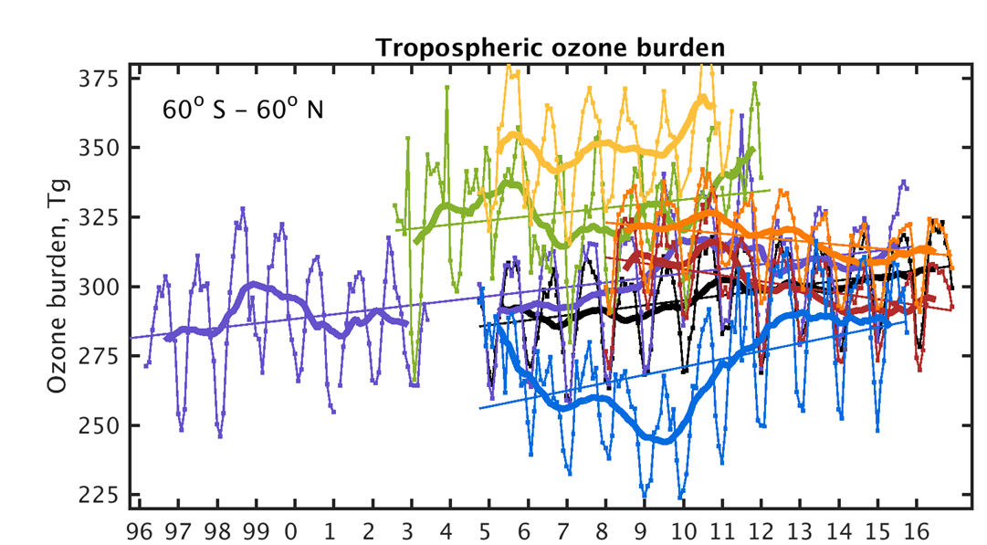
Global tropospheric ozone trends
historical ozone trend (1900-present)
NO_{x} emissions
trends from satellites (1996-present)
Unresolved questions:
Why does historical record show no increase until 1980?
Why is global tropospheric ozone presently increasing, when NO_{x} emissions are thought to have plateaued?
TOAR [2020]

Slide 34
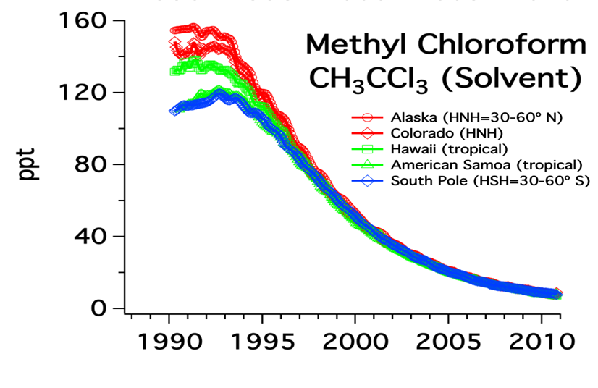
Estimating the OH trend with the methylchloroform proxy
No emissions after 1996:
global mean [OH]
tropospheric mass of methylchloroform
Differentiate:
methylchloroform+OH rate constant

Slide 35
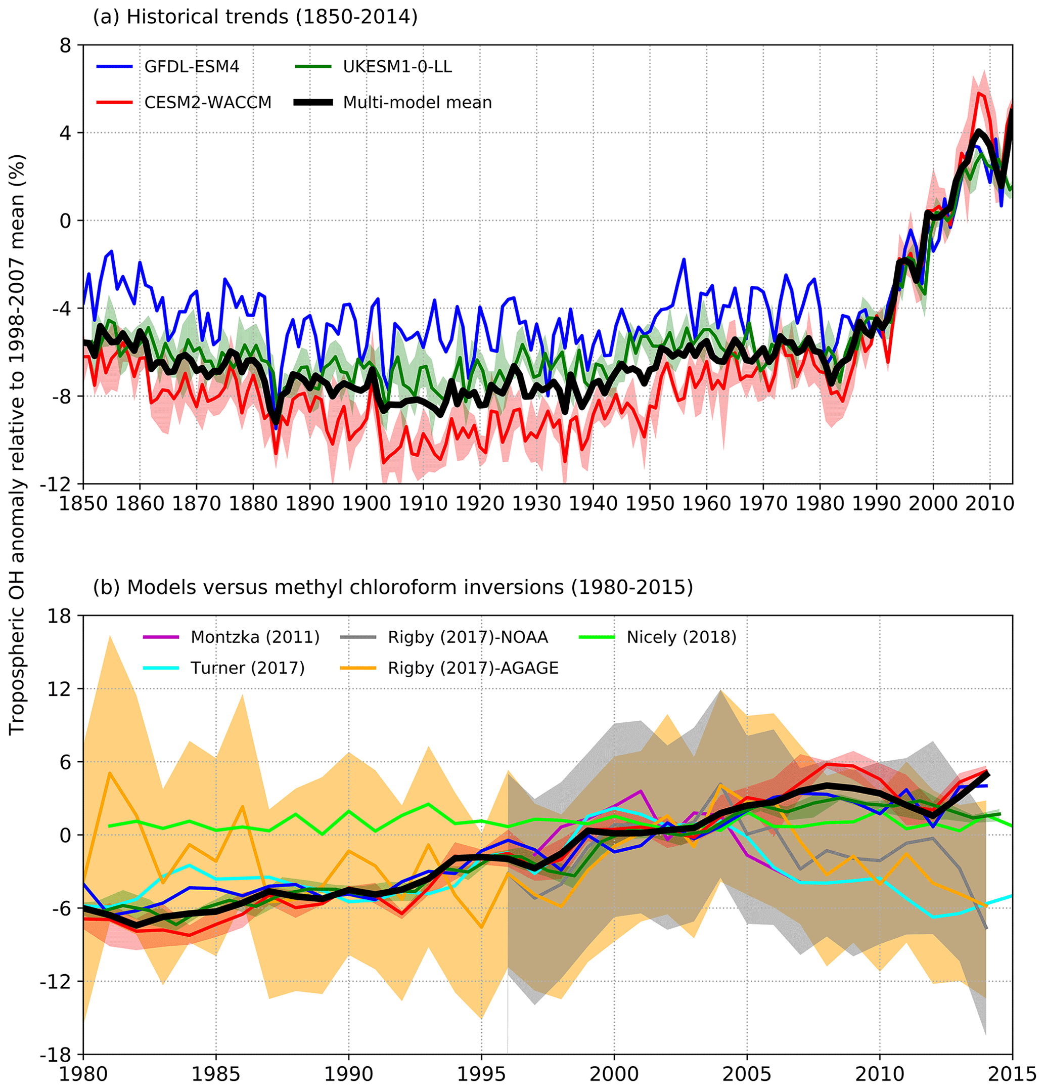

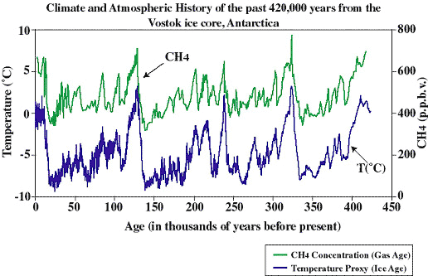
TRENDS IN GLOBALTROPOSPHERIC OH inferred from methylchloroform and computed from models
models
methylchloroform
Stevenson et al., 2020
There is presently no confidence or understanding regarding OH trends
But methane ice core record tells us that OH must have been relatively steady in past:
This is all still a mystery

Slide 36
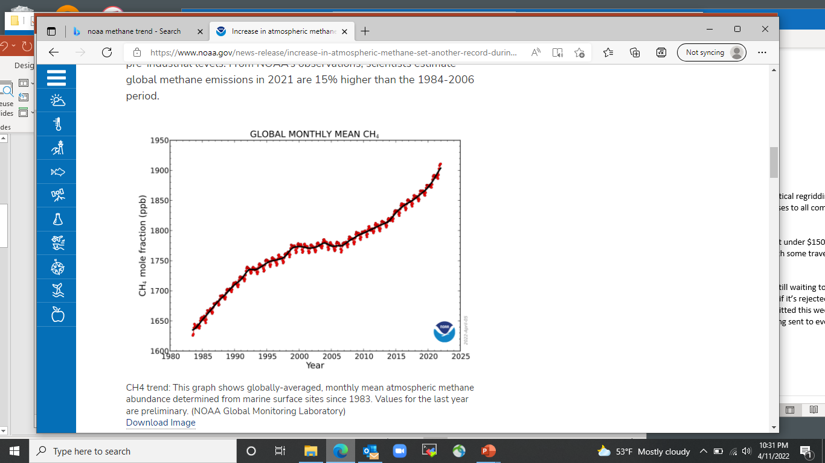
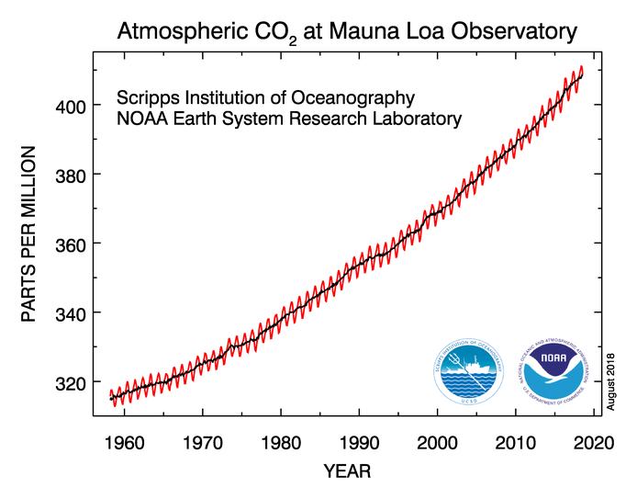
The weird growth curve of methane
CO₂
Methane
CO₂
Could this weirdness be driven by changes in OH? We don’t know.

Slide 37
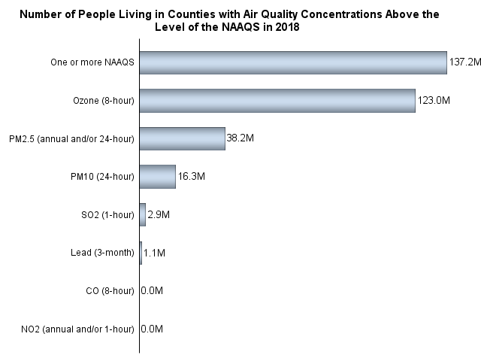
Ozone as an air pollutant
US population exposed to air pollutants
in excess of national ambient air quality standards (NAAQS), 2018
Ozone
137M
70 ppb (8-h average)
38M
PM_{2.5}
31
PM₁₀
16M
SO₂
3M
Lead
1M
CO
0
NO₂
0
US EPA [2020]

Slide 38
Days per year exceeding 70 ppb ozone standard, 2010-2014
TOAR [2020]

Slide 39
Very severe ozone pollution problem in China
revealed by air quality network observations starting in 2013
US
air quality standard
China
air quality standard
Li et al. [2019a]

Slide 40
Air quality standards have been tightening with time…
…and now approach background tropospheric levels
Europe AQS
(8-h avg.)
Canadian AQS
(8-h avg.)
Europe AQS
(seasonal)
U.S. AQS
(8-h avg.)
U.S. AQS
(1-h avg.)
2014
2008
1997
0 20 40 60 80 100 120 ppb
China AQS
(8-h avg.)
Preindustrial
ozone
background
Present-day ozone background at northern mid-latitudes

Slide 41
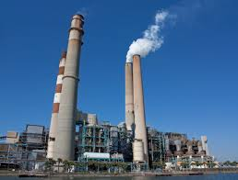
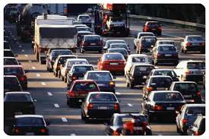

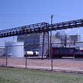

Controlling ozone pollution requires understanding of whether ozone production is NO_{x}- or VOC-limited
This is because anthropogenic sources are different:
NO_{x} is from fuel combustion
VOCs are from leaks, industry, domestic products

Slide 42
Until 1990s, ozone production in US was thought to be VOC-limited…
NO_{x}-limited regime
Typical
anthropogenic
emission inventory
estimate
VOC-limited regime
VOC
…motivating strategy of VOC emission controls

Slide 43
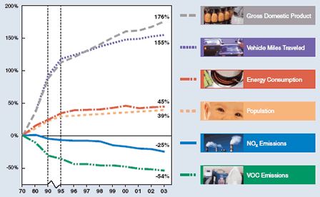

1970-2003 trend of US emissions
Focus was on VOC controls,
but ozone was not decreasing except in
Los Angeles and New York. Why?
Arlene Fiore
1980-1995 trend in summer ozone (ppb a⁻¹)
Fiore et al. [1998]

Slide 44

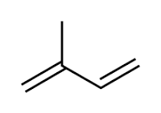
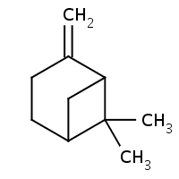
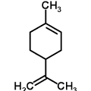
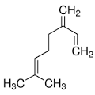
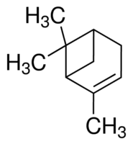


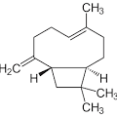
Emission of biogenic VOCs first quantified in late 1980s
Many VOCs emitted as photosynthesis and metabolism by-products, insect attractors or repellents, response to stress and injury
Principal hydrocarbons are emitted as C₅H₈ units:
Isoprene (C₅H₈)
50% of total biogenic VOCs
Atmospheric lifetime ~ 1h
Terpenes (C₁₀H₁₆)
α-pinene
β-pinene
Limonene
Myrcene
Sesquiterpenes (C₁₅H₂₄)
Pat Zimmerman
Caryophyllene

Slide 45
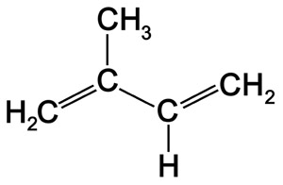


Biogenic VOCs dominate over anthropogenic VOCs in summer
(ozone pollution season)
isoprene
oxidation
hν , OH
HCHO
~ 1 hour
~ 1 hour
Other VOCs
OMI satellite observations of formaldehyde (HCHO) columns, May-Aug 2005-2014
Zhu et al. [2017]

Slide 46


Slide 47
But what this really means is that ozone production is NO_{x}-limited
total
emissions
NO_{x}-limited regime
anthropogenic
emissions
+ biogenic emissions
VOC-limited regime
VOC
…so emission controls should focus on NO_{x}

Slide 48



Rethinking the ozone problem (NRC, 1991)
Tells EPA that ozone is a regional pollution problem, advises NO_{x} emission controls
John Seinfeld
Jennifer Logan

Slide 49
US NO_{x} emissions have decreased steadily since 2000
2000
2016
Power
39% plants
Mobile 56%
26%
57%
4% Industry
(non-power plant)
13%
US EPA, National Emission Inventory (NEI) 2011
Notes:
TRANSITION: in order to monitor these changes in surface emissions we look to satellite observations

Slide 50

Evidence of NO_{x} emission decrease from satellite NO₂ data
OMI NO₂, summer 2005
Russell et al. [2012]

Slide 51

Evidence of NO_{x} emission decrease from satellite NO₂ data
OMI NO₂, summer 2011
OMI NO₂, summer 2005
30% decrease in NO_{x} emissions from 2005 to 2011
Russell et al. [2012]

Slide 52

Take it from the communicator-in-chief…

Slide 53

Trend in #days/year with ozone > 70 ppb, summer 2000-2014
Megacity trends
Parrish [2014], TOAR [2017], Wang et al. [2017]

Slide 54
Ozone in China has been increasing despite Clean Air Action starting in 2013
Emission controls have been targeted (successfully!) at PM_{2.5}
NO_{x} emissions have decreased by 30% since 2013 while VOC emissions have stayed flat.

Slide 55
Unlike in US, ozone production in China is VOC-limited
OMI annual mean tropospheric column data, 2006-2007
Glyoxal (CHOCHO) Formaldehyde (HCHO) NO₂
(440-460 nm) (340-360 nm) (420-450 nm)
NO_{x} emissions are very high and VOC emissions are largely anthropogenic
Chan Miller et al. [2016]

Slide 56
NO_{x} controls are needed to meet current ozone standards … even if production is locally VOC-limited
NO_{x}-limited regime
start point
Natural NO_{x} background
VOC-limited regime
Biogenic VOC background
VOC
VOC controls will only get you so far until you are limited by biogenic background
NO_{x} controls are only way to get to current ozone standards and have side benefits
(NO₂ air quality, nitrogen deposition)

Slide 57


Intercontinental transport of ozone pollution
2012 OMI NO₂ column, 10¹⁵ molecules cm⁻²
Strong westerlies
transport ozone
around mid-latitudes
Ozone pollution transport (GEOS-Chem model)
N America
Europe
Asia

