Slide 1
4. Atmospheric transport

Slide 2
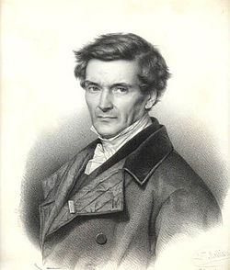
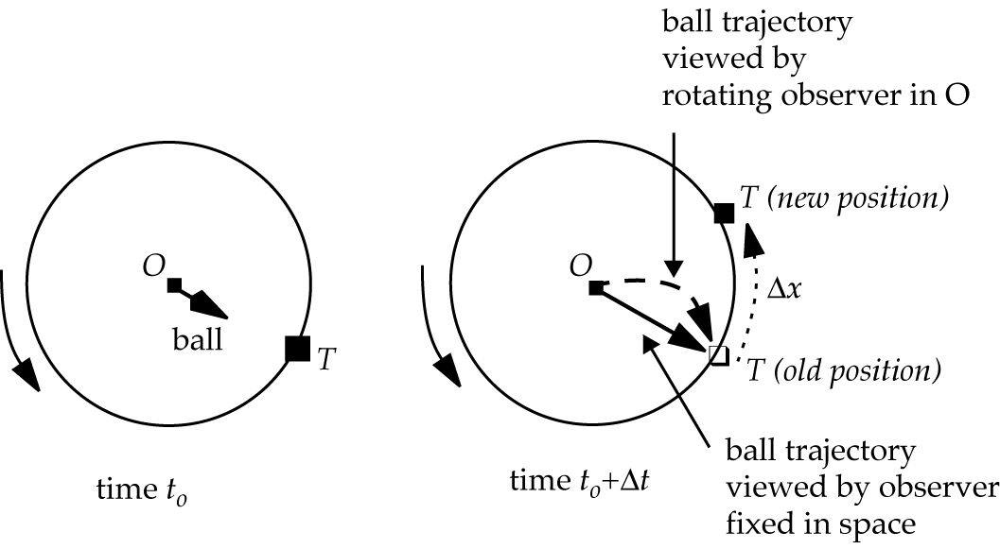
The Coriolis force
Gaspard de Coriolis
(1792-1843)
Consider an observer O standing at the North Pole and throwing a ball at a target T located at a (necessarily) lower latitude:
Rotating Earth (ω)
The observer misses the target and sees the ball as having been deflected to the right. The fictitious force deflecting the ball to the right in the rotating observer’s frame of reference is the Coriolis force. It increases with angular velocity, ball speed, and latitude:
Angular velocity ω = 2π/24h
Wind speed v
Latitude λ
Coriolis acceleration
If the observer was a penguin (South Pole) rather than a polar bear (North Pole) then the Coriolis force would operate to the left of the direction of motion

Slide 3
Forces in the atmosphere:
Gravity g
Pressure-gradient
Coriolis
Friction at surface
for x-direction (also y, z directions)
to R of direction of motion (NH) or L (SH)
Angular velocity ω = 2π/24h
Wind speed v
Latitude λ
Friction coefficient k
Equilibrium of forces:
In vertical: barometric law
In horizontal: geostrophic flow parallel to isobars
(NH perspective)
g
a_{p}
P
v
P + ΔP
a_{c}
In horizontal, near surface: flow tilted to region of low pressure
a_{p}
v
P
a_{f}
P + ΔP
a_{c}
Notes:
Summary of where we will end up in this lecture

Slide 4
Geostrophic flow: equilibrium between pressure-gradient and Coriolis forces
Isobar
a_{p}
steady
parallel to isobars
speed ~
pressure gradient
a_{c}
a_{p}
a_{c}
a_{p}
NH perspective

Slide 5
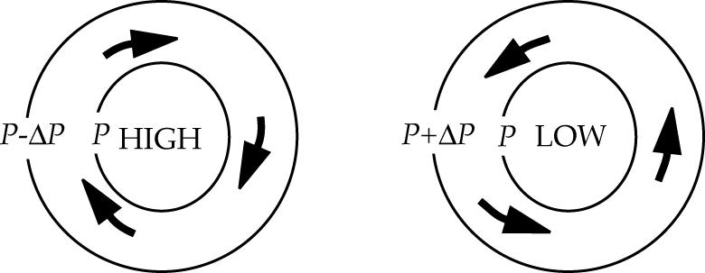
Circulation around Highs (a.k.a. anticyclones) and Lows (a.k.a cyclones) in NH
(in SH it would be the other way around)
Geostrophic flow is clockwise around High, counterclockwise around Low
Near surface, friction force cause air to diverge from the High and converge toward the Low

Slide 6
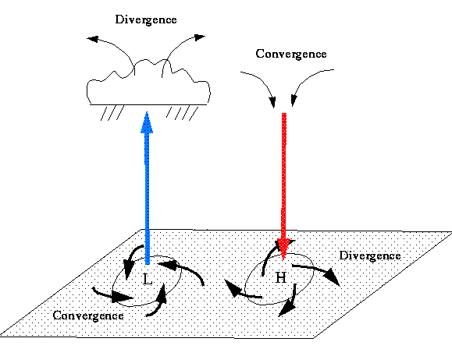
How Highs and Lows affect surface weather
air rises
⇒ precipitation
air sinks
⇒ dry weather
Friction force at surface drives convergence around Low, divergence around High
Surface Low Surface High
Notes:
Consider the way mass is moved here—then discuss MASS FLOW: convergence and divergence / lows and highs / at the surface and aloft. Rain in lows, clear in highs—why is that?

Slide 7
Last Tuesday’s Nor’easter in Boston (slide from last week)
https://www.wpc.ncep.noaa.gov/basicwx/day0-7loop.html

Slide 8
The Hadley circulation (1735): global sea breeze
Explains:
Intertropical Convergence Zone (ITCZ)
Wet tropics, dry poles
Easterly trade winds in the tropics
But… Direct meridional transport of air between Equator and poles is not possible because Coriolis force is too strong
HOT
COLD
Trade winds
COLD

Slide 9
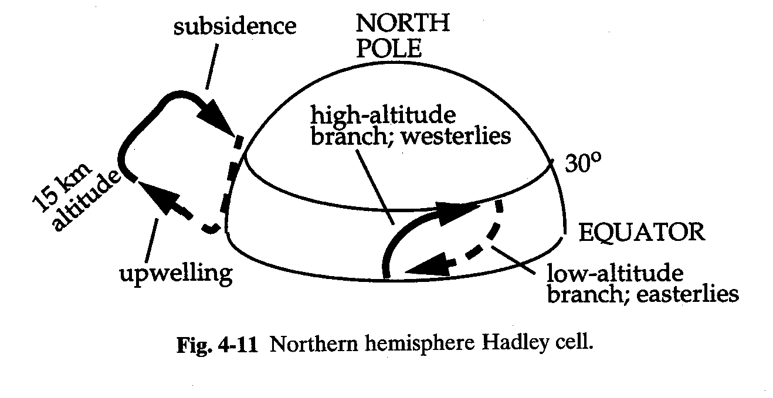
Hadley circulation only extends to about 30º latitude
Easterly trade winds in the tropics at low altitudes
Subtropical anticyclones at about 30º latitude
Westerlies at mid-latitudes

Slide 10
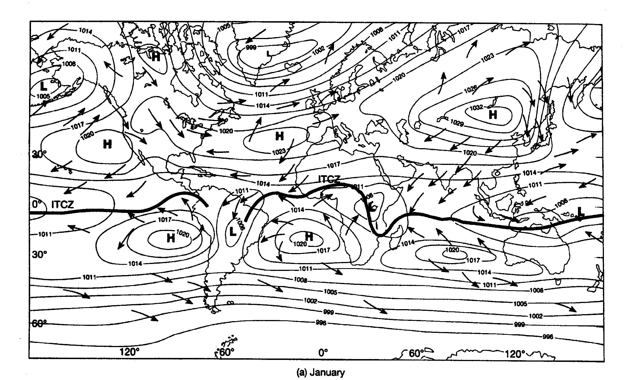
Climatological surface winds and pressures (January)

Slide 11
Climatological surface winds and pressures (July)

Slide 12
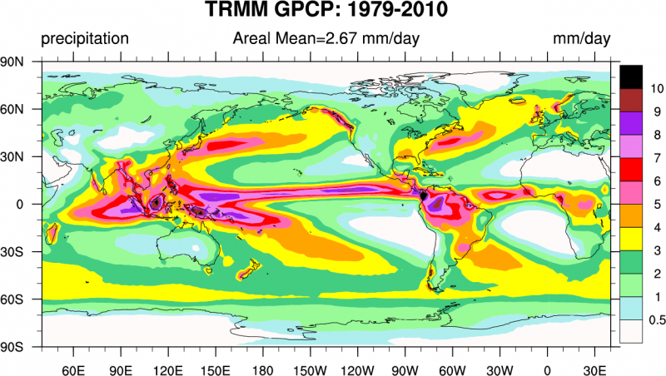
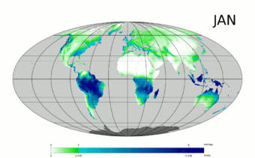
Global precipitation: annual and monthly means

Slide 13
Seasonal distribution of fires (MODIS satellite data)

Slide 14
Time scales for horizontal transport (troposphere)
1-2 months
2 weeks
1-2 months
1 year

Slide 15
Vertical transport driven by buoyancy
Consider an object (density ρ) immersed in a fluid (density ρ’):
z+Δz
Fluid (ρ’)
Object (ρ)
p(z) > p(z+Δz) e pressure-gradient force
on object directed upward
z
g
Buoyancy acceleration (upward) :
For air,
so ρ↑ as T↓
Barometric law assumes T = T’ e a_{b} = 0 (zero buoyancy)
T > T’ causes buoyant acceleration upward
T < T’ causes buoyant acceleration downward
Notes:
buoyancy force= (rho*g); gravity=(rho'*g); net=g*(rho' – rho) ; accel= net/rho (force per unit mass)

Slide 16
Vertical transport: atmospheric lapse rate and stability
“Lapse rate” = -dT/dz
z
Consider an air parcel at z lifted to z+dz and released.
It cools upon lifting (expansion). Assuming lifting to be adiabatic, the cooling follows the adiabatic lapse rate Γ :
stable
Γ = 9.8 K km⁻¹
lifting
z
unstable
What happens following release depends on the local lapse rate –dT_{ATM}/dz:
-dT_{ATM}/dz > Γ e upward buoyancy amplifies initial perturbation: atmosphere is unstable
-dT_{ATM}/dz = Γ e zero buoyancy does not alter perturbation: atmosphere is neutral
-dT_{ATM}/dz < Γ e downward buoyancy relaxes initial perturbation: atmosphere is stable
dT_{ATM}/dz > 0 (“inversion”): very stable
inversion
ATM
(observed)
unstable
T
The stability of the atmosphere against vertical mixing is solely determined by its lapse rate.

Slide 17
What determines the atmospheric lapse rate?
An atmosphere left to evolve adiabatically from an initial state would eventually tend to neutral conditions (-dT/dz = Γ ) at equilibrium
Consider now solar heating of the surface. This disrupts the equilibrium and produces an unstable atmosphere:
z
z
z
ATM
Γ
ATM
final
Γ
Γ
initial
T
T
T
Initial equilibrium
state: - dT/dz = Γ
Solar heating of surface: unstable atmosphere
buoyant motions relax
unstable atmosphere back towards –dT/dz = Γ
Fast vertical mixing in an unstable atmosphere maintains the lapse rate to Γ.
Observation of -dT/dz ≈ Γ is indicator of an unstable atmosphere.

Slide 18
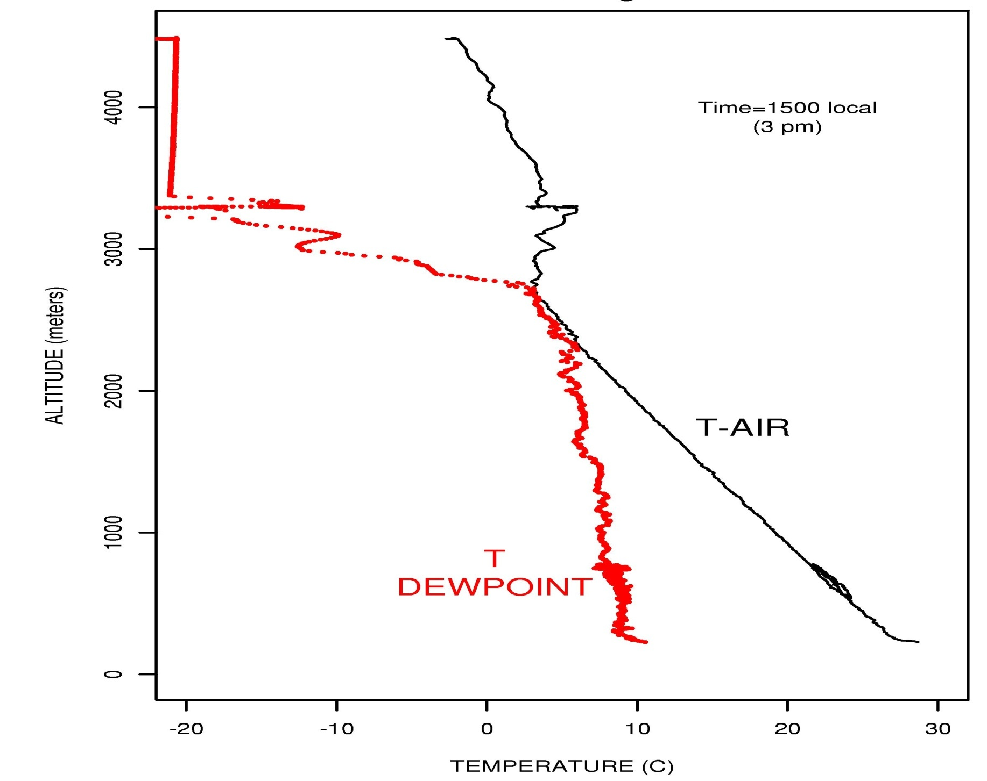
Typical summer afternoon vertical profile over Boston
4
3
cloud
Altitude, km
2
planetary
boundary
layer (PBL)
-dT/dz ≈ Γ
1
0
0
Notes:
A picture to illustrate. Not the same place/time, but the same phenomenon!!
Have the students work out: why the clouds start where they do, and why they stop.
Air is turbulent (cf. airplane take off and landing) below the cloud base and usually smooth above—why?

Slide 19
In cloudy air parcel, heat release from water condensation decreases the lapse rate
“Wet” adiabatic lapse rate Γ_{W} = 2-7 K km⁻¹
z
T
RH
100%
Γ_{W}
“Latent” heat release
as H₂O condenses
Γ_{W} = 2-7 K km⁻¹
RH > 100%:
Cloud forms
Γ
Γ = 9.8 K km⁻¹

Slide 20
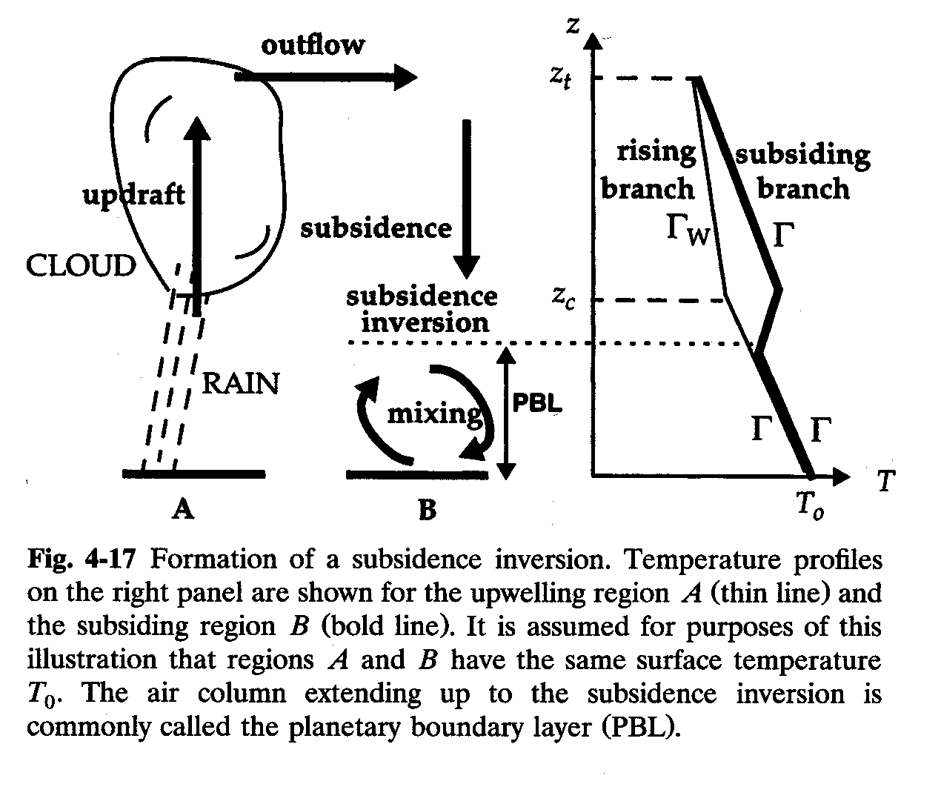
Subsidence inversion
typically
2 km altitude

Slide 21
DIURNAL CYCLE OF SURFACE HEATING/COOLING: ventilation of urban pollution
z
Planetary
Boundary
Layer (PBL)
depth
Subsidence
inversion
MIDDAY
1 km
Γ
Mixing
depth
NIGHT
0
MORNING
T
NIGHT
MORNING
AFTERNOON

Slide 22
VERTICAL PROFILE OF TEMPERATURE Mean values for 30ºN, March
Radiative
cooling (ch.7)
- 3 K km⁻¹
Altitude, km
+2 K km⁻¹
Radiative heating:
O₃ + hν → O₂ + O
O + O₂ + M → O₃+M
heat
Radiative
cooling (ch.7)
- 6.5 K km⁻¹
Latent heat release
Surface heating

Slide 23
TYPICAL TIME SCALES FOR VERTICAL MIXING
tropopause
(10 km)
10 years
1 month
2 km
planetary
boundary layer
1 day
0 km

