Slide 1
1. MEASURES OF ATMOSPHERIC COMPOSITION

Slide 2
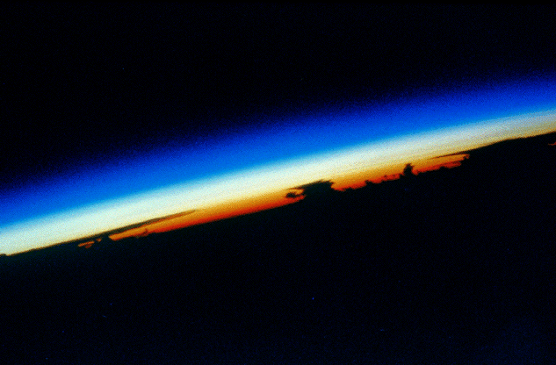
The atmosphere: gas envelope surrounding the Earth
The atmosphere seen from the space shuttle
Size of air molecules ≈ 0.3 nm << λ
scattering is inefficient and ~ λ⁻⁴
Absorption at visible wavelengths is also very weak
Sun seen from space shuttle
Visible solar radiation
wavelength λ = 0.4 µm
scatter
0.5
scatter
0.6
cloudy sunset
0.7
Sky is blue
Sun is yellow
Sunset is red

Slide 3
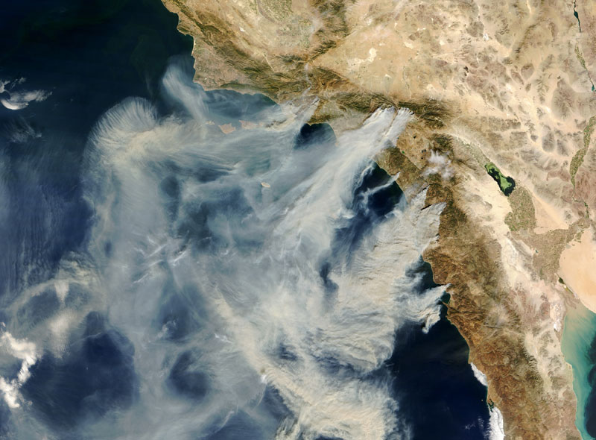
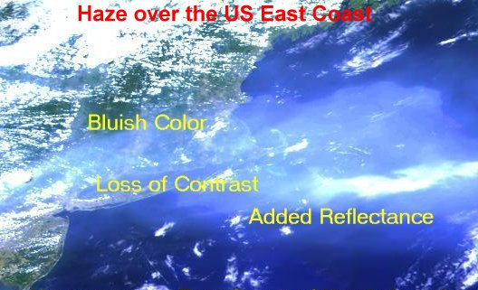
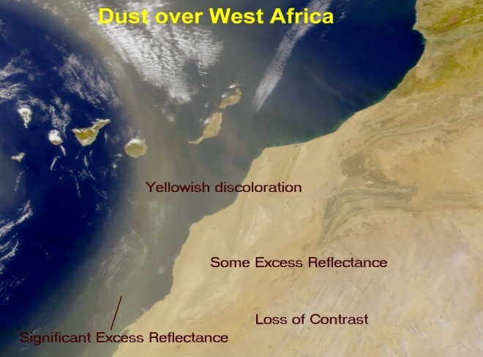
Aerosols and clouds: the visible part of the atmosphere
Aerosols are suspended solid or liquid particles, typically 0.1-1 µm in size
California fire plumes
Pollution off U.S. east coast
Dust off West Africa
Cloud droplets (1-100 μm in size) form by condensation on particles when relative humidity exceeds 100%

Slide 4
Atmospheric gases are “visible” too… if you look in UV or IR
Visible
0.4-0.7 µm
Ultraviolet (UV)
Infrared (IR)
Fraction of solar radiation
absorbed by
atmospheric
gases
Satellite observation of ozone over Antarctica
Nitrogen dioxide (NO₂ ) observed by satellite in the UV

Slide 5
Measure of relative concentration: mixing ratio (mole fraction) C_{X} [mol mol⁻¹]
remains constant when air density changes
⇒ stable measure of atmospheric composition
SPECIES | MIXING RATIO (dry air) [mol mol⁻¹]
Nitrogen (N₂) | 0.78
Oxygen (O₂) | 0.21
Argon (Ar) | 0.0093
Carbon dioxide (CO₂) | 400x10⁻⁶
Neon (Ne) | 18x10⁻⁶
Ozone (O₃) | (0.01-10)x10⁻⁶
Helium (He) | 5.2x10⁻⁶
Methane (CH₄) | 1.8x10⁻⁶
Krypton (Kr) | 1.1x10⁻⁶
Air also contains variable H₂O vapor (10⁻⁶-10⁻² mol mol⁻¹),
aerosol particles, and many trace gases at < 1x10⁻⁶ mol mol⁻¹
Trace
gases
Trace gas concentration units:
1 ppm = 1 µmol mol⁻¹ = 1x10⁻⁶ mol mol⁻¹
1 ppb = 1 nmol mol⁻¹ = 1x10⁻⁹ mol mol⁻¹
1 ppt = 1 pmol mol⁻¹ = 1x10⁻¹² mol mol⁻¹

Slide 6
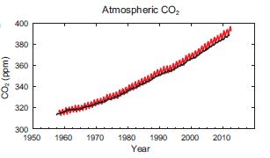
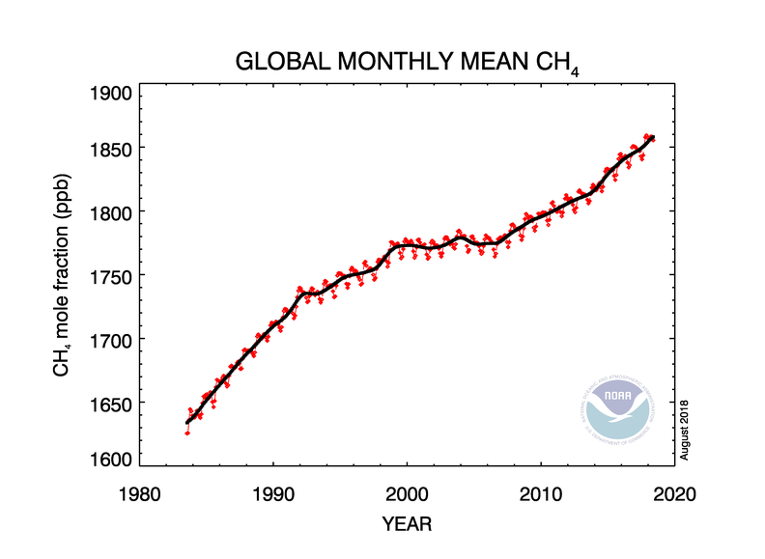
Atmospheric concentrations of greenhouse gases
CO₂
Methane
Mauna Loa
South Pole
Concentration units: parts per million (ppm) and parts per billion (ppb)
CO₂ and methane concentrations are reported as mixing ratios

Slide 7
Measure of absolute concentration [X]: mass or moles per unit volume of air
Number density n_{X} [molecules cm⁻³]
Proper measure of concentration for
reaction rates
optical properties of atmosphere
Proper measure for absorption of radiation by atmosphere
n_{X} and C_{X} are related by the ideal gas law:
n_{a} = air number density
A = Avogadro’s number
p = pressure
R = Gas constant
T = temperature
M_{X}= molar mass of X [g mol⁻¹]
Mass concentration (g cm⁻³):

Slide 8
Gas-phase reaction rates depend on number densities
activated
complex
A
C
reactants
AB*
products
B
D
rate constant
product of number densities,
proportional to collision frequency

Slide 9
Absorption of radiation depends on column concentration
Radiation flux at top of atmosphere
Column
absorption proportional to n_{X}dz
dz
surface

Slide 10
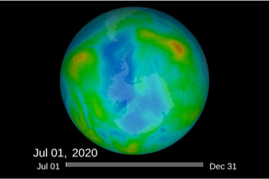
Monitoring the ozone column from satellite
http://ozonewatch.gsfc.nasa.gov/
Method: UV solar backscatter
Sun
λ₁
λ₂
Ozone layer
Reflection by
Earth surface
0
50
100
150
Ozone column, 10¹⁷ molecules cm⁻²
Ozone
absorption
spectrum
Thickness of ozone layer is measured
as a column concentration
λ₁
λ₂

Slide 11
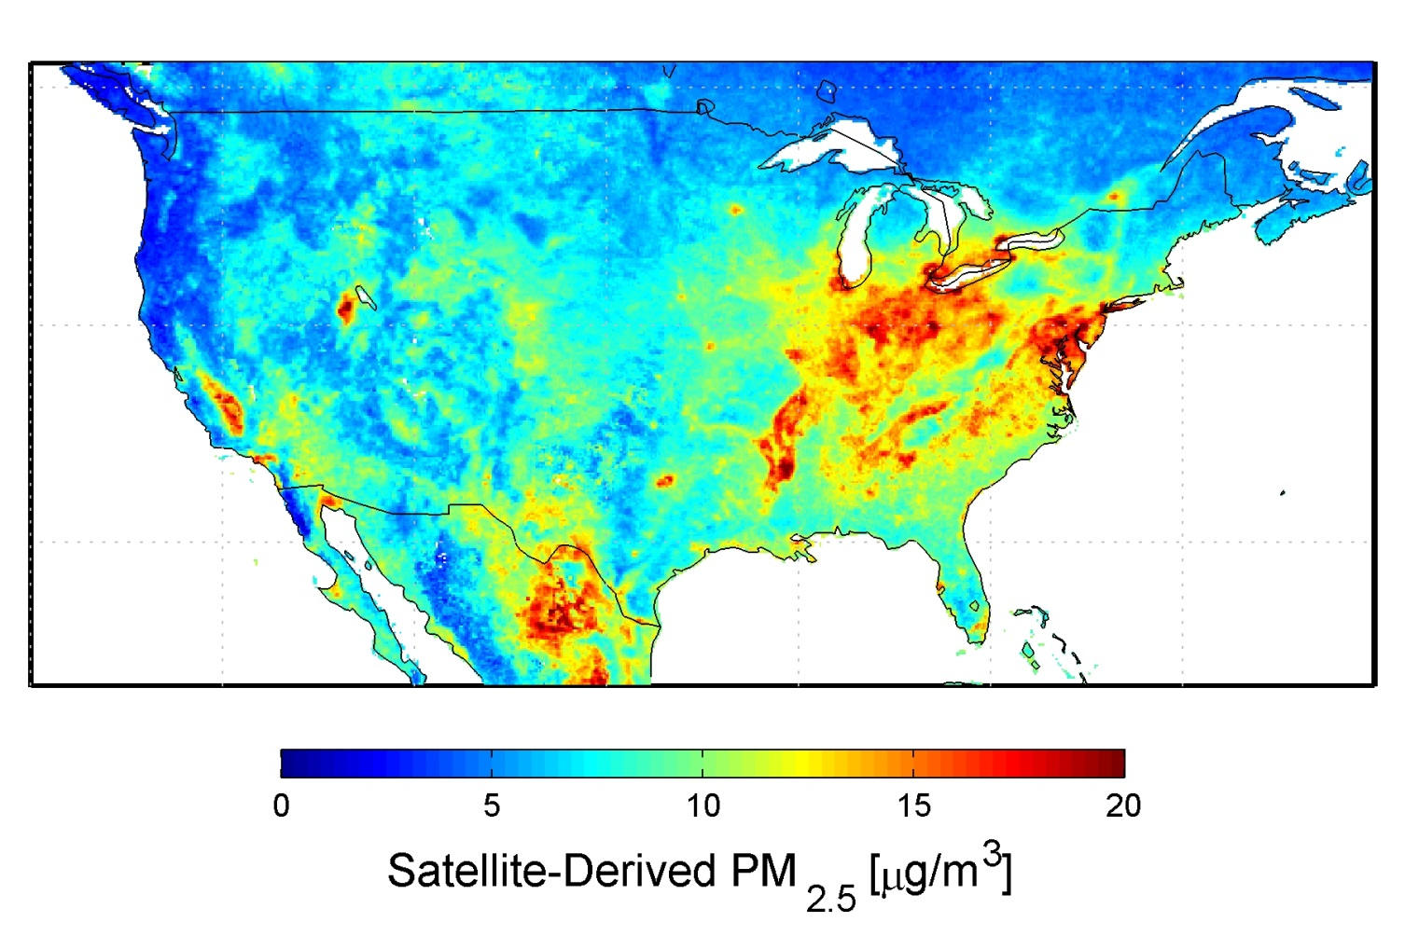
Aerosol concentrations are often expressed as mass per unit volume, typically in units of [μg m⁻³]
Surface PM_{2.5} ≡ fine particulate matter < 2.5 μm diameter
EPA air quality standard: 12 μg m⁻³ (annual mean)

Slide 12
Absolute concentration of gas can also be measured as partial pressure p_{x} [Pa]
The partial pressure p_{X} of a gas X in a mixture is the pressure that the gas would exert if all other gases in the mixture were removed.
Proper measure for phase change
(such as condensation of water vapor)
Dalton’s law
Thought experiment: consider a pan of water with a lid:
head space
T₁
p_{H2O} = p_{H2O,SAT}(T₁)
saturation vapor pressure
liquid water
Now heat the pan:
T₂ > T₁
p_{H2O} = p_{H2O,SAT}(T₂)
> p_{H2O,SAT}(T₁)

Slide 13
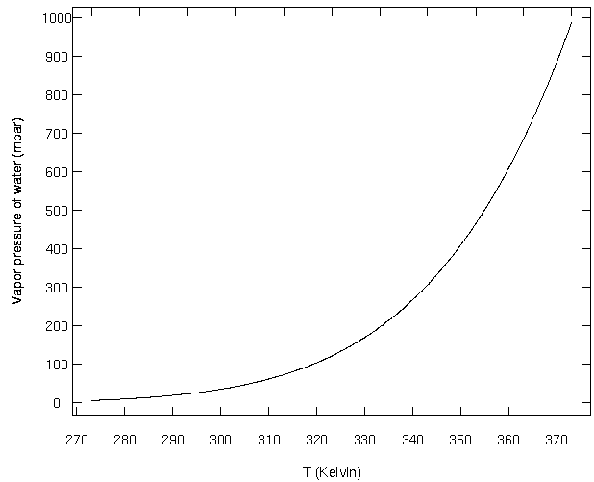
Clausius-Clapeyron equation: p_{H2O, SAT} = f(T)
A = 6.11 hPa
B = - 5310 K
T_{o} = 273 K
P_{H2O,SAT} (hPa)
T (K)
Notes:
DEMO: the freezing experiment. ask for student predictions.
Explain about nucleation of the bubbles. Why are bubbles formed in the liquid and what are they made from?
freezing: more energy in the ordered lattice, latent heat of "fusion" = 0.34 x 10⁶ J/kg (less than evaporation, but still considerable).
relate to boiling – what is boiling?
condensation—as in a shower stall. Is heat released on condensation?
To evaporate 1 kg of ice, 2.26 + .34 = 2.6 kJ/kg.
Clausius-Clapeyron relationship—
P_{sat} = A exp [B( 1/273.15 – 1/T)] A=6.11 mbar, B= 5308K. A=water vap. pressure at 0C.

Slide 14
Phase rule: defines the conditions for different phases to be present at equilibrium in a multicomponent mixture
n = c + 2 - p
c = number of components
p = number of phases at equilibrium
n = number of degrees of freedom (independent variables) determining this equilibrium
Derivation: see chapter 1 of Introduction to Atmospheric Chemistry (2nd edition)
on Jacob’s Education webpage
Example: consider the equilibrium between gas and liquid water. There are two variables determining the system: p_{H2O} and T
For the gas and liquid phases to be at equilibrium we have
c = 1, p =2 → n = 1 only one degree of freedom which can be either p_{H2O} or T
(but not both)
This is indeed expressed by p_{H2O,SAT} = f(T)

Slide 15
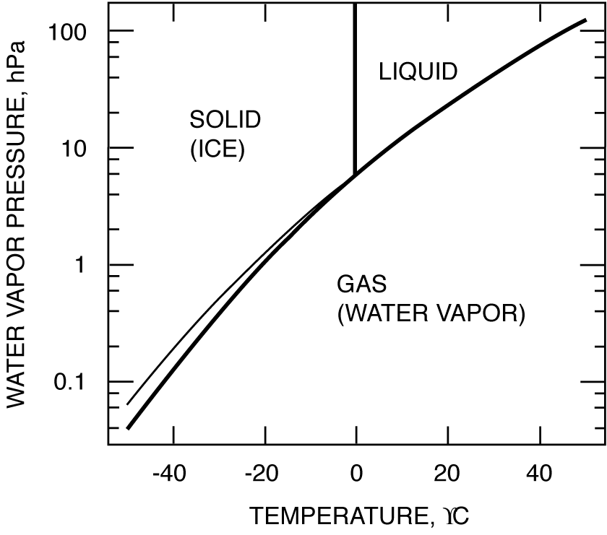
Phase diagram for water
Clausius-Clapeyron curve
triple
point (n = 0)
gas-liquid
metastable
equilibrium
o

Slide 16
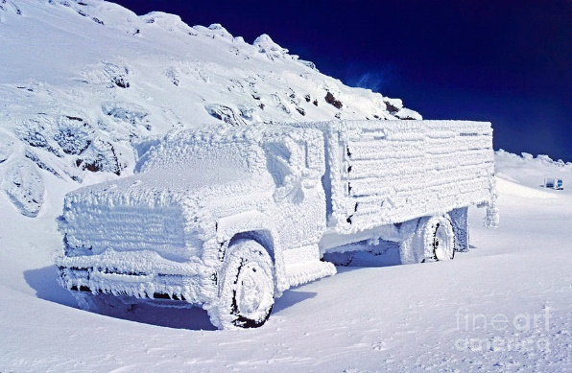
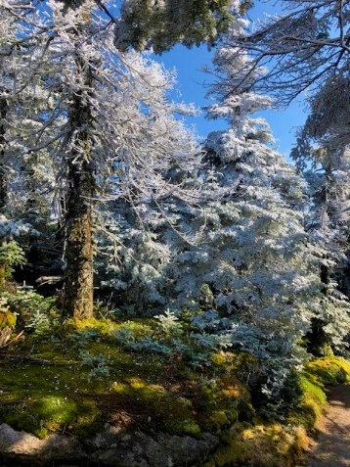
Even at temperatures < 0 ºC, water droplets may not freeze… because creating an ice surface requires energy (surface tension)
Thought experiment: imagine an ice embryo forming in a cloud droplet
Ice molecules at the surface are not happy because they are not bound to their ice neighbors – producing these surfaces requires energy
Because of this, cloud droplets can remain supercooled liquid in metastable equilibrium down to temperatures as low as -40 ºC
When supercooled cloud droplets hit surfaces, you get instant freezing because the freezing surface is provided: this produces rime ice
Frosted trees near the top of Cannon Mt.
truck on Mt. Washington

Slide 17
Working with the phase diagram: current Cambridge weather
cooling
Initial state
cloud
o
Relative humidity (%) = 100(p_{H2O}/p_{H2O,SAT})
Dew point: Temperature T_{d} such that p_{H2O} = p_{H2O,SAT}(T_{d})

Slide 18
RUNAWAY GREENHOUSE EFFECT ON VENUS
due to accumulation of water vapor from volcanic outgassing early in its history
…did not happen on Earth because farther from Sun; as water accumulated it reached saturation and precipitated, forming the oceans
EARTH
VENUS

Slide 19
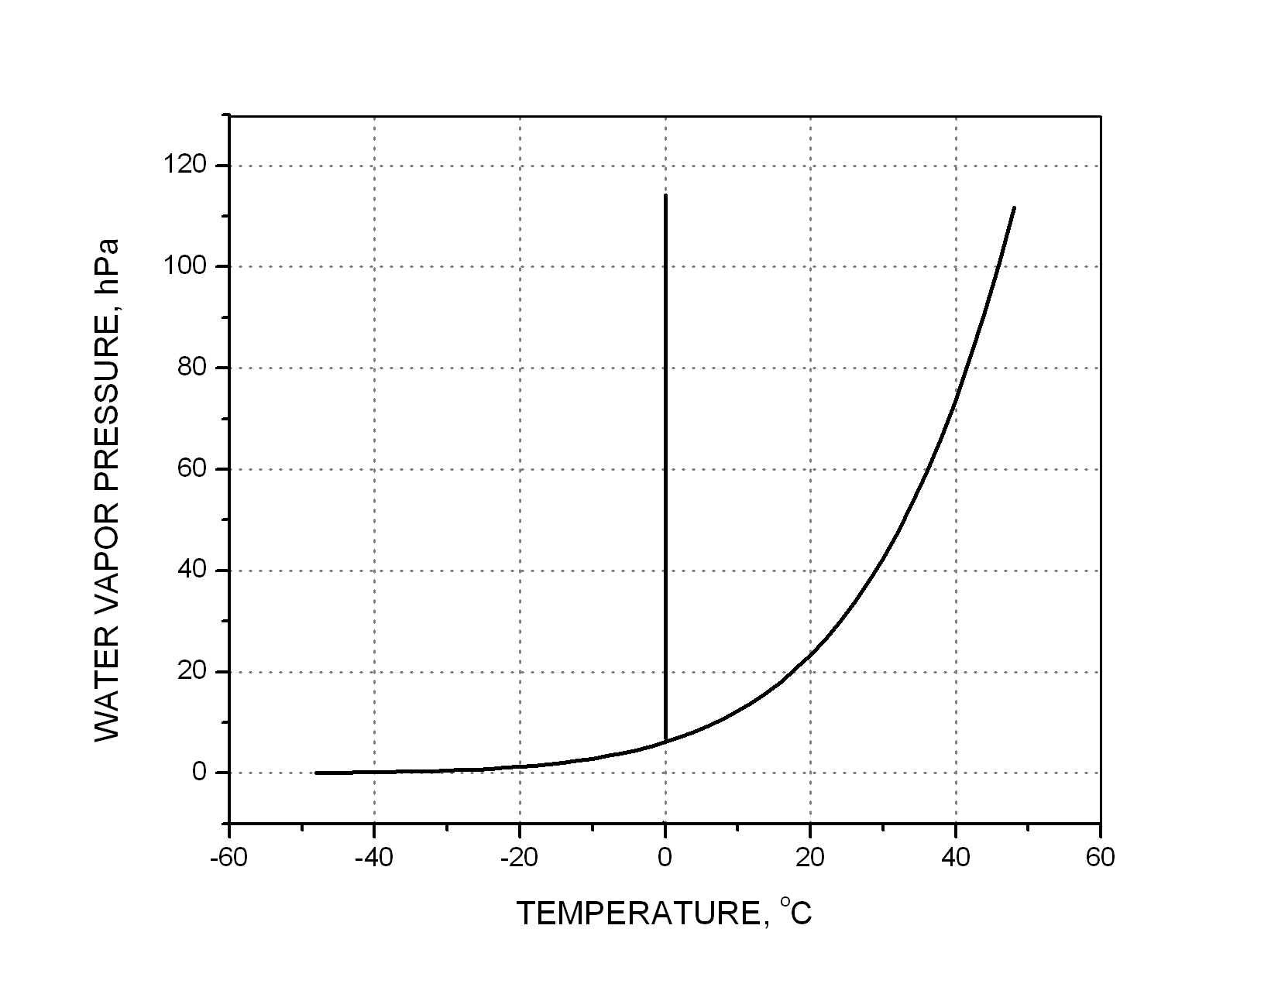
WHY CAN YOU SEE YOUR BREATH ON COLD MORNINGS?
Draw mixing lines (dashed) to describe dilution of your breath plume w/outside air
p_{H2O} is plotted on linear
scale to draw the mixing
lines
LIQ
Your breath
37ºC, ≈ 100%RH
ICE
cloud!
no cloud
warm outside air
cold outside air
GAS

