Slide 1
Atmospheric methane

Slide 2

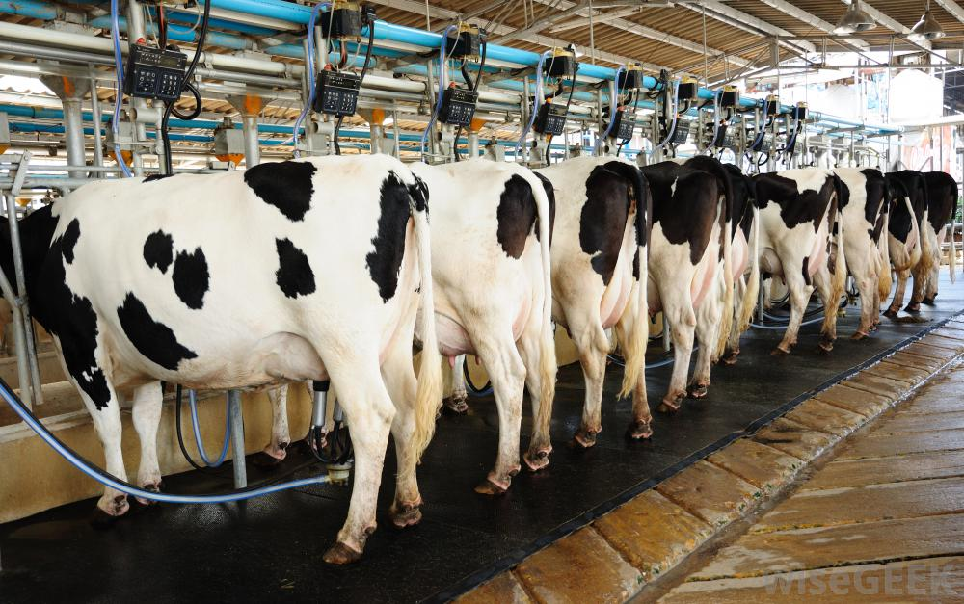
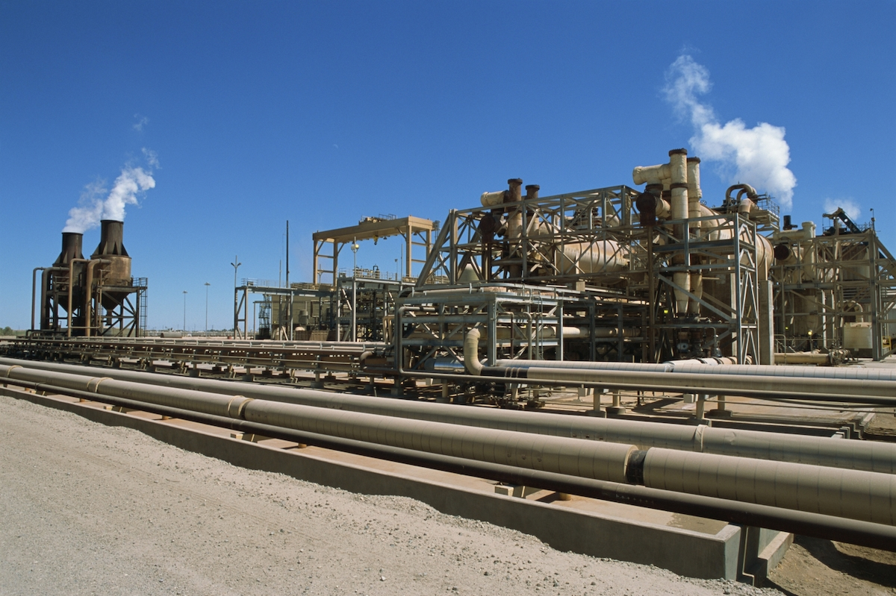
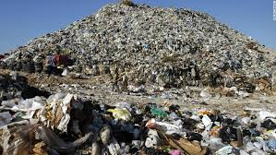
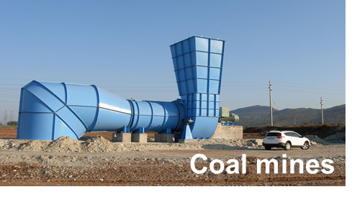
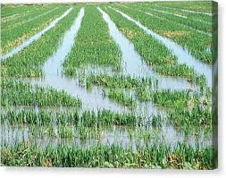
Complexity of methane sources
Methane is a major greenhouse gas… but where does it come from?
Wetlands
Livestock
Oil/gas
Atmospheric oxidation
by OH radicals
CH₄
CO₂
9-year lifetime
global emission
(Tg a⁻¹⁾
Waste
Other human: 30
[20-40]
Waste: 70
[50-80]
Satellite observations hold the key!
Wetlands: 170 [100-220]
Coal: 40
[20-60]
Other natural: 20
[10-100]
Oil/Gas: 80
[60-100]
Livestock: 110 [90-140]
Rice: 30 [20-40]
Rice
‘Bottom-up’ source estimates: activity x emission factor

Slide 3
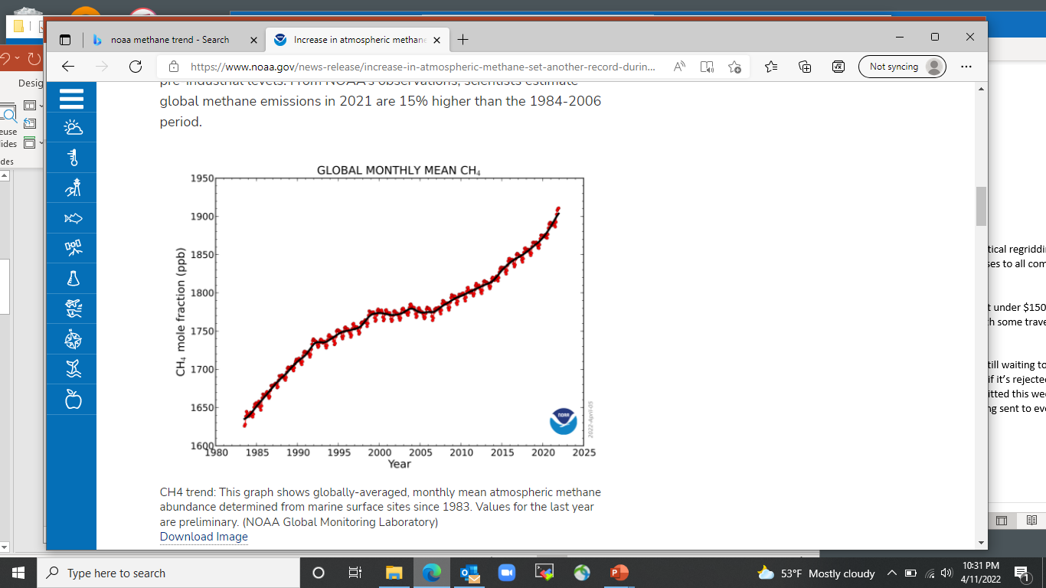
Rise of methane since pre-industrial time
Methane has tripled
Growth in fits and starts
2020-2021: fastest growth on record
atmospheric measurements
(NOAA sites)
Antarctic ice cores [IPCC, 2021]

Slide 4
Radiative forcing since pre-industrial time referenced to emissions
GSAT is global surface average temperature
Observed warming
Greenhouse warming is 50% from CO₂, 30% from methane, 20% from others
Aerosols and nitrogen oxides (NO_{x}) offset ~30% of the greenhouse warming
…but what does that mean for the importance of future controls?
IPCC [2021]

Slide 5
Reducing methane emissions is very important for 10-year horizon…
… but CO₂ totally dominates over 100-year horizon
IPCC [2021]
Reducing methane emissions now would have immediate impact on climate
  It would compensate for expected decrease in aerosol pollution
  It could save us from ‘2 degrees of danger’ (maybe even 1.5)
But methane is largely irrelevant in the long term (~100 years)
Methane and CO₂ emissions should not be viewed as “equivalent” in climate policy

Slide 6


Short lifetime of methane makes it a powerful lever for near-term climate action
…but it cannot be an alternative to action on CO₂
Business as usual
CO₂ emission decrease to near zero
Climate risks
Start of climate action
CO₂ emission decrease
+ carbon capture
CO₂ emission decrease
+ carbon capture
+ methane emission decrease
Time

Slide 7
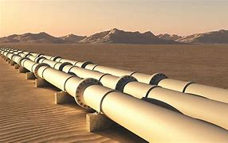
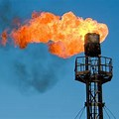
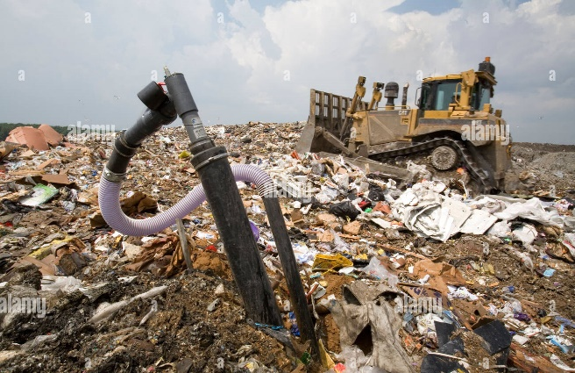
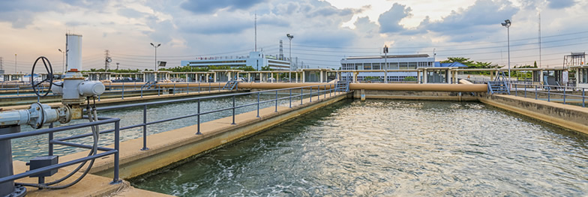
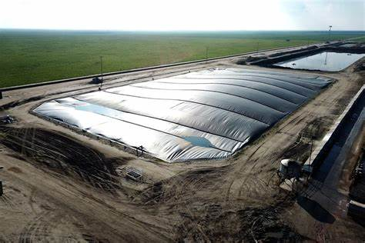

Decreasing methane emissions should be relatively easy if we can figure out where it is coming from…
Fix leaks detected by satellite or aircraft
Flare excess gas
…or use it
recover gas from landfills
Recover/digest gas from manure ponds, wastewater plants
Upland rice agriculture

Slide 8

…but problem is that it could be coming from a zillion of individually small point sources
oil field in California

Slide 9
This translates into order-of-magnitude uncertainties in national oil/gas emissions
National methane emission inventories for oil/gas sector (Tg a⁻¹)
UN reports
Bottom-up
inventories
…and little credibility in emissions reported by individual countries under Paris agreement
Scarpelli et al., 2022

Slide 10

Using satellite observations to better quantify methane emissions
compare
predicted concentrations
observed atmospheric concentrations
inversion
atmospheric transport model relates emissions to concentrations
correct
bottom-up inventory
Posterior estimate
Prior estimate from bottom-up inventory: activity x emission factors

Slide 11
Producing spatially resolved versions of the national inventories reported to the UN under the Paris agreement
Example: US EPA inventory reported to the UNFCCC
Satellite observations then enables us to test and improve these inventories, monitor emission trends
Scarpelli, Jacob, Grossman, et al., 2022

Slide 12
Using satellite observations to better quantify methane emissions
compare
predicted concentrations
observed atmospheric concentrations
inversion
atmospheric transport model relates emissions to concentrations
correct
bottom-up inventory
Posterior estimate
Prior estimate from bottom-up inventory: activity x emission factors
Bayes’ probability theorem:
P (true emissions | observations) P (bottom-up emissions) x P (observations | true emissions)
posterior
prior
observations
errors

Slide 13
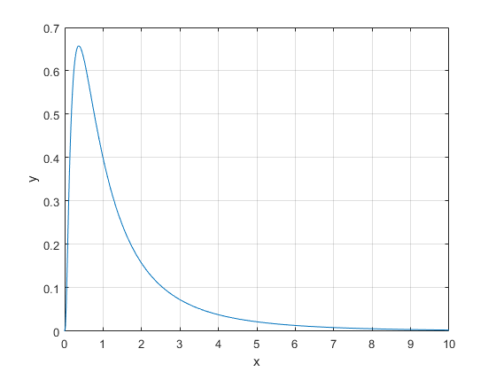
Probability density function (pdf)
Example: log-normal pdf
probability density P(x)
variable x
P(x)dx = probability of variable x having value in range [x, x + dx]

Slide 14
Bayes’ theorem and the optimal estimation of x given y
P(x) = probability density function (pdf) of x
P(x,y) = pdf of (x,y)
P(y | x) = pdf of y given x
Probability of
[x, x+dx; y, y+dy]
P(x,y)dxdy
observation pdf
prior pdf
posterior pdf
a
Bayes’
theorem
normalizing factor (unimportant)
Optimal (posterior) estimate solution for x given y is max[P(x | y)]
a
solve for
Brasseur and Jacob, chapter 11.2

Slide 15
Joint probability density function P(x,y)
Contour lines indicate 10% to 90% of P_{max}
prior estimate x_{A}
posterior estimate
P(x,y)
y
P_{max}
P(y)
integrated over all x
P(x|y)
make observation y
P(x)
integrated over all y
x
Ellipse tilt indicates correlation of the probabilities of x and y (here r = -0.4)

Slide 16
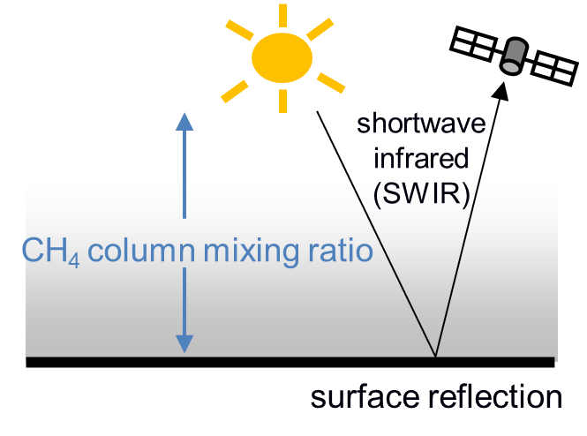
Measuring methane from satellites
1.65 μm band
2.3 μm band
Atmospheric optical depth in the SWIR
Jacob et al., 2016

Slide 17
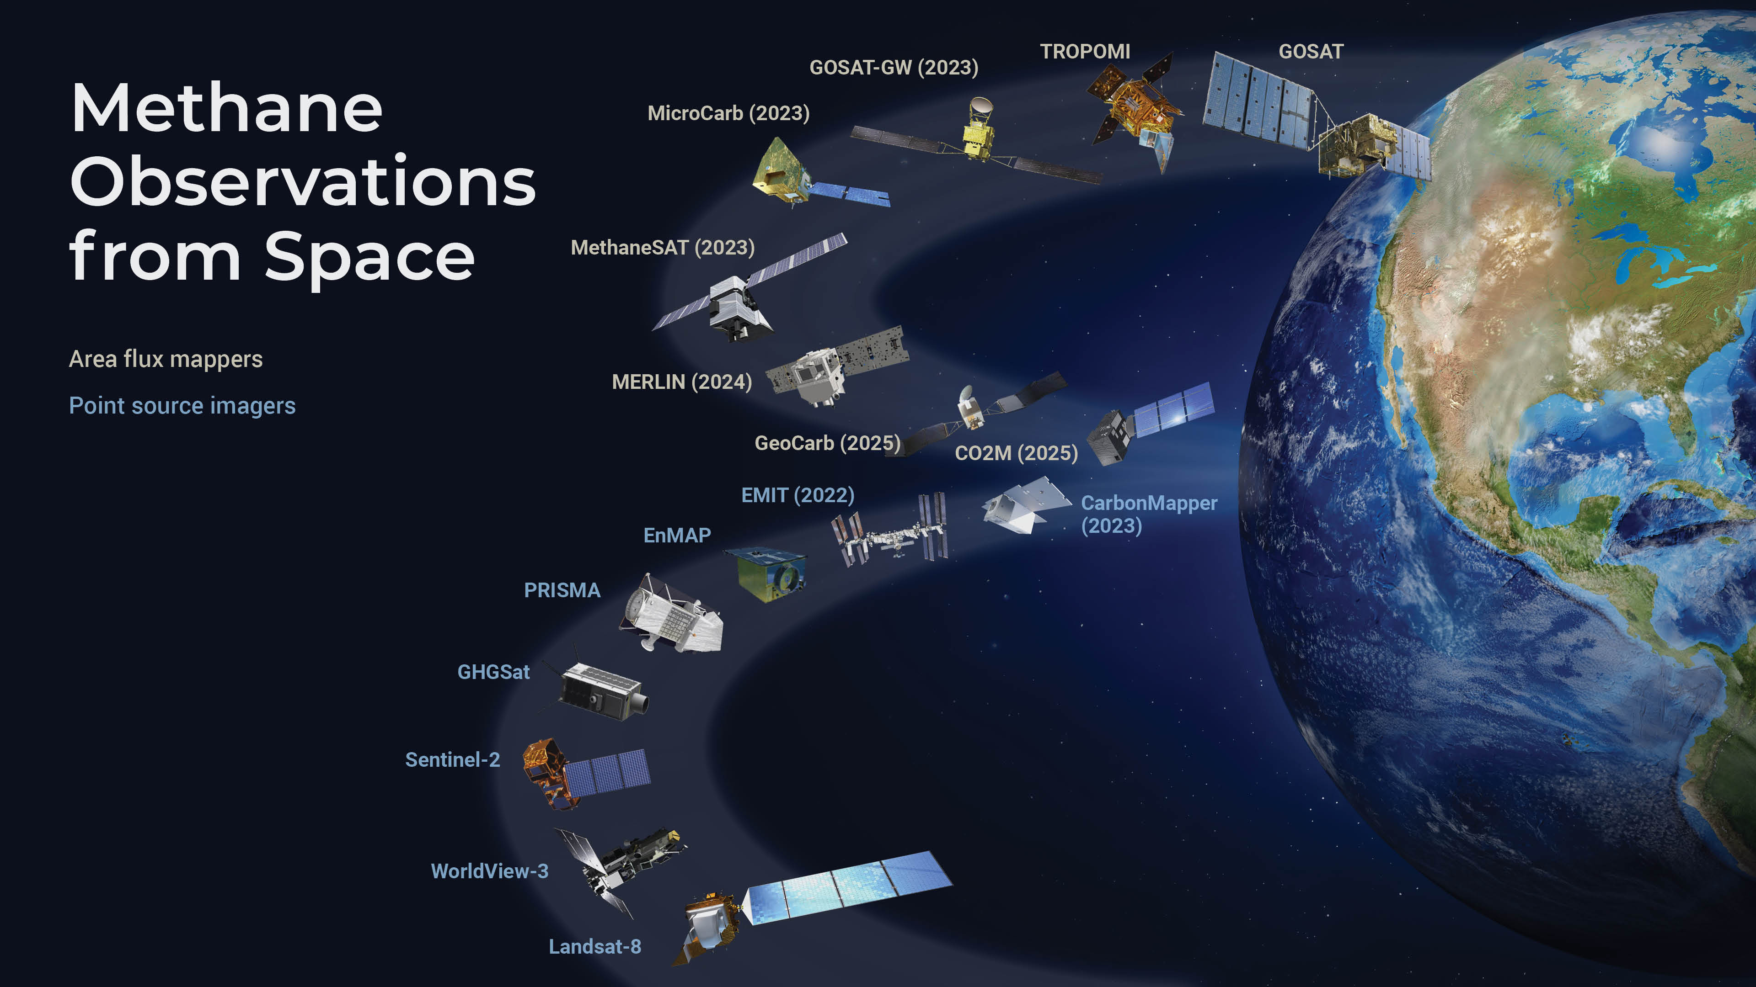
Current and planned satellite fleet
Jacob et al., 2022

Slide 18
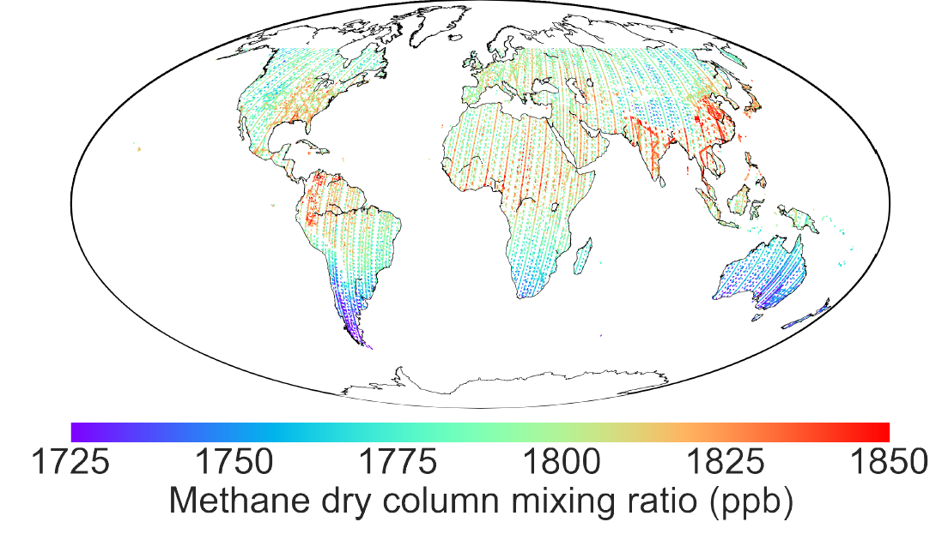
Global methane emissions inferred from GOSAT
2x10⁵ observations per year,
2010-present
Qu et al. [2021];
Worden et al. [2022]
160 Tg a⁻¹
5
140
40
80
30
30
30

Slide 19
Top ten emitting countries [Tg a⁻¹]
Chen et al. [2022]; Lu et al. [2022]; Worden et al. [2022]

Slide 20
2010-2018 methane emission trends inferred from GOSAT
2x10⁵ observations per year
Emission trends (Tg a⁻¹a⁻¹)
Zhang et al. [2021]

Slide 21
Correcting national inventories submitted to UNFCCC
US EPA inventory: 26.0 Tg a⁻¹
Inversion results: 36.9 (32.7-37.8) Tg a⁻¹
Canada ECCC inventory: 3.7 Tg a⁻¹
Inversion results: 5.3 (3.6-5.7) Tg a⁻¹
Mexico INECC inventory: 5.0 Tg a⁻¹
Inversion results: 6.0 (4.7-6.1) Tg a⁻¹
Reported inventories are 20-40% too low
Oil/gas is major culprit
Lu et al. [2022]

Slide 22
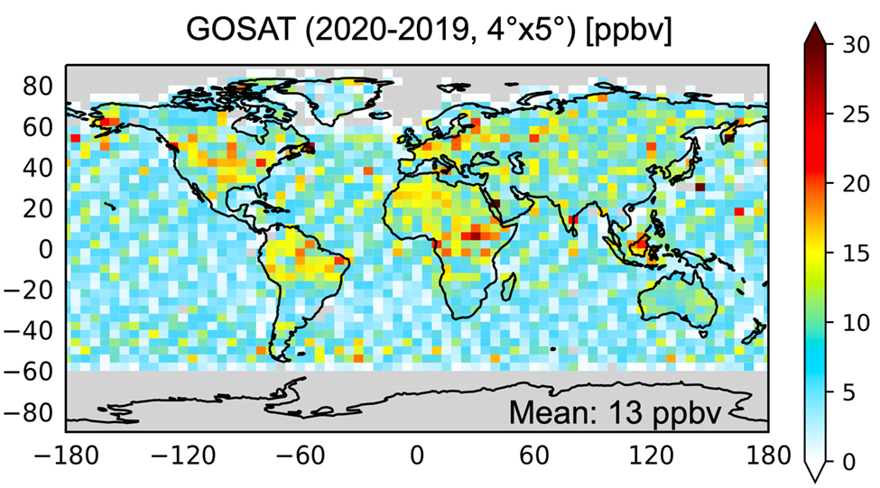
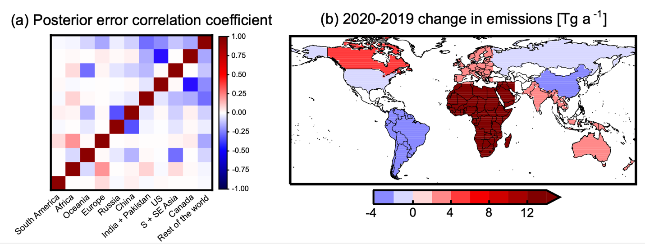
Attribution of 2020 methane surge
inversion
African wetlands drive 55% of the surge; independent evidence from inundation data
Canadian wetland emissions increase by 21%; independent evidence from temperature data
Are we seeing the wetlands respond to climate change?

Slide 23

TROPOMI observations (May 2018 -) global daily coverage
Permian basin (largest US oil field)
iJacob et al., 2022

Slide 24
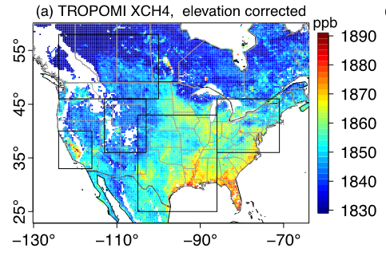
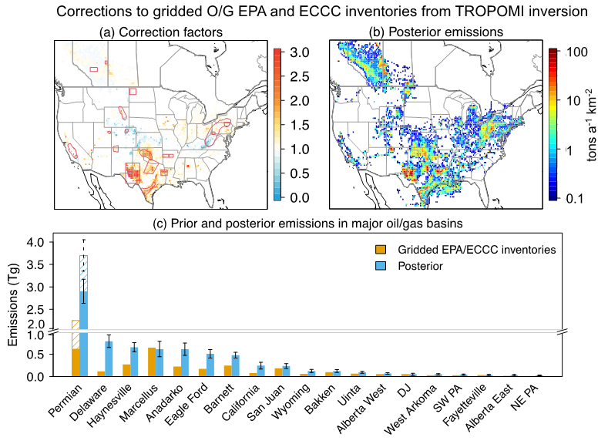
Using TROPOMI data to quantify US oil/gas emissions from individual basins
Correction factors to EPA/ECCC emission reports
TROPOMI
The Permian is responsible for half of the EPA underestimate of oil/gas emissions
Shen et al., submitted

Slide 25
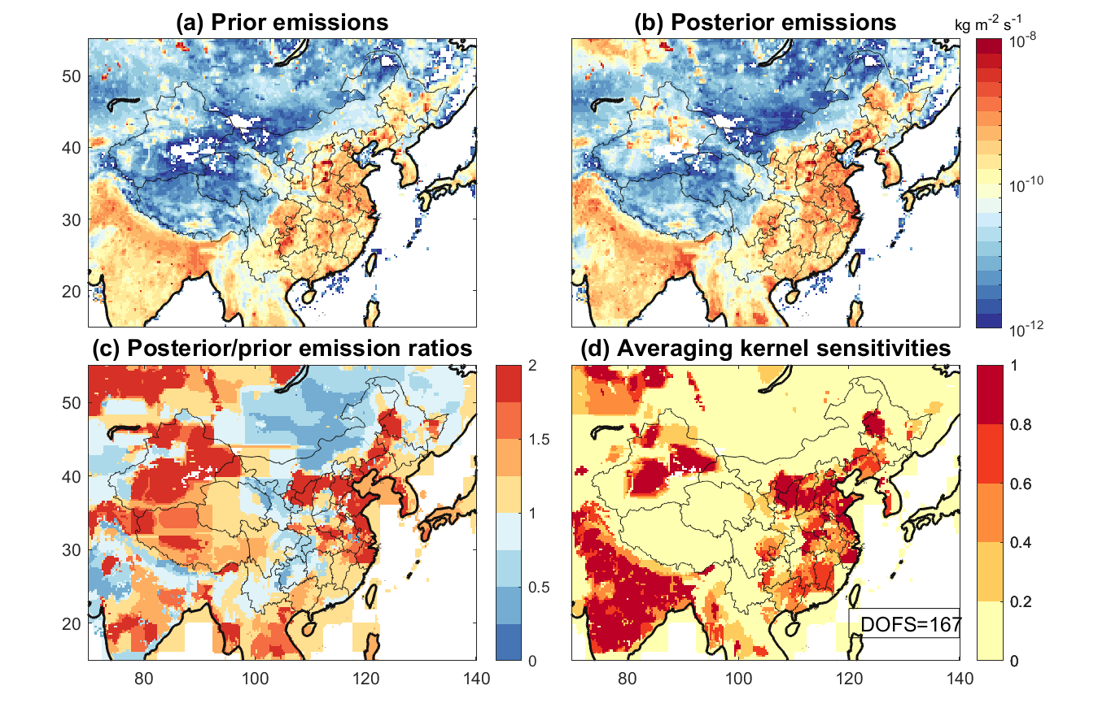
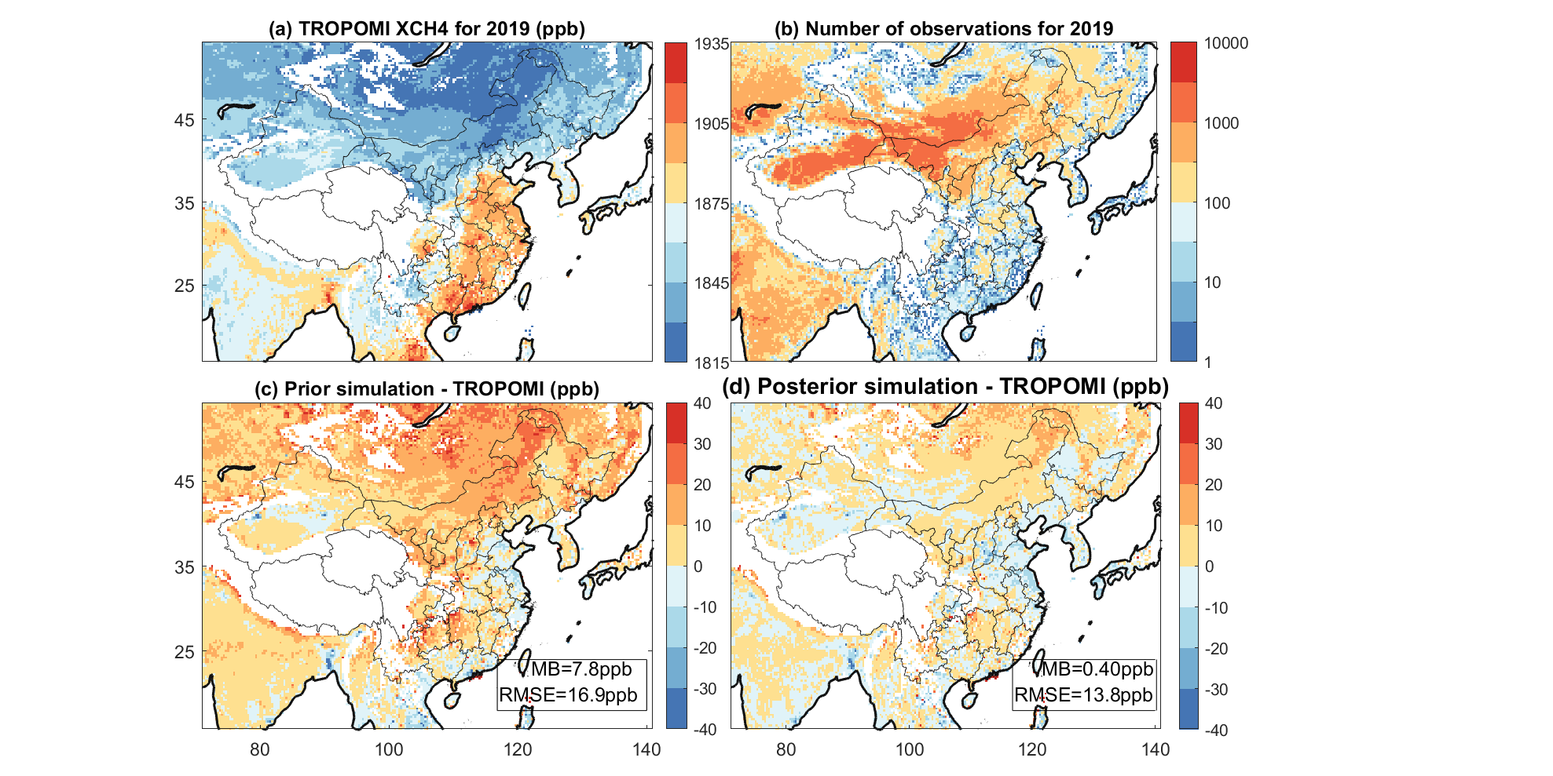
Application of TROPOMI to methane emissions in China
TROPOMI satellite methane
Emissions reported to UN
Rice 11.9
(+34%)
Coal 16.6 (-15%)
Improved emission estimates, Tg a⁻¹
(% correction to UN estimates)
Waste 9.3
(+41%)
Oil/gas 2.6
(+136%)
Oil/gas emissions in China are very low, but they import half their gas from Russia, Turkmenistan…
Zichong Chen, in prep.
Livestock 17.8 (+37%)

Slide 26
TROPOMI observations of ‘ultra-emitters’
leaky pipelines
coal
oil/gas
oil/gas
livestock
landfills
Fixing very large point sources can enable effective climate action…but we need better localization than TROPOMI can provide
Lauvaux et al., 2022

Slide 27
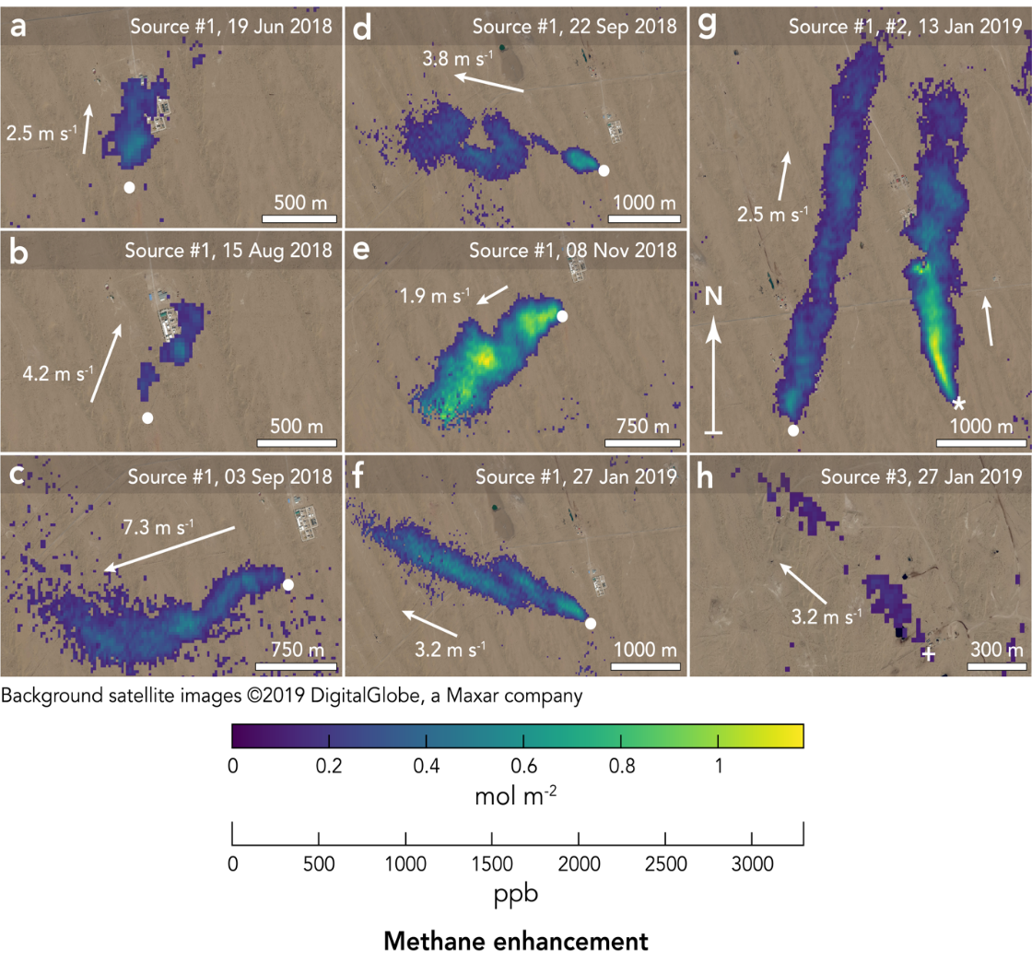
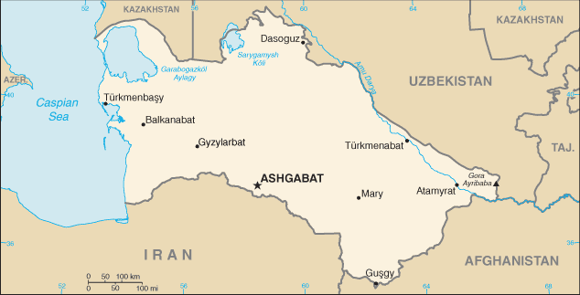

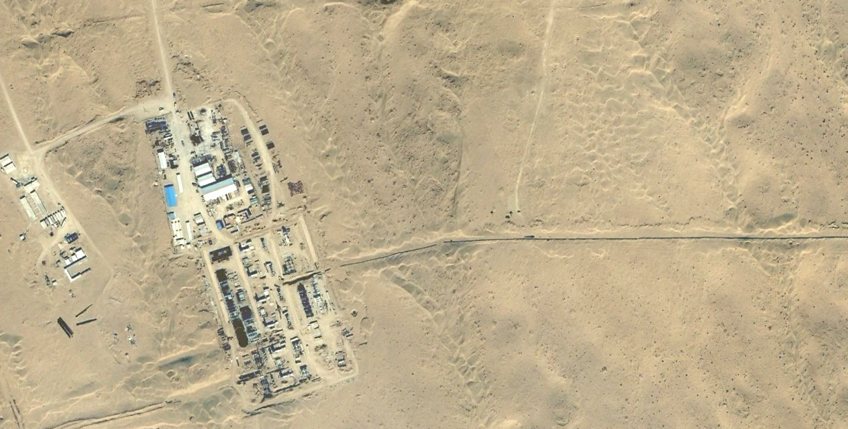
Observation of methane point sources from space
13 Jan 2019
GHGSat microsatellite
25x25 m² pixels
TURKMENISTAN
methane
plume
Point source
buried
pipeline
12 km
30 tons h⁻¹ (once)
12 km
buried
pipeline
10-42 tons h⁻¹ (persistent)
Korpezhe gas compressor station
Varon et al., GRL 2019

Slide 28
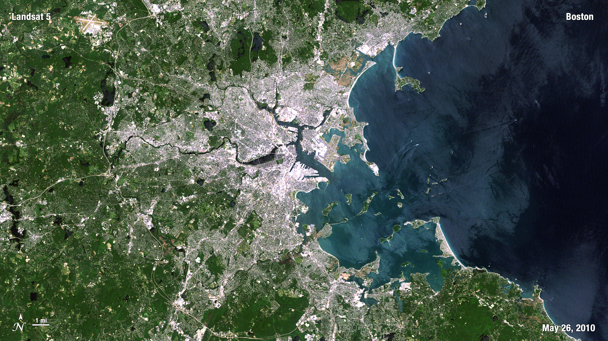
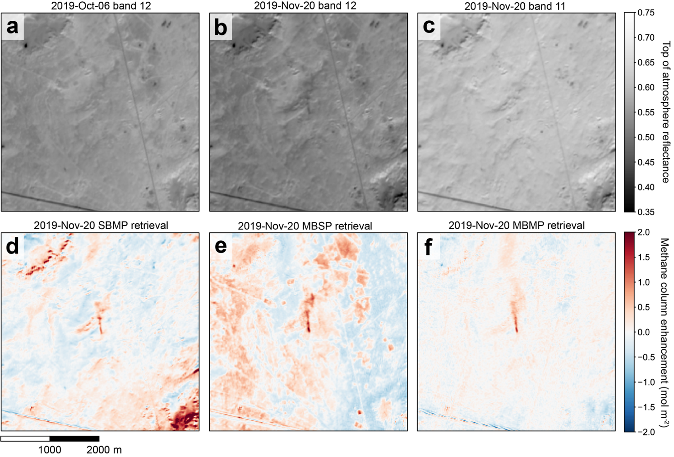
Observing large methane point sources with land-imaging spectrometers
LandSat over Boston
AVIRIS-NG over Permian: methane plumes
Landsat:
100 nm spectral resolution,
useless for methane
Oil well plume in Algeria, observed by Sentinel-2 for almost a year
6% of reported
national O/G emissions
flare lit
Cusworth et al. [2021], Varon et al. [2021]

Slide 29
Take-aways
Methane is important for near-term warming, not long-term.
It is not equivalent to CO₂ !
We need better understanding and global monitoring of methane emissions;
satellites must play a key role in this observing system
National emission inventories reporting to the Paris agreement typically underestimate oil/gas emissions by a factor of 2.
Methane increase over the past decade appears to be mainly driven by tropical livestock.
Satellite observations of large point sources can enable prompt and effective climate action.

