Slide 1
Environmental mercury and the role of the atmosphere
Hg
Hg

Slide 2
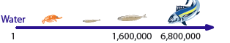
Mercury from fish consumption: a global environmental issue
EPA reference dose (RfD): 0.1 μg kg⁻¹ d⁻¹ (about 2 fish meals per week)
Children IQ deficits (fetal exposure)
Well-established
$8 billion per year cost in US
Adult cardiovascular, fertility effects
Suspected
Mercury biomagnification factor
Hg (mg/kg)
Shark
Marlin
Halibut
Skate
Cod
Squid
Crab
Tilefish
Lobster
Lobster
Croaker
Pollock
Bluefish
Sea trout
Snapper
Mackerel
Swordfish
Scorpionfish
Sablefish
Whitefish
Salmon
Orange Roughy
Canned Tuna (lt)
Grouper, Rockfish
Canned Tuna (alb)

Slide 3
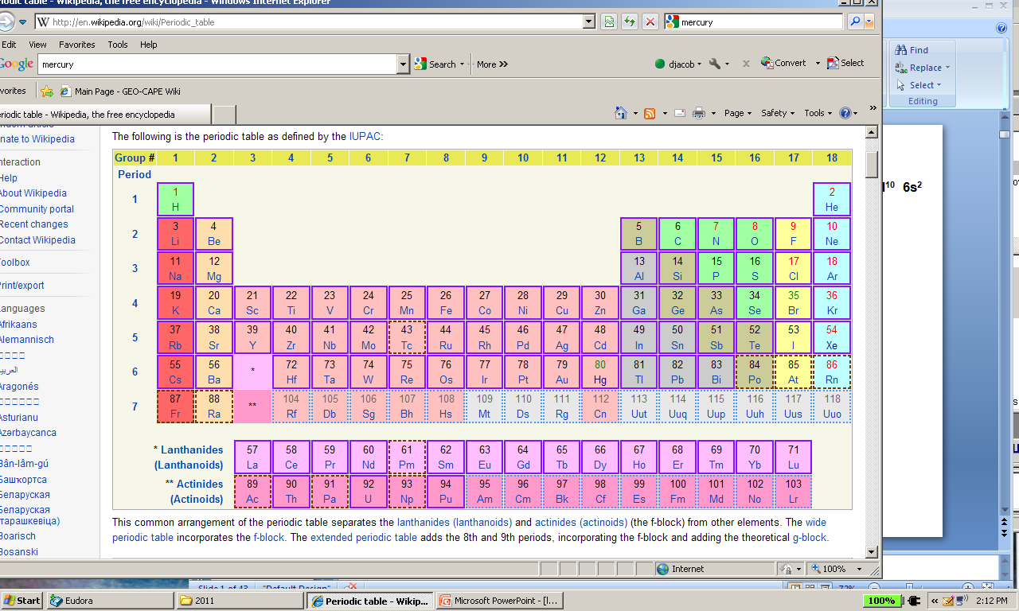
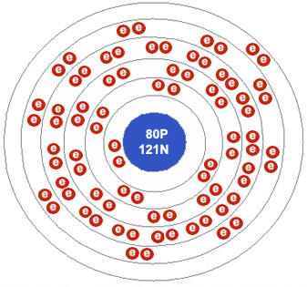
Electronic structure of mercury
Mass number = 80: 1s² 2s² 2p⁶ 3s² 3p⁶ 3d¹⁰ 4s² 4p⁶ 4d¹⁰ 4f¹⁴ 5s² 5p⁶ 5d¹⁰ 6s²
Filling of subshells makes elemental Hg(0) stable, liquid, volatile
Mercury can also shed its two outer electrons (6s²)
to produce Hg(II) (mercuric) compounds
6s²
oxidation
Hg(0)
Hg(II)
elemental
mercury
reduction
mercuric
compounds

Slide 4


Biogeochemical cycle of mercury
ANTHROPOGENIC
PERTURBATION:
coal combustion
mining
~10x natural
VOLATILE
WATER-SOLUBLE
oxidation
Hg(0)
Hg(II)
volcanoes
erosion
ATMOSPHERE
OCEAN/SOIL
Hg(0)
Hg(II)
particulate
Hg
reduction
biological
uptake
uplift
burial
SEDIMENTS

Slide 5
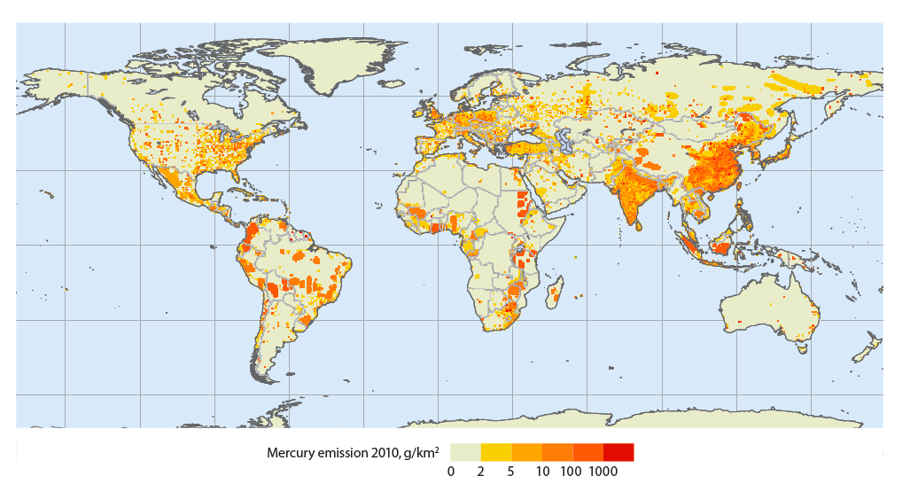
Atmosphere enables global transport of mercury
Implies gPresent-day cale transport of anthropogenic emissions
Present-day emission of mercury to atmosphere from coal and mining
Atmospheric concentrations
Observed variability of atmospheric Hg implies an atmospheric lifetime against deposition of about 0.5 years
Mercury is a global pollution problem driven by deposition to oceans
UNEP [2013]; Horowitz et al. [2017]

Slide 6
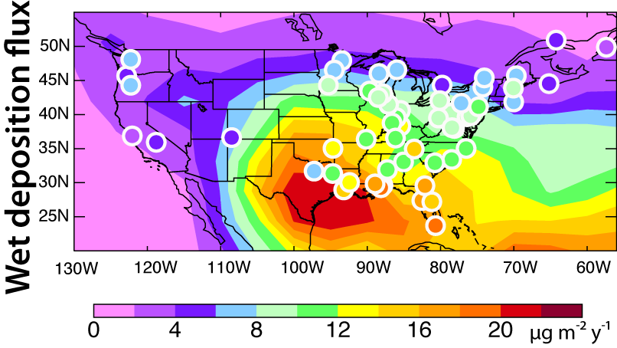
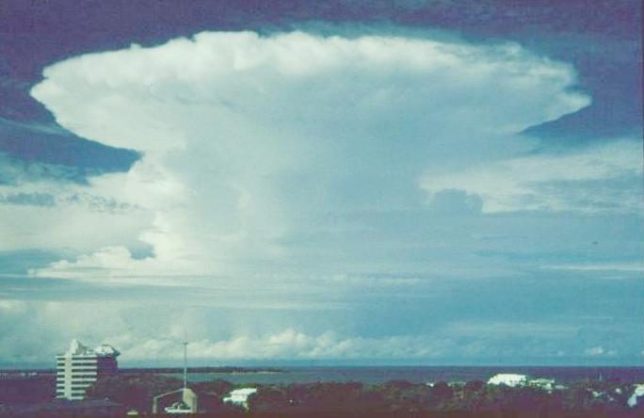
Mercury wet deposition is controlled by global transport
EPA deposition data (circles), model (background)
Florida T-storm
Global Hg(II) pool
scavenging
Highest mercury deposition in US is along the Gulf Coast,
where thunderstorms scavenge globally transported mercury from high altitudes
Selin and Jacob [2008]

Slide 7
Atmospheric redox chemistry of mercury: driver of mercury deposition
Oxidation of Hg(0) by OH is too slow
Oxidation by Br atoms is currently thought to dominate
Hg(0)
hv
OH
Still very uncertain!
CHBr₃
Br
bromoform
weeks
Hg(II)
HBr
deposition
deposition
ocean plankton

