Slide 1
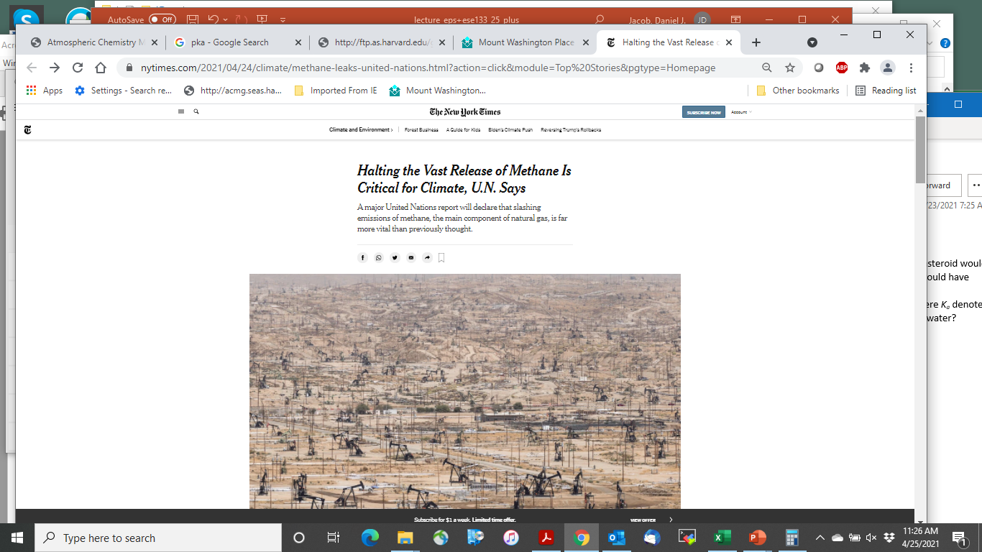
Continued development and application of a prototype system for exploiting satellite data to improve knowledge of methane emission fluxes with focus on North America
Daniel Jacob (PI, Harvard) Anthony Bloom (Co-I, JPL)
Collaborators and stakeholders:
Ilse Aben and Joannes Maasakkers (SRON)
Stephane Germain and Eric Choi (GHGSat, Inc.)
Ritesh Gautam (EDF)
Melissa Weitz and Bill Irving (US EPA)
Mike Moran (ECCC, Canada)
Claudia Villasana (INECC, Mexico)
Debbie Gordon (RMI)

Slide 2
Our general strategy
National EPA, ECCC, INECC inventories reported to UNFCCC
Produce high-resolution gridded versions of national inventories to serve as prior estimates in inversions
Develop WetCHARTs gridded wetlands emission inventory ensemble w/prior error covariance
Observations
of atmospheric methane
satellite:
GOSAT
TROPOMI
Inform emission inventory improvement
Conduct analytical inversions with GEOS-Chem atmospheric transport model to optimize emissions including posterior error statistics
suborbital:
NOAA GLOBALVIEW+

Slide 3

A gridded inventory of Canada's anthropogenic methane emissions [Scarpelli et al., ERL 2022]
ECCC emission inventory allocated to 0.1ºx0.1º grid
Hotspots > 1 ton h⁻¹ from oil sands, landfills
Tia Scarpelli

Slide 4

Methane emissions in the United States, Canada, and Mexico: Evaluation of national methane emission inventories and 2010-2017 sectoral trends by inverse analysis of in situ (GLOBALVIEWplus CH4 ObsPack) and satellite (GOSAT) atmospheric observations [Lu et al, ACP 2022]
US EPA inventory: 26.0 Tg a⁻¹
Inversion: 36.9 (32.7-37.8) Tg a⁻¹
Canada ECCC inventory: 3.7 Tg a⁻¹
Inversion: 5.3 (3.6-5.7) Tg a⁻¹
Mexico INECC inventory: 5.0 Tg a⁻¹
Inversion: 6.0 (4.7-6.1) Tg a⁻¹
National inventories reported to UNFCCC are 20-40% too low
Oil/gas is major culprit
Lu et al. [2022]
Xiao Lu

Slide 5
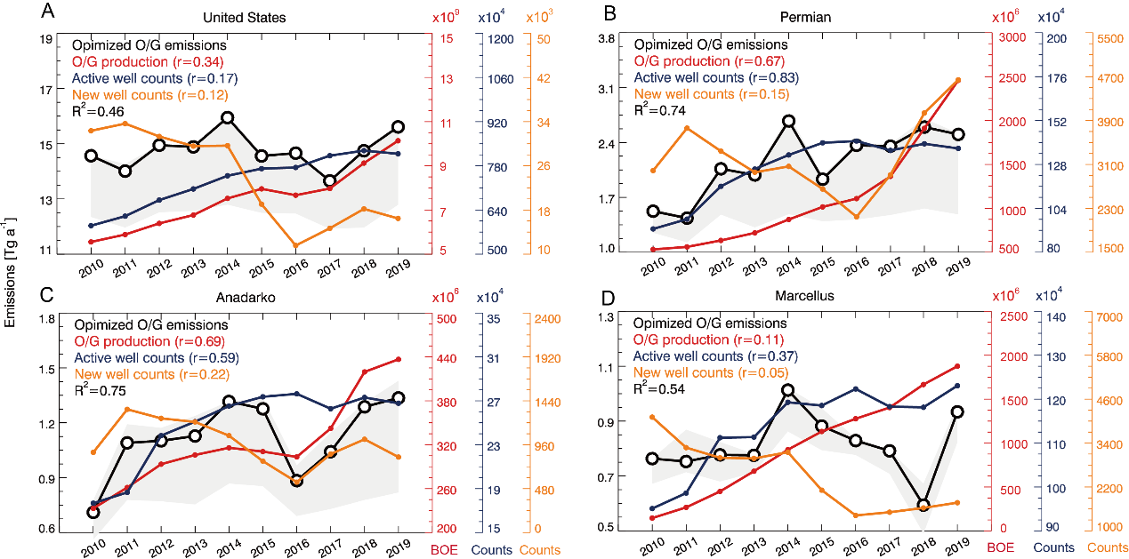
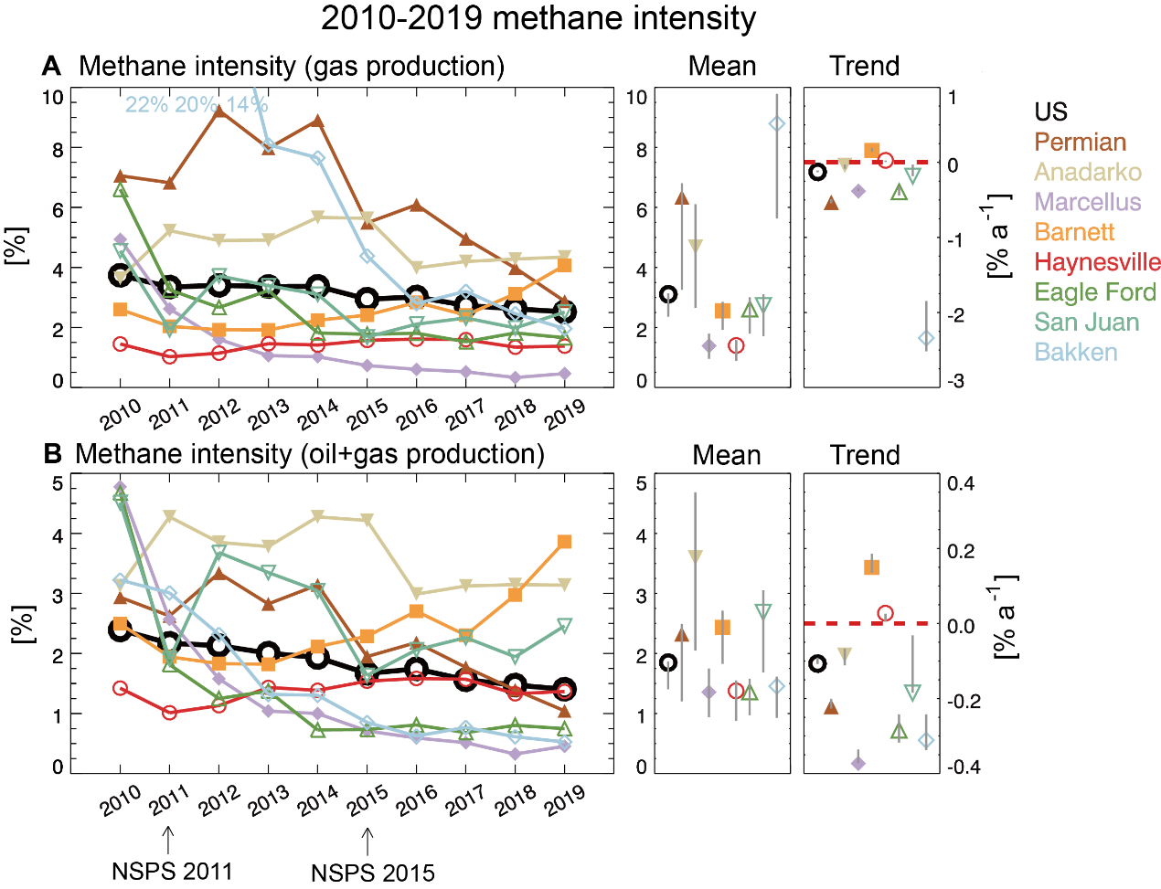
Satellite-derived 2010-2019 trends in methane emissions from US oil and gas fields tied to activity statistics [Lu et al., in prep.]
United States
Permian
Emission trends explainable (R² =0.46-0.75) by
Active well counts
New well counts
O/G production
Anadarko
Marcellus
methane intensity
Methane intensity from oil+gas production in US has been decreasing steadily
Need to go down to 0.5% to meet 2030 goal of 75% emission reduction

Slide 6

Unraveling a large methane emission discrepancy in Mexico using satellite observations [Shen et al., RSE 2021]
First application of TROPOMI to large-scale inversions with 25-km resolution and best practices
Oil/gas emissions higher by factor of 2.5 than INECC inventory, most contributed by Sureste onshore production region
Oil/gas and landfills drive underestimate of Mexico emissions in INECC inventory
Lu Shen

Slide 7
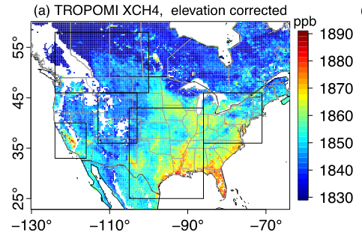
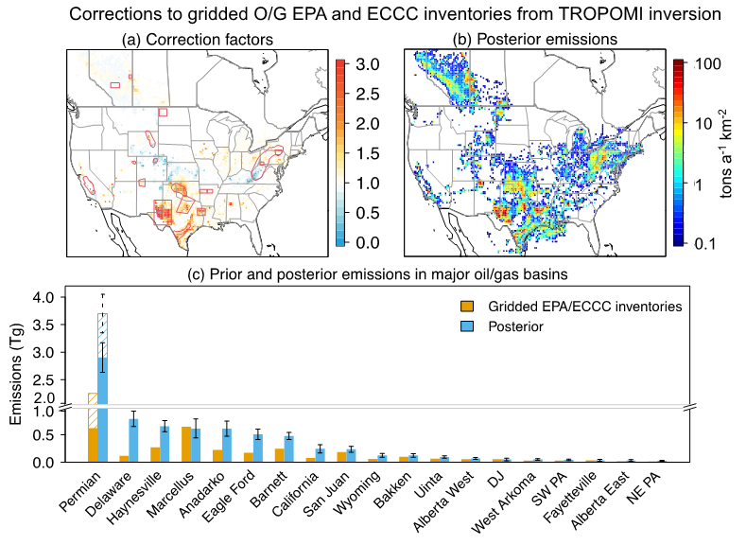
Satellite quantification of national emissions from oil/gas production in the US and Canada including contributions from individual basins [Shen et al., ACP 2022]
Correction factors to EPA/ECCC emission reports
TROPOMI
The Permian is responsible for half of the EPA underestimate of oil/gas emissions
TROPOMI can effectively quantify emissions of 0.2-0.5 Tg a⁻¹ from oil/gas basins

Slide 8
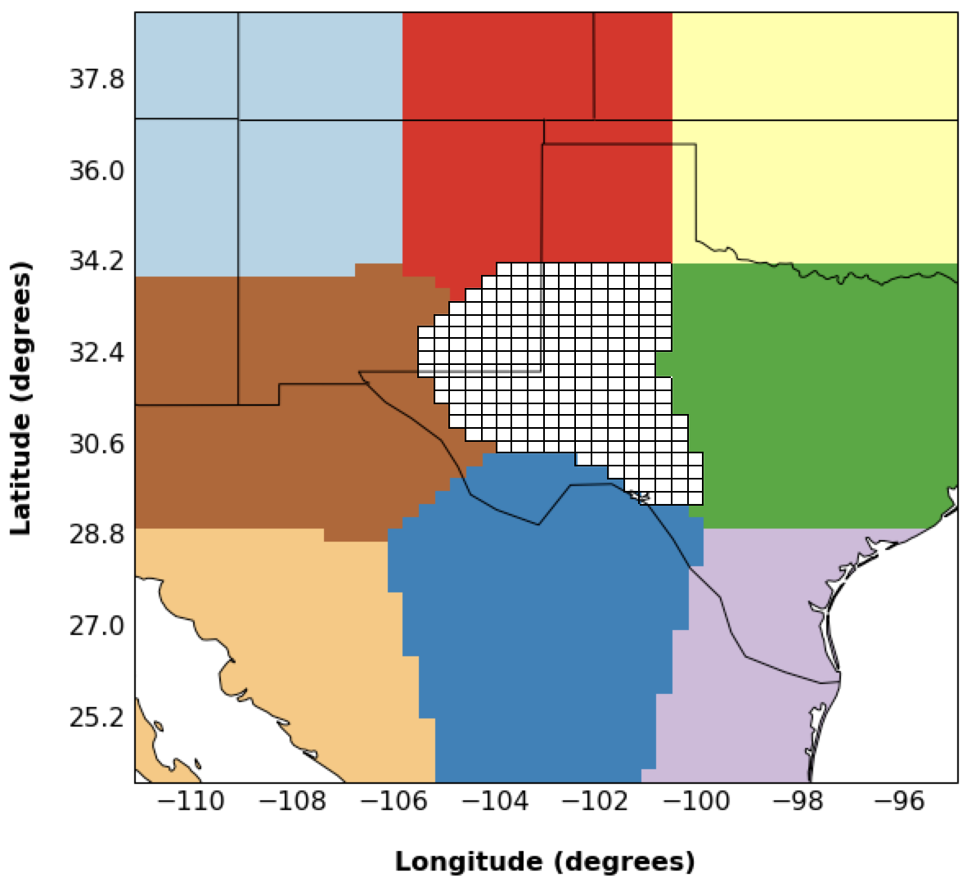
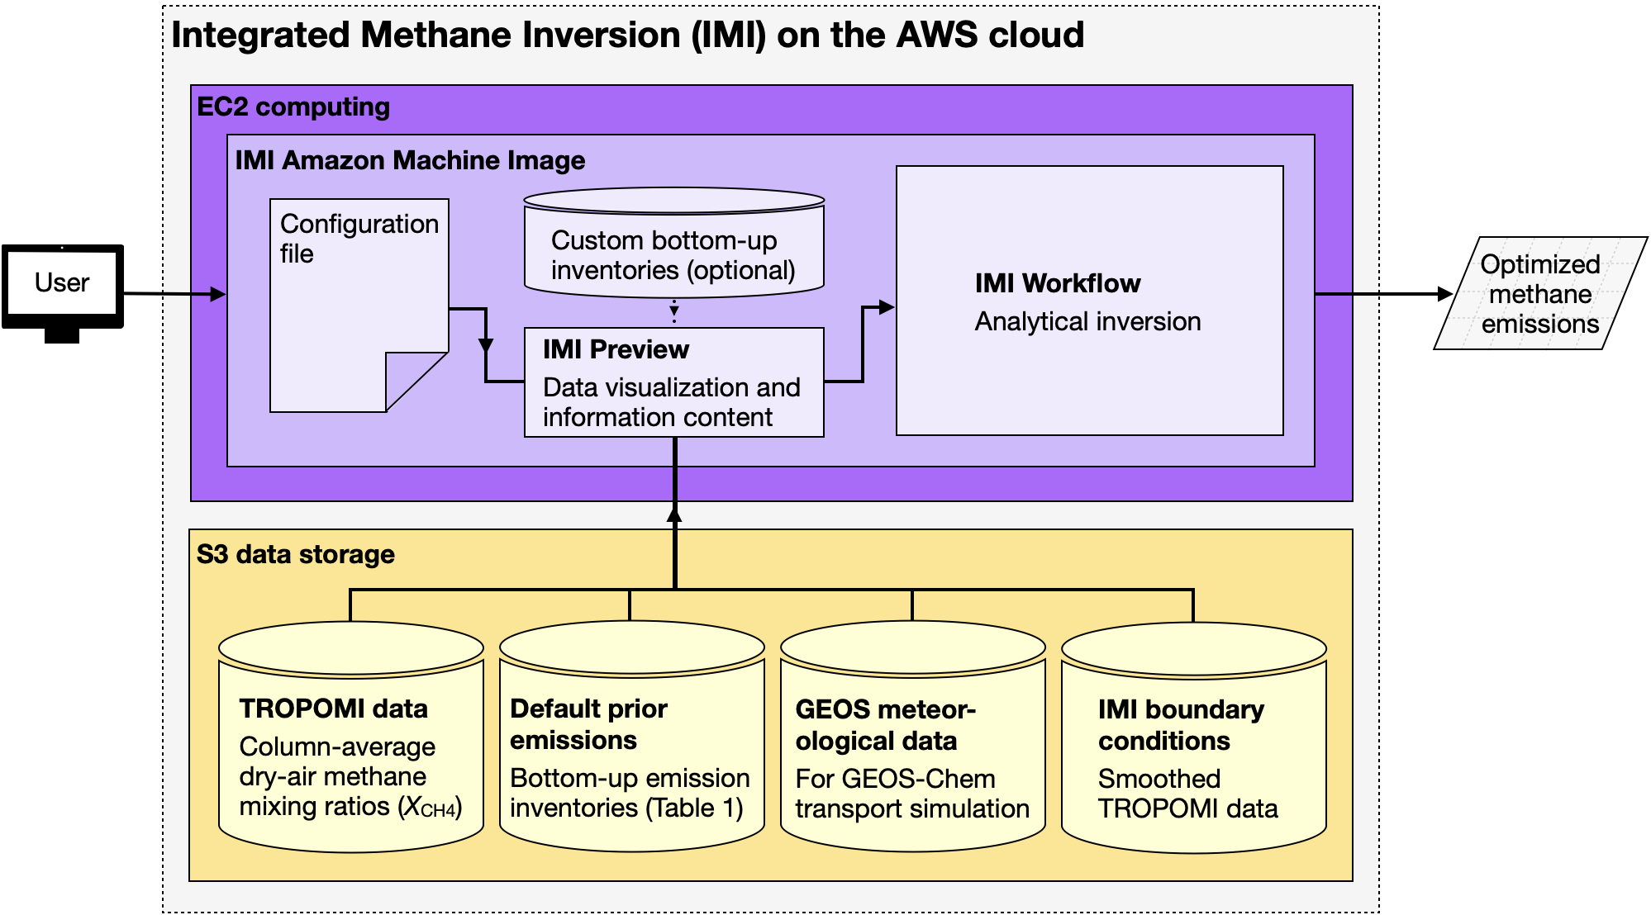

Integrated Methane Inversion (IMI 1.0): a user-friendly, cloud-based facility for inferring high-resolution methane emissions from TROPOMI satellite observations [Varon et al., GMD 2022]
Analytical method, 0.25º or 0.5º resolution
Takes advantage of TROPOMI data and GEOS-Chem forward model both resident on AWS – bring compute to data!
IMI preview displays observations and estimates information content at no incurred cost
Basic users can run inversion out of the box. Advanced users can modify inversion parameters
User selects domain and period of interest
http://imi.seas.harvard.edu
Daniel Varon

Slide 9
Example application of Integrated Methane Inversion (IMI) on AWS
1-month inversion for Permian basin
User checks data for quality, information content:
no significant cost incurred so far
Cost: $20 on-demand, <$10 spot
IMI released in July, currently 26 registered users

Slide 10
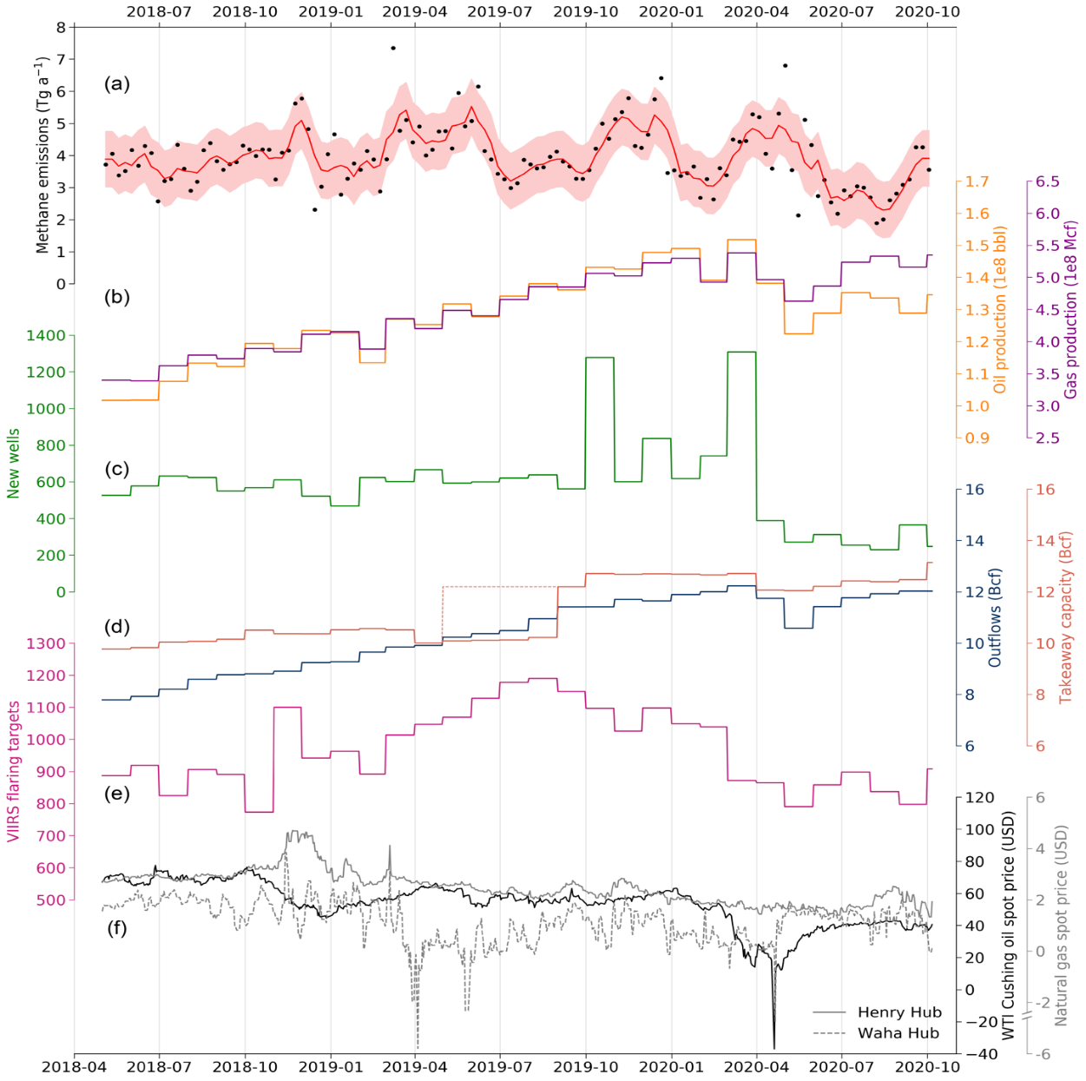
Continuous weekly monitoring of methane emissions from the Permian Basin by inversion of TROPOMI satellite observations [Varon et al., in prep.]
Weekly optimization of emissions
with Kalman filter
methane emission
oil/gas production
new wells
takeaway capacity
flares
Waha Hub
gas price
May 2018
October 2020
Temporal variability of emissions is related to new wells and local (Waha Hub) gas price (R² = 0.21)

Slide 11

Reduced-cost construction of Jacobian matrices for high-resolution inversions of satellite observations of atmospheric composition [Nesser et al., AMT 2021]
prior error information
Hannah Nesser
satellite observation density
patterns of maximum information
Approximate high-resolution Jacobian using satellite information content
to determine where to focus the inversion

Slide 12
Reduced-rank inversion of TROPOMI methane observations to infer 2019 North American methane emissions at 0.25°x 0.3125°resolution [Nesser et al., in prep.]
Corrections to
US EPA, ECCC,
INECC, WetCharts inventories
Achieves 710 targeted pieces of information at 25-km resolution on continental scale
Unique capability to quantify ensemble of emissions from individual cities, states
See Hannah Nesser’s poster this afternoon!

Slide 13
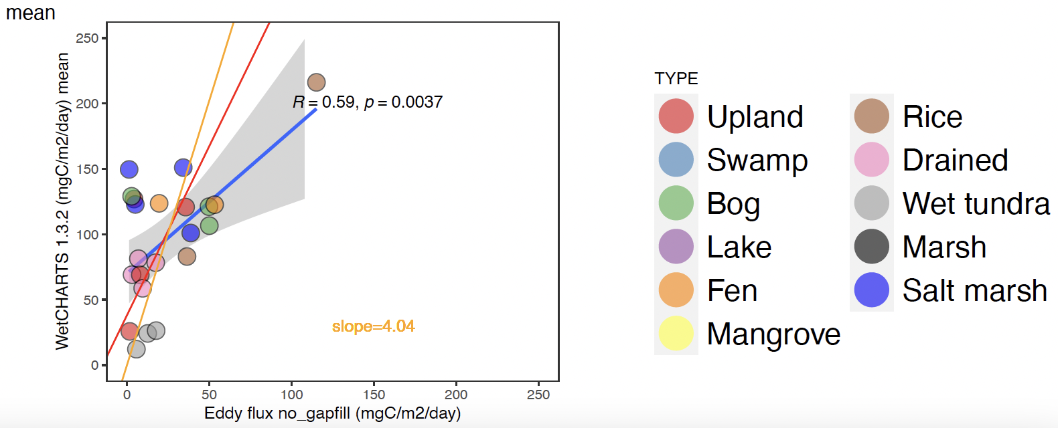
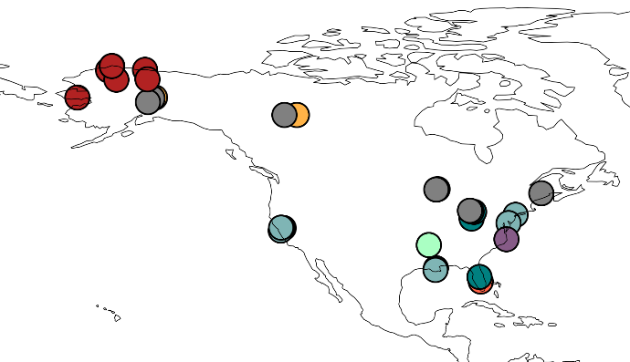
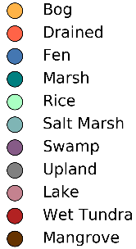
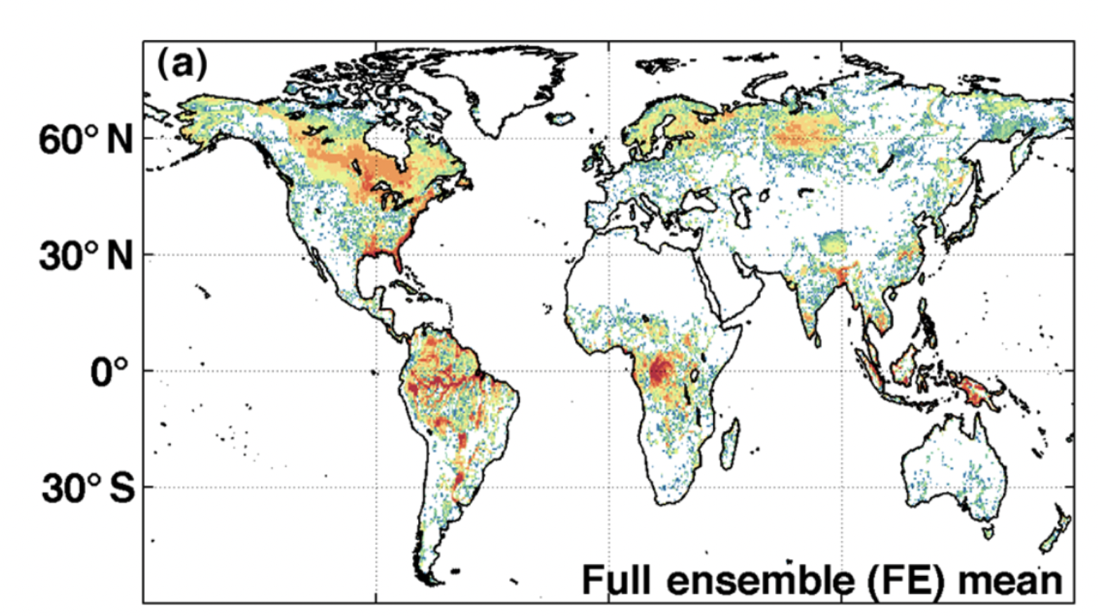
FLUXNET calibration of WetCHARTs CH4 fluxes for the North America domain [Ma et al., submitted]
FLUXNET Eddy-Covariance (EC) sites (n=41)
Delwiche et al., 2021
WetCHARTs CH4 emissions
Ensemble mean WetCHARTs methane fluxes overestimate North America methane emissions.
We used comparisons to 41 FLUXNET eddy covariance sites with multi-month records to calibrate WetCHARTs
The calibrated WetCHARTs is used as prior by Nesser et al. and successfully matches the TROPOMI observations.

Slide 14
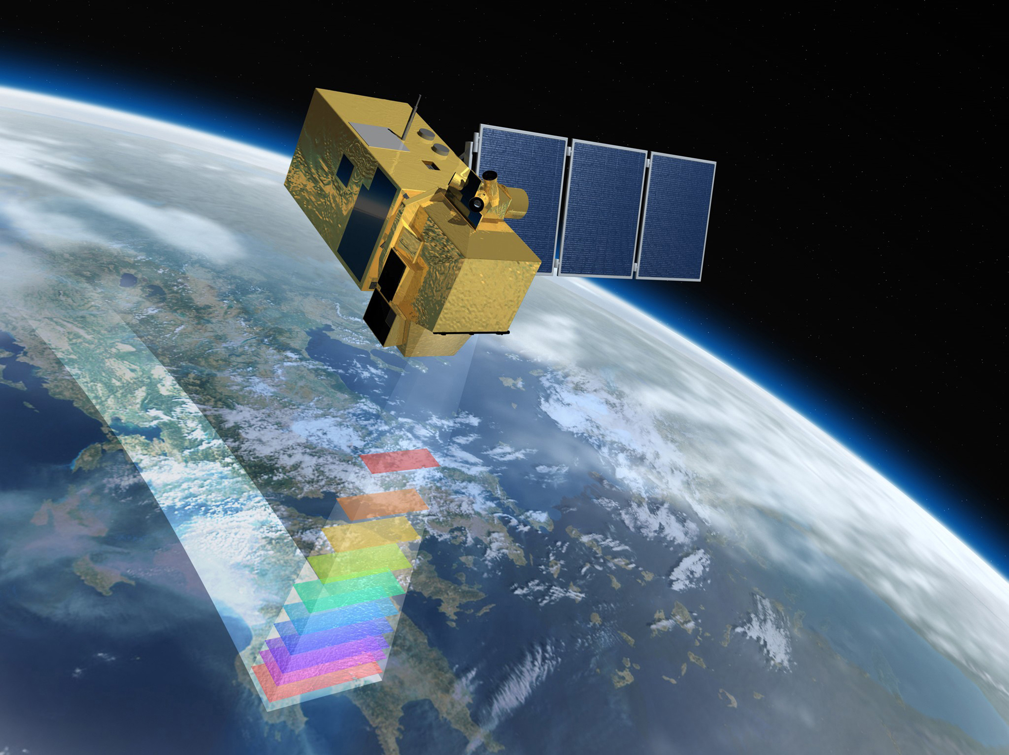
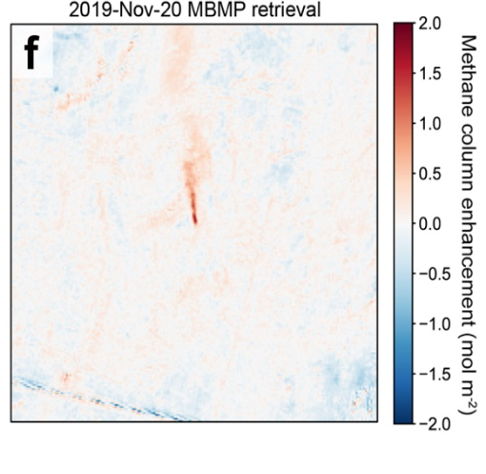

High-frequency monitoring of anomalous methane point sources with multispectral Sentinel-2 satellite observations [Varon et al., 2021]
ESA Sentinel-2
30-m resolution
global coverage in 2-5 days
Landsat:
100 nm spectral resolution,
useless for methane
Band 11
1560-1660 nm
low methane sensitivity
Band 12
2090-2290 nm
high methane sensitivity
surface
Single oil well plume in Algeria, observed by Sentinel-2 for almost a year
6% of reported
national O/G emissions
flare lit

Slide 15
Quantifying methane emissions from the global scale down to point sources using satellite observations of atmospheric methane [D.J.Jacob, D.J., D.J. Varon, D.H. Cusworth, P.E. Dennison, C. Frankenberg, R. Gautam, L. Guanter, J. Kelley, J. McKeever, L.E. Ott, B. Poulter, Z. Qu, A.K. Thorpe, J.R. Worden, and R.M. Duren, ACP 2022]
CMS Methane WG product: Review of current and planned satellite capabilities

