Slide 1
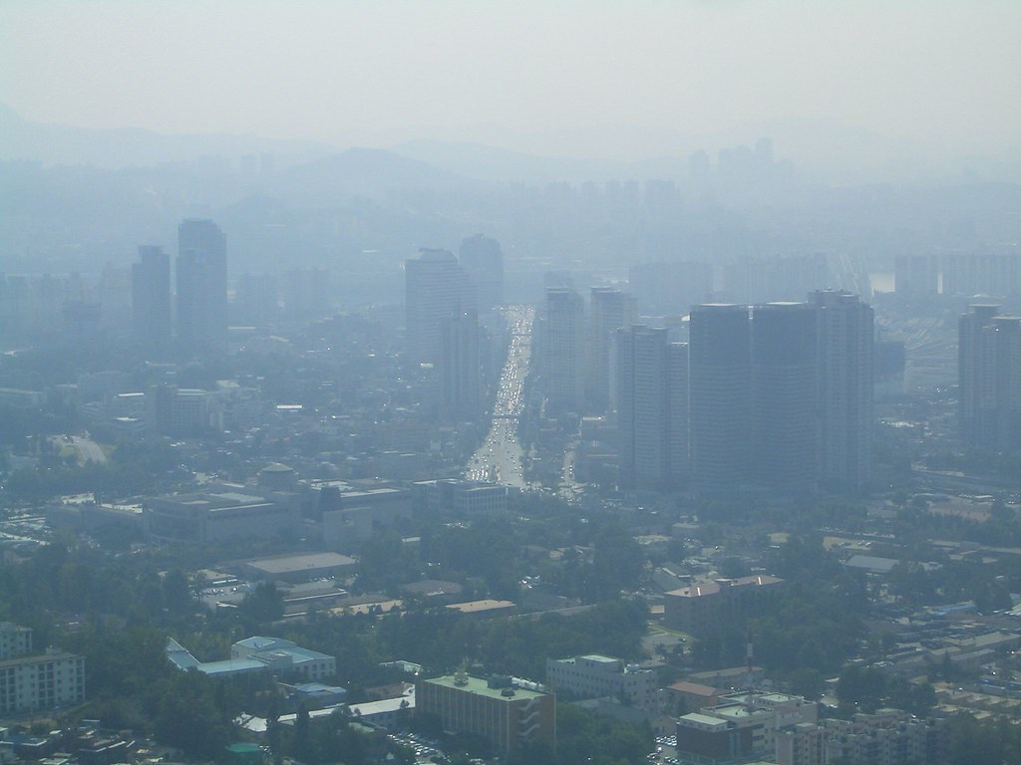






New perspectives on air quality in East Asia:
what we can learn from GEMS
Daniel J. Jacob
Vasco McCoy Family Professor of Atmospheric Chemistry and Environmental Engineering
Harvard University
Nadia Colombi
Laura Yang
Ellie Beaudry
Drew Pendergrass
Shixian Zhai
Ruijun Dang

Slide 2
Why is ozone pollution over Korea and China getting worse?
Seoul concentrations and rate of increase are highest in May
Hypothesis: decreasing PM (summer) and NO_{x} (rest of year), flat or increasing VOCs
Li et al. [2020, 2021], Colombi et al., in prep.

Slide 3
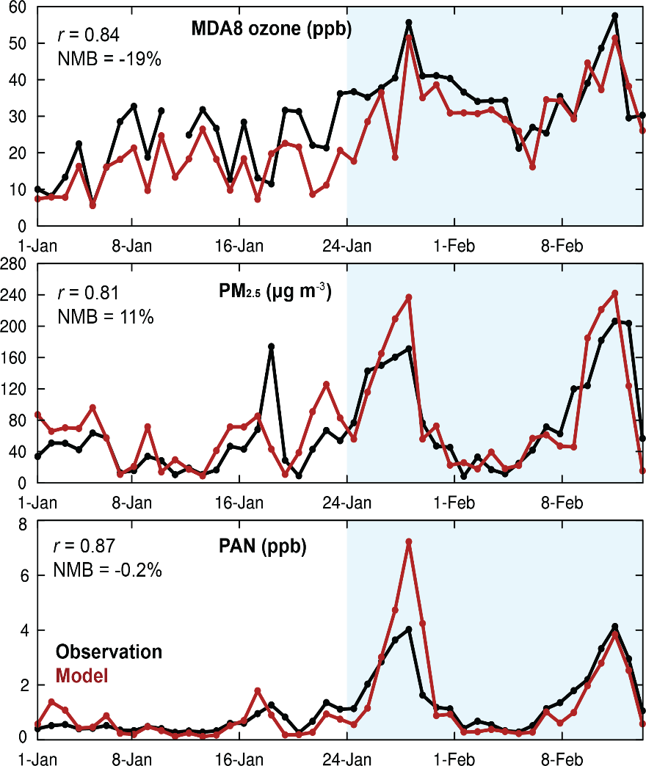
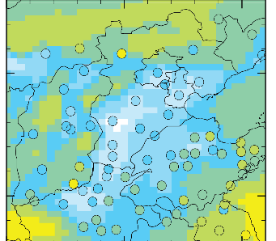
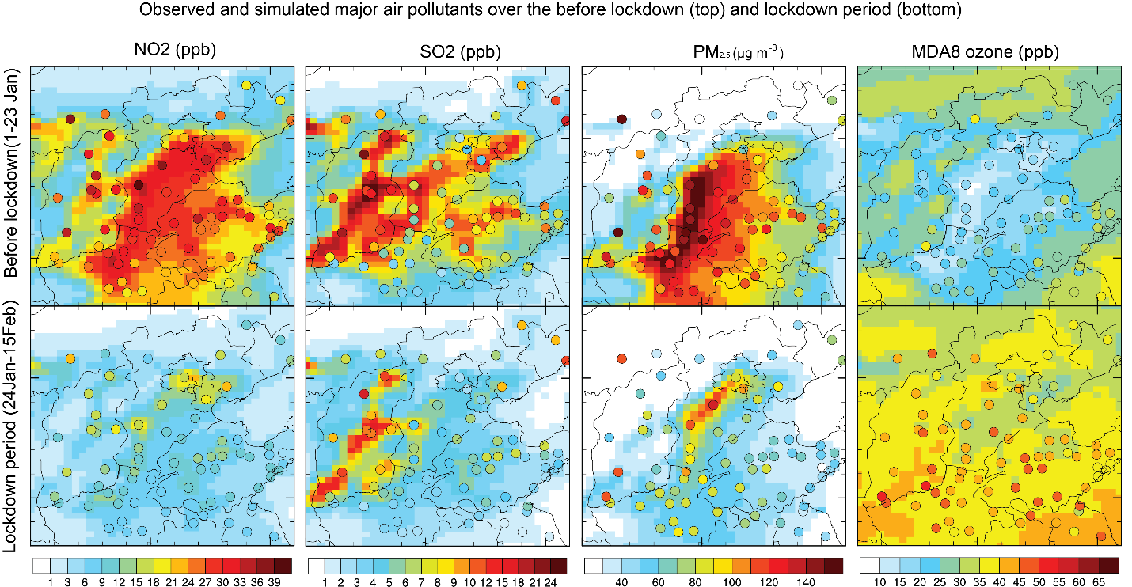
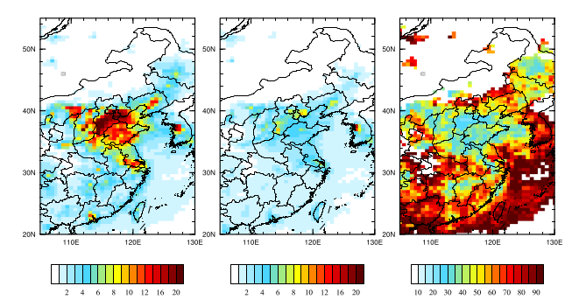
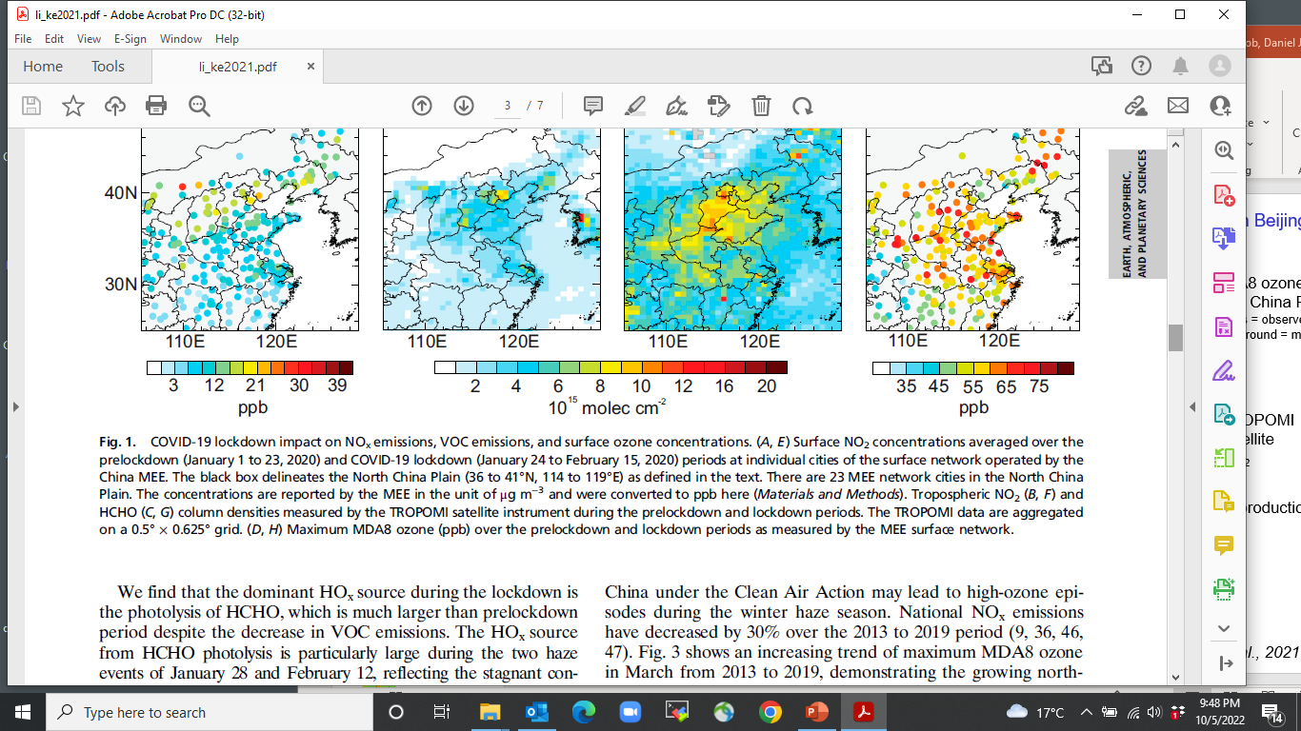
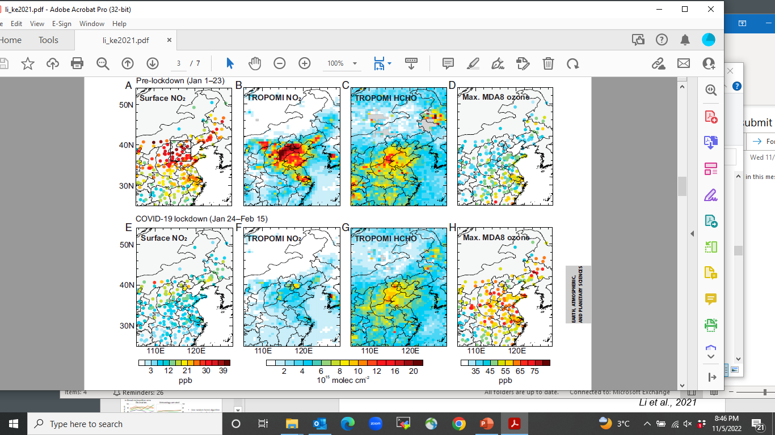
COVID-19 lockdown revealed fast wintertime ozone production in Beijing
Beijing: observations and GEOS-Chem
before Jan 24 after Jan 24
MDA8 ozone (ppb)
in N China Plain
circles = observed, background = GEOS-Chem
MDA8 ozone
PM_{2.5}
TROPOMI NO₂
Observations
Model
TROPOMI HCHO
PAN
NO_{x} emissions decreased by 70% during lockdown,
causing ozone production to surge under strongly VOC-limited conditions
Formaldehyde from VOCs provides the main HO_{x} radical source:
Li et al., 2021

Slide 4
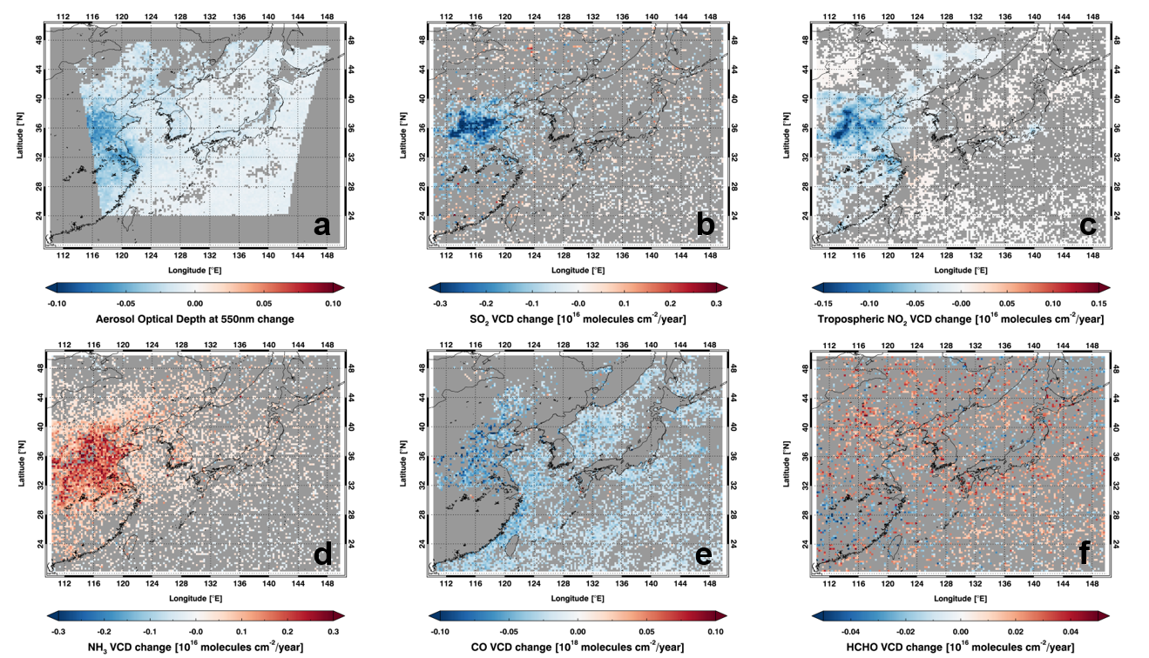
Importance of NO₂ and HCHO monitoring from space to understand ozone trends
OMI NO₂ trend, 2011-2019
OMI HCHO trend, 2015-2019
Korea and China are now targeting VOC emissions – we need to verify this from space
Ahn et al., submitted; Bauwens et al., 2022

Slide 5
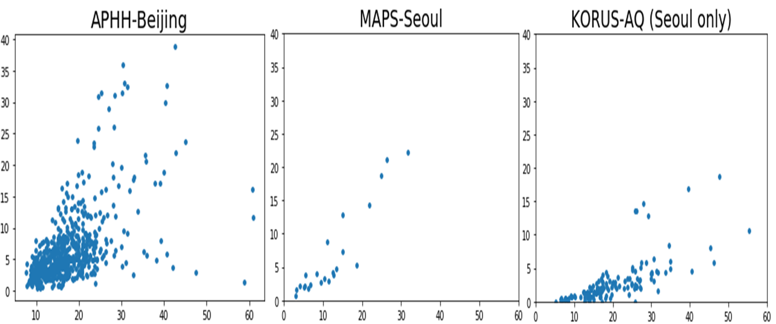
Evidence of very high residential use of volatile chemical products (VCPs) in Korea and China – missing from current inventories
Ethanol (ppb)
Methanol (ppb)
Methanol (ppb)
Methanol (ppb)
Ethanol is common component of residential VCPs; very high in Korea and China
Methanol is highly correlated with ethanol – also used in VCPs?
Residential VCP emissions could be a driver of VOC reactivity – need to be addressed in VOC emission controls
Beaudry et al., in prep.

Slide 6
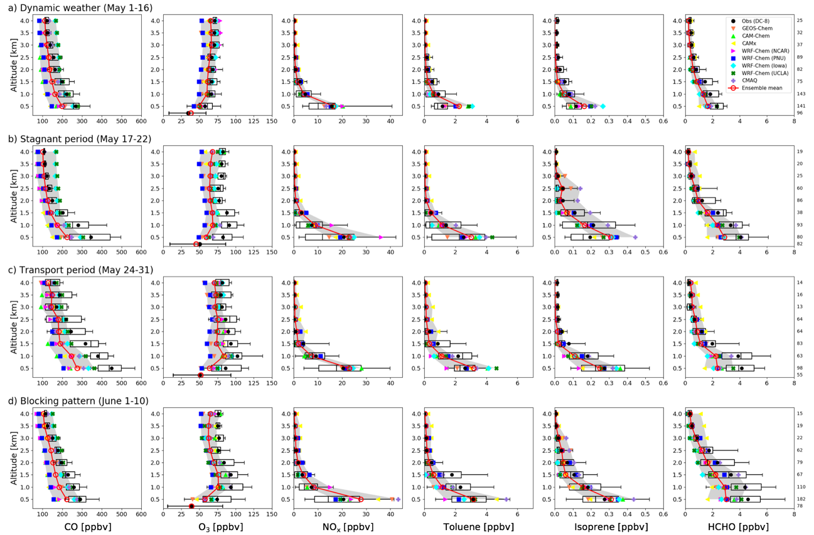
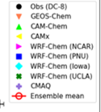
Very high free tropospheric ozone background over East Asia, underestimated in models
KORUS-AQ, May-June 2016
corrected in GEOS-Chem
by nitrate photolysis:
Stagnant period (May 17-22)
Transport from China period (May 24-31)
Ozone, ppb
60 ppb air quality standard for Korea is not achievable with such high background
Origin of high background is not clear; it doesn’t seem to come from China
GEMS observations of free tropospheric ozone can help address that issue
Park et al. [2021]; Colombi et al., in prep.

Slide 7
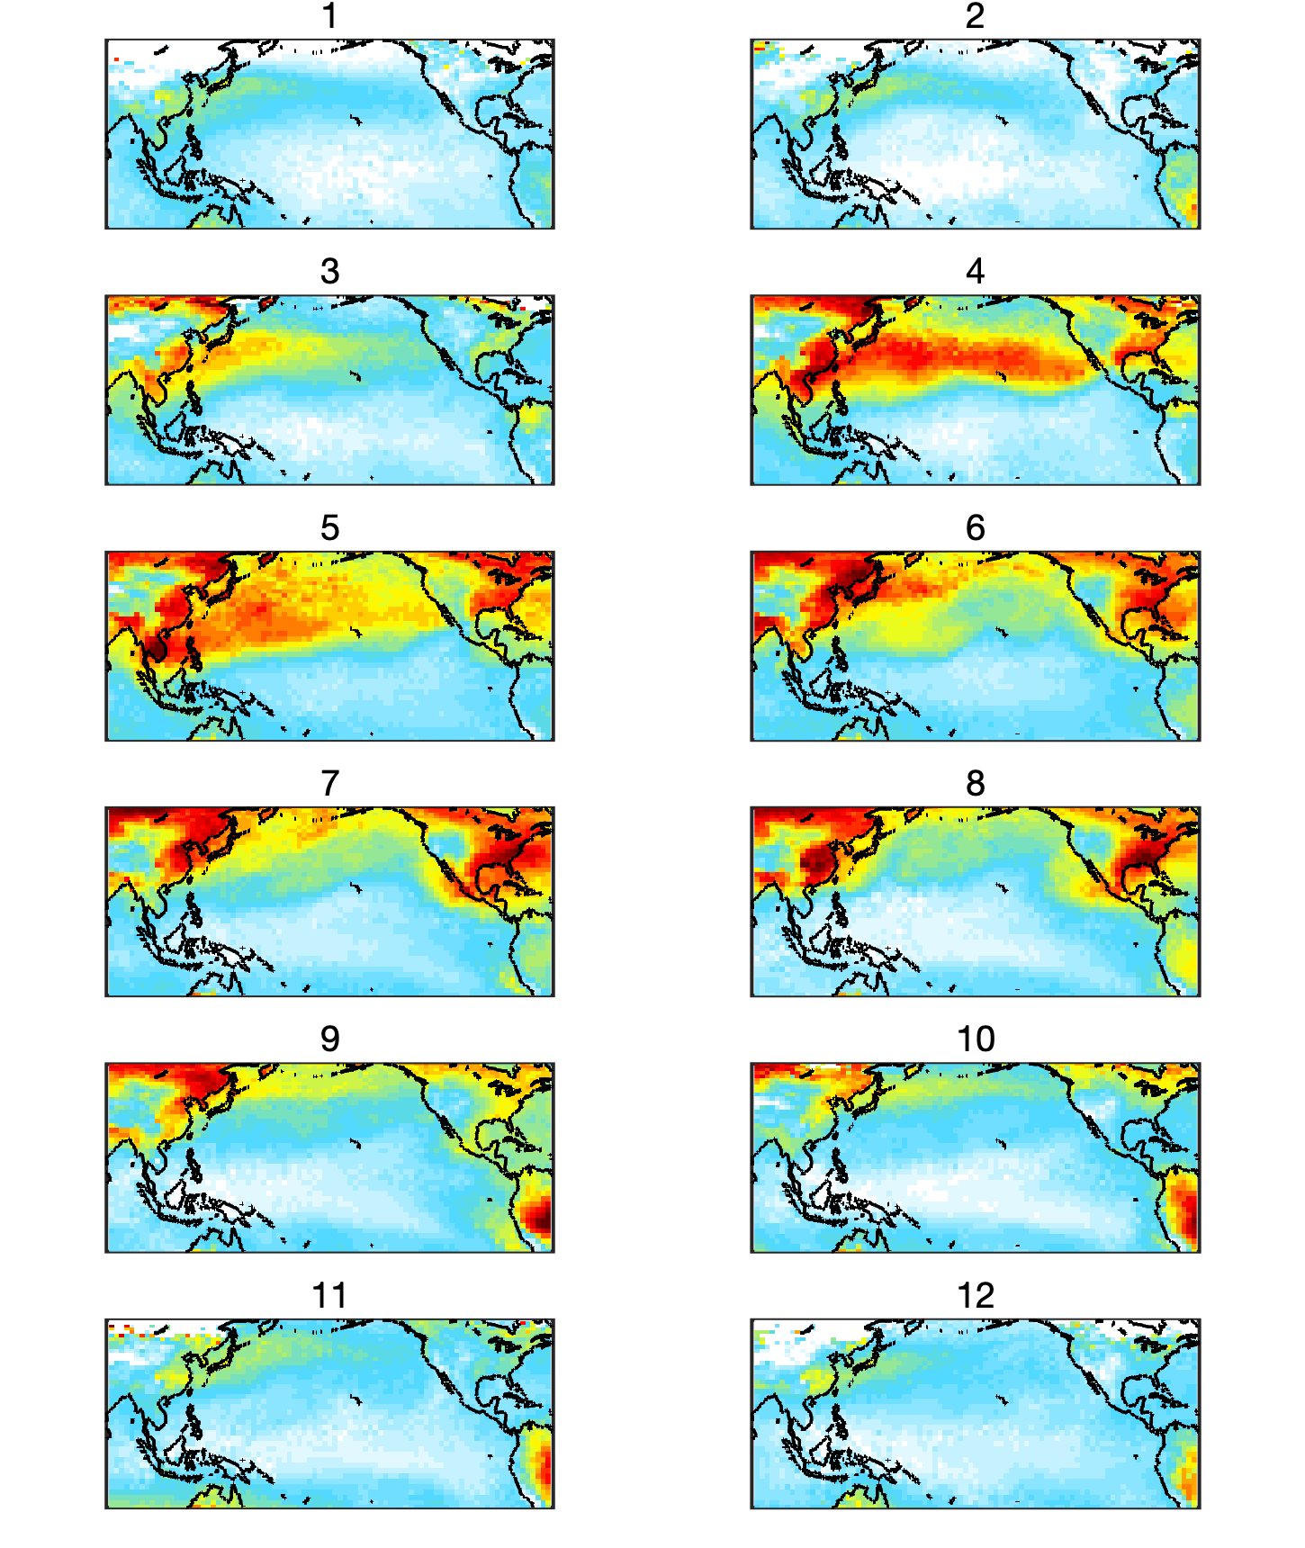
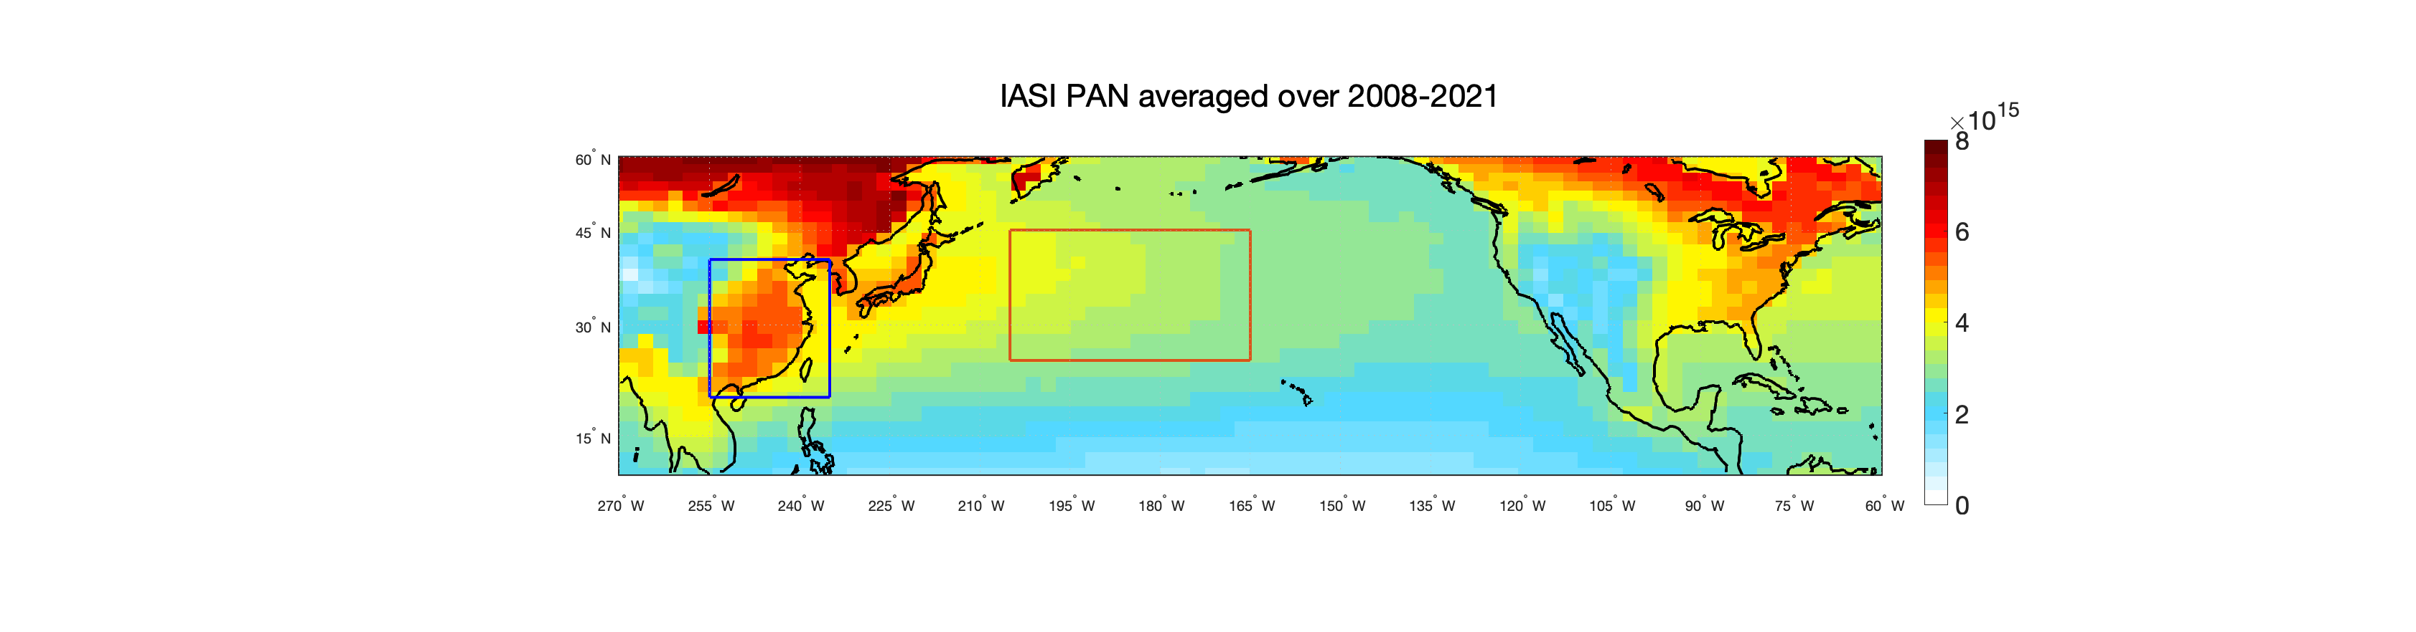
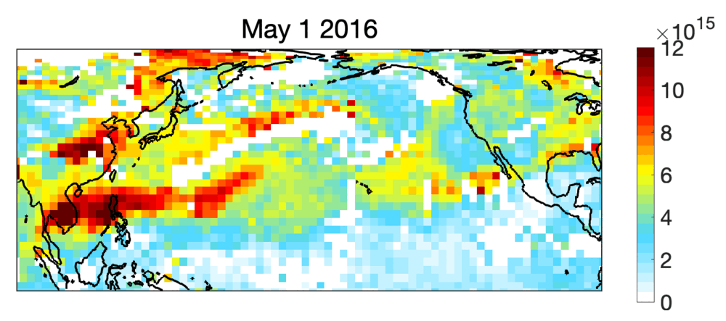
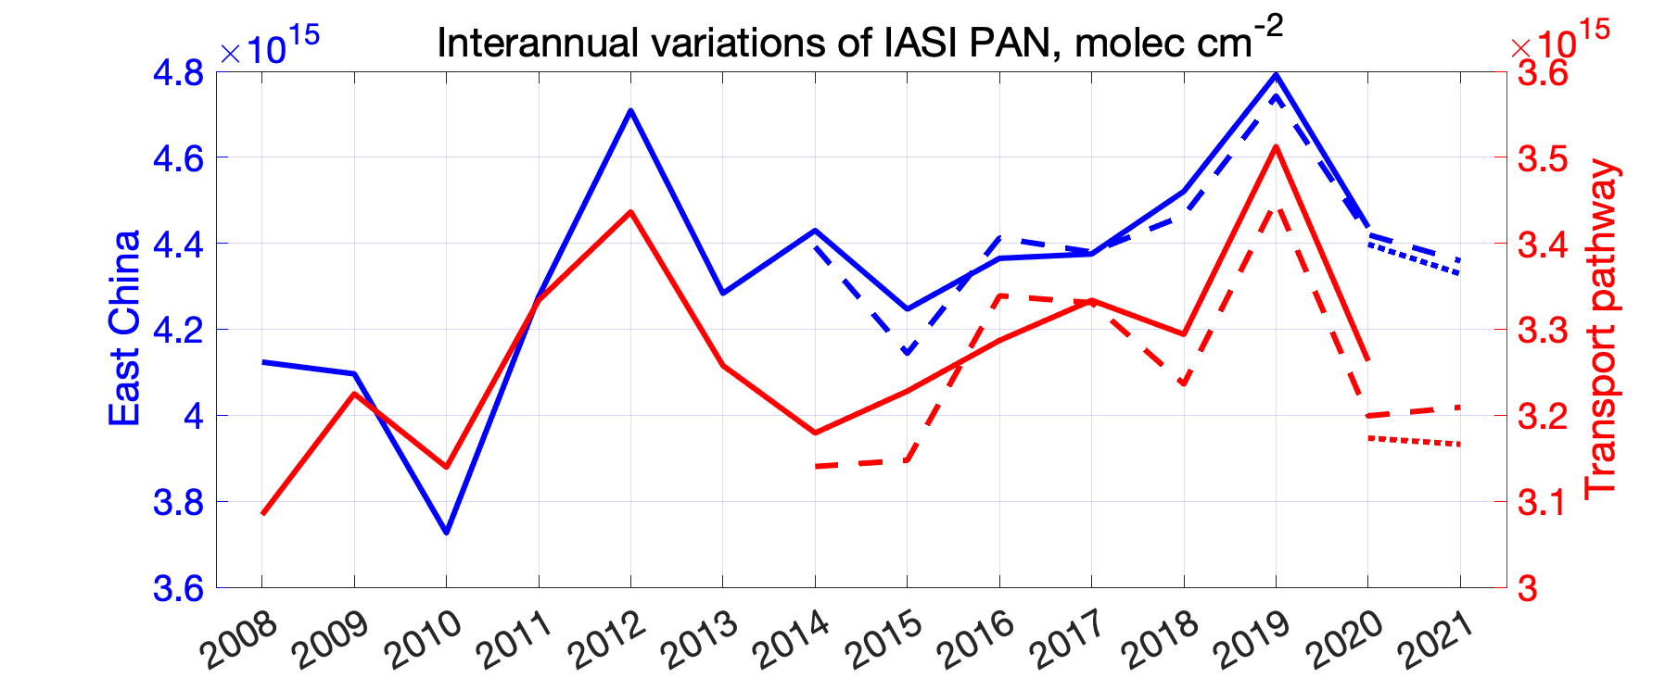
Peroxyacetylnitrate (PAN) from IASI as tracer for global anthropogenic influence on ozone
NO
ozone
PAN is reservoir for NO_{x}, is also produced along with ozone: VOC + OH
NO₂
PAN
Feb 2016 May Aug Nov
molecules cm⁻²
NW Pacific
Transpacific transport of PAN is evidence for global-scale transport of ozone pollution
Increasing PAN over 2008-2019 IASI record is indicative of increasing ozone
Data suggest increasing contribution from Southeast Asia
Zhai et al., in prep.

Slide 8
Wintertime PM_{2.5} nitrate in urban China has not responded to NO_{x} controls…
…and has gotten worse during pollution episodes
PM₁ nitrate in Beijing, winters 2014-2019
Nitrate formation may be NH₃-limited
Maybe also in Seoul, where winter PM_{2.5} has been increasing?
Zhai et al. [2021];
Pendergrass et al. [2022]

Slide 9

Use tropospheric NH₃/NO₂ column (Ω) ratio measured from space to diagnose whether PM nitrate formation is NO_{x}- or NH₃-limited
NO₂: OMI, TROPOMI, GEMS
NH₃: IASI, CrIS
NH₃
oxidation
NH₄⁺ + NO₃⁻
NO
NO₂
HNO₃
PM
agriculture
vehicles
fuel
If satellites measured Ω_{HNO3} and if all NH₃ and HNO₃ were in boundary layer, then Ω_{NH3}/ Ω_{HNO3} = 1 would be threshold for NH₃-limited vs. NO_{x}- (or VOC-) limited regime
But we measure Ω_{NO2}, some of that NO₂ is in free troposphere, and there’s a lag and <1 yield in conversion from NO_{x} to HNO₃
need model to diagnose Ω_{NH3}/ Ω_{NO2} threshold and relevant spatial scale

Slide 10
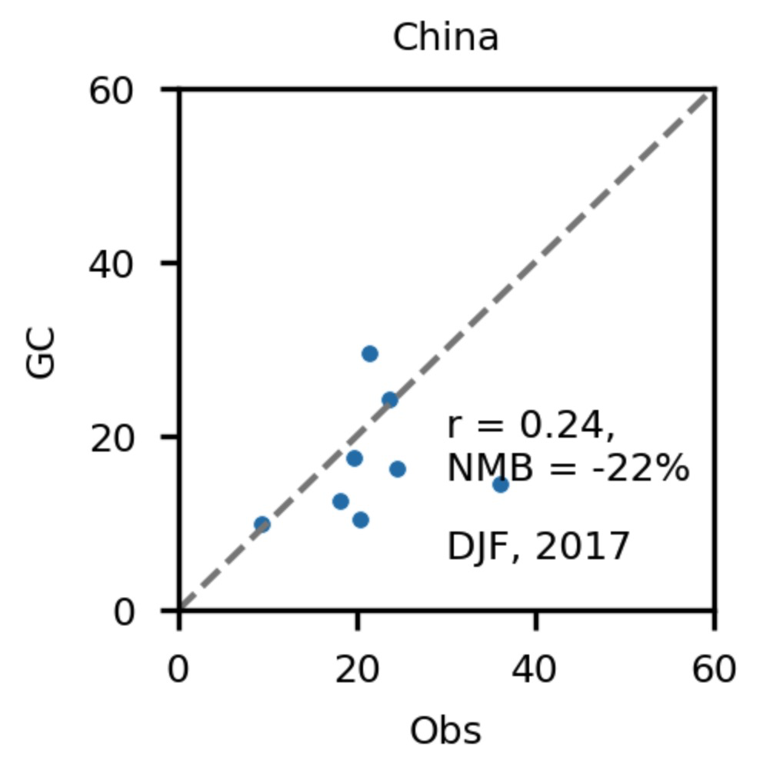
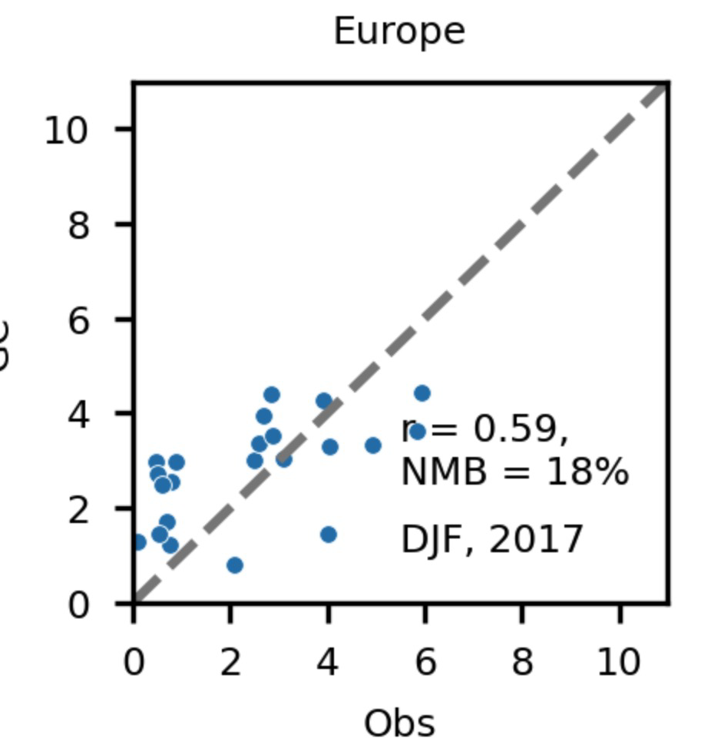
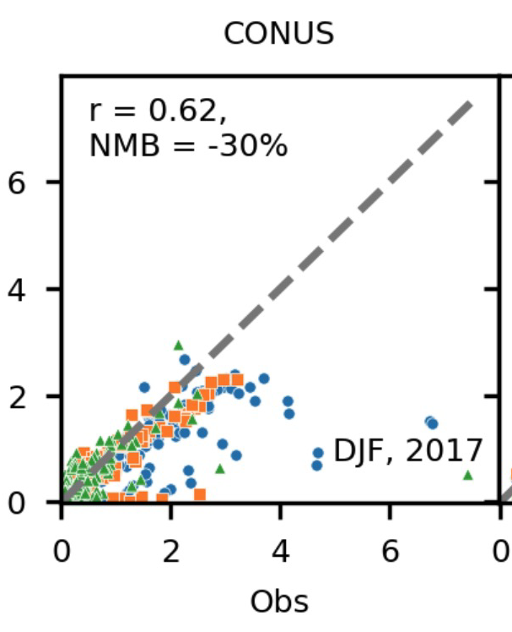
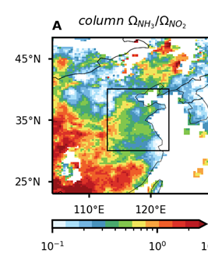
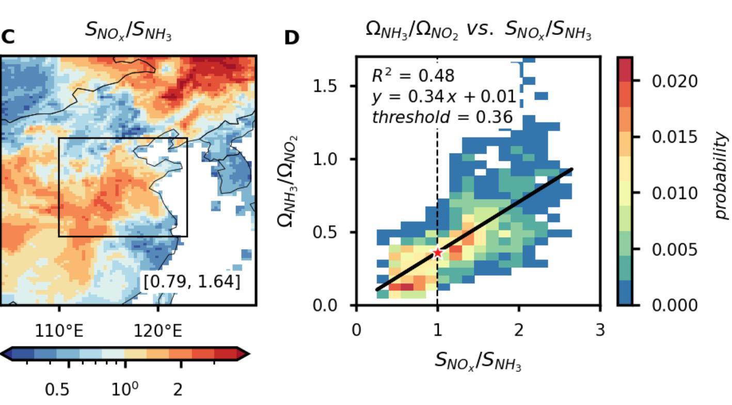
Using GEOS-Chem model to relate Ω_{NH3}/Ω_{NO2} to chemical regime
Model has credible simulation of PM_{2.5} nitrate [μg m⁻³]:
GEOS-Chem
observed
observed
observed
Diagnose relative sensitivities S_{X} = dlog[NO₃⁻]/dlogE_{X} in model world;
Use sensitivity ratio S_{NOx}/S_{NH3} to diagnose chemical regime;
Plot Ω_{NH3}/Ω_{NO2} vs. S_{NOx}/S_{NH3} to diagnose threshold column ratio.
Ω_{NH3}/Ω_{NO2}
S_{NOx}/S_{NH3}
Ω_{NH3}/Ω_{NO2} vs. S_{NOx}/S_{NH3}
GEOS-Chem, January 2017
Threshold Ω_{NH3}/Ω_{NO2} = 0.36
Blue: NH₃-limited
Red: NO_{x}-limited
Dang et al., in prep.

Slide 11
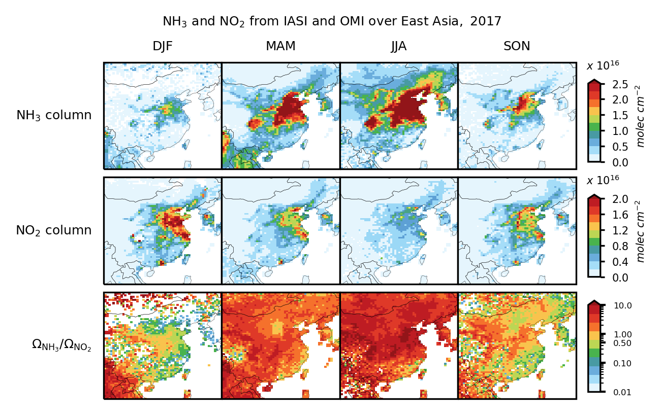
Real-world application to OMI NO₂ and IASI NH₃ data
using model-determined threshold ratio Ω_{NH3}/Ω_{NO2} = 0.36 for transition between regimes
DJF 2017
IASI
OMI
IASI/OMI
NO_{x}-limited
0.36 threshold
NH₃-limited
Urban eastern China and S. Korea are NH₃-limited for PM nitrate production in winter
Dang et al., in prep.

Slide 12
Take-aways
GEMS data density can enable better understanding of emerging air quality issues in East Asia
NO_{x} and VOC emission trends
HCHO as a driver of ozone production
HCHO and CHOCHO as proxies of VCP emissions
Factors controlling free tropospheric background ozone and its trend
NH₃/NO₂ ratios (with IASI or CrIS) as diagnostic for particulate nitrate formation regime

